Slide 1





Preventing and fighting the rise of online Sextortion and Gender Based Digital Violence
For the Safe and Healthy Use of ITC
For Responsible Digital Citizenship
@PantallasAmigas
www.pantallasamigas.net
Urko Fernandez
Project Manager
urko.fernandez@pantallasamigas.net
Meeting of the Council Working Group on Child Online Protection
16 February 2016
ITU Headquarters (Room A), Geneva, Switzerland
Notes:
Sexist violence does not pursue any violence of a man against a woman, but one that is motivated by an alleged inequality between them.

Slide 2
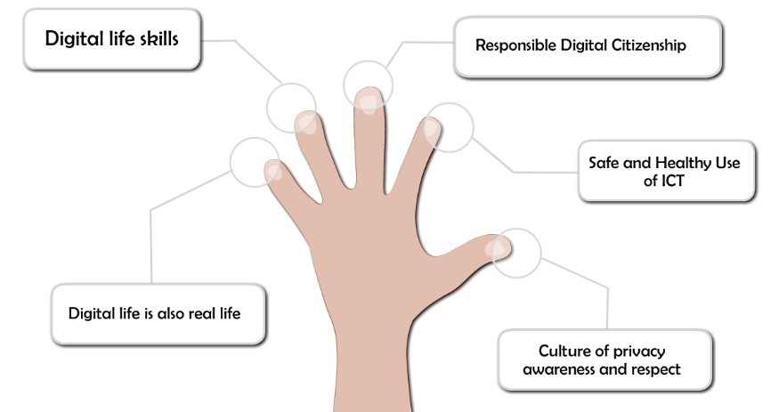
FriendlyScreens: a differentiated approach…

Slide 3
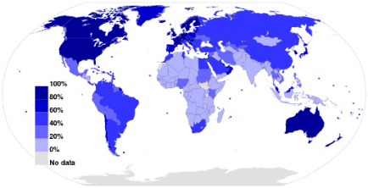
Global scope and interventions
Spain as source and link between Europe and Latin America
Project developed in:
Bolivia
Brazil
Cape Verde
Colombia
Paraguay
Current projects in:
Mexico
Spain
Collaborations with :
Argentina
Chile
Costa Rica
Peru
Venezuela
Colombia
Lebanon
Turkey
Presence in several European and North American Forum
Languages:
Spanish
English
Portuguese
French
Basque
Arabic
Turkish
Hebrew

Slide 4
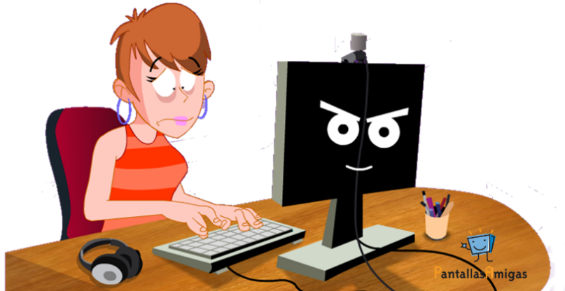
Fighting sextortion and the risks of sexting

Slide 5
Various tools and resources to fight sextortion online
Awareness campaigns
Animations
Interactive games
Booklets and guides for teachers and educators
Intervention protocols for victims
Blogs, thematic websites and complaint forms

Slide 6
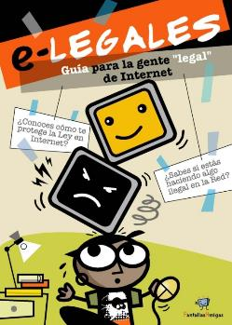
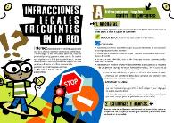
Talking about responsibility and knowing legal implications (2009)
e-Legales, e-Legal guide: Know our rights and responsibilities on the Net
Target:
Adolescents, parents, and educators
Topic:
Cyberbullying and overall risks
Authors:
Ofelia Tejerina and Jorge Flores

Slide 7
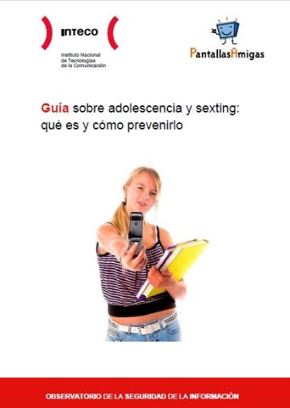
Guide for the prevention of sexting (2011)
Notes:
7

Slide 8


Guide to fight Sexual Violence on the Internet (2012)

Slide 9
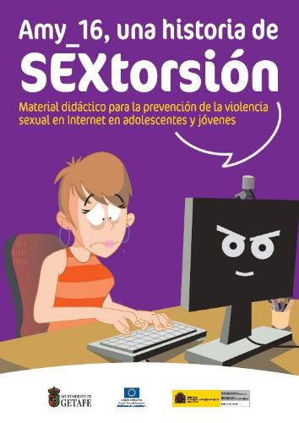


Interactive game: “Amy_16, a story of sextortion” (2012)

Slide 10
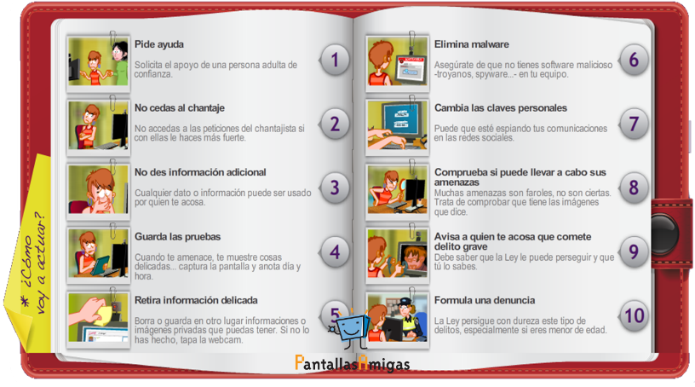
Intervention protocol for a victim of sextortion (2013)
www.decalogovictimasextorsion.com
Notes:
10

Slide 11
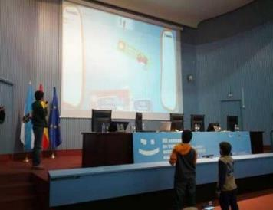
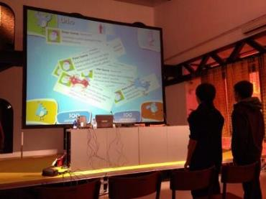
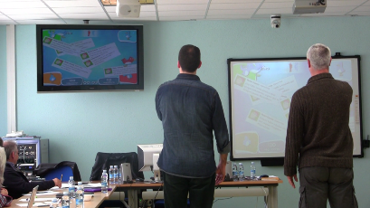

Educational programs and videogames that contain a gender perspective

Slide 12

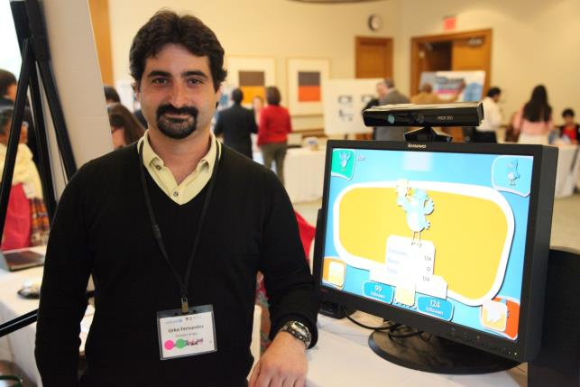

Digitally Connected Symposium Harvard/UNICEF (2014)
http://www.digitallyconnected.org/

Slide 13
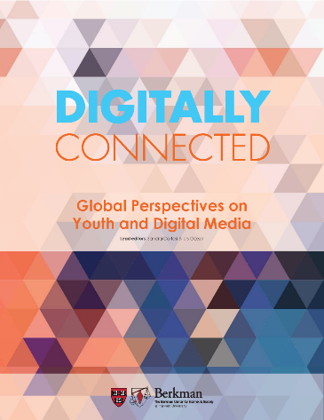
Digitally Connected book – Harvard/UNICEF
(March 26, 2015)
Sexting: Teens, Sex, Smartphones and the Rise of
Sextortion and Gender Based Digital Violence

Slide 14
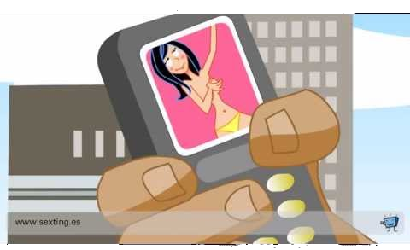
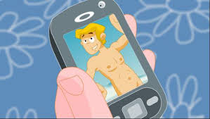
Animation: sexting awareness campaign (2009)
5 million views on YouTube
https://www.youtube.com/playlist?list=PL17350D2F33BC2602
Notes:
14
We put the plame in those who betray the trust of their friends, spouses, couples, acquaintainces…

Slide 15
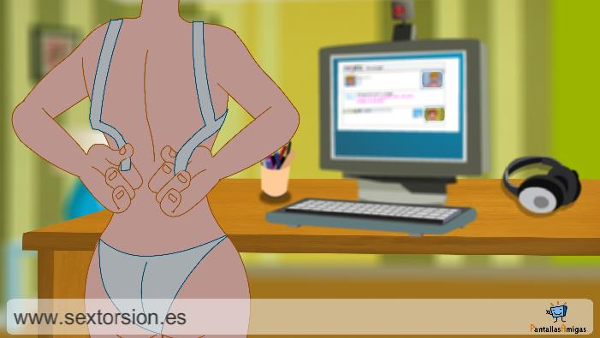
Animation: Sextortion as a form of sexual violence (2013)
13.5 million views on YouTube
https://www.youtube.com/watch?v=H_v0v70WFaA
Notes:
15

Slide 16
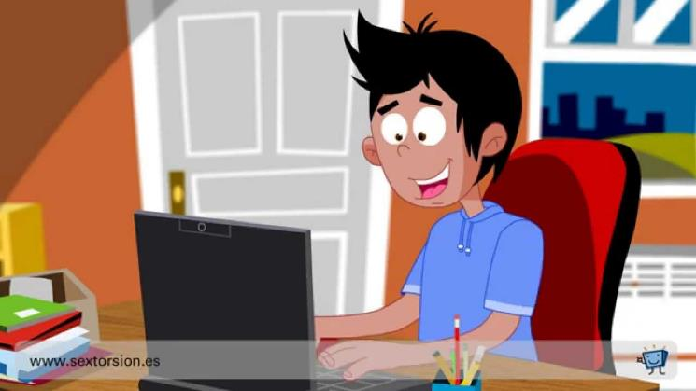
Animation: Sextortion, blackmail started after rogue cybersex offer (2015)
600.000 views on YouTube
https://www.youtube.com/watch?v=kSFjLPYesiU
Notes:
16

Slide 17
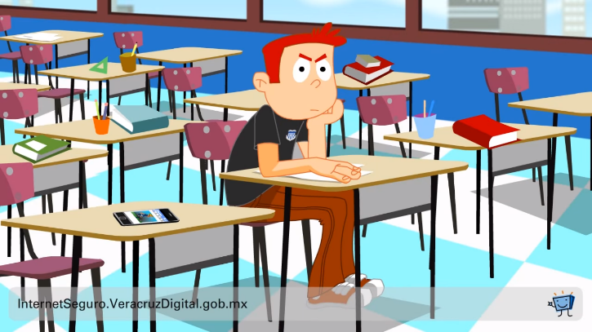
Your safety depends on your device’s security
https://www.youtube.com/watch?v=1yzgSbrn3d4
Notes:
17

Slide 18
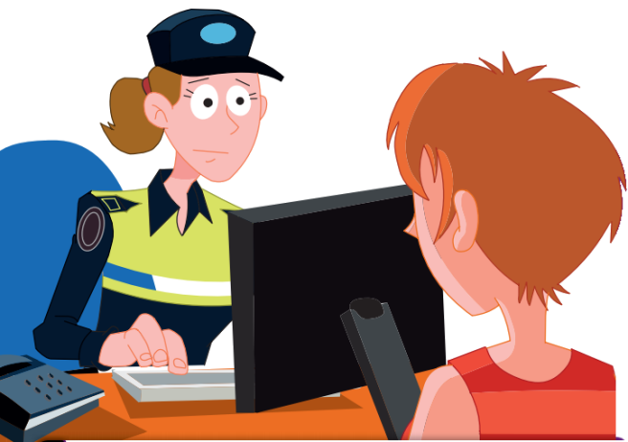
Collaboration with police forces
Notes:
18
Las amenazas, realizar grabaciones o publicarlas sin consentimiento, usar malware para manipular un equipo ajeno o extraer claves privadas son acciones ilegales. La denuncia debe hacerse si peligra laintimidad, el honor o la integridad física o sicológica.

Slide 19

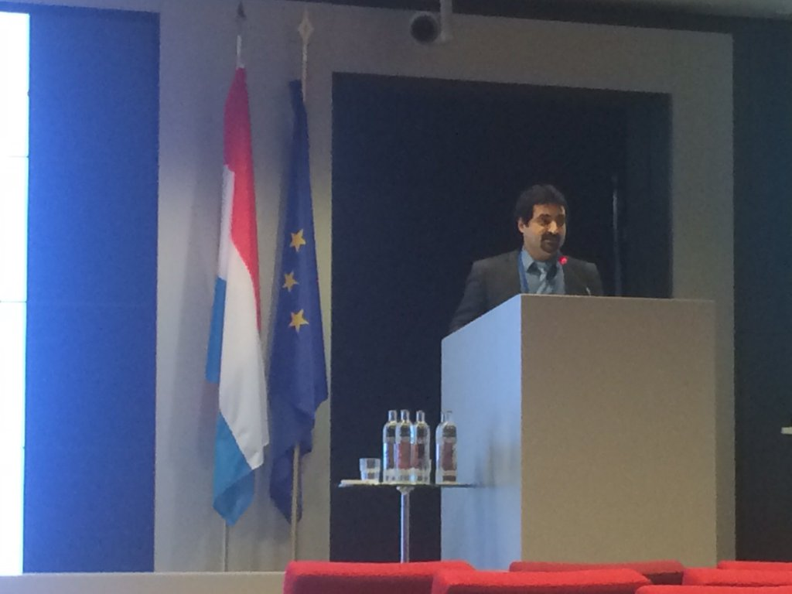
European Crime Prevention Award (ECPA) and Best Practice Conference (BPC) (December 15, 2015)

Slide 20




SmartPRIVIAL – app for iOS and Android
http://www.pantallasamigas.net/SaferIntenetDay-App-Videogame-SmartPrivial

Slide 21
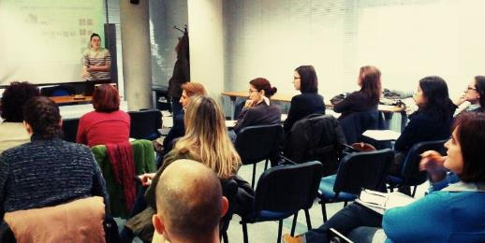
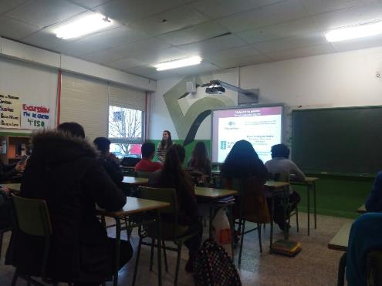
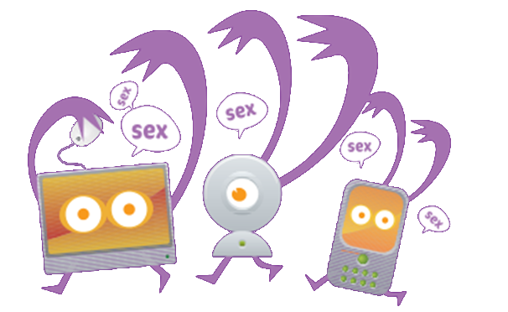
Workshops, courses and talks for parents, teachers and students

Slide 22






Social Media (February 2015)
YouTube Channel
65.100 subscribers
32.000.000 views
1.200.000 views/month
Twitter
11.500 followers
Facebook
6.600 likes
Other web sites
+100.000 views/month

Slide 23

Thank you for your attention
E-mail: urko.fernandez@pantallasamigas.net

