Slide 1
WTSA-20 Overview of IT Tools How to access to services, documents and events Telecommunication Standardization Bureau of ITU

Slide 2
Introduction
The Standardization Sector of ITU has developed a series of IT tools that are aimed at allowing, facilitating and assisting the participation to the work of ITU-T.
Being this the year of WTSA-20, we believe the introduction of this overview is even more necessary. The preparations in the Regions are progressing.
Taking into account of the Covid-19 outbreak worldwide, the Bureau intends to reach out to all and invite ALL to join the work and use the IT tools made available. Thank You.

Slide 3
What are the IT tools that can assist your work with us
ITU MyWorkspace - How can I access ITU-T work at all time:
ITU Translate – How can I read the documents in one of the six official languages
ITU-T Mailing lists - Receiving latest information
ITU-T E-Meetings - ITU-T virtual meetings
ITU-T Experts Community - Connecting with Others
ITU and ITU-T Events – onsite and online
ITU-T Cloud – storage of files

Slide 4
MyWorkspace

Slide 5
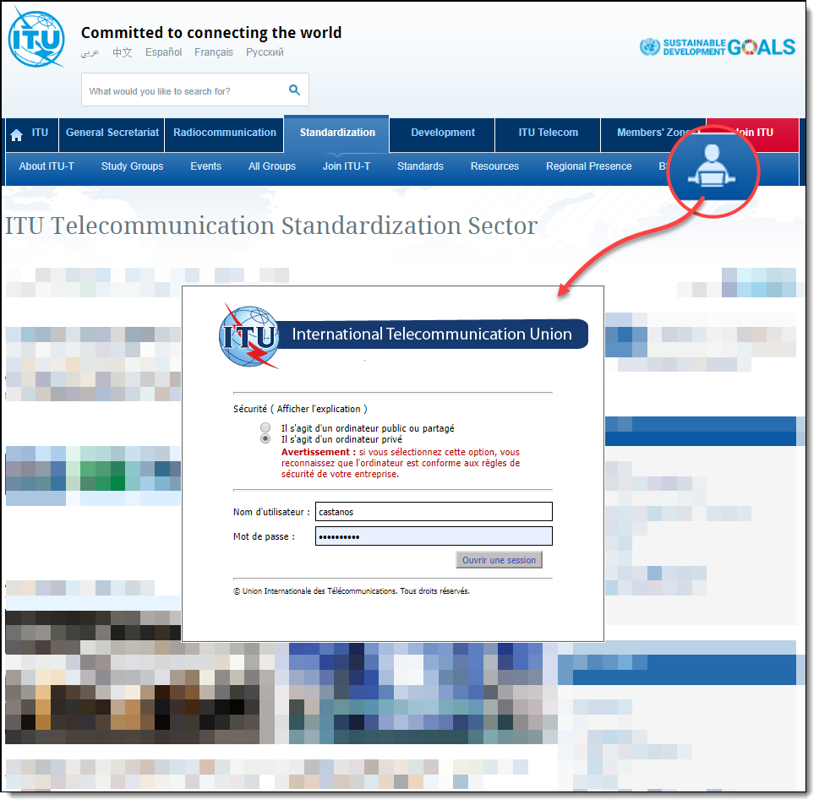
ITU-T MyWorkspace access
https://www.itu.int/myworkspace/
Accessible from ITU-T home page:
itu.int/itu-t
With your ITU account

Slide 6
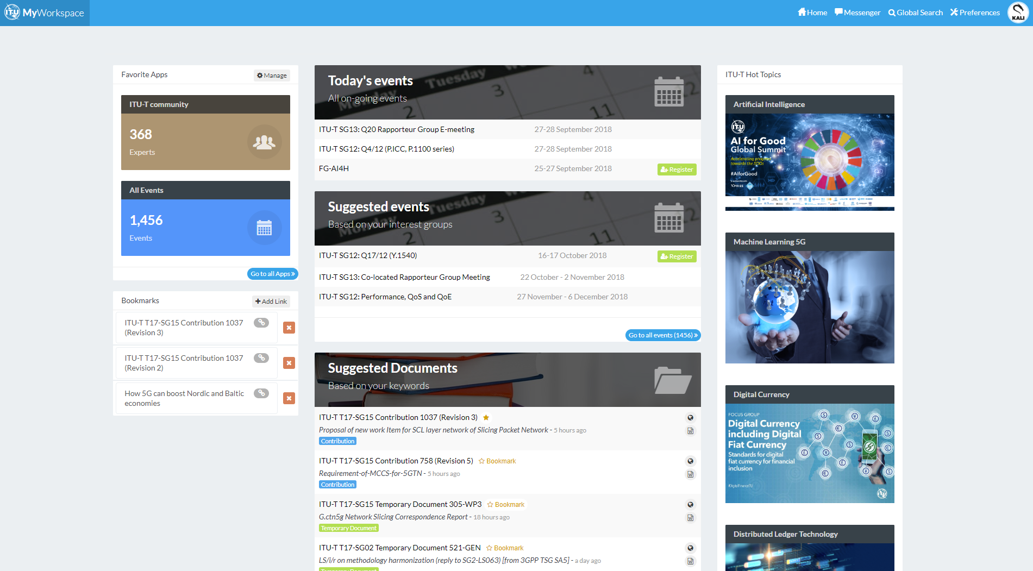
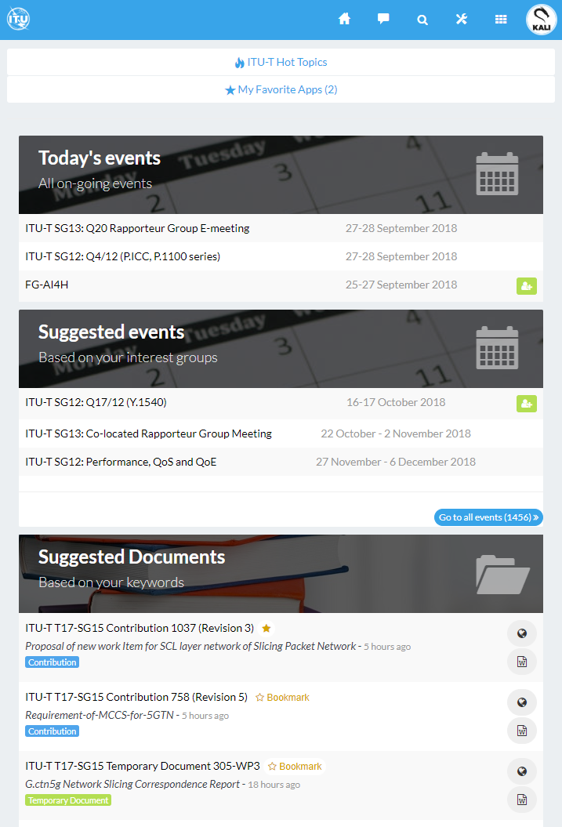
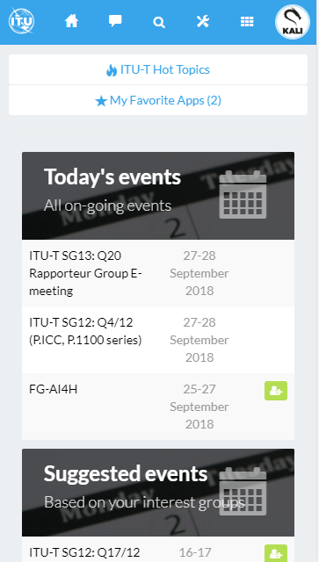
MyWorkspace – Mobile & Desktop App
Web
Android
IOS
itu.int/myworkspace
handle.itu.int/11.1002/apps/mws-android
handle.itu.int/11.1002/apps/mws-ios

Slide 7
ITU Translate How can I read the documents in one of the six official languages عربي 中文 English Español Français Русский

Slide 8
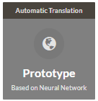
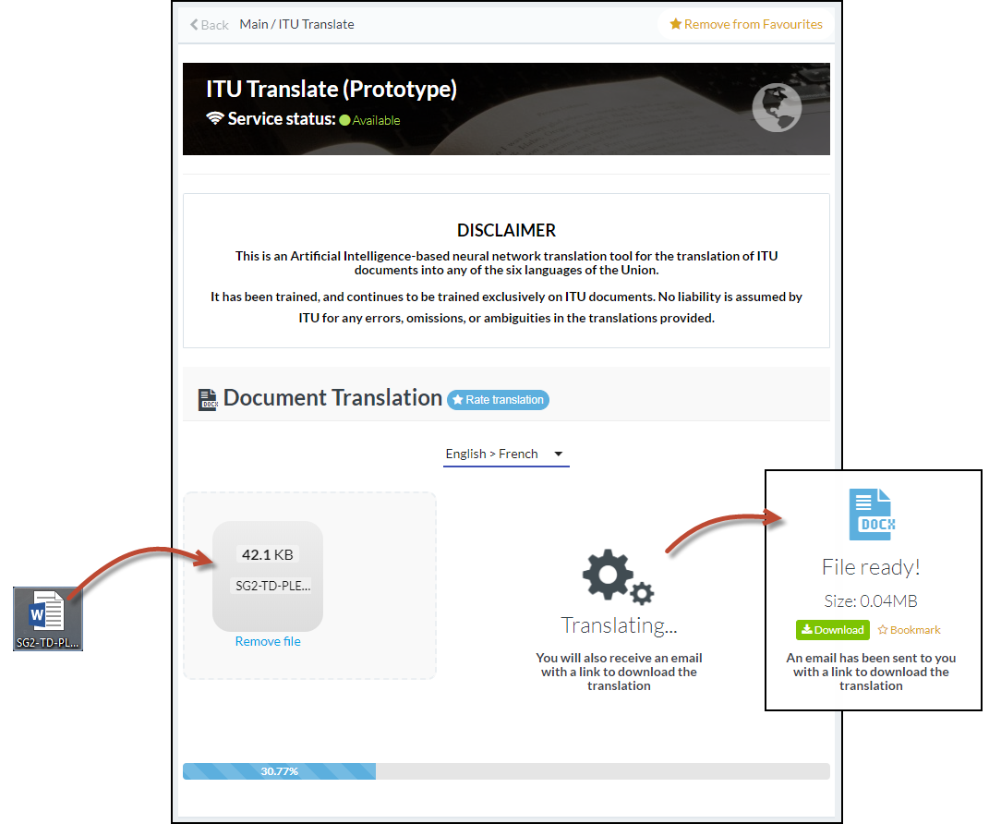
ITU Translate: Based on Machine Learning
https://www.itu.int/myworkspace/#/my-workspace/translate
Integrated with an open source solution based on neural network
Trained exclusively on ITU documents in 6 languages
High performance/quality when translating ITU documents
Translated documents keep the original format of the original document

Slide 9
ITU-T Mailing Lists Receiving latest information in your mailbox

Slide 10
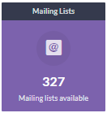
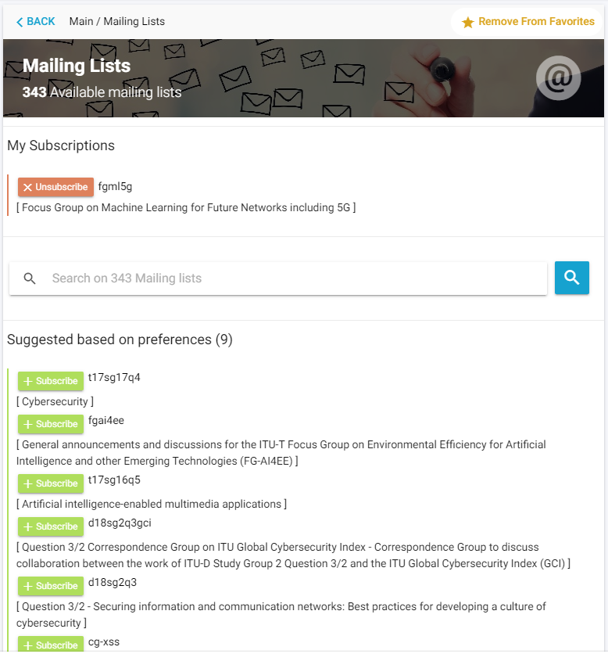
ITU-T mailing lists
https://www.itu.int/myworkspace/#/my-workspace/mails
Quick way to subscribe to ITU mailing lists
Easy to search mailing lists (enhanced visibility)
User can manage mailing list subscription and see the requests status
Suggested mailing lists based on preferences

Slide 11
ITU-T E-Meetings
ITU-T Fully virtual

Slide 12
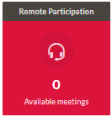
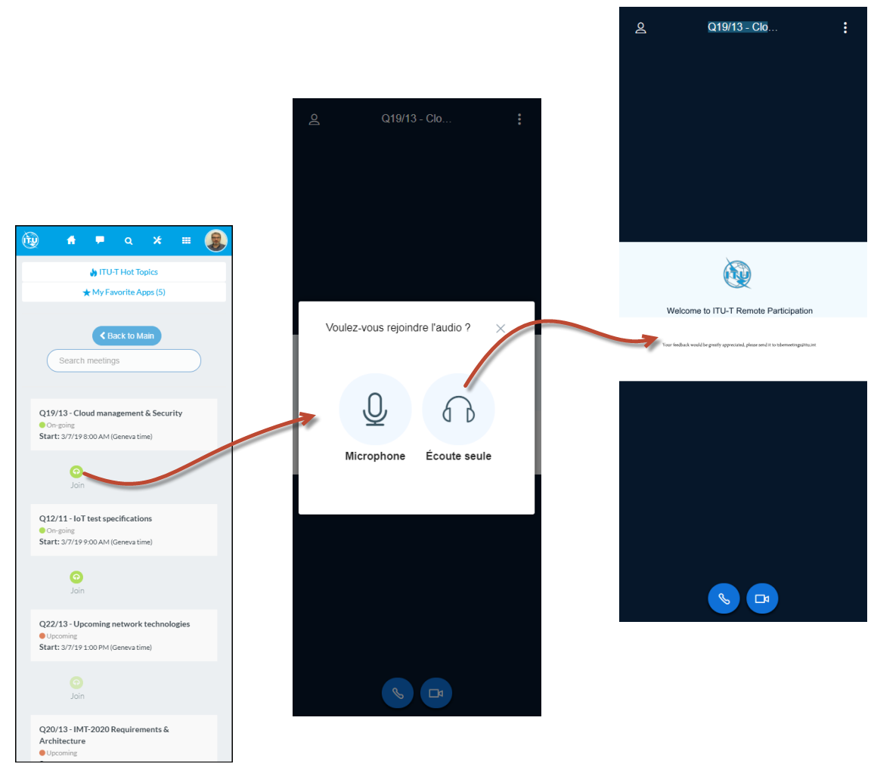
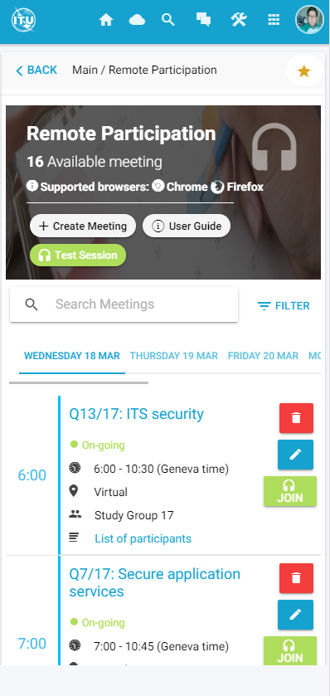
ITU-T E-Meetings
https://www.itu.int/myworkspace/#/my-workspace/remote_participation
Integrated Open Source solution (BigBlueButton)
Real-sharing of audio, video, slides, chat & screens
Web and mobile app
Flexible and scalable

Slide 13
ITU-T Experts Community Connecting with Others

Slide 14
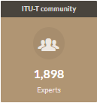
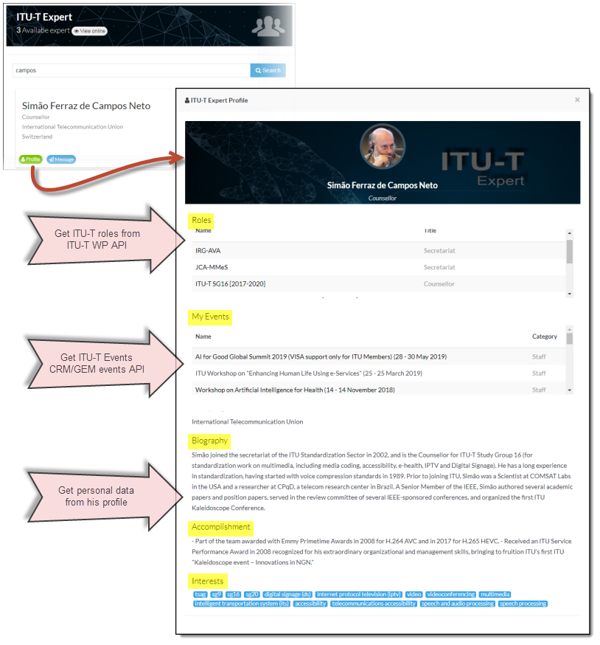
ITU-T Experts community
https://www.itu.int/myworkspace/#/my-workspace/community
Display ITU account data & ITU-T Work Programme database
Access to full ITU-T expert’s profile
Real-time communication between members

Slide 15
ITU-T Events When, where, Online, Onsite

Slide 16
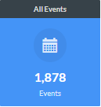
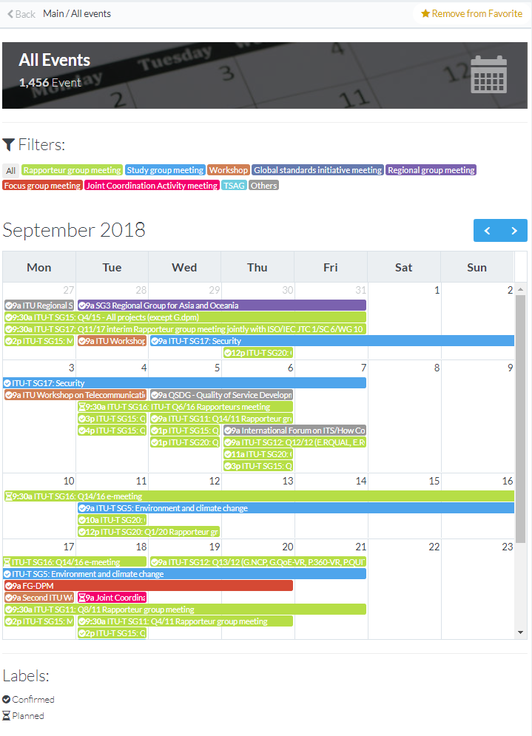
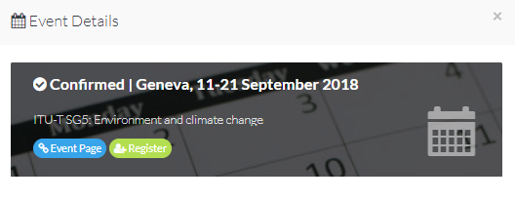
ITU-T Events calendar
https://www.itu.int/myworkspace/#/my-workspace/allevent
Calendar view of all ITU Events planning
Customizable by type of event
Direct access to event registration

Slide 17
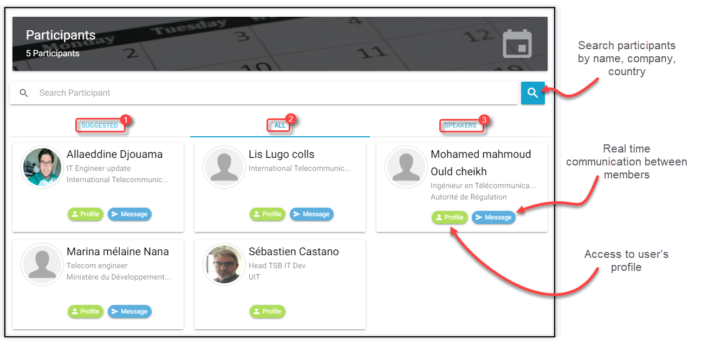
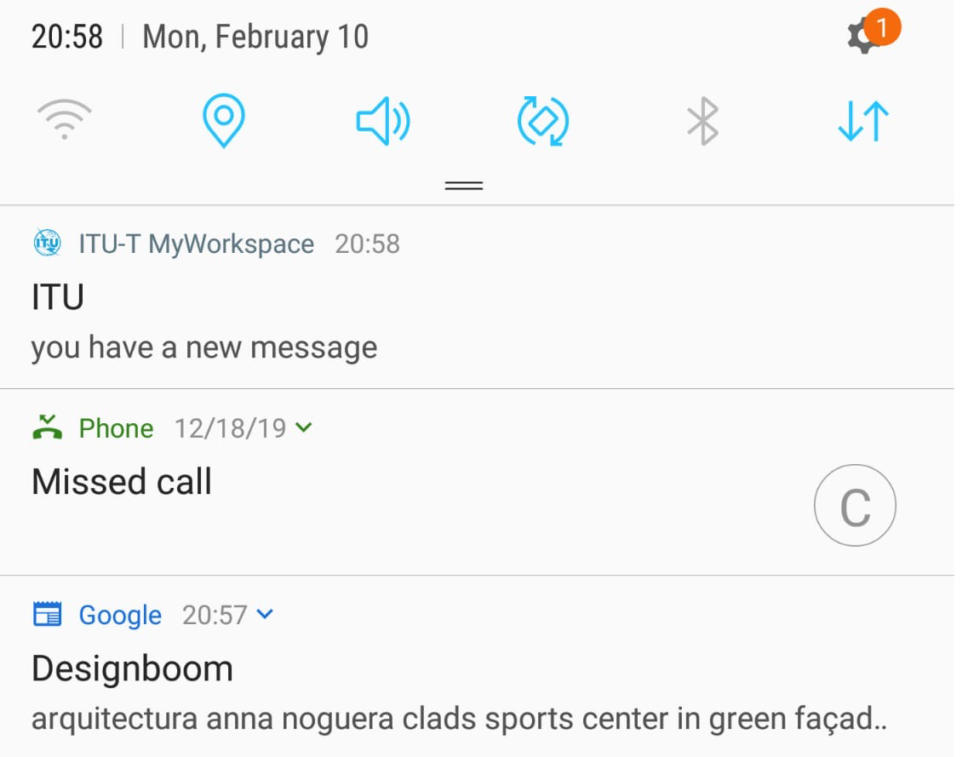
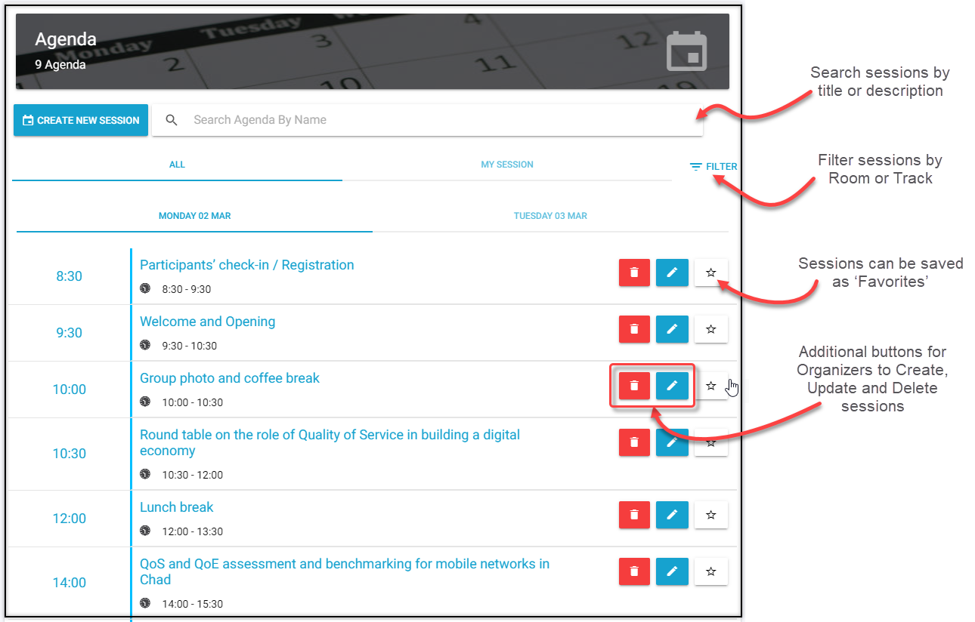
MyEvents ^{NEW!}: Meetings and networking
https://www.itu.int/myworkspace/#/my-workspace/myevents
Direct access to participants
Matchmaking
Live agenda
Realtime notification

Slide 18
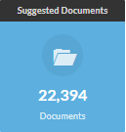
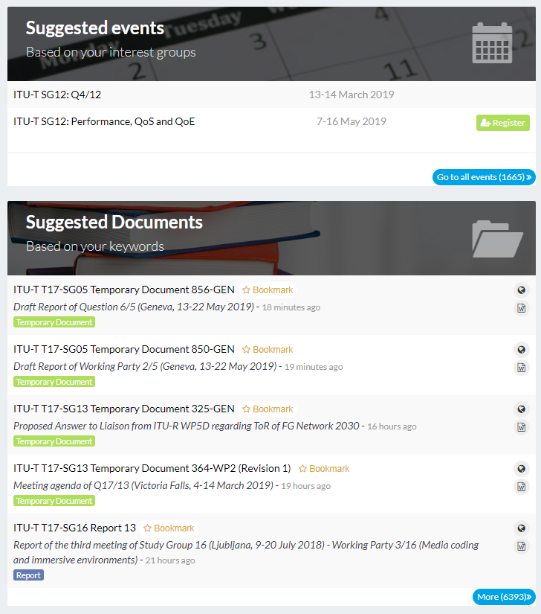
Suggested events & documents
https://www.itu.int/myworkspace/#/my-workspace/documents
Quick access to different documents & topics
Easy access to associated site or to download the document
Possibility to bookmark documents

Slide 19
ITU-T Cloud

Slide 20
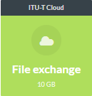
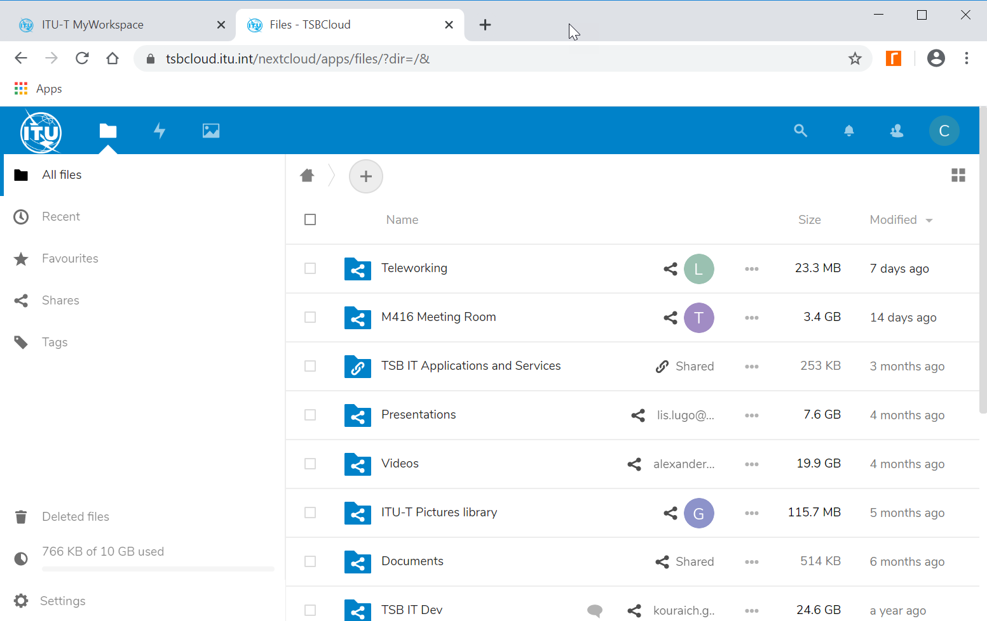
ITU-T Cloud: File sharing and storage
https://tsbcloud.itu.int/
Integrated Open Source solution (NextCloud)
Cloud file sharing and storage solution
Hosted in ITU premises
Web and mobile app
Integrated with ITU authentication system
10 GB per user
Encrypted

Slide 21
This presentation is a result of a great teamwork of developers and relevant ITU Standardization Bureau Staff.
For any question or for help please refer to
tsbitdev@itu.int
Additional contacts: Sébastien Castano Head TSB IT Applications Development Tel : +41 22 730 6224
Sebastien CASTANO, Allaeddine DJOUAMA, Lis LUGO COLLIS, Kouraich GHARSALLAOUI

