Slide 1
Security, privacy and trust in ITU standardization
Reinhard.Scholl@itu.int

Slide 2
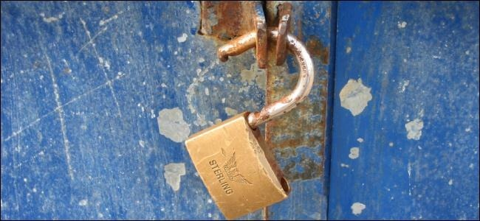
ITU Cybersecurity Symposium 2004

Slide 3
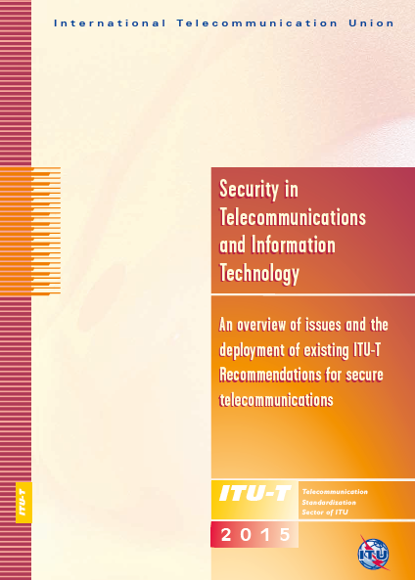
ITU Security Manual,
6th edition, 2015
Deployment of existing ITU-T Recommendations for secure telecommunications

Slide 4
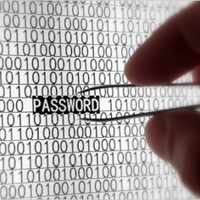
Exposure of ITU Secretariat to cyber-attacks
> 1 MILLION known attacks / day
10,000 known attacks with severity “high” or “very high”

Slide 5
ITU TechReport on trust
“Trust provisioning for future ICT infrastructures and services”

Slide 6
Measuring trust through a trust index

Slide 7
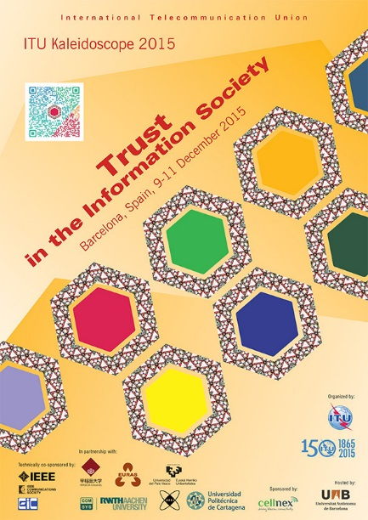
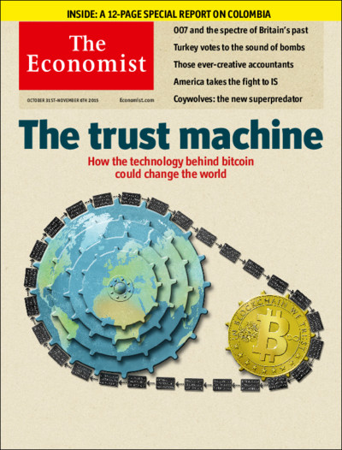
Will new technologies increase trust?

Slide 8
World Standards Day
14 October

