Slide 1
ISO’s standardization approach to security, privacy and trust
Mrs. Sophie Clivio
Director, Standardization and
Technical Policy
GSS16 – Global Standards Symposium
Hammamet, Tunisia
24 October, 2016

Slide 2
About us
163 members
21 100
International Standards
100
new standards each month
More than
100 000 experts
238
technical committees
Founded in 1947
Independent
Non-governmental organization
Global network of national standards bodies*
One member per country
ISO membership comes with rights, benefits, obligations and good practice
*National standard body = national body most representative of standardization

Slide 3
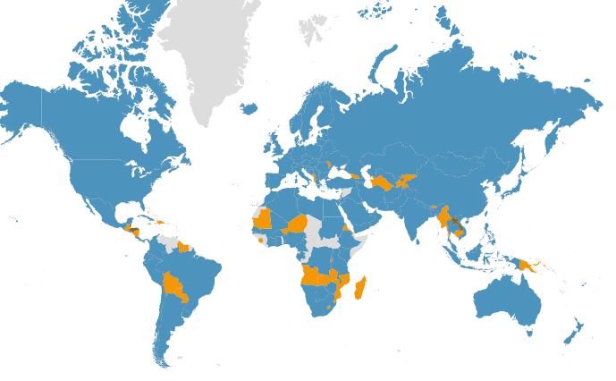
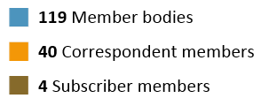
ISO members
As of August 2016

Slide 4
ISO’s broad and multi-sectoral approach to security/privacy/trust
ISO/TC 292: Security and resilience
Authenticity, integrity and trust for products and documents
Organizational resilience
Private security
Community resilience
Emergency management
Supply chain security
ISO/TC 262: Risk management
ISO/TC 307: Blockchain and electronic distributed ledger technologies
ISO/TC 309: Organizational governance
ISO Consumer Policy Committee (COPOLCO)
Consumer privacy
ISO/IEC Joint Committee on Information Technology
Information security / privacy

Slide 5
Information Security / Privacy Areas of activity
JTC 1/SC 27:
Information security management - including ISO/IEC 27001 information security management system
Cryptographic and security mechanisms
Identity management and privacy technologies
JTC 1/SC 37
Biometrics
JTC 1/SC 17
Cards and personal identification
JTC 1/SC 40
IT governance

Slide 6
Information Security / Privacy In progress and Future work
Within ISO/IEC JTC 1
Cyber insurance
Cyber resilience
Cloud computing – Service level agreement for security and privacy, trusted connections, virtualization
Big Data – security and privacy considerations
IoT – privacy, identity management
Privacy – information management system, notices of consent, de-identification techniques

Slide 7
Full coverage
ISO is present in all sectors including:
Healthcare, Transport (Aviation, Intelligent transport, Marine technology), Energy, Construction, Manufacturing (including additive manufacturing)
Cooperation with peer organizations:
IEC: Co-sponsor of ISO/IEC Joint Technical Committee on Information Technology (JTC 1)
ITU-T: SG 13 – Cloud computing, SG 17 – Informaiton security, cloud security, ISMS, Identity, SG 20 – IoT/Smart cities
Cooperation with key organizations including:
INTERPOL, ICAO, OASIS, The Open Group, Amex, Mastercard, VISA

Slide 8
Thank you!

