Slide 1
IEC International Standards and Conformity Assessment Systems for security, privacy and trust
Frans Vreeswijk
IEC General Secretary & CEO
GSS16
24 October 2016
Hammamet, Tunisia

Slide 3
protecting power systems

Slide 4
Industry 4.0

Slide 5
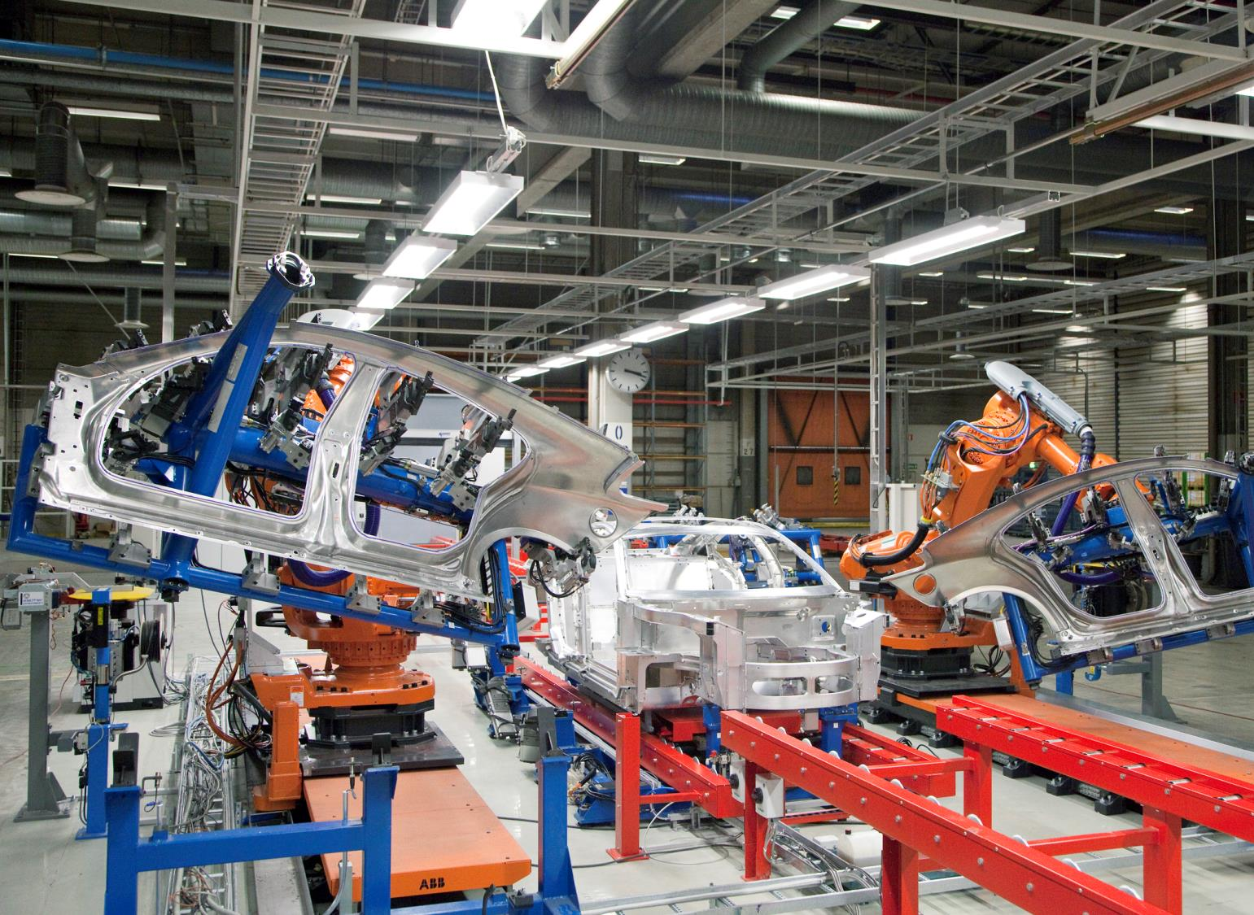
Automation

Slide 6
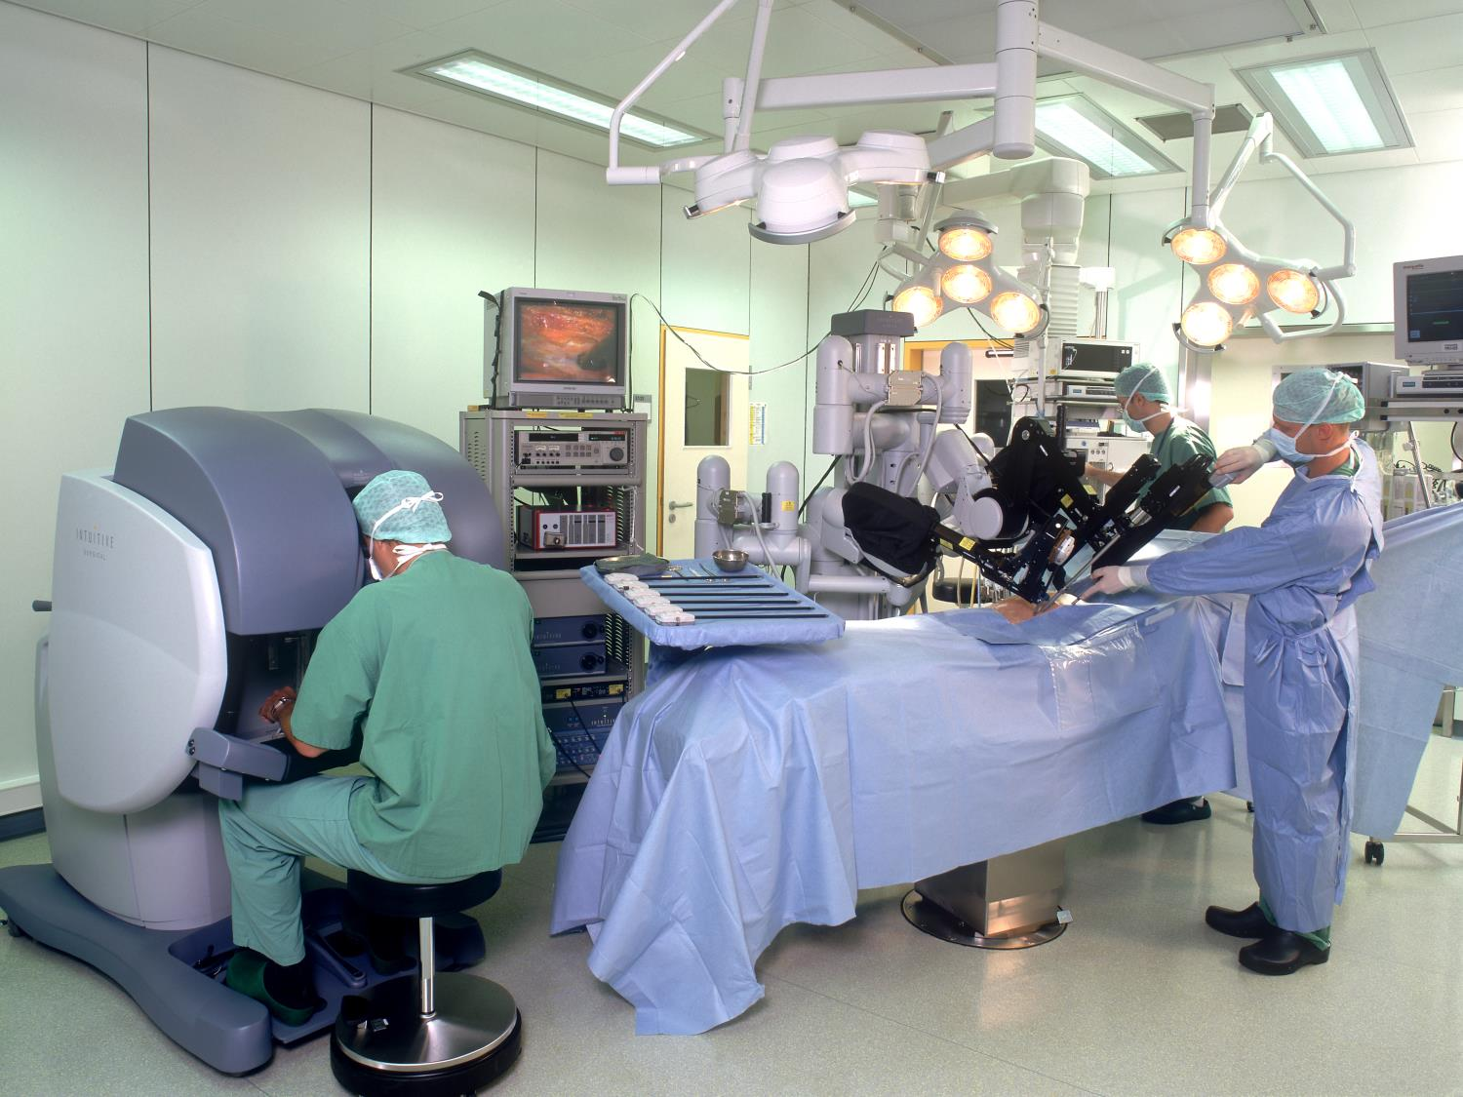
Healthcare

Slide 7
Wearable devices

Slide 8
Sensor networks

Slide 9
ISO/IEC JTC1 IT security techniques

Slide 10
Recommendation: broad cooperation between all standards organizations needed

Slide 11
IEC International Standards and Conformity Assessment Systems for security, privacy and trust
Frans Vreeswijk
General Secretary & CEO
GSS16
24 October 2016
Hammamet, Tunisia

