Slide 1
CEN and CENELEC approach to Security, Privacy and Trust Leading the way in Europe
Ashok Ganesh, CEN – CENELEC
Global Standards Symposium 2016-10-24

Slide 2
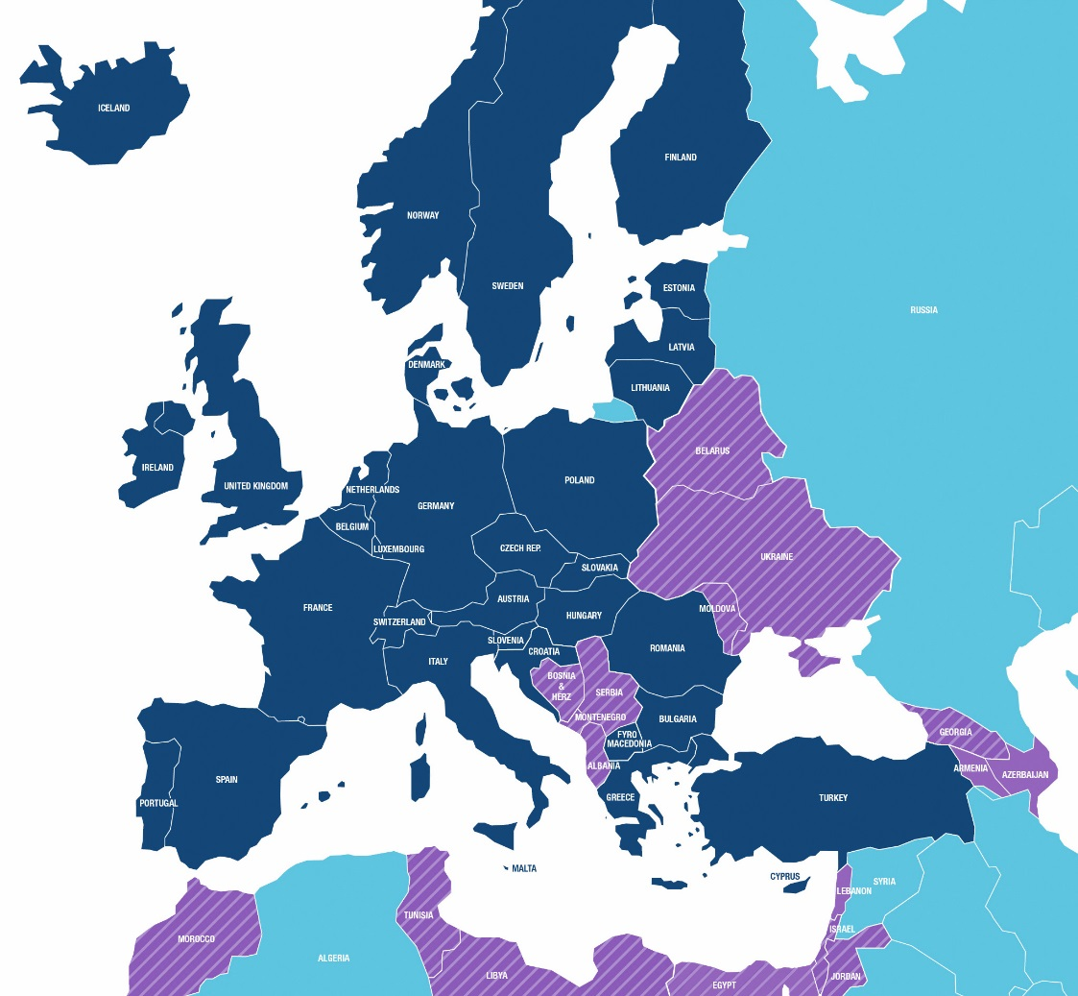
Who are we?
33 Members
Affiliates
Members
Affiliates
Notes:
CEN and CENELEC: recognized by the European Regulation 1025/2005 for preparing European Standards that can be used in the legal context.
Members: NSBs/NCs of 33 countries
Affiliates: Affiliation with CEN or CENELEC is available to a National Standardization Organization, which is a member (or corresponding member) of ISO/IEC, which represents or has the ambition to represent all parties concerned in an evolving market industry. They belong to a EU neighboring country which has links with EU or EFTA in relation to technical scientific political and social conditions.
CEN: Albania, Armenia, Azerbaijan, Belarus, Bosnia and Herzegovina, Egypt, Georgia, Israel, Jordan, Lebanon, Republic of Moldova, Montenegro, Morocco, Serbia, Tunisia, Ukraine,
CENELEC: see CEN Affiliates but without Armenia, Lebanon and Azerbaijan
Partner Standardization Bodies (PSBs) are National Standards Bodies that are a member of ISO, but are unlikely to become CEN Members or CEN Affiliates for political or geographical reasons.
CEN: Kazakhstan, Mongolia, Australia
CENELEC Kazakhstan
Note: June 2016 AG agreed to implement new partnership models to start in 2017 which are more suited to the CEN and CENELEC international cooperation needs:
Affiliation:
now focused on countries having real accession perspectives (candidates/potential candidates to EU accession)
From 16 (CEN) / 13 (CLC) to 4 (or 3) Affiliates: DPS (Albania), ISME (Montenegro), BAS (Bosnia and Herzegovina) and ISS (Serbia)
CSB (Companion Standardization Bodies):
CSB concept open to any NSB/NC not qualifying for membership or affiliation
12 (CEN) and 9 (CLC) Affiliates to become CSBs [11 and 8 if ISS becomes full member]
European Partners: organizations having an interest for cooperation at overall corporate and/or technical level.
SBS is Partner Organization of CEN and CENELEC, while 2 of the (22) SBS members have a liaison status with a CEN TC i.e. SME Safety (CEN/TC 79) and the European Consortium of Anchors Producers (ECAP) (CEN/TC 250). None of the SBS members has a liaison with CENELEC.

Slide 3
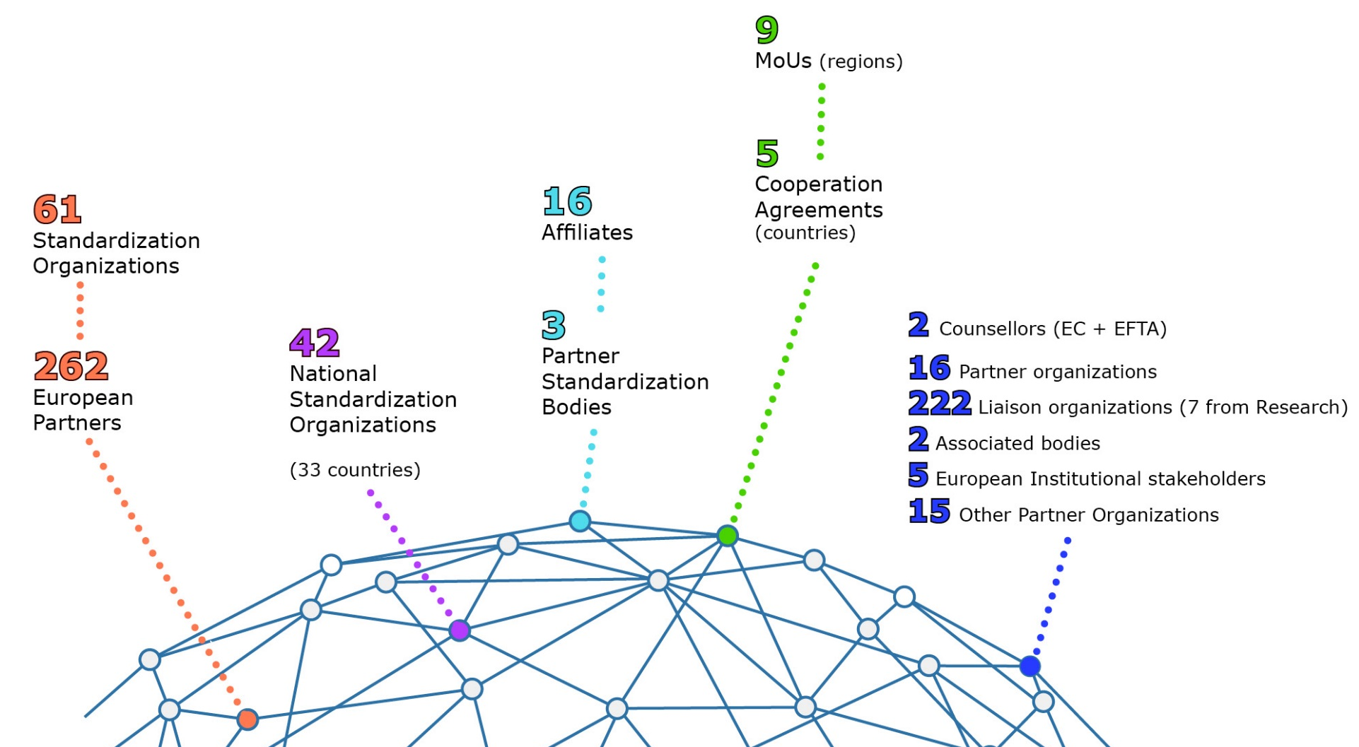
CEN and CENELEC Network
Notes:
CEN and CENELEC activities e.g.: energy, ICT, machinery, healthcare, materials, pressure equipment, transport, measuring instruments, research and innovation.
Highlight increasing convergence of technologies and issues => requiring an increasing coordination effort
Also:
200.000 experts
497 TCs and 1.903 Working Groups
23.196 European Standards

Slide 4
Fundamentals – CEN and CENELEC standards are…
Based on the national delegation principle
Representing consensus among all interested parties, including industry & SMEs and societal stakeholders
Voluntary
Developed by independent organizations distinct from authorities
Notes:
The fundamentals of European standardization

Slide 5
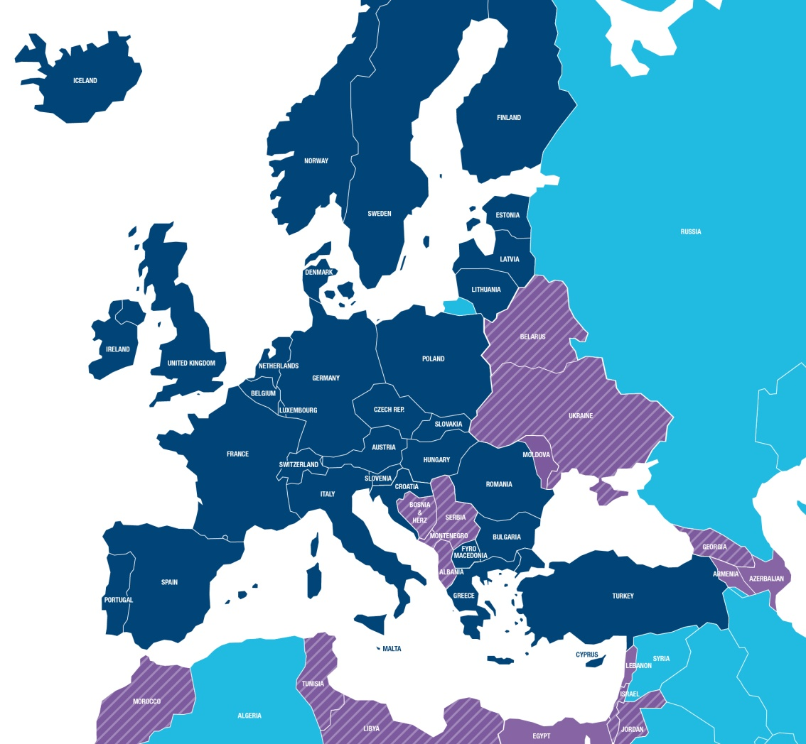
CEN and CENELEC - Impact
33 identical national standards
All conflicting standards removed
Access to a market of 500 million people
Supporting free circulation
goods in Europe
and beyond

Slide 6
European Standards – evolution
1960/1980 Industrialization
Product standards
Test Methods
1980/2000 Single market
Machinery safety
2010 – 2020 Technology
Eco-design
Pressure equipment
Lifts
2000/2010 Services & consumers
Energy
2020 -
Services?
System of systems?
Service innovation?
Near to market innovation?
Smart grids
eMobility
Construction
Smart Cities
Social responsibility
Accessibility
Management Systems
Advanced materials
ICT
Environment
Consumers
Toy safety
…meeting stakeholder needs
Notes:
European standards cover an increasingly wide range of technology, societal, environmental and business needs
The future is exciting – just as the world around us is changing at an ever increasing rate, so standardization is evolving (and must evolve) to meet the challenges….and seize the many business-supporting and life-enhancing opportunities
…there’s never been a better time to be involved in standards making!

Slide 7
Strategic challenge
Supporting the take up of
digital technologies in non-digital sectors

Slide 8
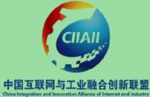
IoT SDOs and Alliances Landscape (Vertical and Horizontal Domains)
Manufacturing/ Industry Automation
Vehicular/
Transportation
Farming/
Agrifood
Home/Building
Healthcare
Energy
Cities
Wearables
Open Automotive Alliance
Open Connectivity Foundation
AIOTI
AIOTI
AIOTI
AIOTI
AIOTI
AIOTI
AIOTI
AIOTI
AIOTI
NB-IoT Forum
Horizontal/Telecommunication
Source: AIOTI WG3 (IoT Standardisation) – Release 2.4

Slide 9
Security & privacy requirements
IoT: innovative services in various application domains
Heterogeneous technologies
Satisfying security and privacy requirements is fundamental
Include data confidentiality, authentication, access control within the IoT network, privacy and trust, and enforcement of security and privacy policies.
Traditional security countermeasures cannot be directly applied due to many different standards and communication stacks involved.
High number of interconnected devices leads to scalability issues

Slide 10
Privacy by design
JWG 8 Privacy management in products and services
define privacy requirements for the implementation of Privacy-by design principles for security product/services lifecycle in any business domain.
EC/EFTA M/530 ‘Privacy management in the design and development and in the production and service provision processes of security technologies’
Work programme
Data protection by design and by default (EN)
Video surveillance (CEN/TR)
Biometric for access control including face recognition (CEN/TR)

Slide 11
Cybersecurity
CEN-CENELEC Focus Group
explore ways and means for supporting the implementation of trustworthy Digital Single Market in terms of cybersecurity aspects and data protection.
ISO/IEC 27001 Information Security Management
Workshop Q1 2017: vertical sectors’ needs:
Efficiency
Integrity
Availability
Confidentiality
Functional safety
Notes:
New legislation came into force in Europe on these topics, namely the European Commission proposed a comprehensive reform of data protection rules in the EU. On 4 May 2016, the official texts of the Regulation and the Directive have been published in the EU Official Journal in all the official languages. While the Regulation will enter into force on 24 May 2016, it shall apply from 25 May 2018. The Directive enters into force on 5 May 2016 and EU Member States have to transpose it into their national law by 6 May 2018.
Secondly, the Directive on Security of Network and Information Systems (NIS Directive) was adopted on 06 July 2016. It is expected that they will impact European standardization any time soon (we might receive a Form A from DIN to create a TC on cybersecurity-related topics).

Slide 12
Thank you!
www.cen.eu
www.cenelec.eu
www.cencenelec.eu
Follow us on:

