Slide 1
ITU-T STUDY GROUP 16
Multimedia
Yushi Naito
Chairman ITU-T SG16
Highlights and future directions

Slide 2
ITU-T SG16 Multimedia
Multimedia systems and services
Advanced multimedia communication
Media Coding
TDM legacy and transition to IP systems
Conferencing Systems
IPTV, Digital Signage, Intelligent Transportation Systems, E‒health, Accessibility (IoT moved into SG20 in Oct. 2015)
Network signal processing, Echo cancellation, Noise reduction, Voiceband data (modems, fax, text telephony)
Telepresence Media gateways, Video conferencing
Audio and video coding
Speech-to-speech translation, Visual surveillance
Notes:
Conferencing systems
Telepresence, media gateways, videoconferencing
Advanced multimedia communication
Multimedia systems and services
IPTV, Digital Signage, Intelligent Transportation Systems, E‒health, Accessibility (IoT moved to in SG20 in Oct. 2015)
Media Coding
Audio and video coding
TDM legacy and transition to IP systems
Network signal processing, echo cancellation, noise reduction, voiceband data (modems, fax, text telephony)

Slide 3
Results
6
1
11
84
STUDY GROUP MEETINGS
WORKING PARTY MEETING
RAPPORTEUR GROUP (E-) MEETINGS
IPTV-GSI EVENTS
Significant collaborative work with:
Questions:
18
16
11
ISO/IEC
IEEE
WTSA-12
WTSA-16
Notes:
6 SG, 1 WP meetings; 11 IPTV-GSI events; 84 Rapporteur group (e-)meetings
Significant collaborative work (ISO/IEC, IEEE, …)
Questions: 18 (WTSA-12) → 16 → 11 (WTSA-16)

Slide 4
Results
Work items under study
Texts approved

Slide 5
Collaboration
Internal
External
Regional SDOs
ISO
SG2 (Human
Factors)
SG9 (IPTV, CDN)
JCT1
SG16
SG17 (ICT Security)
UNECE
SG11 (C&I)
IEEE
WHO
SG12 (QoS/QoE)
CONTINUA (PCHA)

Slide 6
Trend
Increase in e-services and video-centric services
Maturity in classical areas
Notes:
Maturity in classical areas
audio compression, videoconferencing, media gateway, legacy TDM systems and their interfacing with IP networks
Increase in e-services and video-centric services

Slide 7
E-services and video-centric services
Video compression
E-health, E-learning, ITS, Future multimedia mechanisms
VR, immersive systems and artificial Intelligence
Accessibility
Human dimension in communications
Systems: IPTV, Cable, Broadcasting
Streaming, interactivity, immersive

Slide 8
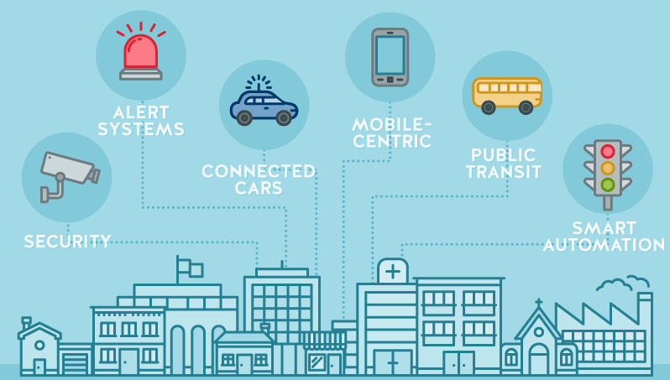
E-services
Combined use of ICTs for service delivery:
Distribution and delivery of e-services:
Healthcare
The building blocks and delivery platforms developed by SG16 are used to enable applications in specific areas
Education
Commerce
Entertainment
Smart cities and communities by SG20
Transportation
Notes:
Combined use of ICTs for service delivery in a specific industry area, such as healthcare, education, administration, commerce, transportation, entertainment, etc.
Distribution and delivery of e-services: channel agnostic
E.g. Internet, cable networks, NGN, GSTN, IMT-2020, future networks, and wireless networks
The building blocks and delivery platforms developed by SG16 are used to enable application in specific areas
E.g. smart cities applications of e-services by SG20

Slide 9
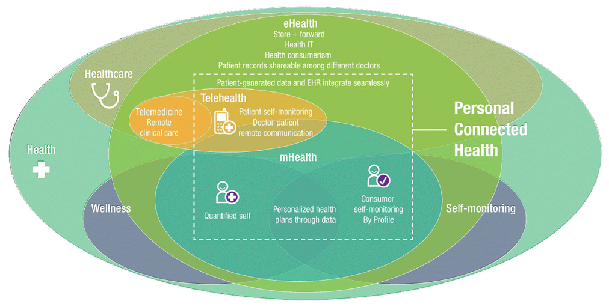
E-health
Notes:
Addressed a specific area: personal connected health – partnership with Continua (PCHA); much more to do! Mobile health, format for data exchange and interoperability
ITU-T H.810-H.850 suite with the Continua Design Guidelines and associated conformance testing specifications (45 Recommendations)

Slide 10
Video content – a strategic area
Opportunities for revenue generation
80%
Video compression: new challenges JVET
50%
Higher demand more efficient compression mechanisms
New IP-based digital TV systems
of Internet Traffic is of Video today
Forecast by 2018
Notes:
More than 50% of internet traffic is of video
Forecast: 80% by 2018
Important opportunities for revenue generation
Content generation and content delivery
QoE / QoE monitoring: constant challenge
Video compression: new challenges → JVET
Higher demand means that more efficient compression mechanisms remains relevant
Higher resolution for larger screens (4K, 8K)
Good quality with higher compression for smaller screens
New IP-based digital TV systems under development

Slide 11
Use of digital video
Consumer electronic video cameras
Digital TV broadcast & cable; Digital TV sets
Internet video Over-the-top
IPTV
Digital Signage
Over-the-top (OTT) applications
Mobile: 3G / 4G / 5G
Notes:
Consumer electronic video cameras
Moving JPEG; MPEG1-Video; H.262
H.264
Digital TV broadcast & cable; digital TV sets
SD: H.262 or H.264 / HD: H.264 / UHD: H.265?
Internet video – over-the-top
YouTube, Apple: convergence around H.264
Skype (v7: H.264)
IPTV; Digital Signage; Over-the-Top (OTT) applications
Mobile: 3G / 4G / 5G

Slide 12
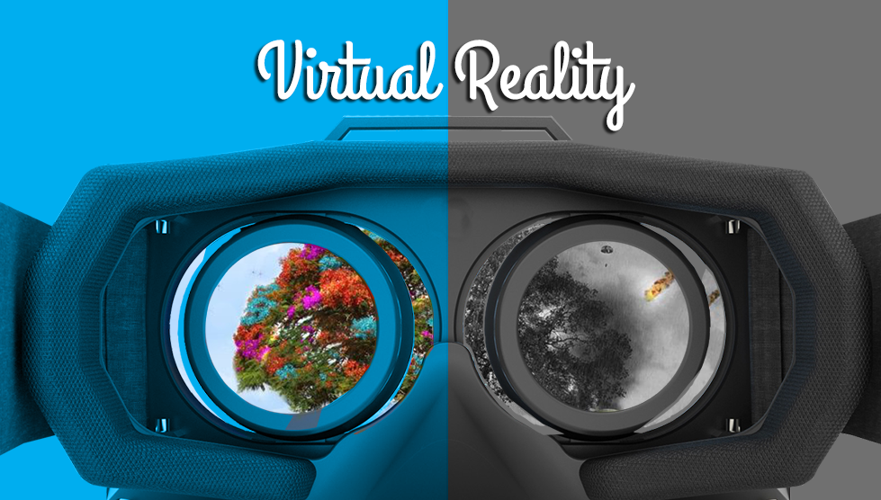
Future areas for video
Besides going after the "best and newest" video codec… it matters what you do with video
Future IP-based broadcasting
Accessibility
Delivery of high volume of video content
Artificial Intelligence to video
Notes:
Besides going after the "best and newest" video codec… it matters what you do with video
Protocols and systems supporting delivery of high volume of video content
Real-time streaming remains a challenge
Higher compression with high quality and lower delay
Highly interactive systems require tactile Internet
Virtual reality and immersive environments (ILE)
Future IP-based broadcasting
E.g. ATSC 3.0 PHY, approved 2016-03
Adding Artificial Intelligence to video: face / object / action recognition, and acting on it
Accessibility: still many open technical and economic issues

Slide 13
E-services
Video
SG16
SG16 "Multimedia" continued to be very productive during the study period
Growth of video consumption drives newer codecs, systems and applications
Work growth in e-services and video-centric services and components
Notes:
SG16 "Multimedia" continued to be very productive during the study period
Work growth in e-services and video-centric services and components
Video will be key to ITU-T's future success
Expected increase in standardization in these areas
Growth of video consumption drives newer codecs, systems and applications
especially delivery over IP and the Internet

