Slide 1



ITU-T
STUDY GROUP 13
Future networks including cloud computing, mobile and next-generation networks
Dr Leo Lehmann,
SG13 Chairman, 2015-2016
All about networks
Notes:
163 Rapporteurs meetings held
1337 contributions received (plus about the same amount for the interim meetings)
7 SG meetings held
Max/Min/Average SG participants: 194/139/164
11 WP meetings held
87 New/Revised Recommendations
10 Supplements
19 Questions assigned by WTSA-12
11 revised Questions during study period
13 Questions proposed for next period

Slide 2
IMT-2020
85
GAPS
ICN/CCN
5G
WIRELINE
SLICING
FRONT/BACK HAUL
SOFTWARIZATION
Base:
SDN
Virtualization
Cloud
IoT
12/2015: transferred to SG20

Slide 3
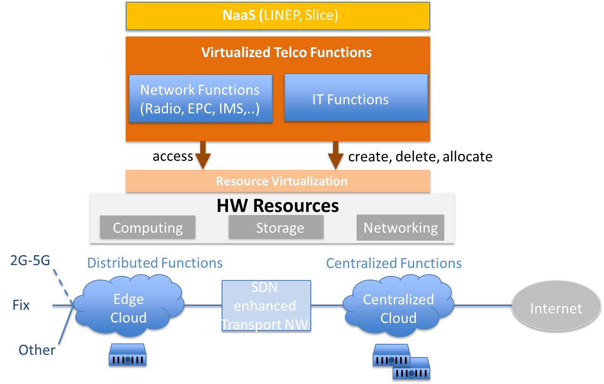
IMT-2020 First Results
in NSP
Definition of IMT-2020 Roadmap
Spring 2017:
IMT-2020 Network Requirements
Framework of IMT-2020 Network Architecture
Softwarization General
Requirements
Notes:
Definition of IMT-2020 Roadmap based on
FG results begin 2017
First IMT-2020 related recommendations
in spring 2017 intended:
IMT-2020 Network Requirements
Framework of IMT-2020 Network
Architecture
Softwarization General
Requirements

Slide 4
Cloud computing/Big data
Performance
Ecosystem
Inter-cloud
Cloud
Availability
Customer
SLA
Roles
Reference
architecture
Partner
Resource management
Provider
Common terminology
cloud service lifecycle management
E2E management
Big Data
IaaS
DaaS
XaaS
Real-time monitoring
BD Ecosystem
BD Capabilities/ Requirements
NaaS
Notes:
cloud computing: Paradigm for enabling network access to a scalable and elastic pool of shareable physical or virtual resources with self-service provisioning and administration on-demand.
NOTE – Examples of resources include servers, operating systems, networks, software, applications, and storage equipment.
Y.3500 (2014)
DaaS is the capabilities provided to the cloud service customer are the ability to build, configure, manage, store, execute, and deliver users' desktop functions remotely.
Resource management [ITU-T Y.3520]: The most efficient and effective way to access, control, manage, deploy, schedule and bind resources when they are provided by service providers and requested by customers.
Inter-cloud Scenarios : Peering, Federation & Service Broker

Slide 5
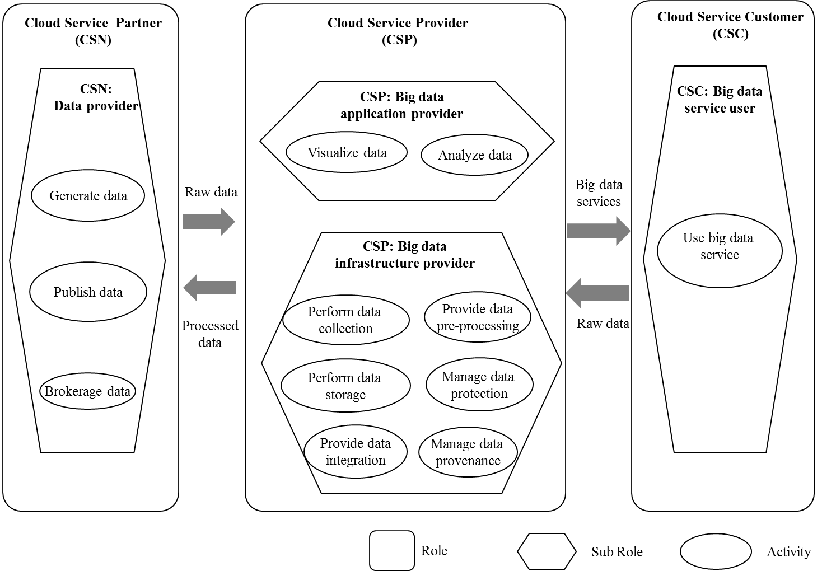
Context Cloud Computing - Big Data
Volume
Variety
Velocity

Slide 6
Cloud computing/Big Data – what’s next
  Capability types
  Infrastructure Platform Application
CC/BD & Trust
Comunication aaS
Compute aaS
XaaS
SaaS
Data
Storage aaS
BD provenance
AI and CC
PaaS
BDaaS
BD-Xchange
Flight monitoring
bDDN

Slide 7


Trust in ICT
Achievements
What’s Next?
Requirements, capabilities and service scenarios for trust provisioning
Architectural framework for trustworthy telecommunication networks
Technical solutions for trust provisioning
Trust provisioning in Big Data analytics
Inter Cloud Trust Management
Technical Report “Trust provisioning for future ICT infrastructures and services”
Draft Rec Y.trusted-env on basic principles of trusted environment creation
Draft Rec Y.CCTIC on concepts for trusted inter-cloud
Notes:
Two workshop on Trust, 24 April 2015 and 1 July 2016
Achievements
Technical Report “Trust provisioning for future ICT infrastructures and services” (accomplished)
Draft Rec Y.trusted-env by Q16/13 on basic principles of trusted environment creation
Draft Rec Y.CCTIC by Q19/13 on concepts for trusted inter-cloud
What's Next
Requirements, capabilities and service scenarios for trust provisioning
Architectural framework for trustworthy telecommunication networks
Technical solutions for trust provisioning
Trust provisioning in Big Data analytics
Inter Cloud Trust Management

Slide 8

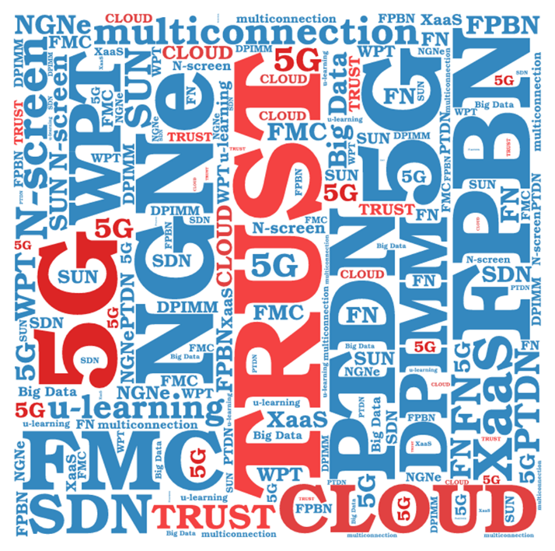
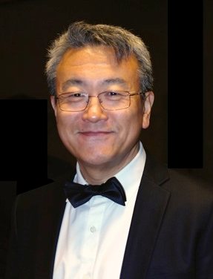
Thank You!
  Dr Leo Lehmann
  SG13 Chairman, 2015-2016
  Leo.Lehmann@ties.itu.int
Dr Chaesub LEE
SG13 Chairman, 2009-2014

Slide 9
Additional Slides

Slide 10
Future networks including cloud computing, mobile and next-generation networks
  “A collection of networks, end user equipment, information, and human resources which can be used to access valuable information, communicate with each other, work, learn, receive entertainment from it, at any time and from any place, with affordable cost on a global scale.”
  G.101 “Global Information Infrastructure terminology: Terms and definitions” (03/2000)

Slide 11
SG13 today – more in depth
  New ideas from research arms
  u-learning, WPT, trust in networks, real-time flight monitoring
  Enhancements to the existing networks
  NGNe, FPBN, PTDN, DPI
  Mobile communications
  MM, FMC (N-screen), multiconnection, IMT-advanced, 5G basics via FG
  Cloud computing
  ecosystem, players, inter-cloud, XaaS, resource management, big data
  Networks of the future
  FN, SUN, SDN, service-, data-, env/socio-ec aware networking, self-managed net
  Assistance and solutions for developing countries – technical papers
  Definitions, Emergency communications
Notes:
Cloud computing: Paradigm for enabling network access to a scalable and elastic pool of shareable physical or virtual resources with self-service provisioning and administration on-demand.
NOTE – Examples of resources include servers, operating systems, networks, software, applications, and storage equipment.
Y.3500 (2014)
Big Data is a paradigm for enabling the collection, storage, management, analysis and visualization, potentially under real-time constraints, of extensive datasets with heterogeneous characteristics. (volume, data velocity and data variety).
Network virtualization: A technology that enables the creation of logically isolated network partitions over shared physical networks so that heterogeneous collections of multiple virtual networks can simultaneously coexist over the shared networks. This includes the aggregation of multiple resources in a provider and appearing as a single resource.

Slide 12
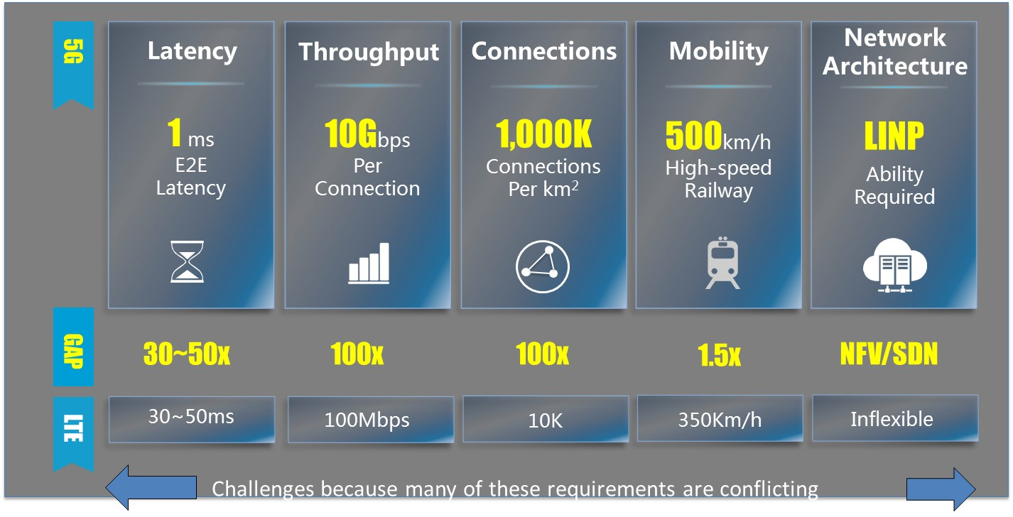
5G: From hardware to software
HW world
SW world
Virtual functions +
virtual links
on generic server /
storage / network pool
Dedicated appliances +
Dedicated wire/radio
Source: Huawei

Slide 13
Key wireline standardization issues
Fronthaul – Fronthaul ties CRAN to Antennas, major downstream effects.
      Is it sliced, where, how.
Backhaul/IDC – latency, jitter, loss at packet layer, flexible data paths
NFV – concept needs to be made broader. Cover some of DSP and all of MEC
MEC – ETSI approach ridged. Any F any CPU + RAT (merge into NFV?)
Orchestration – does not exist yet. Understand AT&T to build in-house
      Danger of orchestration/mgmt duplication (virtual/physical)
Softwarization – high level programming model, profiles, scripts, end to end
OA&M – need “cloud like” approach. Continuous test/repair not just report.

Slide 14
Major Drivers for the 5G wireline architecture
End to end virtualization – obvious operational savings for “tidal” effects
Cloud RAN – opex/capex savings, CoMP, CA, cell edge interference, migration, performance.
Mobile Edge Computing – operators low delay advantage over the OTTs.
Fixed Mobile Convergence – access side also looking for virtualization savings too… can they be combined?
Slicing – differences between RAT’s/CORES etc rather than a one size fits all allows ultra low delay etc. RATS.
SDN and Orchestration – hard to implement all of above with distributed protocols and too complex for manual operation.
NFV – use of general purpose compute as much as possible (but not everywhere) 4G vEPC, 5G-PacketCore_{[slice],} … MEC + some of RAT
Better operations/mgmt, more Cloud-Style, auto problem detect/fix etc.

Slide 15
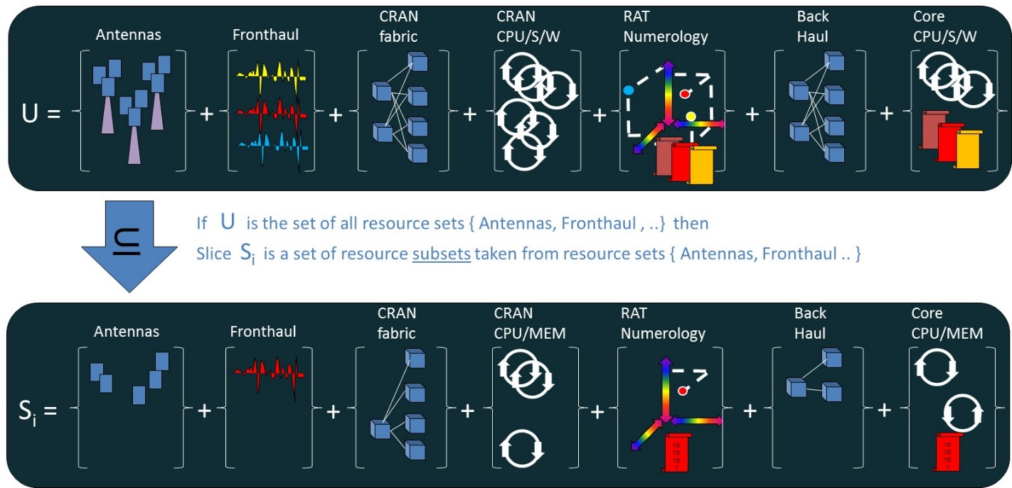
Slicing
Core
FH/BH
UE
Platform/ Applications
Slice
Horizontal Extension
UE-Slicing
Horizontal or
Vertical
Vertical
Extension
Infrastructure
Example: 5G concept of end to end slice
FG IMT2020
Source: Huawei

Slide 16
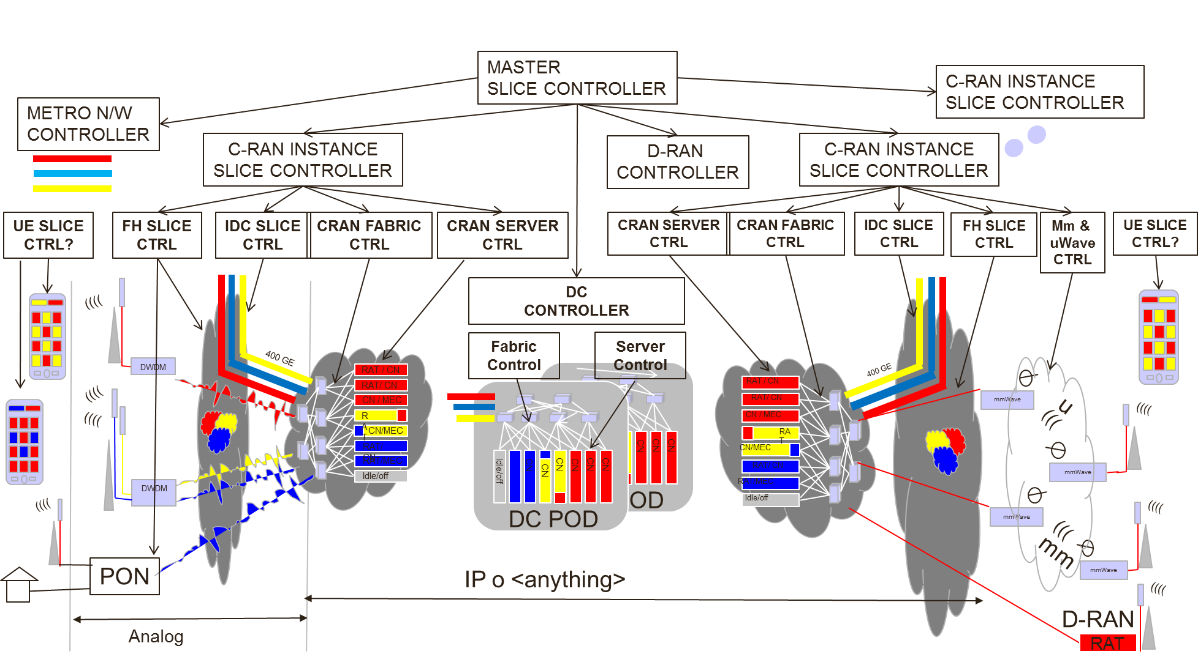
IMT-2020 Hierarchical Orchestration
Source: Huawei
Shift from classical NMS towards controller/orchestrator hierarchy

Slide 17
From IP-based networks to non-IP
IP
Non IP
ICN/CCN
Data aware networks
NGN, Internet, WWW
This shift is expected to contribute to
Flexible network function implementation/ operation
Opex / capex reduction
Faster business cycle, rapid adaptation to demand, increased resource usage, …

Slide 18
NW becomes more complicated
Multi-RAT for better QoE
Applications / virtual servers wanders
Various reqs on mobility, security, …
Underlying NW must be flexible
An example of more complicated network architecture: QoE enhancement in a multi-RAT environment
ITU-R M.2320-0 (11/2014)

Slide 19
Y.3011: Network Virtualization for FNs
Definition of “network virtualization":
  A technology that enables the creation of logically isolated network partitions over shared physical networks so that heterogeneous collection of multiple virtual networks can simultaneously coexist over the shared networks. This includes the aggregation of multiple resources in a provider and appearing as a single resource.
Motivation
  Key technology for Service Awareness of FNs
    Diverse services
    Heterogeneous network architectures
Problem spaces & design goals
  Coexistence of multiple networks
  Simplified access to resources
  Flexibility in provisioning
  Evolvability
  Design goals
    Isolation, network abstraction, topology awareness and quick reconfigurability, performance, programmability, management, mobility, wireless
Detailed requirements are in Y.3012, architecture in Y.3015

Slide 20
Y.3015: Functional architecture of Network Virtualization for FNs
Functional architecture that realizes:
  Isolation of virtual networks (“Logically Isolated Network Partition”)
  Programmability on LINPs
Overview of Functional Architecture
Overview of Functional Architecture
User Roles
Reference Points
Functions
  Management
    Abstraction of Physical Resources
    Allocation of Physical/Virtual Resources to LINPs
    Coordination of Resources
  Operations
    LINP Activation
    Service Deployment & Activation
  Service Development
  LINP Federation
  Authentication & Authorization
Service
Developer
SMI
LINP
Operator
LMI
VMI
VMI
UNI
NNI
End-user
Network
Operator
LINP
Exchanger

Slide 21
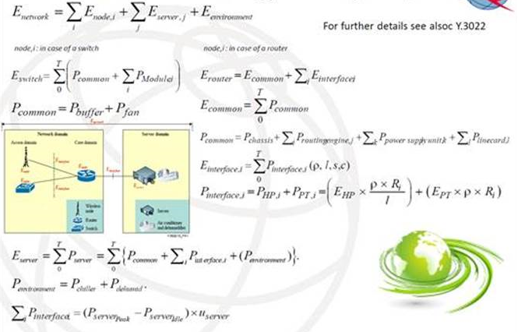
Calculation of network energy consumption

Slide 22
Reliance on others

Slide 23
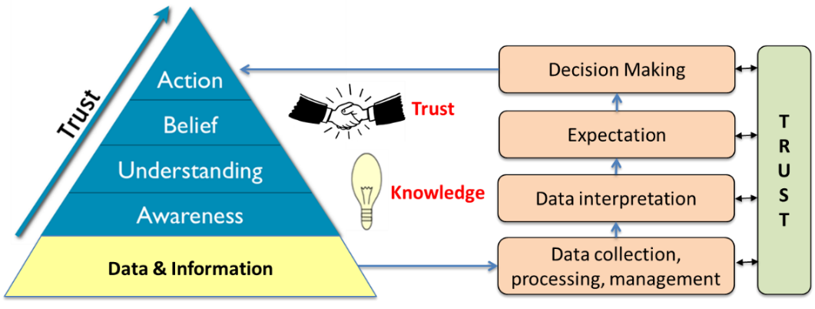
Knowledge and trust

Slide 24
Trust for ICT
Definition
Existing tendencies
Trust
Trust relationships
Key features
Asymmetric
Dynamic
Context-dependent
Trusted inter-cloud

Slide 25
ITU
  Stands for
  I
  Trust
  You

Slide 26
SG13 today - enhancements
NGNe
PTDN
FPBN
DPI
DSN
u-learning
IMT-advanced
Mobility Management
FMC

Slide 27
SG13 today – future networks
Virtualization
SUN
SDN
FN
DSN
X aware-networks
Socio-economic aware
Service-aware
Data-aware
Self-managed

Slide 28
SG13 today – new ideas
Virtualization
u-learning
SDN
WPT
DSN
X aware-networks
Socio-economic aware
Service-aware
Data-aware
Self-managed

Slide 29
Finally, SG13 today
  New ideas from research arms
  Enhancements to the existing networks
  Mobile communications (network aspects)
  Cloud computing
  Networks of the future
  Assistance and solutions for developing countries

Slide 30
Cloud Computing: Definition (ITU-T Y.3500)
“paradigm for enabling network access to a scalable and elastic pool of shareable physical or virtual resources with self-service provisioning and administration on-demand”
NOTE – Examples of resources include servers, operating systems, networks, software, applications, and storage equipment.
[Source: ISO/IEC 17788 | Recommendation ITU-T Y.3500 “Information technology - Cloud computing - Overview and vocabulary”, approved on 13 August 2014]

Slide 31
Cloud Ecosystem
Three actors playing different roles:
Cloud Service Provider CSP: XaaS Provider, Inter-Cloud…
Cloud Service User CSU: Consumer, Enterprise…
Cloud Service Partner CSN: Application Developer, Integrator…

Slide 32
Cloud Functional Architecture
First Cloud ICT Architecture
User Layer
End-User Function
Partner Function
Administrator Function
Cross-Layer
Functions
Access
Layer
Endpoint Function
Inter Cloud Function
Operational Management Function
SaaS / CaaS
Cloud Performance
Function
Services
Layer
PaaS
Service Orchestration
IaaS
NaaS
Security & Privacy Function
Resource Orchestration
Resources & Network
Layer
Pooling &
Virtualization
VN
VS
VM
Software & Platform Assets
Virtual Path
Virtual Circuit
Physical
Resources
Intra Cloud Network
Storage
Computing
Core Transport Network
Inter Cloud Network

Slide 33
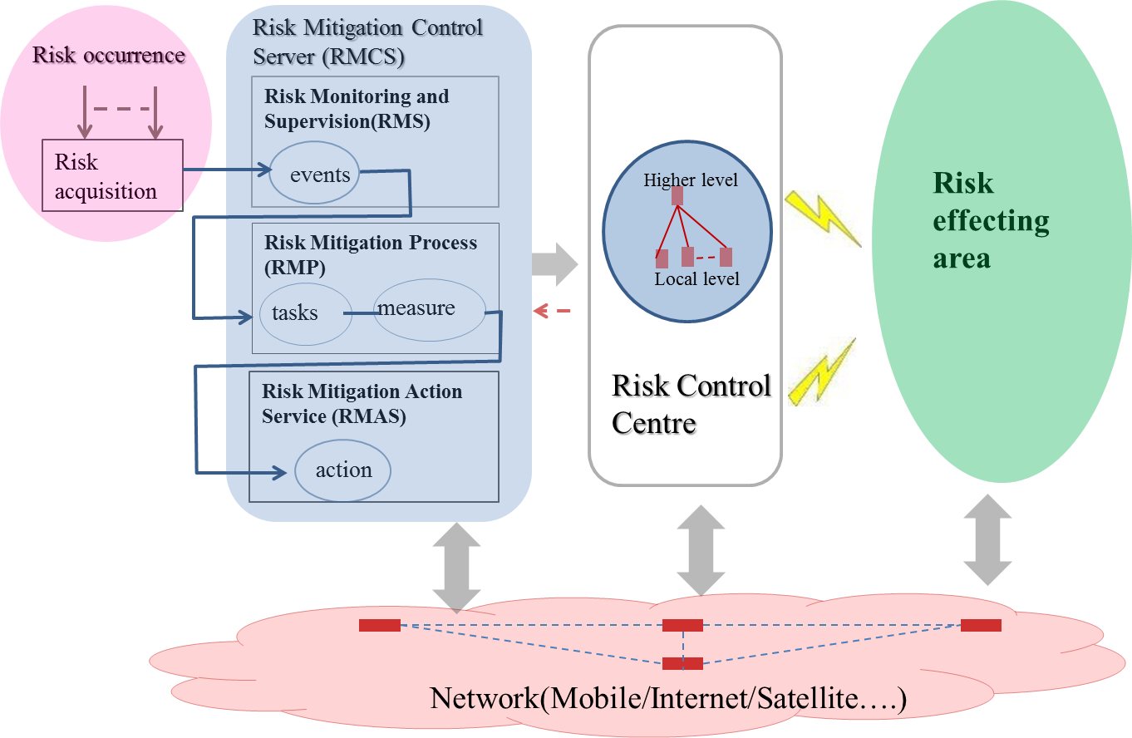
Conceptual model of risk mitigation service

Slide 34
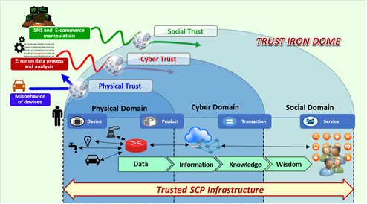
Trust in ICT

Slide 35
Future ICT
Enhancements of networking/ service scope/capabilities
Extension of service
Extension of network
Extension of end-user

Slide 36
Consider Trust as a Key Component for
Future ICT Infrastructure
Key Design Principles
Interactions and relationships among Social/Cyber/Physical worlds
Trustable intelligent services based on data convergence and mining
Trustworthy environment for correct operations
Enhanced security and privacy

Slide 37
Study Group 13 Mandate
Per Res.2: Future networks including CC, mobile and NGNs
Mission:
studies relating to the requirements, architectures, capabilities and mechanisms of future networks;
studies relating to service awareness, data awareness, environmental awareness and socio-economic awareness of future networks.
Responsibility:
studies relating to cloud computing technologies such as virtualization, resource management, reliability and security
studies relating to network aspects of mobile telecommunication networks, including IMT and IMT-Advanced, wireless Internet, mobility management, mobile multimedia network functions, internetworking and enhancements to existing ITU-T Recommendations on IMT
studies relating to NGN/IPTV enhancements, including requirements, capabilities, architectures and implementation scenarios, deployment models, and coordination across study groups.
WTSA 2012 added a mission for SDN by Resolution 77
TSAG 06/2015 entrusted IoT studies to SG20

Slide 38
History of studies in SG13
ISDN
I series Recommendations
GII
Y.100 series Recommendations
IP-based Networks
Y.1000 series Recommendations
Y.2000
series Rec
NGN
Y.1900
series Rec
IPTV
IMT 2000
Future Networks
Q.1700 series
Y.3000 series

Slide 39
Study Group 13 Overview
SG13 - Future networks including cloud computing, mobile and next-generation networks
Lead SG on:
  future networks
  mobility management and NGN
  cloud computing
  Software-Defined Networking
Participants: ~200 delegates from 37 countries
Around 230 contributions

Slide 40
Study Group 13 Overview (2)
WORKING PARITES AND LEADERSHIP FOR STUDY GROUP 13
1/13 | Service scenarios, deployment models and migration issues based on convergence services
2/13* | Requirements for NGN evolution (NGN-e) and its capabilities including support of IoT and use of software-defined networking
3/13* | Functional architecture for NGN evolution (NGN-e) including support of IoT and use of software-defined networking
4/13 | Identification of evolving IMT systems and beyond
5/13 | Applying IMS, IMT and other new technologies in developing country mobile telecom networks
6/13 | Requirements and mechanisms for network QoS enablement (including support for software-defined networking)
7/13 | Deep packet inspection in support of service/application awareness in evolving networks
9/13 | Mobility management (including support for software-defined networking)
10/13 | Coordination and management for multiple access technologies (Multi-connection)
11/13* | Evolution of user centric networking, services, and interworking with networks of the future including Software-Defined Networking
12/13 | Distributed service networking
13/13 | Requirements, mechanisms and frameworks for packet data network evolution
14/13 | Software-Defined Networking and Service-aware networking of future networks
15/13 | Data-aware networking in future networks
16/13 | Environmental and socio-economic sustainability in future networks and early realization of FN
17/13 | Requirements, ecosystem, and general capabilities for cloud computing and big data
18/13 | Cloud functional architecture, infrastructure and networking
19/13 | End-to-end Cloud computing management and security
* Per TSAG June 2015 meeting decision, IoT portion of the work of this Question is being performed in the new SG20

Slide 41
Focus Group on IMT-2020
  Established on 1 May 2015, runs till Dec 2016
  Looks after the network aspects of IMT-2020
  Reports to SG13
  Had 7 meetings and planned one more
  Delivered the Gap Analysis Report identifying the network standardization requirements for the "non-radio" ‘5G’ of International Mobile Telecommunications (IMT) for 2020 and beyond
  Complements the work in ITU-R on IMT-2020
  Currently working on the technical reports on network architecture and network softwarization techniques

Slide 42
SG13 Regional Group for Africa
WORKING PARITES AND LEADERSHIP FOR STUDY GROUP 13
The main objective: encourage national authorities and operators from countries in Africa to work together and better contribute to ITU-T SG 13 activities in general and to Cloud Computing (CC) in particular in line with SG 13 mandate.
Terms of Reference:
a) To encourage participation in the SG 13 and to report SG 13’s outcomes and deliverables.
b) To establish an electronic forum on CC implementation challenges incl. regulatory issues.
c) To establish training needs on current hot topics and future networks in Africa and coordinate the organization of technical tutorials in the region on such topics with SG 13.
d) To encourage African countries to the development of new/revised ITU-T Recommendations on CC and future networks.
e) To disseminate relevant information provided by ITU-T on current hot topics and future networks standards and document relevant use cases of CC architectures and services including emerging mobile services.
f, g) To provide the focal points identified on hot topics issues and future networks in African countries and to collaborate with African Telecommunication Union (ATU).
h) Act as a liaison body between administrations, operators, regulators and ITU-T in matters relating to CC and future networks.
i) Continent priorities are set to: CC, IMT-2020 (non-radio aspects), Big Data and Trust in ICT

Slide 43
JCA-SDN
  JCA-SDN “Joint Coordination Activity on Software-Defined Networking”:
  Created by TSAG in June 2013
  Since June 2015 JCA-SDN reports its progress to SG13
  Maintaines the SDN standardization roadmap
  Lifetime extended until the end of 2017

Slide 44
JRG-CCM
  JRM-CCM “Joint Rapporteur Group on Cloud Computing Management”:
  Composed of Qs 5/2, 7/2 and 19/13
  Develops the Recommendations on Cloud Computing Management
  Managed by co-Rapporteurs from each SG involved
  Reports to its parent groups, SGs 2 and13
  Had 2 Recommendations approved on cloud computing management (M.3070/Y.3521, Y.3522)

Slide 45
Results in brief: 2013 – 2016
WP1
Two SG13 Recommendations on e-health Y.2065, Y.2075 Service and capability requirements and framework for e-health monitoring services, approved and consented respectively
Twelve more Rec on IoT developed
One Rec on functional requirements of mobile IPTV
Two (new and revised) Recs on emergency communication
One Rec on smart farming
One Rec on Next Generation Network evolution

Slide 46
Results in brief: 2013 – 2016 (2)
WP2
Y.2771, Framework for Deep Packet Inspection
Y.2772, Mechanisms for the network elements with support of deep packet inspection
Y.2773, Performance models and metrics for deep packet inspection◊
Y.3500, Cloud computing - Overview and Vocabulary*
Y.3502, Cloud computing - Reference architecture*
Y.3503, Requirements for Desktop as a Service
Y.3504, Functional architecture for desktop as a service
Y.3512, Cloud computing - Functional requirements of Network as a Service
Y.3513, Cloud Computing - Functional requirements of Infrastructure as a Service
Y.3520, revised, Cloud computing framework for end to end resource management
Y.3521/M.3070, Overview of end-to-end cloud computing management
Rec on big data - Y.3600: Requirements and capabilities for cloud computing based big data and its standardization roadmap in Supplement 40
11 Recs on cloud computing, including the latest mentioned above (three Recs were revised)
* Common text with ISO/IEC/JTC1 SC38/WG3
◊ Determined

Slide 47
Results in brief: 2013 – 2016 (3)
WP3
Three Recommendations on SDN Y.3300, Framework of Software-Defined Networking, Y.3320, Requirements for applying formal methods to SDN, Y.3321, Requirements and capability framework for NICE implementation making use of SDN technologies, approved. Four more, Y.3301, Functional requirements of SDN, Y.3302, Functional architecture of SDN, Y.3322, Functional architecture for NICE implementation making use of SDN, and Y.3323, Requirements of Soft network Architecture for Mobile, consented
13 Recs on Future Networks
One Rec on home network
3 Recs on smart grid

Slide 48
Workshops
SG13 organized
Algiers, Algeria, 8 September 2013 “ITU Workshop on Standardization on IMT, M2M, IoT, Cloud Computing and SDN​”
Tunis, Tunisia, 28 April 2014 “2nd SG13 Regional Workshop for Africa on "Future Networks: Cloud Computing, Energy Saving, Security & Virtualization"
Geneva, 14 November 2014 “ITU Workshop on "Cloud Computing Standards - Today and the Future”

Slide 49
Workshops (2)
SG13 organized
Livingstone, Zambia, 23 – 24 February 2015 “Third SG13 Regional Workshop for Africa on “ITU-T Standardization Challenges for Developing Countries Working for a Connected Africa”
Geneva, 24 April 2015 “ITU workshop on Future Trust and Knowledge Infrastructure, Phase 1”
Accra, Ghana, 14 – 15 March 2016 “The fourth SG13 Regional Workshop for Africa on Future Networks for a better future for Africa: IMT-2020, Cloud Computing and Big Data”
Geneva, 1 July 2016 “ITU workshop on Future Trust and Knowledge Infrastructure, Phase 2”

Slide 50
Workshops (3)
SG13 participated and contributed to
ITU Workshop on "Internet of Things – Trends and Challenges in Standardization", Geneva, 18 February 2014
ITU Workshop on Software Defined Networking (SDN) Standardization Landscape, Geneva, 4 June 2013
ITU Workshop on Big Data, Geneva, 17 June 2014

Slide 51
Planned Workshop
“ITU-T Standardization Work on Future Networks: Towards a Better Future for Africa” 3 – 4 April 2017, Egypt.

Slide 52
Management Team
Chair | Leo Lehmann succeed Chaesub Lee | (Switzerland) (Korea, Rep. of)
Vice-Chairs: | Simon Bugaba | (Uganda)
 | Mohammed Al Ramsi | (UAE)
 | Jamil Chawki | (France)
 | Rim Belhassine-Cherif (succeed Slaheddine Maaref) | (Tunisia)
 | Hui-Lan Lu | (USA)
 | Hyoung Jun Kim | (Korea, Rep. of)
 | Yoshinori Goto | (Japan)
 | Ahmed Raghy | (Egypt)
 | Konstantin Trofimov | (Russia)
 | Heyuan Xu | (China)
TSB | Tatiana Kurakova
 | Lara Al-Mnini and AnaMaria Meshkurti (succeed Svetlana Kagermazova and Gabrielle Regan)

Slide 53
Statistics
163 Rapporteurs meetings held
1337 contributions received (plus about the same amount for the interim meetings)
7 SG meetings held
Max/Min/Average SG participants: 194/139/164
11 WP meetings held

Slide 54
Statistics (2)
87 New/Revised Recommendations
10 Supplements
19 Questions assigned by WTSA-12
11 revised Questions during study period
13 Questions proposed for next period

Slide 55
SG13 “Future networks including cloud computing, mobile and next-generation networks”,
its Chairman Leo Lehmann and
Counsellor Tatiana Kurakova
are thankful to you for your attention

