Slide 1



ITU-T
STUDY GROUP 11
Signalling requirements, protocols and test specifications
Kaoru Kenyoshi
(NEC, Japan)
Vice-chairman, SG11
on behalf of
Wei FENG
(Huawei, China)
Chairman, SG11
www.itu.int/itu-t/go/sg11
tsbsg11@itu.int

Slide 2
SG11 in a nutshell
  SG11 is home to SS7 and holds expertise in:
  Combating counterfeiting
  Signalling architectures,
  requirement and protocols
  for legacy and future networks
Conformance
& Interoperability
  Internet performance measurements
  Test methodologies
  and specifications
Our Mission
To develop protocols and test specifications to achieve consistent end-to-end interoperability of systems and networks

Slide 3
SG11 in numbers, positive trend
Study Period
Study Period
Study Period
Study Period
Study Period
Notes:
During the just concluded Study Period (2013-2016), SG11 has doubled its numbers as compared to the previous Study Period (2008-2012).
Total Publications (Recs., Supplements, Technical Reports and Guidelines) 109 (earlier 71)
Total new Recommendations 88 (earlier 47)
Average number of participants to SG meetings 106 (earlier 56)
Total number of Contributions submitted 503 (earlier 304)
Total number of TDs (without considering revisions) developed 503 (earlier 304)

Slide 4
Achievements

Slide 5
Achievements
SDN (software-defined networking)
Signalling and Protocols
COMPLETED
WORK
ON-GOING
WORK
Five ongoing draft Recommendations on SDN signaling requirements
Supplement 67 (2015/04) to Q-series “Framework of signalling for SDN”
Q.3711 (2016/08) “Signalling requirements for software-defined broadband access network”
Q.3712 (2016/08) “Scenarios & signalling requirements of unified intelligent programmable interface for IPv6”
Broadband Network Gateway
(Q.BNG-DBoD, Q.BNG-IAP)
Mapping physical/virtual networks (Q.PVMapping)
Metro orchestration (Q.SMO)
Central office (Q.SCO)
Notes:
Innovative applications running on networks lead to diverging requirements. There is a need to treat different traffic in different manners, and to make networks more application and service oriented.
Software-defined network (SDN) provides a set of techniques that enables to directly program, orchestrate, control and manage network resources to facilitate the design, delivery and operation of network services in a dynamic and scalable manner (Ref. ITU-T Y.3300).
SG11 achievements:
Supplement 67 to Q-series “Framework of signalling for SDN”
Q.3711 “Signalling requirements for software-defined broadband access network”
Q.3712 “Scenarios & signalling requirements of unified intelligent programmable interface for IPv6”
Five ongoing draft Recommendations on
SDN signaling requirements:
Broadband Network Gateway
(Q.BNG-DBoD, Q.BNG-IAP)
Mapping physical/virtual networks (Q.PVMapping)
Metro orchestration (Q.SMO)
Central office (Q.SCO)

Slide 6
Achievements
Other Signaling and Protocols
Network
attachment
Peer2Peer communication,
multimedia streaming
IPv6
2 Completed
ITU-T Q.3404, Q.3712
1 On-going
Draft ITU-T Q.IPv6ProBB
4 Completed
ITU-T Q.3228, Q.3229, Q.3231, Q.3232
2 On-going
Draft ITU-T
Q. NEA-REQ,
Q.SAN-MIM
3 Completed
ITU-T X.609, X.609.1, X.609.2
(joint texts with ISO/IEC)
4 On-going
Draft ITU-T Q.rrp, X.mp2p-msomp, X.mp2p-mspp, X.mp2p-mssr
Control plane of
Distributed Service
Networking
IP-based SMS
over NGN
Emergency Telecommunications
1 Completed
ITU-T Q.3051
1 On-going
Draft ITU-T
Q.Arc-IPSMS
Four Supplements to
Q-series approved
ITU-T Sup. 49, 62,
63, 68
Notes:
Signalling requirements and protocols to support IPv6 transition and to provide broadband services over IPv6 (Q.3404, Q.3712, draft Q.IPv6ProBB)
Signalling and control requirements and protocols for network attachment supporting multi-screen service and future networks (Q.3228, Q.3229, Q.3231, Q.3232, draft Q. NEA-REQ, Q.SAN-MIM)
Management, control, signaling and protocols supporting distributed, smart service networking and end-to-end multicast
P2P communication, multimedia streaming (X.609, X.609.1, X.609.2, draft Q.rrp, X.mp2p-msomp, X.mp2p-mspp, X.mp2p-mssr)
Collaboration with ISO/IEC JTC 1 SC 6 WG7 (joint texts)
Signalling architecture and requirements for
the control plane of Distributed Service Networking (Q.3051)
IP-based SMS over NGN (draft Q.Arc-IPSMS)
Signalling Requirements and Protocol for Emergency Telecommunications (ETS)
Four Supplements to Q-series approved: Sup. 49, 62, 63, 68

Slide 8



Achievements
Combating Counterfeiting ICT Equipment
The Problem
Past Events
PP-14 Resolution 188 (BUSAN, 2014)
"Combating counterfeit telecommunication/information and communication technology devices"
Workshop on Combating counterfeit and substandard ICT devices (November 2014)
International trade in counterfeit: hundreds of billion USD
Growing problem particularly in developing countries
Demo on a solution to combat Counterfeiting of ICT products based on the Digital Object Architecture (April 2015)
Economic impacts on manufacturers and Governments
DEMO
Affects operators networks
Dangers to the health
Workshop on Combating counterfeit using conformance and interoperability solutions (June 2016)
COMPLETED
WORK
ON-GOING
WORK
  Technical Report on
  “Counterfeit ICT Equipment”
  (2014, rev. 2015)
  Draft Rec. Q.FW_CCF “Framework for solution to combat counterfeit ICT Device”
  Two technical reports ongoing
Notes:
PP-14 Resolution 188 (BUSAN, 2014) "Combating counterfeit telecommunication/
information and communication technology devices"
International trade in counterfeit: hundreds of billion USD (2-7%
of world trade), number and range of affected products is growing
Growing problem worldwide particularly in developing countries
Economic impacts on manufacturers and Governments
(brand devaluation, loss of revenue, loss of taxes, copyright)
Dangers to the health (safety and privacy of consumers).
Affects operators (QoS degradations, network disruptions, EMC problems)
Achievements: Technical Report on “Counterfeit ICT Equipment” (2014, rev. 2015)
Ongoing work:
Draft Rec. Q.FW_CCF “Framework for solution to combat counterfeit ICT Device”
TR-CF_BP “Best Practices and Solutions in the Combating of Counterfeit ICT Devices”
TR-Uni_Id “Use of anti-counterfeiting technical solutions relying on unique and persistent mobile device identifiers“
Events held:
Workshop on Combating counterfeit and substandard ICT devices (November 2014)
Demo on a solution to combat Counterfeiting of ICT products based on the Digital Object Architecture (April 2015)
Workshop on Combating counterfeit using conformance and interoperability solutions (June 2016)
More info: http://www.itu.int/en/ITU-T/studygroups/2013-2016/11/Pages/counterfeit.aspx

Slide 9

Internet
performance measurements

Slide 10

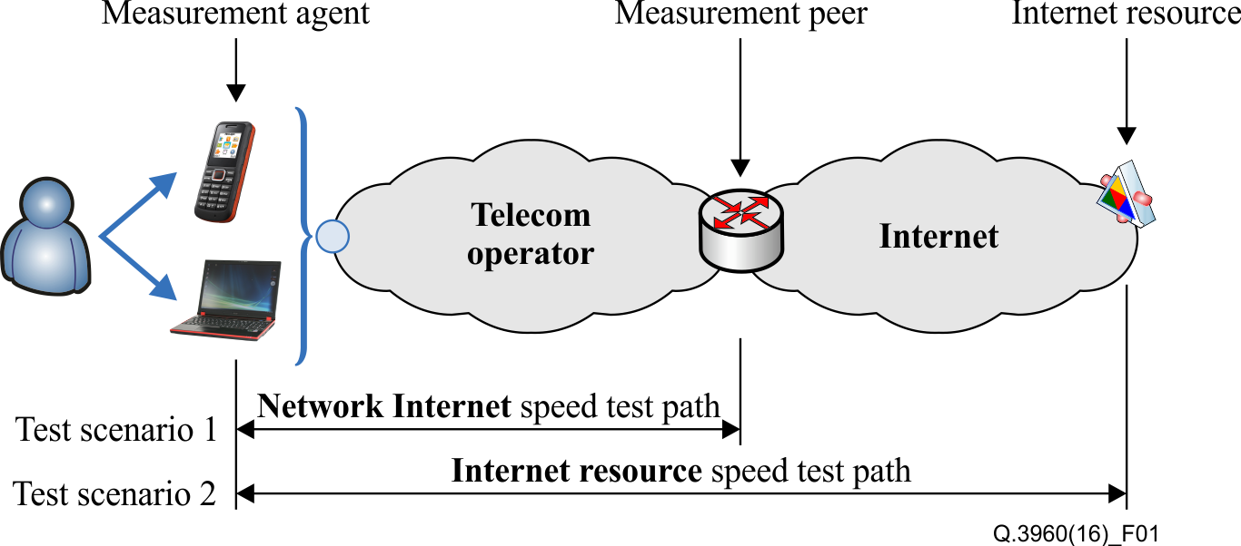
Achievements
Internet performance measurements
Vision: Unified methodology of Internet speed measurement usable by end-users on the fixed and mobile networks
Two types of measurements:
Network Internet access speed
Internet resources access speed
Approved
ITU-T Q.3960
Framework of Internet related performance measurements
Ongoing work:
Q.TM_Int_sp_test (Q.3961)
Testing methodologies of internet speed measurement system to be used on the fixed and mobile networks
Fig.1 - Global scenario and test definition [REF. ITU-T Q.3960]
http://itu.int/en/ITU-T/C-I/Pages/IM/Internet-speed.aspx

Slide 11
Achievements
Framework for VoLTE Interconnection
Current issues of interconnection of
VoLTE-based networks
Operators Challenges
SG11
Related Activities
Workshop on Voice and Video Services Interoperability Over Fixed-Mobile Hybrid Environments, Including IMT-Advanced (LTE) (Geneva, 1 December 2015)
Roaming issues and scenarios
Roaming charges
Numbering/addressing
Emergency services
different VoLTE interconnection/roaming solutions available
these solutions are not always interoperable.
VoLTE roaming procedures are not agreed and therefore may not be implemented
New draft Recommendation: “Framework
of interconnection of VoLTE/ViLTE-based networks”
Stakeholders involved:
SG11, SG2, ETSI TC INT, GSMA
Notes:
Operators Challenges to implement VoLTE/ViLTE:
There are different VoLTE/ViLTE interconnection/roaming solutions available; these solutions are not always interoperable.
VoLTE/ViLTE roaming procedures are not agreed and therefore may not be implemented.
Current issues of interconnection of VoLTE/ViLTE-based networks:
Roaming issues: different options for signaling protocols used
for Inter-IMS interconnection;
different options for roaming scenarios (there are no strict requirements for operators);
charging (e.g. roaming charges, calls using interconnection networks);
numbering/addressing (e.g. ENUM resolution, ITU-T E.164 à SIP-URI conversion);
Emergency services (e.g. emergency call 112), Lawful interception; Data retention;
SG11 related activities:
To follow up on the Workshop on Voice and Video Services Interoperability Over Fixed-Mobile Hybrid Environments, Including IMT-Advanced (LTE) (Geneva, 1 December 2015), SG11 started a new draft Recommendation: (Q.30xx_VoLTE_Interconnection_FW)
Framework of interconnection of VoLTE/ViLTE-based networks
Stakeholders involved: SG11, SG2, ETSI TC INT, GSMA

Slide 12
Achievements
Conformance & Interoperability
Conformity Assessment Steering Committee (CASC)
Recommendations
Tools
SIP-IMS conformity assessment work plan (57 new Recs)
Benchmarking of IMS platform work plan (10 new Recs)
Conformance test plan for Number Portability requirements in Q Sup.4 (Q.3905)
Cloud computing test specifications (Q.4040, Q-Sup.65)
Living list of key technologies suitable for C&I testing
Reference table of ITU-T Recs and test specifications
Pilot projects among SGs
Working on a test laboratory recognition procedure in ITU-T
Collaboration with IECEE
Three guidelines ongoing
Notes:
Established Conformity Assessment Steering Committee (ITU-T CASC) to elaborate detailed procedures for the implementation of a test laboratory recognition procedure in ITU-T (web page).
Three guidelines ongoing:
collaboration procedure with established accreditation bodies to assess TLs in the scope of ITU-T Recommendations (Collaboration with IECEE)
procedure to appoint ITU-T technical experts;
detailed procedure to recognize Testing Laboratories
Recommendations:
Conformance test plan for Number Portability requirements defined by ITU-T Q.Suppl.4 (ITU-T Q.3905)
IoT and Cloud computing test specifications
SIP-IMS conformity assessment work plan (TD1050-GEN11)
Benchmarking of IMS platform work plan (TD41-WP4/11)
Tools:
Living list of ITU-T Recs on key technologies suitable for C&I testing as well as a reference table of ITU-T Recs and corresponding test specifications: (http://itu.int/go/key-technologies ; http://itu.int/go/reference-table )

Slide 13


Slide 14
Future Developments
SG11 aims to:
LEAD protocol development for 5G/IMT-2020
COMBAT the proliferation of counterfeit ICT equipment
ESTABLISH ITU Test Lab recognition procedure
STANDARDIZE Internet performance measurements
ACHIEVE VoLTE interconnection
DEVELOP test specifications for IoT, Cloud, SDN, 5G
ENHANCE SS7 security

Slide 15

SG11 contacts
www.itu.int/itu-t/go/sg11
tsbsg11@itu.int

Slide 16
Additional Slides

Slide 17
Relevant URLs
Combat counterfeiting
Internet speed measurements
Conformity and Interoperability Portal
Conformity Assessment Steering Committee (CASC)
SIP-IMS Conformity assessment
Software-defined networking (SDN)
www.itu.int/itu-t/go/sg11

Slide 18
SG11 mandate
SG11 developed Signalling System N.7 (Q.700-series Recommendations) which allowed international telecom connectivity
Signalling architectures, requirements and protocols, including those for IP-based network technologies, NGN, M2M, IoT, FNs, Cloud Computing, SDN, mobility, some multimedia related signalling aspects, ad hoc networks (sensor networks, RFID, etc.), QoS, and signalling to inter-network with legacy networks ATM, N-ISDN and PSTN networks.
In addition, studies relating to reference signalling architectures and test specifications for NGN and emerging network technologies

Slide 19
Working Party Structure
Signalling requirements and protocol for emerging networks
SG11
WP1
WP1 Chairman: Xiaojie Zhu (China Telecom),
Wei FENG (China)
SG11 Chairman
Q1/11, Q2/11, Q3/11
assisted by
Stefano POLIDORI
SG11 Advisor (TSB)
Software-Defined Networking (SDN) and resource control
WP2
WP2 Chairman: Kaoru Kenyoshi (NEC)
Q4/11, Q5/11, Q6/11
Attachment and service networking
WP3
WP3 Chairman: Shin-Gak Kang (ETRI)
WP3 Vice-chair: Isaac Boateng (NCA, Ghana)
Q7/11, Q8/11, Q9/11
Conformance and Interoperability (C&I) testing
WP4
WP4 Chairman: Martin Brand (A1 Telekom Austria AG)
WP4 Vice-chair: Prof Andrey Koucheryavy (Russian Federation)
Q10/11, Q11/11, Q12/11, Q13/11, Q14/11, Q15/11

Slide 20
List of Questions
QUESTIONS | TITLE
Q1/11 | Signalling and protocol architectures in emerging telecommunication environments
Q2/11 | Signalling requirements and protocols for service and application in emerging telecommunication environments
Q3/11 | Signalling Requirements and Protocol for Emergency Telecommunications
Q4/11 | Signalling requirements and protocols for Bearer and Resource control in emerging telecommunication environments
Q5/11 | Protocol procedures relating to services provided by Broadband Network Gateways
Q6/11 | Protocol procedures relating to specific services over IPv6
Q7/11 | Signalling and control requirements and protocols for network attachment supporting multi-screen service, future networks, and M2M
Q8/11 | Guidelines for implementations of signalling and protocols, and for addressing counterfeited ICT devices
Q9/11 | Protocols supporting distributed, smart service networking and end-to-end multicast
Q10/11 | Service and networks benchmarking measurements
Q11/11 | Protocols and Networks Test Specifications; frameworks and methodologies
Q12/11 | Internet of things test specifications
Q13/11 | Monitoring parameters for protocols and emerging networks
Q14/11 | Cloud interoperability testing
Q15/11 | Testing as a service (TAAS)

Slide 21
SIP-IMS conformance testing
Vision: provide a conformity assessment framework to worldwide telecom operators to test equipment against SIP-IMS profiles based on ITU-T Recommendations, and create a list of TEs based on SIP-IMS profile which comply with ITU-T Recommendations.
Collaboration with ETSI TC INT to
  endorse existing European regional standards as international ITU-T Recommendations on SIP-IMS profiles
  complement those with missing standards (e.g. requirements, test specifications, use cases, etc.)
Outcomes:
57 new ITU-T Recommendations on requirements and relevant test specifications for basic call and some supplementary services for SIP-IMS were finalized, according to the established standardization work plan
  Q.3617-Q.3639: Service and session control protocols – supplementary services based on SIP-IMS
  Q.4000-Q.4039: Testing specifications for SIP-IMS

Slide 22
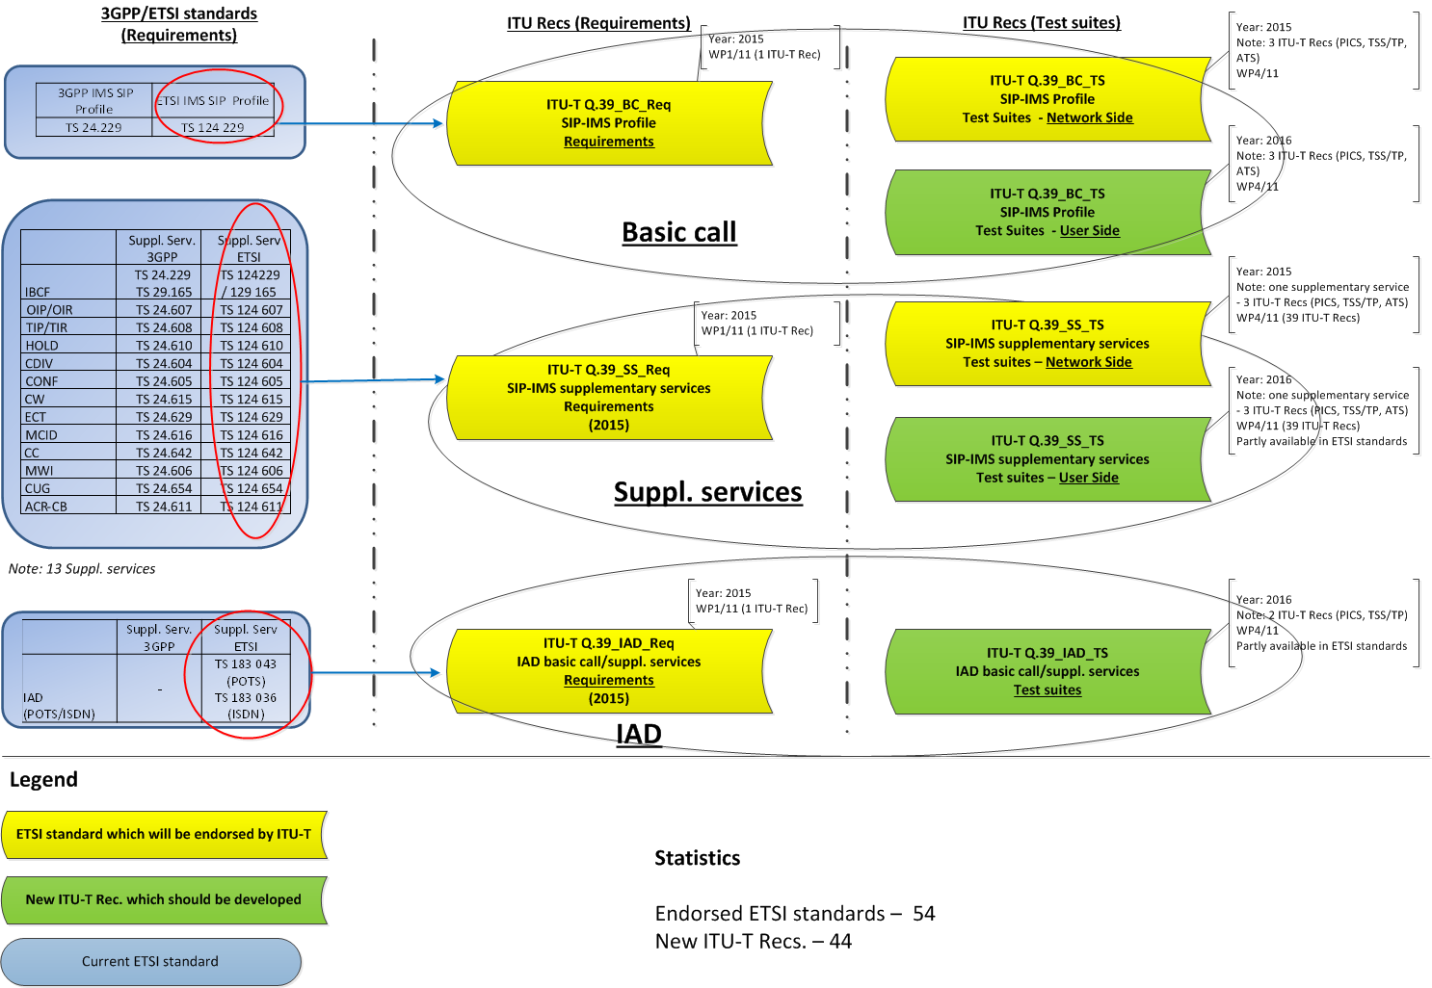
WORK PLAN ON SIP-IMS STANDARDIZATION

Slide 23
Benchmarking standardization
Vision: provide a framework to worldwide telecom operators to test the performance of the IMS/NGN/PES and VoLTE network equipment according to ITU-T Recommendations.
10 Recommendation were approved as follows:
Basic concept of benchmark testing
  Q.3930
Benchmark testing for PSTN/ISDN emulation
  Q.3931.1, Q.3931.2, Q.3931.3, Q.3931.4
Benchmark testing of IMS/NGN/PES and VoLTE
  Q.3932.1, Q.3932.2, Q.3932.3, Q.3932.4
Reference benchmarking for VoIP and Fax over IP
  Q.3933

Slide 24
ITU Workshop on "Voice and Video Services Interoperability (over LTE)”
The 7th ITU CTO meeting agreed to organize a workshop on Voice and Video service interoperability in the fix and mobile environment in order to identify the current status and issues.
The workshop on "Voice and Video Services Interoperability” was held on 1st December in Geneva. 14 presentations were introduced from operators, SDOs, vendors and institutes. After the presentations, the panel discussion identified the items which should be studied in SG11.
SG11 meeting from 2nd December reviewed the report of the workshop and created the following two new work
  Framework of interconnection of VoLTE/ViLTE-based networks (Q2/11)
  Interworking between the IP Multimedia (IM) Core Network (CN) subsystem and Circuit Switched (CS) networks. Protocol specification (Q2/11)
ITU Workshop on "Voice and Video Services Interoperability Over Fixed-Mobile Hybrid Environments, Including IMT-Advanced (LTE)" Geneva, Switzerland, 1 December 2015
http://www.itu.int/en/ITU-T/Workshops-and-Seminars/conformity-interoperability/20150112/Pages/Programme.aspx

Slide 25
SG11 organized two Workshops during SG11 meeting (June 2016)
ITU Workshop on "Combating Counterfeit Using Conformance and Interoperability Solutions“
Geneva, Switzerland, 28 June 2016
http://itu.int/en/ITU-T/Workshops-and-Seminars/20160628/Pages/default.aspx
ITU Workshop on “Signalling System N.7 (SS7) Security“
Geneva, Switzerland, 29 June 2016
http://itu.int/en/ITU-T/Workshops-and-Seminars/201606/Pages/default.aspx

Slide 26
Joint Coordination activity
Conformance and Interoperability Testing (JCA-CIT)
General statistic
8 meetings
Was concluded by SG11 in July 2016
Main focus
Addressing C&I coordination issues within ITU and with other SDOs
Key outcomes
Discussed key ITU-T activities on C&I (CASC, SIP-IMS profile, Internet speed measurements etc.)
Coordinated collaboration works in ITU and with other SDOs on C&I.
Assisted SG11 to maintain living lists on C&I (key technologies, reference table, pilot projects)
Informed participants about the planned ITU testing events and outcomes of the conducted events (e.g. APT/ITU C&I events, etc.)
http://www.itu.int/en/ITU-T/jca/cit/Pages/default.aspx

Slide 27
ITU-T recognition procedure of testing laboratories (1/2)
Background:
Russian Contribution to SG11 meeting (November 2013) and corresponding group was created
The corresponding group concluded in July 2014 and the work transferred to Q11/11
SG11 achievements:
New guideline “Testing laboratories recognition procedure” (Q.TL-rec-pro) was approved in April 2015
ITU-T Conformity Assessment Steering Committee (CASC) was established under SG11 in April 2015
Mr Isaac Boateng (NCA, Ghana) was appointed Chair of CASC
CASC will adopt the working methods of a Working Party
First meeting of CASC held in December 2015 and second meeting in June 2016
All ITU-T SGs are invited to appoint a representative to the CASC
[see TD 245 (TSAG)]

Slide 28
ITU-T recognition procedure of testing laboratories (2/2)
Detailed procedures will be developed by ITU-T CASC.
The general work flow will be as follows:
The candidate TL shall submit to the ITU-T CASC an application for recognition
The ITU-T CASC will provide to the relevant committee of IEC and ILAC the necessary documentation and the list of ITU-T technical experts
Based on the decisions of IEC and ILAC, ITU-T CASC will recognize a TL
The TL is notified and added to the list of ITU-T recognized TL
TL recognition procedure work flow

Slide 29
FG on M2M service layer
The Focus Group on the M2M service layer (FG M2M) studied activities currently undertaken by various standards developing organizations (SDOs) in the field of M2M service layer specifications to identify key requirements for a common M2M service layer.
This focus group concluded in December 2013 and these deliverables are transferred to relevant SGs in order to initiate developing recommendations based on them.
 | Working group | Leadership
WG1 | Use cases and service models | M. Morrow (Cisco) R. Istepanian (Kingston University) M. Berrebi (eDevice)
WG2 | Requirements and architectural framework of the M2M Service Layer | M. Carugi (ZTE) H.J. Kim (ETRI)
WG3 | API and protocols | Guodong Xue (Huawei Technology) Hideo Himeno (NEC Corporation) Ali Amer (Saudi Telecom Company)
Deliverables | TITLE
D0.1 | M2M standardization activities and gap analysis: e-health (SG16 and SG13)
D0.2 | M2M enabled ecosystems: e-health (SG16 and SG13)
D1.1 | M2M use cases: e-health (SG16 and SG13)
D2.1 | M2M service layer: requirements and architectural framework (SG16 and SG13)
D3.1 | M2M service layer: APIs and protocols guideline (Q1/11 developed Rec. ITU-T Q.3052)

