Slide 1
ITU-T STUDY GROUP 2
Operational aspects of service provision and telecommunications management
Dr. Sherif Guinena Chairman of SG2

Slide 2
SG2 Main topics
ISC
E.164
E.212
IIN
E.118
ICC
M.1400
ENUM Delegation
SG2 Focus is “Operations”
Operations are the backbone of service providers in ensuring that services are provided to meet objectives of the customer expectations, while supporting the key business objectives of the corporation.
SANC
Q.708
NNAI & Routing
IP Addresses
Carrier ENUM
UIN
E.169 Series
.TEL
NP
IoT NNAI
Caller
ID
Misuse
E.FAST
E.OKID
Human Factors
TM and OAM PP
C&I Pilot
CCM
TF
Suppl.3
TM
X.mfsiwt
UIS
E.15x
E.161
Specification
Methodology
Rev. M.3020
E.123
EW/DR&NRR
M.cbnmsa
UPT
F.85x
Services & Operation
TMN
Principles
eTOM
Notes:
NNAI: Numbering Naming Addressing identification
ISC: International Shared Code
IIN: Issuer Identifier Number
ICC: ITU Carrier Code
SANC: Signaling Area Network Code
UIN: Universal International Number
UIS: Universal International Service
TF: Telecom Finance
NP: Number Portability
EW: Early warning
DR: Disaster Relief
NRR: Network Resilience and Recovery
UPT: Universal Personal Telecommunication
CCM: Cloud Computing Management
TM: Telecommunication Management
White ones mean completed and important toptics
Grey ones mean on-going topics
X.mfsiwt : The measurement framework for the statistical indicators of website traffic
CCM: M.3070 (Approved) and M.3371 (Consent)
Cloud based network management system architecture: M.cbnmsa

Slide 3
Achievements, and Future Work

Slide 4
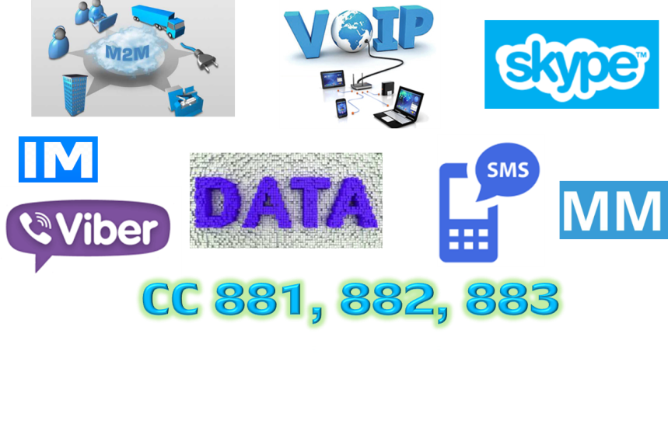
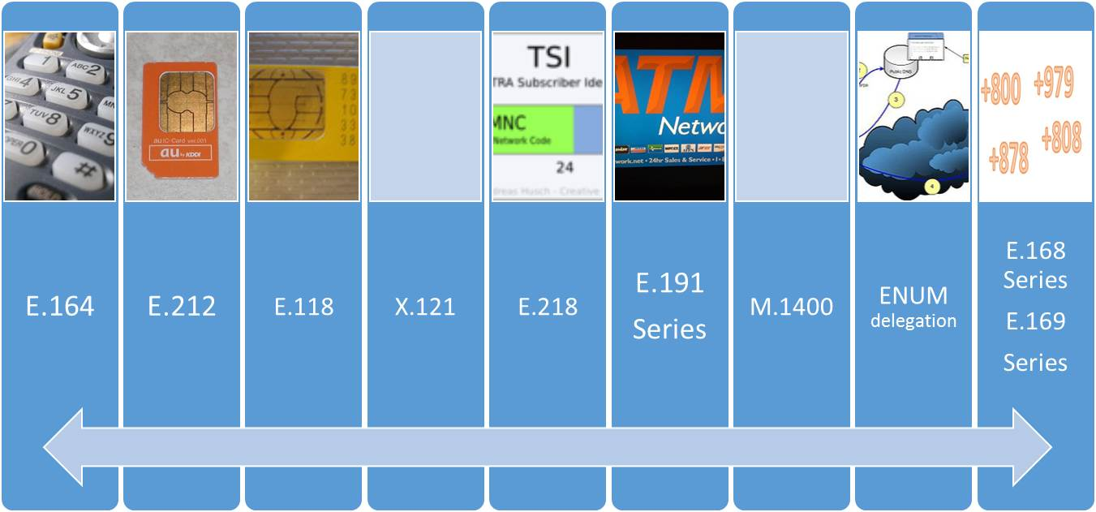
NNAI for Global Networks and Services
Highlights of Achievements
Enabling new and/or expanding global networks and services through assignment of shared numbering resources:
12 E.164 shared CC and ICs were assigned
14 E.212 shared MCC and MNCs were assigned
MCC 901 MNC XX
( Rev. E.212 )
One of the Main Competencies of SG2
is NNAI

Slide 5
NNAI and Routing
Future work
Lead role: in NNAI and Routing
Physical World
Information World
IoT Device
Communication
Without Gateway
Evolution: Draft new Rec. E.NNAI-IoT
Physical Thing
Virtual
Thing
New applications: of E.212 Mobile Resources
Communication
Via Gateway
Communication
Network
Mapping
Number Portability: in an IP environment. (Carrier ENUM for international IMS interworking)
GW
GW
Originating Identification: CPND, CLI, OI : E.157
Examples of virtual things include multimedia content, application software, or computational process.
Routing information: ACP
Examples of physical things include the surrounding environment, industrial robots, goods and electrical equipment
Direct
Communication (Adhoc)
Misuse: Guidelines : E.156

Slide 6
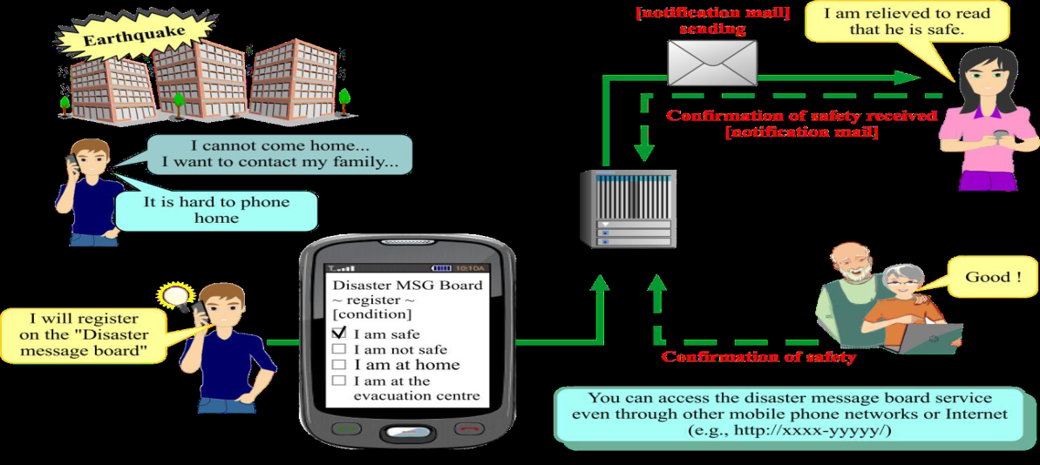
Disaster Relief
Highlights of Achievement
Future Work
Requirements for Safety Confirmation and Broadcast Message Service for Disaster Relief.
DR&NRR Focus Group: 8 Deliverables
New E.108, Requirements for a disaster relief mobile message service.
New E.1110, CC 888 for UN OCHA
Revised E.129, Presentation of NNP

Slide 7
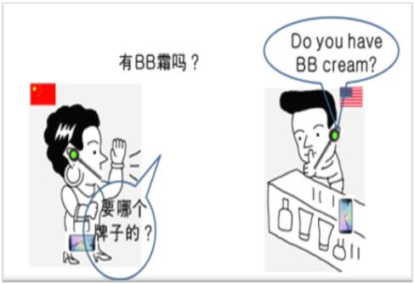
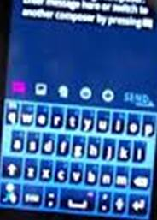
Human Factors, Telecom Management
한국어 키보드
Network Management
HF: New Annex A to E.161, Arrangement of digits for Korean KBD character set and symbols.
9 New Recommendations
11 Revised /Amended Rec.
Future Work
Future Work
E.FAST : Face-to-Face Translation
E.OKID : On screen Keyboard Standardization
Human Factors for 5G , IoT, DFS
New critical operational requirements to prevent Telecom fraud globally

Slide 8
Building TRUST
NNAI
Service Delivery
Routing
Management
in Origin Identification in IP environment.
in use and veracity of NNAI Resources:
SS7 , NUMB-DB ...
Classification of Data Networks.
in IoT Identifiers: Unique, persistent, transparent scalable, reliable, interoperable, private/secure.
in EW and DR&NRR
in Digital Financial Services
Re-innovation of UPT
in management Security.
in Security management.
New consideration for management of network entirety , in the physical domain and in the cyber domain, for trustworthy management
in Routing → ACP
in carrier ENUM (ENUM Query), for international IMS interworking.
in Number portability in IP environment

Slide 9
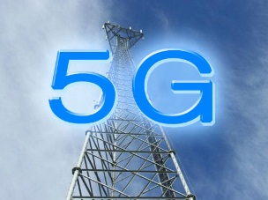
Future ?
Human factors in the context of IMT-2020 / IoT
DR&NRR
Holistic Approach to Network Management
Interworking and Interoperability
Global Platform to address and combat Misuse and Caller ID spoofing
NNAI for M2M & IoT
TRUST

Slide 10
Thank You

