Slide 1
ITU-T Review Committee
Yoichi MAEDA Chairman, RevCom
Vice-chairmen:
Musab ABDULLAH, Bahrain
Reiner LIEBLER, Germany
Jim MACFIE, Canada
Fabien MBENG EKOGHA, Gabon (2013-2015)
Guy-Michel KOUAKOU, Côte d'Ivoire (2015-2016)
Albert NALBANDIAN, Armenia
Kishik PARK, Rep. of Korea

Slide 2
RevCom in a nutshell
The ITU-T Review Committee (RevCom) was established by WTSA Resolution 82 (Dubai, 2012)
The core objective of RevCom was reviewing the structure and working methods of ITU-T, ensuring that it meets the standardization needs of an evolving business environment

Slide 3
Summary of RevCom work
Survey on ITU-T restructuring and collaboration
Monitoring of standardization -related activities
Outcomes of CxO meetings
Review of ITU-T cooperation and collaborations mechanisms
Assessment of Technology Watch Reports

Slide 4
Summary of RevCom work
ITU-T SG restructuring
Creation of a standardization strategy function
Guidelines for efficient transfer of focus-group deliverables to its parent group
Creation of a "vertical" study group

Slide 5
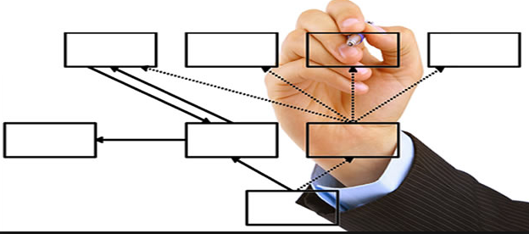
Conclusions
RevCom recommendations
Review of SG statistics at each TSAG meeting
Adoption of high-level principles for ITU-T restructuring
Adoption of guidelines for efficient transfer of focus-group deliverables to parent groups
Review of current cooperation/ collaboration mechanisms and groups
Creation of a Standardization Strategy Function
Creation of a "vertical" study group on key industry topics

Slide 6
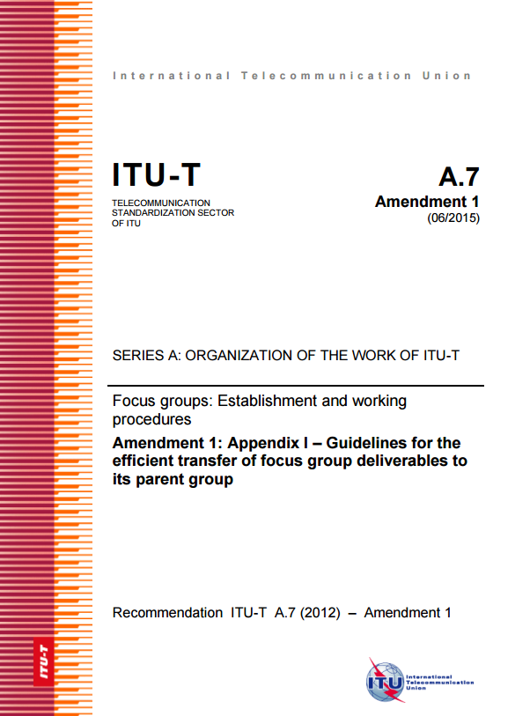
Conclusions
Implemented by TSAG
New TSAG Rapporteur Group on Standardization Strategy was created
Appendix I to ITU-T Rec. A.7 was agreed
Seven high-level principles for ITU-T Restructuring were agreed
New SG20 was created
SG20

Slide 7
Conclusions
Proposals to WTSA-16
Continue monitoring ITU-T SG activities by TSAG
Apply the restructuring principles adopted by TSAG in WTSA-16
Continuation of review of current cooperation/collaboration mechanisms and groups by TSAG
Continue using the outcomes of CxO Group meetings/ Technology Watch
Suppress WTSA Resolution 82 at WTSA-16; TSAG to continue the review functions
Continue review functions by TSAG via its various Rapporteur Groups such as Standardization Strategy

Slide 8
Thank you!

