Slide 1
WTSA-16: Using the Proposals Management System (PMS) for tracking Proposals
October/November 2016
Rob Clark
ITU-T Study Groups Department (robert.clark@itu.int)

Slide 2
Proposals Management System (PMS) web view
The PMS web view:
Web-based tool for delegates to identify and monitor Proposals
Ensures traceability from initial submission to final disposition
Tracks whole Contributions and individual Proposals
Notes:
The PMS web view is an intuitive system, but it requires some understanding of the purposes and working methods of WTSA-16. These are outside the scope of this presentation.
The system supports ITU’s commitment to transparency by providing filtering and tracking features, and provides timely, structured information to ensure the smooth running of Committee and Working Group meetings.

Slide 3
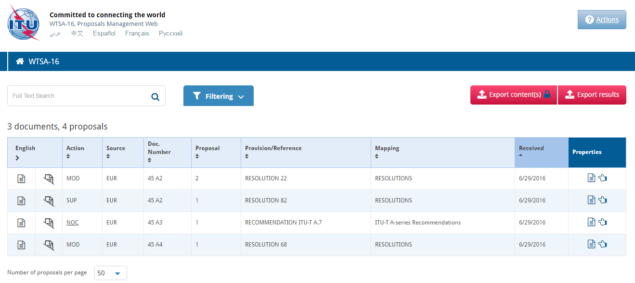
Proposals Management Webpage
Select your preferred language.
PMS will display information and document content in that language
Export report of Proposals listed below in Word format, either with or without appending content
Search and filtering options (see following slides)
Metadata for the Proposals listed below
Download the complete document
Download only the Proposal content
Click to see more specific information, and to download content in other languages. (see next slide)
Notes:
The main page and all content are available in all six official languages of the Union.
Filtering – covered in the next slides – provides a clear view of what has been submitted and by whom.
A table of metadata provides an overview of Proposals, and gives easy access to their content.
Two reports are available, providing a structured list of Proposals with or without the content appended.

Slide 4
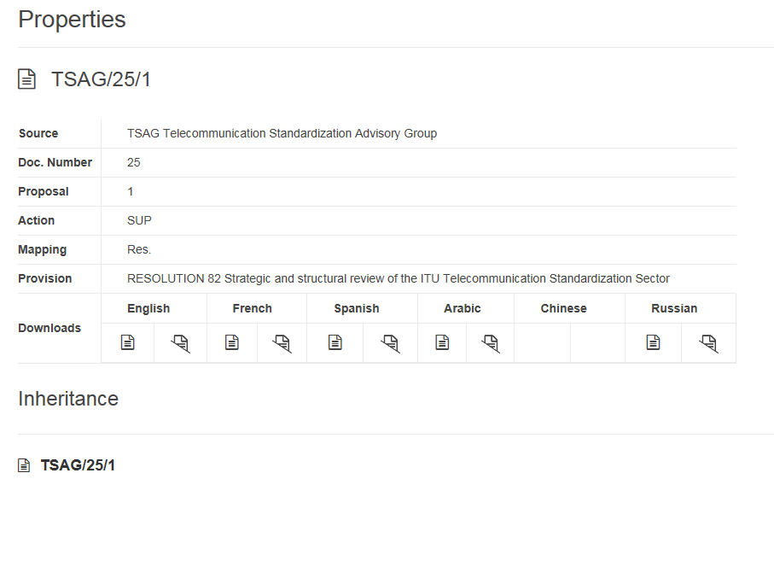
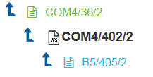
The Properties screen
Metadata relating to the selected Proposal
For each language, download links for the complete document or just the Proposal content (in this example, Chinese is not yet published)
Track the progress of this Proposal throughout the Assembly, and potentially into the Proceedings (NOTE – these data are fictitious)
Notes:
For any Proposal, click on the “Properties” icon to see more detailed metadata or access multiple language versions of complete Assembly documents, or just the Proposal content.
“Inheritance” will build for each Proposal during the Assembly. Each subsequent Working Group or Committee document that cites the Proposal as an original or direct input will be listed, providing a clearly defined path from initial submission by ITU Membership to its final disposal, e.g., its Approval by a Plenary session.

Slide 5
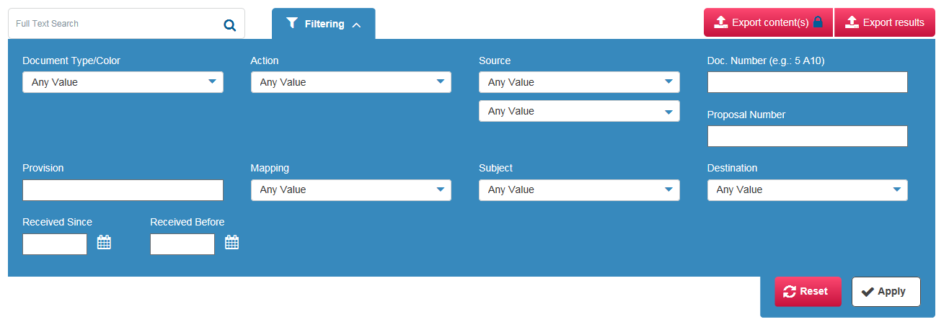
PMS filtering criteria (1/2)
Filter by Document type:
Proposal (main Document series)
Green: TD (or DT)
White series: Proposals sent to Editorial Committee
Blue series: Proposals sent to Plenary for Approval
Source of the Proposal, filter by either:
Short identifier, e.g., “USA”, or
Full identifier, e.g., “United States”
Identifiers are linked, and autocomplete each other.
Overall Action proposed to the Assembly, one of:
ADD: Add a new Provision to the Proceedings
MOD: Modify an in-force Provision
SUP: Suppress (delete) an in-force Provision
NOC: Proposal specifically to not change a Provision
Filter by Document or Proposal number (if known)
Reset or apply filtering criteria
Notes:
A wide range of filters can be built up to identify all Proposals that meet certain criteria.
In order for filters to take effect, click on the “Apply” button. To clear all filters, click on “Reset”.

Slide 6
PMS filtering criteria (2/2)
Once filters have been applied, click here to output a report in Word format (with or without the Proposal content appended)
Complete or partial Provision identifier, e.g., “Resolution 75” or just “75”
Destination Committee or Working Group (only available once Plenary decides WTSA structure and assigns work)
Mapping of Proposals to one of:
Res (in-force Resolutions)
Draft new Resolutions
A-series Recommendations (in force)
Draft new Recommendations
Date range for reception (publication) of the Proposal
Reset or apply filtering criteria
Notes:
The filtering criteria become more powerful as the volume of published documents increases.
One specific filter, “Destination”, will become available in PMS only once the WTSA-16 Plenary session has agreed to the Assembly structure and started to assign Proposals to Committees and Working Groups.
When combined with the reporting features, these filters provide valuable insights to help delegations participate in those meeting activities of greatest interest.

Slide 7
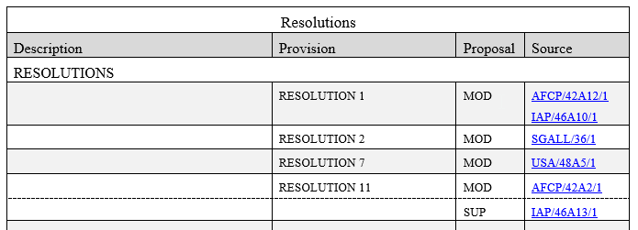
Typical report (specific to the filters applied)
Provisions that have received Proposals
Action type
Link to Proposal
Notes:
The output reports reflect the filtering criteria that have been applied on the web page.
Reports are structured by:
In-force Resolutions
Draft new Resolutions
In-force/draft new Opinions
In-force A-series Recommendations
Draft new Recommendations
Each part is ordered by Provision identifier, and lists per Action type the Proposals received.

Slide 8
Any questions?
WTSA-16 Secretariat: wtsa-doc@itu.int
Notes:
Please contact the WTSA-16 Secretariat if you have any issues or questions. We are at your disposal to ensure the provision of high-quality, timely documentation to support the smooth running of WTSA-16.
We wish you a successful Assembly,
Best regards,
WTSA-16 Docs Control

