Slide 1


From Innovations to Collaborative Standardization
WTSA-12 Side Events
Side event on ICT Innovations
(Dubai, UAE, 22 Nov. 2012)
Ramy Ahmed
rahmed@tra.gov.eg
WG-2 Chair, Focus Group Innovation
Sen. Manager, Digital Services Policies
National Telecom Regulatory Authority (NTRA)
Notes:
Improving the capacity of developing countries to fully participate in the development of global standards represents the core essence behind one of the major strategic goals of the ITU Telecommunication Standardization Sector (ITU-T); which is the assistance in bridging the standardization gap between developed and developing countries. This presentation touches upon the core obstacles that prohibit developing countries from fully engaging in the standardization development process. In addition, it highlights a typical pattern governing the process that drives innovations to standardization, in an attempt to illustrate its effect on the standards making capabilities of developing economies. Finally the presentation ends up with illustrating some possible tools that could help in bridging the standardization gap, in an effort to complement the current international efforts in this regard.

Slide 2
Bridging the Standardization Gap
one of the major strategic goals of the ITU Telecommunication Standardization Sector (ITU-T)
Has a lot of implication on developing countries

Slide 3
The Magnitude of the Problem
How can we assess the magnitude of the gap?
  Level of Participation ITU Meetings
  Number of Standalone Contributions
  Number of Addendums and modifications to existing contributions
But…. is this enough? If these indicators increases → Standardization Gap is Bridged?

Slide 4
The Magnitude of the Problem
Concept of Effective Participation
  Contributions that reflects the true interests and concerns of developing countries
  Participation in the standards development process with proper competences that would enable them from submitting proposals, and defending them, and possibly obtaining consensus

Slide 5
Towards Effective Participation in Standardization Process
Competences
Exposure and training
Drivers
Means to increase demand for top notch ICT services
Industrial Incentives
Foundational ICT Infrastructure
Develop national R&D strategies
Innovation as a major driver
ITU BSG Programmes
Academic cirrucula ammendments
Fellowships?
Government Policies?
Funds?
Effective Participation
Notes:
Comes the question about the importance of fellowships, and impact of government policies, and the necessity of funds to establish each of the shown pillars for achieving effective participation

Slide 6
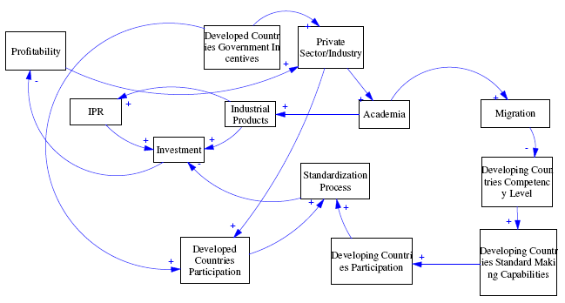
Innovation Life-Cycle
Gap will always increase !!
Notes:
This section highlights a typical pattern governing the process that drives innovations to standardization, in an attempt to illustrate its effect on the standards making capabilities of developing economies.
The process that drives innovations to standardization follows a certain pattern. While we acknowledge that what is presented here does not represent a generalization for all innovation to standardization policy procedures, we however believe that this model catches more or less a glimpse on innovation development cycle in addition to some important driver behind its development. From a pure economic perspective, economies and administrations focus on developing innovative technologies for many reasons. A possible reason could be to increase the overall welfare of their societies in addition the encouragement of their national industries.
Playing a leading role in the international market could definitely enhance a country’s strategic position in its region, in addition to opening up new possibilities for further investment opportunities, and new trade agreements. And in order to do that, governments usually encourage R&D and innovation development by setting innovation development policies that encourage innovations and facilitate new technologies that have a high social impact.
Tax credits and other benefits like R&D equipments tax exemptions, and other facilitations are given to private industry in order to encourage them in investing in R&D. Triggered by these incentives, and the possibility of revenue maximization through the creation of totally new revenue streams; the industry reacts by financing R&D projects either through academic channels or through other industrial channels.
Cooperating with entrepreneurs, academic institutes, and/or any other industrial partner to achieve an innovative product/solution is usually the next step. This fact is apparent in many situations and examples around the globe, when we see academic positions being availed, and funded by the industry every day.
By the availability of funds, academic institutes open up research (degree or non-degree) vacancies for national and international candidates; where a screening process is conducted to acquire best fitting individuals for their projects. Eventually, any IPR and/or patent applications filed to protect resulting inventions are registered to those who financed the whole operation. The resulting situation demonstrates a gap between patents registered in developed and developing countries; a fact although is true, however, ignores also the fact that these innovations are the resulting collaboration between intellectual minds from all over the globe including minds from developing economies. Figure 2 represents a high level migration patterns sketch of the innovative workforce worldwide.
Furthermore, to secure their investments, the private industry and their governments engage into the standardization processes, through different SDOs, to protect their long term interest, and attain economies of scale for their newly developed innovative product/solution. Pushing emerging technologies, emerging from different regions in any standardization process, eventually leads to the creation of different interest groups and the probable appearance of interest conflicts between these groups.
This is a major obstacle facing the smooth transition process of innovations to the standardization, and eventually leads to multiple competing standards; with a global condition that needs collaboration rather than competition; and complementary solutions rather than competing ones. This sort of ecosystem almost makes it impossible for small organizations and young entrepreneurs, even to developing industries to participate in the standards development process; even though their proposed technology might be superior or of a very good impact on societies' welfare.

Slide 7
Remedies
Innovation is the key principle that forms the way out of the gap for the developing countries
ITU should support currently established regional study groups and encourage the establishment of new regional groups

Slide 8
Thank You

