Slide 1
ITU-T Study Group 15 Optical transport networks and access network infrastructures
Yoichi Maeda

Slide 2
Contents
Terms of reference
Highlights of achievements / Projects / FGs
Future work
Conclusions
Supplemental slides

Slide 3
Terms of Reference
Optical transport networks and access network infrastructures
Optical and other infrastructures, systems, equipment, fibres, control plane technologies
Customer premises, access, metropolitan and long haul
Lead SG for:
access network transport
optical technology
optical transport networks

Slide 4
Highlights of achievements (WP1)
G.hn with MIMO > 1 Gb/s home networking
G.9970/1 for Smart Grid and home networking management
G.9955/6 standards (G.hnem) for narrowband OFDM Power Line Communications (PLC)
Approved G.9959 (Wireless Narrowband) regarding wireless narrowband transceivers for home networking in collaboration with ITU-R
Enhancing DSL performance using vectoring
New work on G.fast for up to 1 Gb/s for very short copper access lines
10Gb-capable PON systems; XG-PON series

Slide 5
Highlights of achievements (WP2)
Test methods of optical fibres and cables
Optical terrestrial systems at 40&100 Gb/s
Optical components and subsystems such as optical amplifier devices, optical splitters
Multi-channel DWDM applications for repeaterless optical submarine cable systems
New work on “Optical fibre cable constructions for a new application” considering riser, high-density micro-cable and indoor/outdoor cables
Update L.dmosp “Disaster management for outside plant facilities” of optical cables networks

Slide 6
Highlights of achievements (WP3)
OTN hierarchy (G.709), and OTN equipment specs (G.798) considering the mappings for IEEE 40GBASE-R and 100GBASE-R client signals
OTN linear and ring protections
OTN error performance and OTN jitter and wander
New Recommendation for hitless resizing of ODUflex (GFP) signals
Progress on Ethernet over Transport Recommendations including the terminology, the equipment specifications , the OAM and the test equipment specification for Synchronous Ethernet

Slide 7
New ITU-T Handbooks
Wireline Broadband Access Networks and Home Networking
WP1/15, 2010
Fibres, cables and systems
WP2/15, 2009
Optical transport systems – from TDM to packet
WP3/15, 2011

Slide 8
Future Work (I)
Faster broadband access solutions over fibre, copper and fibre plus copper
In-premises networking transceivers for twisted pair, coax and powerline including support for Smart Grid energy management
Improved optical systems and associated installation and maintenance

Slide 9
Future Work (II)
Easy and environmentally friendly installation technology for outside plant
Fibres: robustness and low bending loss
Faster, more efficient core transport solutions, including protection, timing, OAM and element management – beyond 100Gb/s

Slide 10
Conclusion
Leading development of optical transport network standards in ITU.
The largest study group in ITU-T
Highlights include home networking, smart grid, high speed access, optical transport network infrastructure and transport technologies.
Handbooks - bridge the standards gap
Extend and facilitate international cooperation

Slide 11
Supplemental Slides
Management team
Structure
Statistics
Others (if any)…

Slide 12
Management Team
Chairman | Yoichi Maeda | (Japan)
Vice-Chairmen | Sadegh Abbasi Shahkooh | (Iran)
 | Baker Baker | (Syria)
 | Júlio Cesar Fonseca | (Brazil)
 | Helmut Schink | (Germany)
 | Shaohua Yu | (China)
WP Chairmen | Tom Starr | (USA)
 | Francesco Montalti | (Italy)
 | Stephen J. Trowbridge | (USA)
TSB | Greg Jones
 | Hiroshi Ota
 | Rob Clark
Notes:
COUNTRY: should be the letter acronym, e.g. USA, I (for Italy), J (Japan), etc, as used in the ITU list of participants
Delete UNUSED rows in the PowerPoint table

Slide 13
Study Group Structure
WP 1: Optical and metallic access network
Lead SG on Access Network Transport standards
Access network standards. (PON and xDSL)
Home networking
WP 2: Optical transport network (OTN) technology
Lead SG on Optical Technology standards
OTN Layer 1 related standards.
WP 3: Optical transport network (OTN) structure
Lead SG on Optical Transport Networks standards
OTN structure related standards such as network architecture, network protection/ restoration, Interworking, synchronization, signal & frame structure, interfaces, network management; SDH,ASON,Ethernet …

Slide 14
Statistics (I)
2390 contributions received
3104 TDs generated
447 liaisons sent
7 SG meetings held
4 separate WP1/15 meetings held
Around 350 participants per SG meeting

Slide 15
Statistics (II)
50 New Recommendations
50 Revised/Amended Recommendations
13 Supplements
12 Implementers’ Guides
19 Questions assigned by WTSA-08
3 New or revised Questions
One deleted Question
One Question moved to SG5
18 Questions proposed for next period

Slide 16
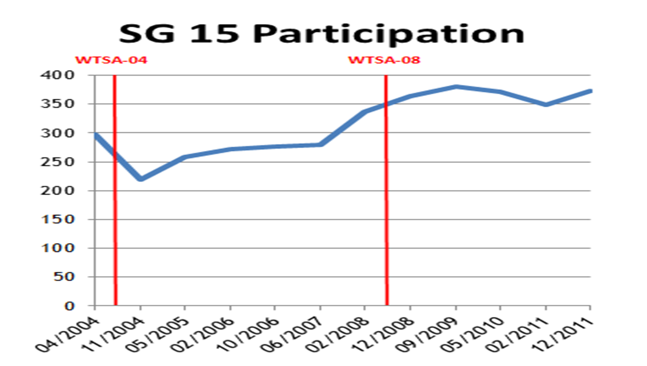
SG15 is the largest in ITU-T by number of participants and contributions

Slide 17
Workshops
ITU/IEEE workshop on Ethernet - Emerging Applications and Technologies Geneva, 22 September 2012
Workshop on 100G and beyond in ITU-T & IEEE Geneva,18 September 2011
Forum on compatibility between PLT and Radiocommunication Services Geneva, Switzerland, 27 May 2011
ITU-T/IEEE Workshop on The Future of Ethernet Transport Geneva, 28 May 2010

Slide 18
Tutorials and webinars
Webinar on optical transport networks from TDM to packet online, 20 Sept 2011
Tutorial on Optical Fibre Cables and Systems Mexico City, 19-30 Sept 2011
Webinar on Optical fibres, cables & systems online, 15 Sept 2011
Tutorial on Optical Fibre Cables & Systems Kigali, 6-17 Sept 2010

Slide 19
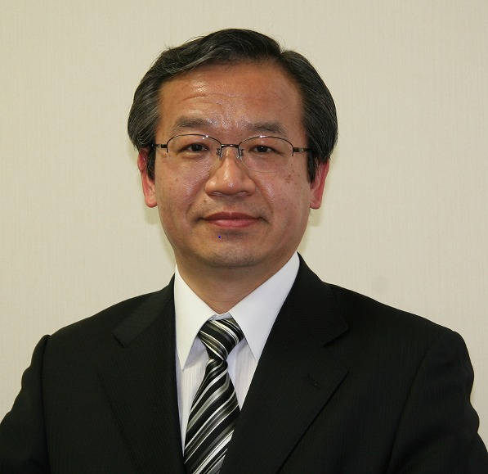
Thank you!
Mr Yoichi Maeda: CEO & S.V.P. of TTC
Mr Maeda received his B. E. and M. E.
Degrees in Electronic Engineering from
Shizuoka University, Japan, in 1978 an
1980, respectively.
Since joining NTT in 1980, he has been engaged in research and development on transport network systems for broadband communications including SDH, ATM and IP technologies.
Mr Maeda is a member of the IEEE and a Fellow of IEICE of Japan. He is the Feature Editor on Standards for the IEEE Communications Magazine.
Having been appointed as CEO and S.V.P. of TTC (The Telecommunication Technology Committee) in October 2010, he currently leads the Japanese telecommunication standardization organization.

