Slide 1
ITU-T Study Group 11
Signalling requirements, protocols and Test specifications
Wei Feng

Slide 2
Contents
Terms of reference
Highlights of achievements
Focus Group on M2M Service Layer
Future work
Conclusions
Supplemental slides

Slide 3
Terms of Reference
Responsible for studies relating to signalling requirements and protocols, including those for IP-based networks, NGN, mobility, some multimedia related signalling aspects, ad hoc networks (sensor networks, RFID, etc.), QoS, and internetwork signalling for ATM, N ISDN and PSTN networks. This also includes reference signalling architectures and test specifications for NGN and emerging networks (e.g., USN).
Lead SG for:
  Signalling and protocols
  Intelligent networks
  Test specifications

Slide 4
Highlights of achievements (I)
Produced various NGN Protocols for resource, session, service control and multicast communication etc.
Resource control protocols for RACF
(Q.33xx-series)
Service and session control protocols - NGN supplementary services (Q.36xx series)
Multicast communication protocol
(X.6xx series)

Slide 5
Highlights of achievements (II)
To achieve NGN interoperability and as lead SG for NGN test specifications, SG 11 produced Recs in Q.39xx series and a Handbook on “testing NGN”.
Handbook on “deployment of packet-based networks”
Network Attachment Control Signalling Requirements and Protocols for NACF.
Signalling requirements to support the emergency telecommunications service (ETS) in IP networks and protocol extensions for the support of IEPS communications

Slide 6
Focus Group on M2M Service Layer
(FG M2M)
Established in Jan 2012 (held 4 meetings since)
Chairman: Mr. Heyuan Xu (China)
Goal to study requirements and specifications for a common Machine-to-Machine (M2M) Service Layer
Initial focus on E-health
Aims at including vertical market stakeholders that are not part of the traditional ITU-T membership (e.g. WHO, Continua Health Alliance)
Coordinates its efforts with the ITU-T Internet of Things Global Standards Initiative (IoT-GSI)
Next meeting 21-24 January 2013, Santander, Spain
→ http://itu.int/en/ITU-T/focusgroups/m2m

Slide 7
Future Work
SG11 will study signalling, protocols and test specifications for new services and new networks e.g. IPv6, IoT, SUN, M2M, Cloud computing, Smart Grid and SDN, etc.

Slide 8
Conclusion
SG11 would take the lead coordinating role in the harmonization of various protocol standards based on the concept of consistent end-to-end interoperability.
SG 11 would take the lead coordinating role in the development of Machine-to-machine protocols building on the work of its current FG M2M.
SG 11 would continue to lead the signalling and protocols standardization

Slide 9
Supplemental Slides
Management team
Structure
Statistics

Slide 10
Management Team
Chair(s) | Wei Feng | (China)
Vice-Chairs: | Jane D. Humphrey Kaoru Kenyoshi Hyeong-Ho Lee Andrey Koucheriavy | (Sweden) (Japan) (Korea) (Russia)
WP Chairs: | Jane D. Humphrey (WP1 Chair) Kaoru Kenyoshi (WP2 Chair) Ting Zou (WP2 vice-Chair) Hyeong-Ho Lee (WP3 Chair) Andrey Koucheriavy (WP4 Chair) Martin Brand (WP4 vice-Chair) | (Sweden) (Japan) (China) (Korea) (Russia) (Austria)
TSB | Stefano Polidori (Engineer) Patricia Van Den Heuvel (Assistant)
Notes:
COUNTRY: should be the letter acronym, e.g. USA, I (for Italy), J (Japan), etc, as used in the ITU list of participants
Delete UNUSED rows in the PowerPoint table

Slide 11
Study Group Structure
WP1 Protocol Architecture and Application Control
(Questions: 1, 2, 13, 14, 16/11)
WP2 Session, bearer, resource control
(Questions: 3, 4, 5/11)
WP3 Multicast and attachment
(Questions: 6, 7, 15/11)
WP4 Test specifications
(Questions: 8, 9, 10, 11, 12/11)
Focus Groups on M2M Service Layer (FG M2M)
  Chairman: Heyuan Xu (MIIT, China)

Slide 12
Statistics (I)
29 Rapporteurs meetings held
304 contributions received
6 Study Groups meetings held
17 Working Parties meetings held
Max/Min/Average SG participants:
  Max: 69
  Min: 47
  Average: 53

Slide 13
Statistics (II)
Total of 65 Recommendations approved [New(47)/Revised(18)]
3 supplements, 2 Handbooks and 1 technical paper approved
15 Questions assigned by WTSA-08
1 New (Q16/11) and 1 revised (Q12/11) Questions during the study period
15 Questions proposed for next study period (note: 3 newly drafted Questions)

Slide 14
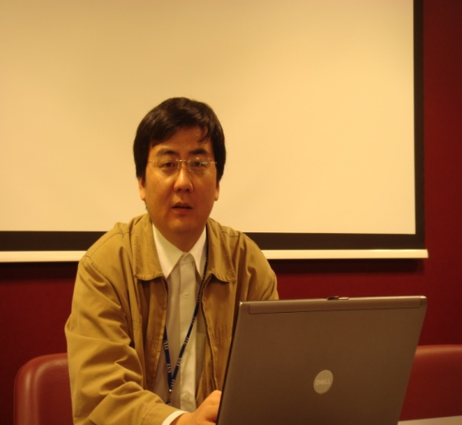
Thank you!
Mr Wei Feng is Director for standards in Huawei Technology (UK) Co., Ltd. He is participating in ITU activities since 2003 and has been Rapporteur for Q8/11, SG11 vice-Chairman since 2004 and SG11 Chairman since 2008. He contributed to NGN standards in the area of QoS, NGN service conformance and testing. Mr Feng is also promoting ITU standards activities in the area of Cloud Computing, Smart metering/Grid, ITS, IoT, M2M, SDN, etc.

