Slide 1
About Continua Health Alliance:
Continua Health Alliance is an international not-for-profit industry organization dedicated to establishing guidelines for combining and applying existing standards to personal connected health products and services.
Continua makes a transition from the personal connected health marketplace to a marketplace of interoperable devices that facilitate better care, empower consumers, improve outcomes and lower overall healthcare costs possible. With more than 240 member companies around the world, Continua is comprised of technology, medical device and healthcare industry leaders as well as service providers dedicated to making personal connected health a reality. .
This presentation contains only PUBLIC information.

Slide 2
A Solution: Personal Connected Healthcare
There is increasing evidence to support the value of remote monitoring for individuals with chronic conditions, including:
  35-56% reduction in mortality;
  47% reduction in risk of hospitalization;
  6 days reduction in length of hospital admission and
  65% reduction in office visits;
  40-64% reduction in physician time for checks and
  63% reduction in transport costs
(Cleland et al 2005; Lee R, Goldberg et al, 2003; Scalvini S et al., 2001; Elsner et al, 2006; Van Ginneken et al 2006)

Slide 3

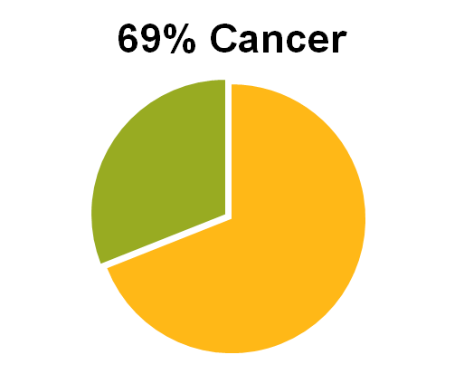

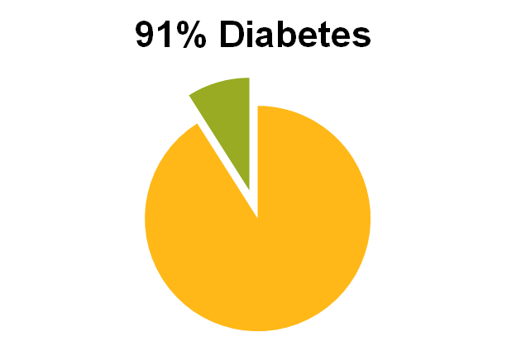
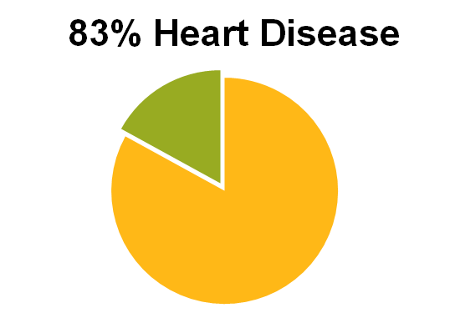
The Goal: Improve Lifestyle Choices, Health
= Non Modifiable Contributors to Disease
= Modifiable Contributors to Disease
Hu et al. Diet, lifestyle and the risk of type 2 Diabetes in women. NEJM 2001 Sep 13;345(11):790-7.
Stampfer MJ, Hu FB, Manson JE, Rimm EB, Willett WC. Primary prevention of coronary heart disease in women through diet and lifestyle. N Engl J Med. 2000; 343: 16–22
3
Notes:
3

Slide 4
Benefits of Personal Connected Health
Patient:
  Remain/return home
  New awareness of health status=> understanding & engagement
  Avoidance office and/or ER visits
  Regular discourse with providers.
Provider:
  Automatic alerts on patient status
  Improved triage capability & preservation of physician resources for most serious cases
  Maximal time for preventive action
  Ideal for chronic diseases
  ➔ Improved Outcomes

Slide 5

























Already Complete: Interfaces & Standards
Personal Device
Aggregation
Manager
Telehealth
Service
Center
Health
Records
Thermometer
Pulse Oximeter
CCD
Pulse /
Blood Pressure
PCD 01
Weight Scale
Glucose Meter
HDP and LE
Cardio / Strength
EHR
Independent
Living Activity
HIE
Peak Flow
PHR
Medication
Adherence
Wide
Area
Network
(WAN)
Interface
Health
Record
Network
Interface
NHIN
Physical Activity
Device
Connectivity
5

Slide 6




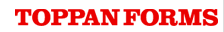

Continua Interfaces Enable Rapid Deployments & Cost Savings
DISASTER CARDIOVASCULAR PREVENTION NETWORK (D-CAP)
Target: 1,500 survivors of Great East Japan earthquake living in evacuee camps, two conditions that put them at risk for cardiac events
Tech Objectives: Determine comparative time/cost of implementing Continua-certified devices
Method: RPM for pts identified as high risk (400 pt), using devices previously certified by Continua
Tech Providers: A&D (Automatic blood pressure monitors), Alive Inc. (Gateway firmware), Ryoto Electro Corp. (data server), Panasonic (PC), Toppan Forms (Patient ID Cards), Intel (Project coordination)
OUTCOMES *Figures based on actual experience, **Estimates
Saved USD 139,000 (27K* vs. 166K**) → Amount of savings would fund monitoring of add’l 2K pts
Eliminated 10-Week Delay of Launch (2* vs. 12** wks) →Positive impact on cardiac events implied
Reduced Manhours by 60 Man-Weeks (12* vs. 72** - 1 FTE)
Clinical Outcomes: All patients still living; program ongoing and credited with saving lives; format allowed pts to continue monitoring when moved to long-term transitional housing
Source: Interview with Tagami Shinsuke (Intel) and Minami Kimio (Panasonic)
Note: Information prepared by PwC for Continua Health Alliance and restricted to use by
Continua’s Board of Directors. This information cannot be copied or shared without prior
written consent of PwC.

Slide 7






















Industry Organizations Working with Continua
Continua End-to-End Architecture
Based on Existing Standards
Industry Trade Groups
Promotional & Policy Support
11073
Sensors
PAN
Transport
EHRs
Regional Adoption
Global Certification
Global Adoption

Slide 8
Interoperability is a Key Driver for Adoption in mHealth
Enables convenient, robust data exchange
Reaches Large Scale - Simplifies consolidation of health data from different sources
Ease of use promotes positive user experience (providers, patients, administrators)
Introduces new flexibility for launching & maintaining home health and other PCH programs
  Devices guaranteed for forward/backward compatibility with all Continua-ready products
  Same-use devices are interchangeable
  Easy to expand or add new programs due to
  plug-and-play connectivity

Slide 9

Thank you!
For more information or to join Continua Health Alliance…
Sign up for our newsletter
admin@continuaalliance.org
Visit our website
www.continuaalliance.org

