Slide 1
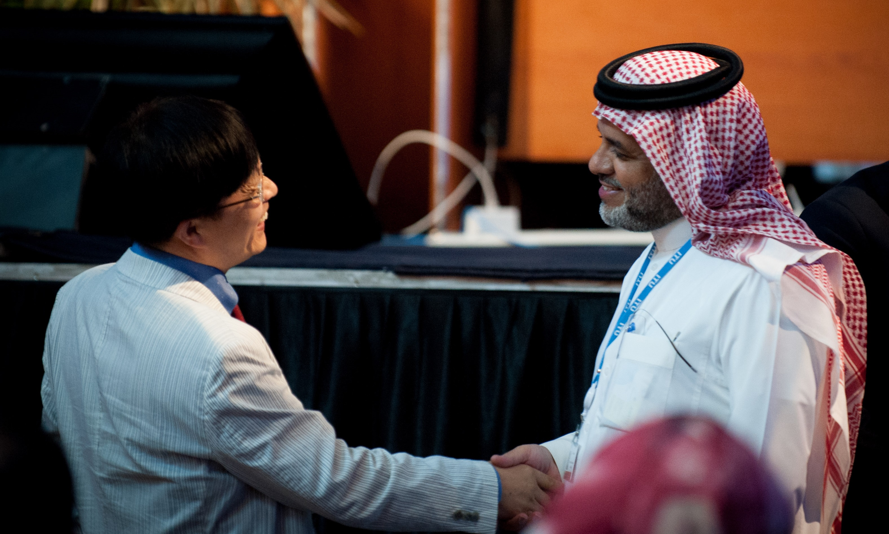
Decision-making and collaboration in ITU-T

Slide 2
Outline
Types of ITU-T decision-making
“soft” and “hard” criteria
Traditional Approval Process
WTSA Resolution 1, Section 9
Alternative Approval Process
Recommendation ITU-T A.8
Collaboration with other organizations

Slide 3
Flexibility

Slide 4
Decision making
There are many kinds of decisions made within ITU-T
The rules of procedure sometimes indicate quantitative approval criteria but not always
The following slides list various ITU-T decision-making mechanisms
In general, decision-making avoids formal “voting” in ITU-T
First instance I’ve seen in >25 years recently occurred in SG15

Slide 5
Decision Making
Important note: ITU is a United Nations Specialized Agency – ONLY Member States have the right to vote
However, agreement of Sector Members is important for approval of technical Recommendations
The rules allow for a public/private partnership, while respecting MS rights
Most decisions, but not all of them, are made on the basis of consensus

Slide 6
Decision-making in ITU-T
Decisions to enable progression of work
“Soft” criteria
SG agrees to start new work
SG decides to establish a Focus Group
SG determines that a draft Recommendation is sufficiently mature…
SG reaches consent that a draft technical Recommendation is sufficiently mature …
SG selects the relevant approval procedure by consensus
TSAG endorses Questions proposed by SG

Slide 7
Decision-making in ITU-T
Definitive decisions for approvals
Quantifiable (“hard”) criteria
70% affirmative of the MSs responding to Formal Consultation to authorize a study group to approve a Recommendation
Unopposed agreement of MSs present to approve Recommendation under the Traditional Approval Process (TAP)
No more than 1 MS present being in opposition to approve Rec under the Alternative Approval Process (AAP)
Notes:
Gary Fishman
© PEARLFISHER INTERNATIONAL, 2011

Slide 8
Approach to decision making
From the examples, we see that some decisions are quantifiable and some are not
This has been carefully, and successfully, designed in this manner to have flexibility so work can progress: (decides, agrees, determines, etc), but to have specificity when final decisions are taken (unopposed agreement, no more than one MS, etc)

Slide 9
Observations (1)
In general, the day-to-day work progresses by consensus among the participants
Chairman’s job is to create an environment that allows the meeting to find consensus
Resolution of disagreements is generally achieved by those directly involved, with reporting back to parent group
Consensus is the foundation of global standardization
Non-binding specs need buy-in from stakeholders

Slide 10
Observations (2)
Avoid putting a sovereign Member State in a position that forces it to state support or opposition until it is ready to do so, e.g., open voting, show of hands, direct query
Elegant solution is “unopposed agreement”
Chair can help by carefully crafted questions to move the meeting ahead
“Is there any support/opposition to the proposal?”

Slide 11
ITU-T Recommendation Approval
There are two methods for approving Recommendations between WTSAs
Traditional Approval Process (TAP) for Recommendations having policy or regulatory implications
Member States (MS) have final decision
Alternative Approval Process (AAP) for all other Recommendations
MSs and SMs both fully participate

Slide 12
ITU-T Recommendation Approval
TAP is described in WTSA Resolution 1, Section 9
Key terminology, unique to TAP, is summarized in Figure 9.1 – TAP sequence of events
AAP is described in Recommendation ITU-T A.8
Key terminology, unique to AAP, is summarized in Figure 1 – AAP sequence of events

Slide 13
Outline
Types of ITU-T decision-making
“soft” and “hard” criteria
Traditional Approval Process
WTSA Resolution 1, Section 9
Alternative Approval Process
Recommendation ITU-T A.8
Collaboration with other organizations

Slide 14
TAP Process Chart
WTSA Resolution 1, Figure 9.1

Slide 15
Main steps in TAP (1)
SG DETERMINATION (that work is sufficiently mature)
Can be done by SG or WP
Director’s ANNOUNCEMENT (of intent to seek approval at next SG meeting)
Director’s REQUEST (for MSs to approve request that SG can decide on approval; 70% affirmative required)

Slide 16
Main steps in TAP (2)
TEXT DISTRIBUTED (at least 1 month before SG meeting)
DECISION meeting
Approval requires unopposed agreement of the MSs present

Slide 17
Other steps in the process (1)
SMs, MSs, Associates, Academia participants and liaisons can propose changes for the DECISION meeting’s consideration of the DETERMINED text
Editorial corrections and amendments not affecting the substance may be accepted
A Recommendation Summary is required

Slide 18
Other steps in the process (2)
If there are major changes, the SG should defer approval to another meeting, EXCEPT
The SG can proceed with approval if the Study Group Chairman, in consultation with TSB, considers that changes are reasonable for MSs not present and that the proposed text is stable
This is a very, very normal occurrence

Slide 19
Other steps in the process (3)
A MS that does not want to oppose approval but has a concern, can have its concern noted in meeting report and in the Recommendation
If a MS requests more time to consider its position, the “4-week rule” allows that MS to inform TSB of its disapproval within 4 weeks of the meeting
No reply from that MS means no objection, and the Recommendation is approved

Slide 20
Outline
Types of ITU-T decision-making
“soft” and “hard” criteria
Traditional Approval Process
WTSA Resolution 1, Section 9
Alternative Approval Process
Recommendation ITU-T A.8
Collaboration with other organizations

Slide 21
Evolution of the approval process for dramatic improvement
2001: After adoption by a SG, Recommendations that do not require formal consultation of the MSs are considered as approved
Only applies to Recommendations that do not have policy or regulatory implications, or for which there is a doubt
This is known as the Alternative Approval Process (AAP)

Slide 22
AAP Process Chart
Recommendation ITU-T A.8, Figure 1

Slide 23
Main steps in AAP (1)
CONSENT (that work is sufficiently mature)
Can be done by SG or WP
Same as DETERMINATION in TAP
Director’s AAP ANNOUNCEMENT of LAST CALL (review before approval)
Posted on the 1st and 16th of every month
LAST CALL (LC) is 4 weeks
MSs, SMs, Associates and Academia participants can submit LC comments

Slide 24
Main steps in AAP (2)
If there are no comments (other than typographical corrections) the Rec is approved
If there are any comments, including “editorial” comments, SG Chairman considers next step in Last Call Judgment
Consult with relevant experts and TSB
Address and attempt to resolve comments
Provide new, revised text and report on comment resolution attempts

Slide 25
Main steps in AAP (3)
Depending on calendar, Chairman has a choice to get the fastest approval:
(1) Post revised text for an Additional Review (AR) of 3-weeks,
MSs and SMs can comment
This is the most common course
If there are no comments in 3 weeks, the Recommendation is approved; or
(2) Send draft revised Recommendation and comments to next SG meeting

Slide 26
Main steps in AAP (4)
If there are AR comments, Chairman considers next steps in Additional Review Judgment
Changes are only typographical; Recommendation is approved
Comments are substantive or “editorial”; draft Recommendation and all comments are sent to the next SG meeting

Slide 27
Main steps in AAP (5)
At SG meeting, if there are major changes, the SG should defer approval to another meeting, EXCEPT
The SG can proceed with approval if the SG Chairman, in consultation with TSB, considers that changes are reasonable for MSs not present and that the proposed text is stable
This is a very, very normal occurrence
Only about 2% of AAP Recommendations even get to the SG stage

Slide 28
Main steps in AAP (6)
Draft Recommendation may have gone through many changes at the SG, causing a new MS concern:
If a MS states that the Rec now has policy or regulatory implications, the Rec can be moved back to the beginning of TAP or AAP
SG does not make a DECISION at this meeting
SG picks path that will ensure best progress towards a decision

Slide 29
Main steps in AAP (7)
If there is unopposed agreement of MSs and SMs present, the Recommendation is approved
If there continues to be any objection, the Chair asks only MSs present if there is objection to approval
Recommendation is not approved if there is more than one MS objecting (i.e., 2 or more MSs)
Recommendation is approved if 1 or no MSs object

Slide 30
AAP Experience*
About 76% of AAP Recommendations are approved in LAST CALL with no comments
More than 78% of AAP Recommendations are approved in LAST CALL
About 4% of AAP Recommendations need to go to the SG DECISION meeting
Average time from CONSENT to NOTIFICATION of approval is 11.5 weeks
Efficient management of the AAP process is a key task for SG Chairmen, Rapporteurs and Editors
* Data for 2010-2016

Slide 31
Approvals in numbers

Slide 32
Amendments and Corrigenda
Amendment to a published Rec:
Includes only the change or addition
If integral part of Recommendation: Approved using the same approval process as the Recommendation
If not normative: agreed by SG
Corrigendum to published Recommendation:
Includes only the correction
Obvious correction: published by TSB with concurrence of SG Chairman
Otherwise: same approval as for Rec
Change in Feb. 2016: All texts published in full version

Slide 33
Implementer’s Guide and Revisions
Implementer’s Guide:
Historical record of identified defects with their corrections since Rec was published
Agreed by SG, or by WP with concurrence of SG Chairman
Eventually issued as Corrigenda (Corr.) or Revised (Rev.)
Revision:
Full text of published Rec with all approved changes, corrections, additions
Same approval process as for Rec

Slide 34
Deletion of Recommendation
Deletion is considered on a case by case basis
Recommendation has been superseded or has become obsolete
Choices: Deletion by WTSA or between WTSAs
Deletion by WTSA:
Upon decision of SG, Chair reports to WTSA requesting deletion
WTSA acts as appropriate

Slide 35
Deletion of Recommendation - TAP
SG agrees to deletion by unopposed agreement of MSs present
Inform membership of proposed deletion, including an explanatory summary of the reasons, via Circular
If no objection within 3 months, deletion comes into force
In case of objection, refer back to the SG

Slide 36
Deletion of Recommendation - AAP
SG agrees to deletion by unopposed agreement of MSs and SMs present
If not achieved, then SG agrees to deletion if no more than 1 MS present is opposed
Inform membership of proposed deletion, including explanatory summary of the reasons, via Circular
If no objection from a MS or SM within 3 months, deletion comes into force
In case of objection, refer back to SG

Slide 37
Outline
Types of ITU-T decision-making
“soft” and “hard” criteria
Traditional Approval Process
WTSA Resolution 1, Section 9
Alternative Approval Process
Recommendation ITU-T A.8
Collaboration with other organizations

Slide 38
A sample of ITU private sector members

Slide 39
ITU collaborates with relevant standards development organizations
40+ formal
partnerships

Slide 40
Light, medium and heavy approaches
Exchange of liaison statements
Co-location or joint meetings
Formal collaboration mechanisms:
A.Sup5 - Guidelines for collaboration and exchange of information with other organizations
A.23 - Collaboration with the ISO/IEC JTC1
Ad hoc arrangements
e.g. SG5 and ETSI TC EE

Slide 41
ITU-T Focus Groups
Specialized groups on a topic
Explore new areas of study under the mandate of one or more study groups
Short term, specific task
Open to non-members
Appendix - Guidelines for efficient transfer
A.7 - Focus groups: Establishment and working procedures

Slide 42
Recognizing organizations
A.6 – Cooperation and exchange of information between the ITU Telecommunication Standardization Sector and national and regional standards development organizations
A.4 – Communication process between the ITU Telecommunication Standardization Sector and forums and consortia

Slide 43
References to external material
Normative references
A.5 – Generic procedures for including references to documents of other organizations in ITU-T Recommendations
A.25 – Generic procedures for incorporating text between ITU-T and other organizations
A.5 justification:
Not needed for informative references
Not needed for ITU-R / ISO / IEC standards

Slide 44
Thank you! Questions?

Slide 45
Additional slides

Slide 46
Additional Information
WTSA Resolution 1 (2016) - Rules of procedure of the ITU Telecommunication Standardization Sector (ITU-T)
Pre-published English version:
http://www.itu.int/en/ITU-T/wtsa12/Documents/resolutions/Resolution%2001.pdf

Slide 47
Additional Information
Recommendation ITU-T A.1 (2016)- Work methods for study groups of the ITU-T
Updated at WTSA-16
https://www.itu.int/rec/T-REC-A.1

Slide 48
Additional Information
Recommendation ITU-T A.8 (2008)- Alternative approval process for new and revised ITU-T Recommendations (Unchanged)
Unchanged at WTSA-16
https://itu.int/rec/T-REC-A.8-200810-I

