Slide 1
ITU-T and Academia: Visit to George Mason University Malcolm Johnson Director Telecommunication Standardization Bureau, ITU Washington DC, 6 December 2013

Slide 2
ITU structure
Standardization Sector (ITU-T) produces interoperable technical ICT standards
Radiocommunication Sector (ITU-R) coordinates global wireless communication
Development
Sector (ITU-D)
provides assistance to the un-connected
ITU General Secretariat (GS)
provides inter-sectoral coordination for the whole organization

Slide 3
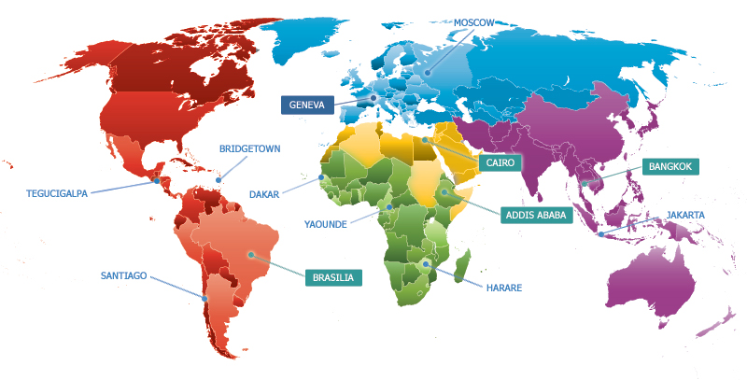
ITU’s global presence
Notes:
760 Staff from 80 Countries
6 UN Official Languages: Arabic, Chinese, English, French, Russian, Spanish
Headquarters in Geneva with Liaison Office in New York
Regional offices in Addis Ababa, Bangkok, Brasilia, Cairo
Area offices in Bridgetown, Dakar, Harare, Jakarta, Moscow, Santiago, Tegucigalpa, Yaoundé

Slide 4
ITU’s unique membership
193 Member States and regulatory bodies
800 companies
Business associations
International organizations
NGOs
66 Universities
&
Research
Establishments

Slide 5
ITU’s private sector members

Slide 6
ITU’s network of Academia members
63 universities and research centers in 38 countries
63 universities and research centers in 38 countries
Notes:
ITU’s membership opened up to Academia in 2011, pursuant to Resolution 169 (ITU PP-10) : Academia, universities and associated research establishments can join ITU’s three sectors in their own right
Our academic network includes renowned universities such as the University of Tokyo, Tsinghua University, Institut Mines-Télécom in France, KIST, University of Zurich, KAIST and the Georgia Institute of Technology as well as a number of leading institutions from developing countries in Africa, Latin America and Asia.

Slide 7
ITU-T: the Standardization Sector of ITU
Strategic goals:
To develop interoperable, non-discriminatory international standards (ITU-T Recommendations)
To assist in bridging the standardization gap between developed and developing countries
To extend and facilitate international cooperation among international, regional and national standardization bodies
Notes:
ITU-T is behind many of the global standards that drive the telecommunications and information technology industries.
ITU standards work done mostly in Study Groups. We have 10 in total. These groups produce recommendations, which in turn become standards. Examples include G992.1 (ADSL), G993.1 (VDSL).
The study groups operate on a global basis, with a consensus decision-making process.
Standards are approved by 193 Member States + 700 Sector Members. Processes are very flexible to meet emerging needs such as Internet of Things, Cloud computing, ITS, Smart grid, Accessibility, Climate Change, IPTV, etc. We have fast, transparent procedures and a trusted brand name.

Slide 8
ITU-T and Academia
Resolution 80 (WTSA-12)
Resolution 71 (WTSA-12)
Expanded participation of academia, including at GSS, TSAG and WTSA.
Continue organizing Kaleidoscope conferences annually
Invited ITU Council to considered the positive contribution made by academia and recommended that they be admitted to participate in the work of three sectors of ITU
Correct to acknowledge significant contributors to work of ITU-T
Instructed TSB Director to acknowledge the value of active participation of academia members in the work of ITU-T
Instructed TSAG to study options of how to clearly acknowledge significant criteria
Notes:
The World Telecommunication Standardization Assembly (WTSA) is held every four years and defines the next period of study for ITU-T. WTSA-12 took place on 20-29 November 2012 in Dubai, United Arab Emirates.
Sets direction, policy, structure for ITU-T
Meets every four years
Defines the general policy for the Sector
Establishes ITU-T study groups
Approves work program of study groups
Appoints chairs and vice-chairs of study groups
Reviews existing WTSA Resolutions (49)

Slide 9
Benefits of ITU-T Academia members
Access to all Study Groups
Right to submit contributions
Leading positions: rapporteur or editor
Unlimited participation of delegates

Slide 10
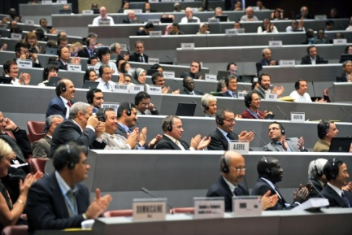
Invaluable networking opportunities
Working with 193 Member States and regulatory bodies from all around the world
Meeting key players in the ICT industry
Partner with the most innovative research institutes and universities

Slide 11
Access to exclusive ressources
Access key standards and other information sources, facilities and databases
Seek out potential new sources of income and finance (patenting, funding by major companies)

Slide 12
Internships for students at ITU
Flexible duration:
from 1 to 6 months
Wide range of skills covered: from engineering and web design to public relations
Privileged opportunities for academia members
Notes:
ITU regularly welcomes interns who wish to improve their skills, raise their academic profile.
It is also possible to organize remote internships where a student can work on a research paper at a distance and receive tutoring via video/phone/mail.
We also offer opportunities for academic research for Master and PhD students.
Privileged opportunities are offered to students from academia members

Slide 13
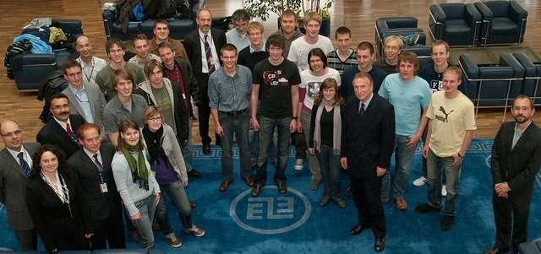
Seminars and lectures to meet our experts
ITU Experts visit academia members
Seminars organized for academia members at ITU
Seminars organized for university students at ITU
Notes:
ITU-T also encourages visits and seminars for university students to familiarize them with our activities.

Slide 14
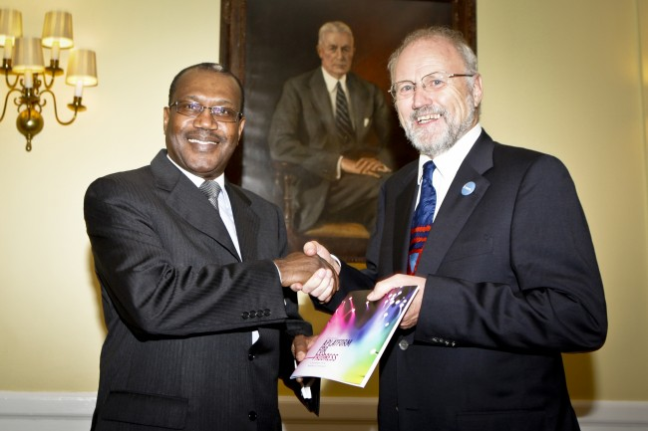
Visibility on a global scale
Raise the profile of your academic institution and see the advancement of your ICT innovations through adoption of global standards
Boost your CV by becoming an Editor or Rapporteur of a Study Group
Raise the profile of your work with the opportunity of publication

Slide 15
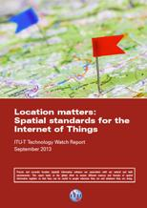
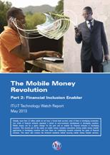
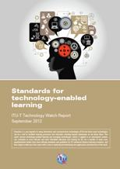
Publish your research in ITU-T Technology Watch
Notes:
Technology Watch surveys emerging information and communication technologies and how they can be included within the ITU-T work programme.
Technology Watch Reports are intended to provide an up-to-date assessment of new technologies in language that is accessible to non-specialists. Further, the reports assess the impact of new technologies both on developed and developing countries, analyses relevant standardization activities, with a view to identifying areas for new work in ITU-T.

Slide 16
Share your innovative ideas at Kaleidoscope
International academic conference
Rigorous, double-blind peer review process
Brings together academic, research and industry players
Brainstorming on future ICT trends in standardization
Notes:
Kaleidoscope is a series of peer-reviewed academic conferences organized by ITU which brings together a wide range of views from universities, industry and research institutions of different fields. The aim of Kaleidoscope conferences is to identify emerging developments in Information and Communication Technologies (ICTs) at an early stage to generate successful products and services through the development of international and open standards.

Slide 17
Kaleidoscope 2013 "Building sustainable communities"
Kyoto University, Japan, 22-25 April 2013
Over 180 participants from 22 countries
3 Invited Papers
2 Keynote Speakers
2 Special Sessions
2 Side events: Showcasing
Workshop on Education about Standardization
30 accepted papers (out of 99 submitted):
Published in IEEE Xplore
Considered for publication in a special edition of IEEE Communication Magazine
Notes:
Kaleidoscope 2013- “Building Sustainable Communities” 22-25 April 2013− was the fifth in the series.
The conference focused on how ICTs can be used as a catalyst for transforming life to meet the challenges of the new millennium, including global economic and financial crises, high unemployment rates, accessibility issues, global diseases, food availability and distribution, climate change, environmental disasters, energy consumption, transport systems, safety, security, and welfare. Sustainable communities will combine human-oriented technologies and human values.
To address these issues, and for a co-evolution of technology and sustainable communities, standards are indispensable. Developing these standards will require concerted global efforts by inter-sectoral stakeholders. Kaleidoscope 2013 helped to further such collaborations and highlight multidisciplinary aspects of future ICTs.

Slide 18
Next Kaleidoscope conference
Kaleidoscope 2014
Living in a converged world - impossible without standards?
Saint Petersburg University, Russian Federation,
3-5 June 2014
kaleidoscope@itu.int
Notes:
Kaleidoscope 2014 will highlight the need for future standards for ICT services and applications to take into account aspects of socio-economic, cultural, ethical, legal and sustainable-development policy. The event will also pinpoint aspects to increase the inclusivity of the Information Society; addressing the demands of people with disabilities, and the need for standards to be accessible to people of different countries and languages.
Recognizing the steadily growing role of ICT in other social and economic sectors and the resulting challenges for global standards makers, ITU has begun forming partnerships with organizations not traditionally part of the ICT ecosystem in the interests of developing global standards tailored to new ICT-enabled services in other industry sectors.
Kaleidoscope 2014 will explore this new paradigm, looking at how the standards can bring these different worlds together and evolve in line with ensuing industrial and technological convergence.

Slide 19
Get involved in our new Education about Standardization initiative
TSB Director’s Ad hoc Group on Education about Standardization (AGH SE):
Develops guidelines for enhancing the involvement of the ITU-T Sector in the field of education about ICT standardization.
Gathers information on standards education activities in ITU-T, in universities, and in relevant organizations such as ISO, IEC and IEEE
Reviews existing “gap analyses”, studies, surveys, and other research about standards education in academic curricula, and then performs a new gap analysis with the information gathered.
On the basis of the previous analyses, propose and develop policy initiatives to fill the identified gaps.
Notes:
AGH SE includes ITU-T standardization experts, representatives of academia, and representatives of other standards development organizations (SDOs) interested in collaborating with ITU-T to advance standards education worldwide.
How to subscribe to the mailing list:
An account is needed…
Members: use a TIES account (members-only) For creating/managing TIES accounts, see http://itu.int/TIES/
Non-members: create or use a Guest account For instruction on creating a Guest account, see http://itu.int/ITU-T/edh/faqs-guest.html
Once you have a TIES or Guest account, you can subscribe to the mailing list using the ITU-T Electronic Registration and Subscription Service: http://itu.int/ITU-T/services
Secretariat Mailbox: tsbstdsedu@itu.int
Mailing list: standardsedu@lists.itu.int

Slide 20
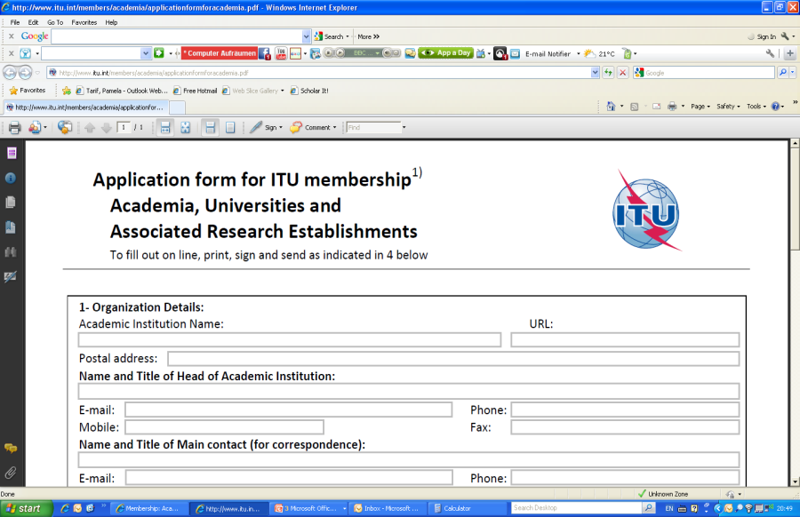
Join us!
Annual ITU-T Academia membership fee:
For developed countries: 3.975 CHF
For developing countries: 1.987 CHF
Step 1: Fill the Form www.itu.int/members/academia/applicationformforacademia.pdf
Step 2:
Send the form
membership@itu.int

