Slide 1
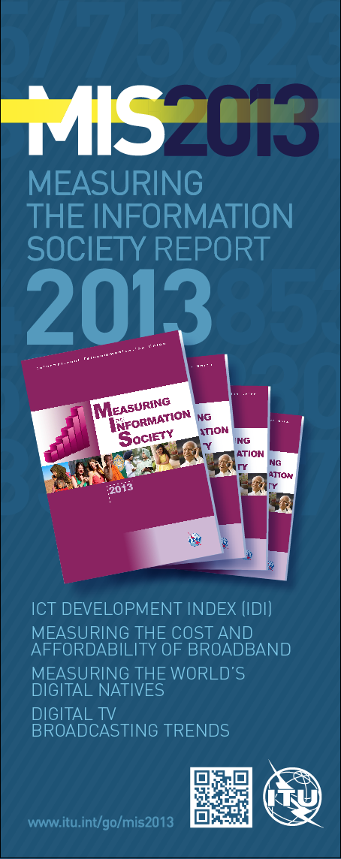
Measuring the Information Society 2013
Malcolm Johnson, ITU
Innovation and Sustainable Development: Data and Evidence to support Policy Makers
New York, 10 December 2013
Notes:
Ladies and gentlemen.
It is a great pleasure for me to present to you a snapshot of this year’s Measuring the Information Society report.
This report has been published annually since 2009. It is the main analytical report that is produced by ITU based on its statistical work.

Slide 2
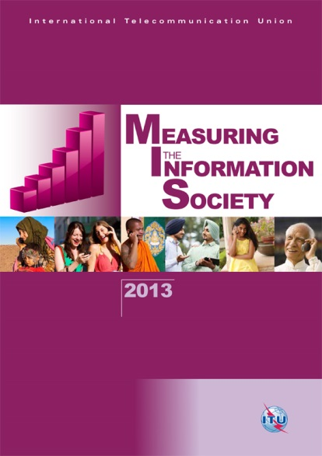
MIS 2013
Latest key indicators
ICT Development Index (IDI)
Broadband pricing and affordability
Digital natives
Digital TV broadcasting
Methodological and statistical annexes
Notes:
This year’s report contains five main chapters.
In the interest of time, I would like to keep it short and show you a few selected findings related to each of the topics.

Slide 3
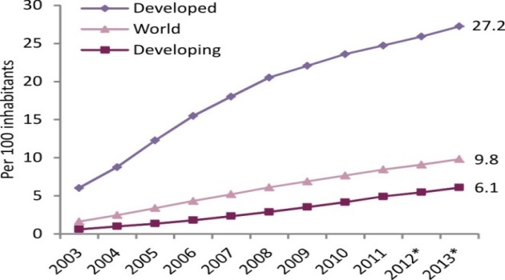
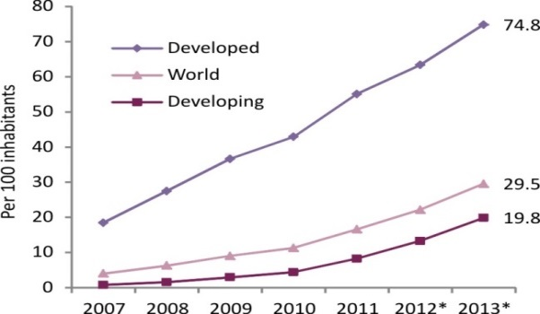
Broadband progress
Fixed broadband:
double-digit growth rates in developing countries
slowdown in developed countries
divide remains substantial
Mobile broadband:
3G population coverage 50%
2 billion subscriptions, mobile-broadband penetration 29.5%
subscriptions in developing countries doubled in 2 years
Fixed (wired)-broadband penetration, 2003-2013*
Active mobile-broadband penetration, 2007-2013*
Source: ITU MIS 2013, * Estimate
Notes:
Let me start by looking at broadband.
Throughout the report, we pay particular attention to the uptake and spread of fixed- and wireless-broadband services worldwide.
The latest trends show that fixed-broadband subscriptions continue to grow at double-digit rates in developing countries, starting from a low base. In developed countries, growth has slowed down over the past couple of years. There is still a substantial divide, with fixed-broadband penetration in developing countries remaining at a low 6% compared with 27% in developed countries.
[A key barrier to fixed-broadband uptake in developing countries is the lack of fixed-broadband infrastructure, and the still very limited fixed-telephone network overall.]
Mobile-broadband access is growing very fast, at over 40% annually. By the end of this year, about half of the world’s population will live within reach of a mobile-broadband or 3G network. This is impressive given that in many developing countries 3G services were only introduced very recently.
Mobile-broadband penetration stands now at almost 30% globally, up from only 6% 5 years ago.
In developing countries, the number of mobile-broadband subscriptions doubled over the last two years. Still, the gap between developed and developing countries is big: mobile-broadband penetration will reach almost 75% in developed countries by the end of this year, compared with around 20% in developing countries.

Slide 4
The ICT Development Index (IDI)
11 indicators, covering 3 areas:
ICT access
ICT use
ICT skills
157 economies
2012 and 2011 comparison
Digital divide analysis
Regional analysis
Notes:
One of the main features of the report is the ICT Development Index or IDI. The IDI has been developed by ITU as a global benchmarking tool that monitors and ranks countries according to their ICT achievements. The IDI combines 11 indicators into a single measure, covering the 3 areas of ICT access, ICT use and skills. This year’s IDI covers 157 economies.
[The report highlights top performers as well as those countries that have made the greatest progress between 2011 and 2012.
The IDI is also used to track and monitor the digital divide and to make regional comparisons.]

Slide 5
IDI highlights
Top ten
Key findings
Korea (Rep.)
Sweden
Iceland
Denmark
Finland
Norway
Netherlands
United Kingdom
Luxembourg
Hong Kong, China
Between 2011 and 2012:
ICT levels increased almost everywhere
Gap between top and bottom performers remains
Developing countries are catching up in the IDI use sub-index
Lowest IDI group: Least Connected Countries (LCCs), home to 2.4 billion people
These could potentially derive the greatest benefits from ICTs in areas such as health, education, job creation
Notes:
Let’s have a look at the top performers and other key findings.
The Republic of Korea, followed by Sweden, continues to lead the world in terms of ICT developments. The other Nordic countries - Iceland, Denmark, Finland and Norway follow closely. The Netherlands, the United Kingdom, Luxembourg and Hong Kong (China) also rank in the top ten.
Overall, ICT levels continue to mature throughout the world: almost all countries increased their IDI values between 2011 and 2012.
At the same time, huge differences remain. For example, the average IDI value in developed countries is twice as high as the developing-country average. Also, the gap between the top and bottom performers has remained. Results also show that developing countries are catching up on the use sub-index, driven by strong growth in mobile broadband and internet use.
The IDI can also be used to monitor and analyse the digital divide by grouping countries on the basis of their ICT levels or IDI values. The group with lowest IDI values [i.e. with an IDI value below or equal to 2.33] includes a total of 39 countries and they are referred to as least connected countries (LCCs). They are home to 2.4 billion people – almost one-third of the world’s population. People in these countries have only limited access to advanced ICT services, such as broadband Internet access. At the same time, it is precisely in these countries where ICTs could potentially make a huge impact in terms of improving access to basic services such as health and education, and for creating new jobs.

Slide 6
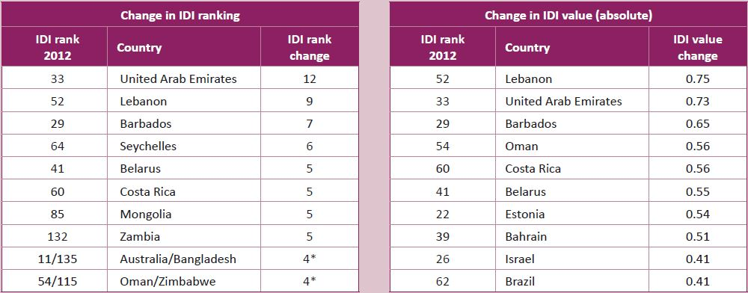
Most dynamic countries are from the developing world
Changes between IDI 2011 and 2012
Source: ITU MIS 2013
Governments can play an important role by: adopting national ICT/ broadband plans, promoting competition, setting concrete targets and fostering ICT investments.
Notes:
These are the most dynamic countries when it comes to IDI improvements over the past years. The majority are from the developing world.
For example, the United Arab Emirates has jumped up 12 places over the past year, and Lebanon 9 places. Other countries that have made good progress include Barbados, Costa Rica, Zambia, Bangladesh, Oman, Zimbabwe, to name a few.
What is interesting about this group: how did they achieve such improvements? We will hear more about this later on but our analysis shows that governments can play an important role in driving ICT growth and uptake, for example by adopting and implementing national ICT plans that include concrete targets; by creating an open regulatory framework that promotes competition and brings down prices; and by encouraging private-sector investment.

Slide 7
Broadband cost and affordability
Fixed broadband:
prices dropped by 82% (2008-2012) but differ hugely between countries
remains unaffordable in low-income countries
Mobile broadband:
relatively affordable in developed countries
still relatively expensive in many developing countries…
… but tends to be cheaper than fixed-broadband for low data-volume packages/offers (in developing countries)
Policy makers: should monitor the affordability of ICT services and identify regulatory policies that bring down prices
Notes:
The report includes a detailed analysis of consumer prices for both fixed and mobile broadband services, and for different types of packages that are offered in the market.
For fixed broadband, the results show clearly that services are becoming more affordable. We already heard about the impressive fall in prices since 2008 [by 82%, from 115 % of GNI p.c. in 2008 to 22 % in 2012]. The biggest drop occurred in developing countries, where prices fell by 30% annually between 2008 and 2011 alone. At the same time, fixed broadband remains unaffordable in most low-income countries.
For the first time, ITU collected price data for mobile-broadband services, for around 130 countries. They are all featured in the report. Overall results show that:
First, mobile-broadband, similar to fixed-broadband, is relatively affordable in the developed world, while services are much less affordable in the developing world.
Second, price data comparisons between fixed- and mobile-broadband packages show that mobile-broadband services are often cheaper than comparable fixed-broadband services, especially in developing countries and for low data-volume offers.
[The report therefore emphasizes the need for policy makers to monitor the affordability of ICT services and identify regulatory policies that bring down prices.]
[Among typical mobile-broadband plans offered, post-paid handset-based services tend to be the cheapest.]

Slide 8
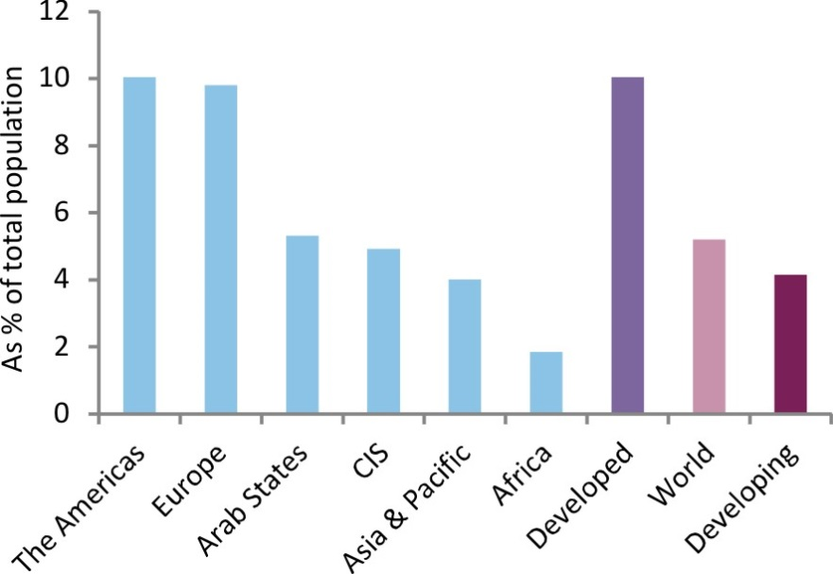
Digital natives - a driving force of the information society
Digital natives:
5% of world population
30% of young people (15-24 y.)
Proportion of digital natives is twice as high in developed regions
Young people are twice as networked as average population - age gap more pronounced in developing countries
Digital natives in developing countries will more than double within next 5 years
Digital natives as a percentage of total population, by region and level of development, 2012
Source: ITU MIS 2013
Notes:
This year’s report presents the first-ever model to quantify the world’s digital natives. This is a term used to characterize young people born during the digital age and growing up using ICTs. Data on the digital natives population are provided for 180 countries.
According to our model, in 2012 around 5% of the world population were digital natives, or 30% cent of the world’s youth. It means that the digital natives are, globally speaking, still a minority of today’s youth.
Data also show that the proportion of digital natives is more than twice as high in developed countries, compared to developing countries. This is in line with differences in Internet access and use.
Our findings also show that young people are almost twice as networked as the average population. In other words, the percentage of Internet users is much higher among the younger people than among the other age groups. We call this age gap. This gap is even more pronounced in the developing world. For example, in Eritrea, Internet usage among young people is almost 3 times as high as the average, whereas in Sweden (the other end of the spectrum), there is little difference among Internet usage between young people and others.
The report also shows that more than 50% [53 per cent] of today’s young Internet users in the developing world are not yet digital natives because they have only started to use the Internet recently, they are still ‘newcomers’. However, with the recent growth in Internet user penetration, many more young people will become digital natives in the near future. We therefore estimate that within the next five years, the digital native population in developing countries will more than double.
Note: ITU data show that over the past five years, Internet usage has increased significantly in the developing world, from 12 percent in 2007 to 31 per cent in 2012.

Slide 9
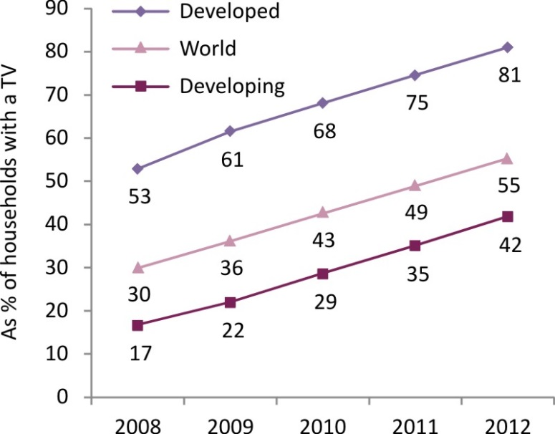
TV remains one of the most pervasive ICTs and is becoming digital
Households with TV:
80% (world)
72% (developing countries)
98% (developed countries)
Households with digital TV: surpassed those with analogue TV in 2012, reaching 55%
Digital cable and DTT uptake doubled between 2008 and 2012
IPTV increased fourfold, but still represents only 5% of total households with a TV
Households with digital TV, 2008-2012
Source: ITU MIS 2013
Notes:
Finally, this year’s MIS report takes a closer look at the evolution and current state of play of TV broadcasting services.
Today, almost 80% of households worldwide have a TV. This makes TV much more pervasive than most other ICTs.
Between 2008 and 2012, the world witnessed a massive shift from analogue to digital TV reception. The halfway mark was passed in 2012 when more households received digital than analogue signals. (55 per cent of households with a TV received digital TV signals in 2012, compared with 30 per cent in 2008).
The report shows that traditional multichannel TV platforms [such as cable and satellite TV] face increasing competition from new service providers. For example, digital cable subscriptions and digital terrestrial TV (DTT) more than doubled between 2008 and 2012.
But the technology that had the highest growth was IPTV, with total subscriptions increasing more than fourfold, although in absolute terms it still represents only a marginal share of total households with a TV (5%).
[In addition, audiovisual delivery over the Internet is becoming more and more popular. Particularly through over-the-top (OTT) audiovisual content providers, such as YouTube, Netflix, the Chinese PPLive and many traditional broadcasting stations that offer streaming or downloading of TV and video content on the Internet.
The report recommends that progress could be accelerated by the adoption of national strategies and roadmaps for the digital switchover, including the setting of clear targets and deadlines to monitor progress.]
[if question: more accurate metrics are necessary in order to precisely measure the uptake of OTT TV, and to compare it with traditional TV uptake]

Slide 10
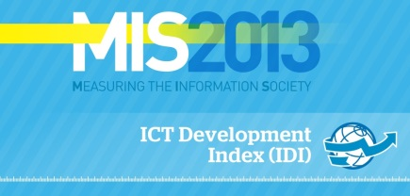
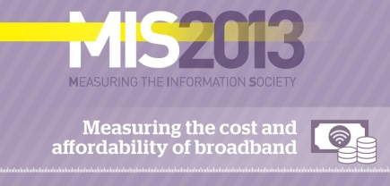
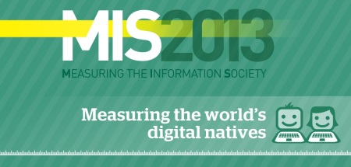
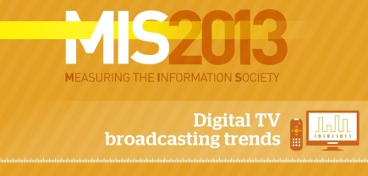
For further information:
www.itu.int/go/mis2013
infographics:
Notes:
I would like to invite you to please take a look at the report itself and our website for more details. I also hope you will enjoy the four infographics booklets that you have received in a blue envelope, and which are also available online.
I thank you for your attention and look forward to the debate.

