Slide 1
Malcolm Johnson Director, ITU Telecommunication Standardization Bureau
ITU-T
Presentation at ANSI
December 2013

Slide 2
Outline
ITU and ITU-T in a nutshell
Interoperability
Convergence
Cooperation and collaboration
Food for thought

Slide 3
1. ITU and ITU-T in a nutshell

Slide 4
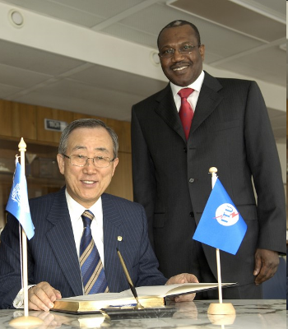
ITU is the specialized agency of the UN for telecommunications and ICTs
Unique public/private partnership:
193 Member States (Governments and regulatory bodies)
700 Private Sector (Sector Members and Associates)
66 Academia
In ITU-T, 95% of work is done and approved by private industry

Slide 5
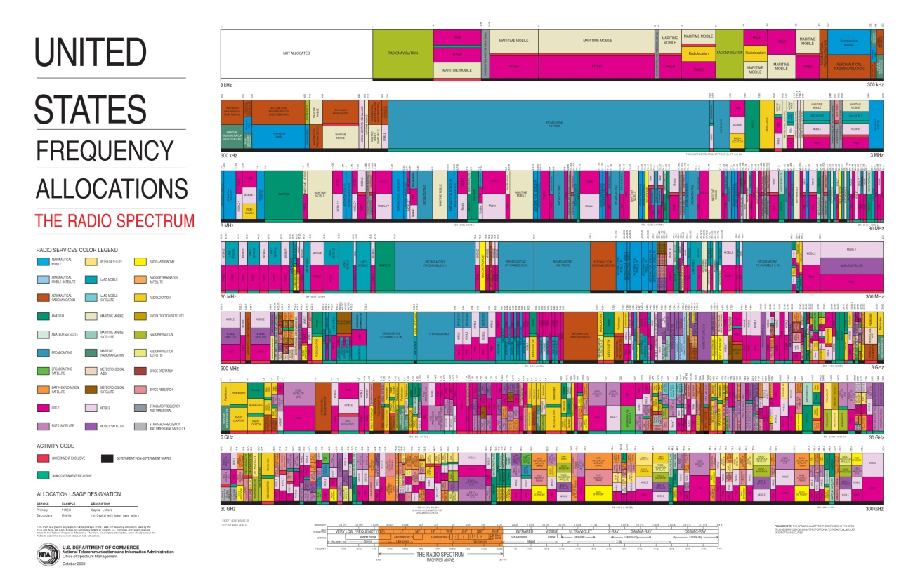
ITU (1) frequency spectrum allocation to different services, (2) satellite orbit coordination (3) assigns numbers and identities
Notes:
ITU-R
- Develop global regulations for spectrum and satellite orbit resources
- Establish harmonized, global standards for wireless systems
- Assist membership develop advanced radio-com systems
ITU-R Study Groups deal with themes such as: spectrum management, radiowave propagation, satellite services, terrestial services, broadcasting, science services (systems for space operation, space research, Earth exploration and meteorology).
ITU-T
- Develop International Telecommunication Regulations for the provision and operation of international telecommunication services offered to the public as well
as to the underlying international telecommunication transport means used to provide such services.
- Allocate international numbering and Identification resource such like E.164 numbering resource, E.212 Identification resource and Q.708 signalling Area/Network Codes (SANC) resource.

Slide 6
ITU develops standards
Notes:
ITU-T
- Develop interoperable, international standards (ITU-T Recommendations)
- Bridge standardization gap
- Cooperation among standardization bodies
ITU-T study groups look at issues such as: multimedia, security, environment and climate change, network and transport, broadband access, quality of service and experience, next generation networks, cloud compuring, intelligent transport systems, numbering and addressing, tarrif, security.
Some examples:
Internet Access through ITU standards
95% of all international traffic runs over fibre = ITU standards
Access:
ADSL: ITU-T G.992
Powerline Transmission:
ITU-T G.9960 (G.hn)
FTTX (Fibre to the <x>):
GPON (Gigabit Passive Optical Networks) ITU-T G.984
Bendable fibers: ITU-T G.657
Multimedia
Advanced video coding: ITU-T H.264
Used to compress billions of clips on YouTube, high-definition content on Blu-ray Discs
New work H.265:
Joint Collaborative Team (ITU-T, ISO/IEC) to reduce data rate by 50%

Slide 7
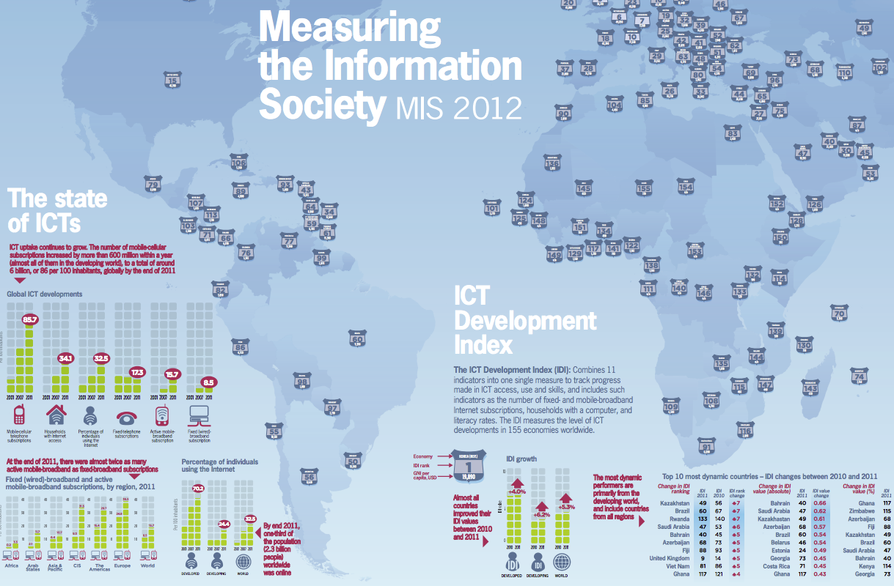
ITU assists developing countries
Notes:
ITU-D
- Neutral broker for multi-stakeholder partnerships, resource mobilization
- Executing agency for project implementation
Building capacity among members: technical assistance, advice on policy-regulatory frameworks for investment
Statistics and policy/regulatory trends
Membership Benefits:
- Support your CSR agenda. Build profile and relationships in new markets.
ITU-D Study groups looking at issues such as policy and regulatory reforms needed to stimulate ICT investment. Public-private partnership models for infrastructure roll-out, such as infrastructure sharing. Tax incentives. Licensing. How to expand rural connectivity.
ITU-D publishes its very much acclaimed annual report “Measuring the Information Society”. The report, which has been published annually since 2009, features two benchmarking tools to measure the information society: the ICT Development Index (IDI) and the ICT Price Basket (IPB). The 2012 IDI captures the level of ICT developments in 157 economies worldwide and compares progress made during the last year. The 2012 IPB combines the consumer prices for (fixed and mobile) telephone and Internet broadband services for 161 economies into one measure and compares these across countries, and over time. The 5th edition of the ITU Measuring the Information Society (MIS) report was launched on 7 October 2013, at ITU headquarters, Geneva, Switzerland

Slide 8
A sample of ITU key events
WRC/RA-12
WSTA-12
WTDC-14
WCIT-12
WTPF-13
Sector World Conferences
Other major ITU conferences and fora
ITU Connect series
Other major ICT sector events

Slide 9
ITU Patent Roundtable in 2012 and accelerated meetings of the IPR group in 2013
Any patents in an ITU, ISO or IEC standard must be available
- free of charge or - RAND
Goal of patent roundtable: find a solution to some RAND encumbered problems related to SEPs (standards essential patents), in particular:
The availability of injunctive relief
The meaning of “reasonable” in RAND
ISO and IEC send representatives to IPR group

Slide 10
ITU-T’s three strategic goals
To develop interoperable, non-discriminatory international standards (ITU-T Recommendations)
To assist in bridging the standardization gap between developed and developing countries
To extend and facilitate international cooperation among international, regional and national standardization bodies

Slide 11
Key topics in ITU-T
Optical fibre access and backbone
Multimedia, IPTV
E-Health
Cloud computing
Smart Grid
Internet of Things
ICT and environment
Security
Intelligent Transport Systems
Accessibility for persons with disabilities
Emergency communications
Numbering resources
Economic issues such as roaming charges

Slide 12
BSG: Bridging the standardization gap
Goal:
Increase participation of developing countries in standardization activities
Voluntary BSG fund
Fellowships (travel and/or accommodation)
Implementation guidelines
Mentoring programme
Reduced fee for Sector Members from certain developing countries
Remote participation
Regional groups

Slide 13
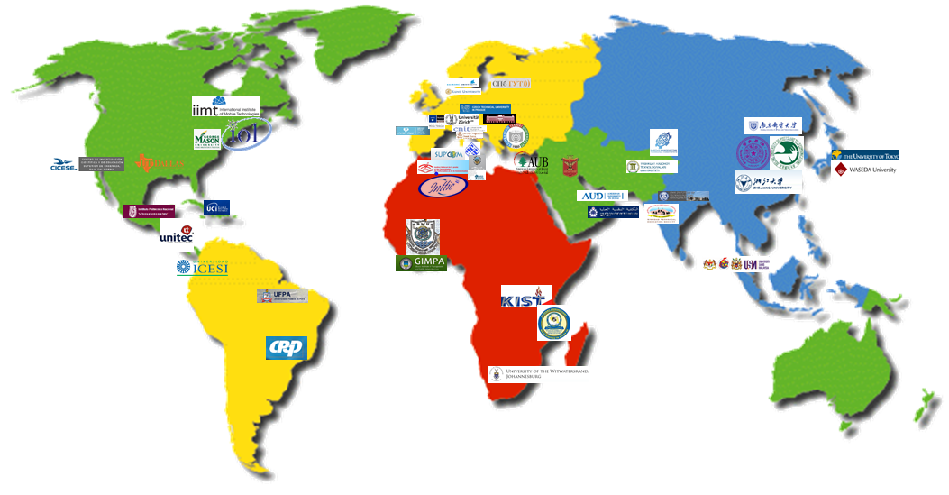
ITU’s network of Academia members keeps growing
63 universities and research centers in 38 countries
66 universities and research centers in 38 countries
Notes:
ITU’s membership opened up to Academia in 2011, pursuant to Resolution 169 (ITU PP-10) : Academia, universities and associated research establishments can join ITU’s three sectors in their own right
Our academic network includes renowned universities such as the University of Tokyo, Tsinghua University, Institut Mines-Télécom in France, KIST, University of Zurich, KAIST and the Georgia Institute of Technology as well as a number of leading institutions from developing countries in Africa, Latin America and Asia.

Slide 14
2. Interoperability

Slide 15
ITU Conformance and Interoperability program rests on 4 pillars
Conformity assessment
Interoperability events
Capacity building
Assistance in the establishment of test facilities in developing countries

Slide 16
Pillar 1: Conformity assessment program
Accredited test lab tests products/services against ITU-T Recommendation according to test specification
If vendor so wishes, can publish the fact that test was passed on ITU website database
Voluntary program - only if there is a market demand for a conformity assessment

Slide 17
Pillar 2: Interoperability testing events
1st ITU IPTV Interop testing and showcasing, July 2010

Slide 18
3. Convergence

Slide 19
Convergence of telecommunications and Information technology sectors continues
Manifestation of convergence also in governing texts:
ITU references “telecommunication/ICT” in its governing texts
ISO/IEC JTC 1 just changed its mission statement from IT to ICT

Slide 20
Challenges for global standards makers
With convergence the traditional demarcation lines between ICT SDOs are becoming blurred
Forums and consortia continue to proliferate
Risk of overlap and duplication increasing
Concerns on both sides (ISO, IEC, ISO/IEC JTC 1 and ITU-T) have been voiced
Complexity of standards landscape keeps increasing

Slide 21
And it gets even more complicated
ICTs are ubiquitous in all walks of life:
Healthcare, transportation, banking, energy, entertainment, trade, education, …
Each sector has its own ecosystem which differs in:
Market environment
Product life cycle
Policy and regulatory aspects
Ownership of data
Safety
Security
Privacy
Nomenclature
Standards culture

Slide 22
Key to today’s complex world
International standards are becoming ever more essential in a global market
Key for SDOs: collaboration and cooperation rather than competition
Recognize each others strengths and complementarities
work towards common or complementary international standards

Slide 23
4. Cooperation and collaboration

Slide 24
ITU membership’s emphasis on collaboration / cooperation
One of the three strategic objectives of ITU-T is:
“To extend and facilitate international cooperation among international and regional standardization bodies”

Slide 25
Global Standards Symposium (Nov 2012)
ISO Sec-Gen and IEC Vice-President were speakers
GSS recognized the increasing challenges due to convergence and involvement of vertical sectors
GSS affirmed the importance of addressing these challenges
ITU’s World Telecommunication Standardization Assembly (Nov 2012) created Review Committee
One of the goals: Identify means to enhance cooperation between and among SDOs

Slide 26
ITU-T’s Chief Technology Officers’ Group
ITU established high-level industry advisory group in 2009
Consists of 20+ chief technology officers from many of the world’s leading ICT companies
Proliferation of standards bodies a major concern of CTOs
CTO meeting 18 November 2013:
Calls also for development of bilateral coordination between ITU and SDOs

Slide 27
ITU-T has 5 MoUs and > 60 collaboration agreements

Slide 28
World Standards Cooperation (WSC):
ISO, IEC and ITU
Goals
“to strengthen and advance voluntary consensus-based international standards system of IEC, ISO and ITU …”
About 10% of ITU-T’s standards are common text with ISO/IEC JTC 1
Common patent policy ITU-T, ITU-R, ISO, IEC
Three-year rolling plan
ITU recently joined ISO/IEC Resolution Group
Information now exchanged on new work items

Slide 29
GSC (Global Standards Collaboration)
Current members:
ITU-T, ITU-R, CCSA (China), TTA (Korea), TTC & ARIB (Japan), ISACC (Canada), TIA & ATIS (USA), ETSI (Europe)
Currently reform discussion under way
Expand membership?

Slide 30
Food for thought

Slide 31
Food for thought
Improve communication: how to ensure that new work items are communicated to relevant groups ?
ITU-T/JTC 1 liaison officers could be "facilitators" during discussions between the relevant groups ?
Web page providing information on past and current collaborative work ?
Encourage collaboration between the ITU-centric and ISO/IEC-centric players at the national level ?
Continue leadership meetings of ITU-T & ISO/IEC JTC 1 ?
Explore collaboration on C&I matters (ANSI-ASQ has accredited test labs for testing to ITU-T Recommendations) ?

Slide 32
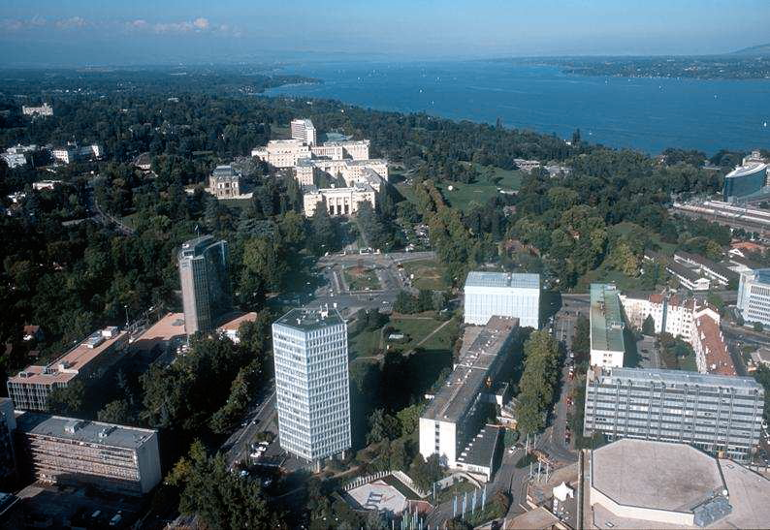
Thank You !
Notes:
32
Thank you.

