Slide 1

“Personalized, Privacy-enhancing Identity Management”,
A Service Provisioning Infrastructure for a
Global Ecosystem,
supported by interconnected Operators
Thomas Andersson/ IKED org.
ITU T-Meeting, Geneva 31.08.2012
  You are invited to contribute!

Slide 2
Developed against the backdrop of:
A stalemate in international collaboration on adopting a systemic approach to identity management
A fragmented arena with disparate experimentation and stifled innovation
Users lacking control and information how their identities and personal data are being used
The market dynamics favor exploitation of the expanding data, which is becoming increasingly easy to obtain and integrate for commercial purposes
Outstanding interrelated issues in identity management and data governance, affecting security, privacy, accountability, and trust, leading to distortions in service development and consumer behaviour

Slide 3
What is GINI?
A Support Action with DG INFSO of the EC
Mission: Recommendations to EC, Governments, Industry, R&D
  Is technology-neutral, refrains from favoring or developing a particular platform
  Defines requirements for users and management of privacy
  Takes market trends into account, and aims to stimulate innovation and differentiation in service development
Is motivated by the vision of an ecosystem of personalized, privacy respecting (and enhancing) identity management
Engages with industry, researchers and policy makers
  Can we agree on some principles for the ecosystem?
Will publish findings as a White Paper and a Roadmap

Slide 4
The User Perspective
  Current state of affairs: lack of awareness, and lack of options to develop and articulate appreciation for user control
  What could be the user experience?
  What infrastructure is required?
  What interoperable interfaces and standards to use?
  What agreements and type of governance might be necessary?
  What business models might emerge?

Slide 5
Vision and Concepts

Slide 6
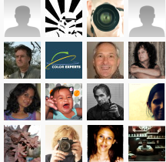



Internet Megatrends
Information –
search engines
Personal relations –
social networks
Mobile applications –
smart phones
All data-driven and provider-controlled
VISION: Next megatrend built around
individuals getting better control of their data
Is there a business case?

Slide 7
Motivational Drivers:
User-centricity considerations
Can I create and manage my own online identity?
Can I delete it and have it forgotten, or transfer it when I want to?
Can I use it with any service or person and be able to negotiate a trust relationship, without having to enter into prior agreements?
Can I use it anonymously or pseudonymously?
Can I choose which verified and verifiable attributes to bind with it, from the data source I prefer? Can I change those bindings?
Can I choose which attributes to disclose, when, and to whom? Can I change these preferences at will?
Can I have these facilities offered to me as a service which safeguards my privacy, without unsolicited profiling and unchecked data storage?

Slide 8
The Individualized Digital Identity (INDI)
INDI: a self-created digital identity
  Self-managed throughout its lifecycle (creation, change, management, revocation etc.)
    Either with IT system support in the domain of the individual
    Or through the support of an “Operator” under a service model
  Verified and verifiable attributes
    Verified against authoritative or other data sources
    Verifiable only when, and to the degree that, the user chooses
User presents the INDI to Relying Parties:
  Legal entities in the context of agreements and service transactions
  Physical persons, in the context of online transactions and/or communicates

Slide 9
User Centric Communication
  No direct communication of identity information between services!
  Identity (related) information is always requested and distributed by the User Agent

Slide 10
Grouping of Services (GINI Operator Model)

Slide 11
Protocols
  Distribute/transmit identity (related) information among different building blocks based on the specific need of distribution/transmission and rulesets, e.g.:
    disclose information only where necessary:
      confidentiality of identity (related) information
      confidentiality of transactions/relationships
    realize the pre-defined informational flow between different building blocks
    map existing trust relationships between the building blocks onto the information flow
    ...

Slide 12
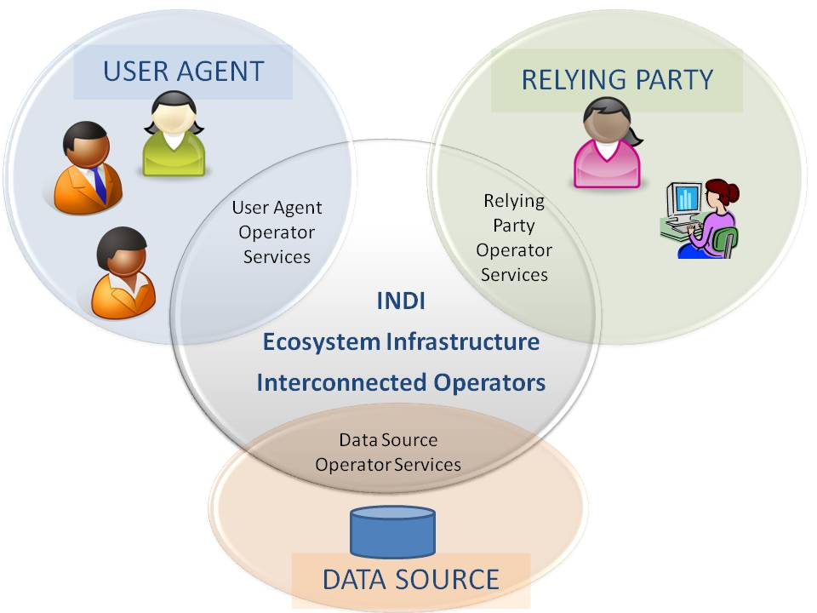
Overview of the INDI ecosystem
Notes:
If the individual is to have all those choices, then infrastructure and services must be available to allow any-to-any relationships between the main actor types. Transactions within this ecosystem would be facilitated through actor type-specific interfaces supported by entities we call ‘Operators”. These logical intermediaries can take the physical form of either interfaces and service endpoints native within the actor domain, or provided by third parties. Individual requirements and preferences are expected to justify different types of topology scenarios and related business models.

Slide 13
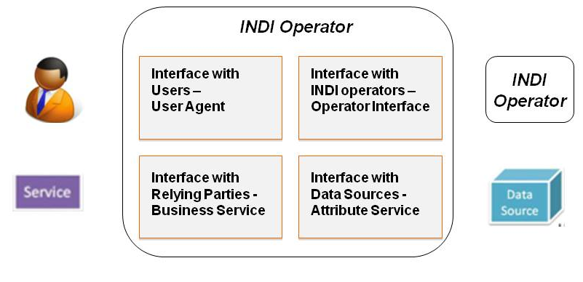
INDI Operators in a
Multi-Party Ecosystem
Scale-up
No silos
Disintermediation
Global, Cross-Domain INDI ecosystem
  Sign-up once, communicate with anyone, anywhere
Flexible but reliable User-Operator relationship
  Contractual and legal, not just technical
  Non-exclusive and Portable

Slide 14
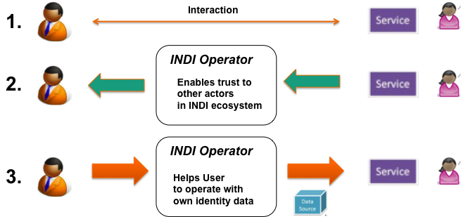
Identity Claims-as-a-Service:
Using an INDI through an Operator
Presentation of own INDI to a service provider or individual
Verifying other individuals’ data based on their disclosure policies
Linking an INDI with authoritative (or claimed) ID data sources

Slide 15
Privacy Enhancement drives INDI Operator Models

Slide 16
New Privacy Regulation in the EU
Privacy is now mandated
  Providers must look more seriously into compliance
  …but this is not made easier for businesses
    Hence: opportunities for Relying Party services
Data portability
  Does it require interoperability between INDI Operators?
Data minimization
  Do multi-party models enabling user control help?
  Needs interpretation and agreement on ground rules
    Hence: industry cooperation, interoperability and common governance
Right to be forgotten
  Does it warrant regulation? Can self-governance suffice?

Slide 17
The “Calling Home” Problem
Serious Privacy & Security problems
Trust established and controlled by Relying Party and Identity Provider
Must an “Identity Provider” be involved in every interaction of user and relying party?
Can this be avoided through INDI Operators?

Slide 18

Business Models for INDI Operators
USER
DOMAIN
RELYING PARTY
DOMAIN
INDI
User’s Operator
Service’s Operator
Service
End user interfaces and contracts towards users
User in Control
Compliance and compatibility
between operators
B2B interfaces and
contracts towards services
Data Source’s Operator
DATA SOURCE DOMAIN

Slide 19
INDI ecosystem as a market
Two-sided, even three-sided market
Multi-party, multi-corner model; market actors interact across Operators
Business models should not inhibit market takeup – transfer fees?
Standardization requirements for a cross-interoperable infrastructure
Governance requirements: inter-operator agreements, (self?)regulation

Slide 20
INDI business models should bring value for users
Enhanced privacy, conditionality of attribute disclosure control, reduction of uncertainty and behavioural distortion
Possibilities for building up their reputation when given the possibility to wilfully disclose verified and verifiable attributes of their own identity (e.g. professional status in a social network)
Personalized services within the INDI ecosystem can offer behavioural simulation of real-life control of basic life processes
  Users control information exchange with relying parties such as internet merchants, social networking sites and other vendors with an online front
  Users can negotiate trust relationships given that they want to share data and decide what they wish to share, how and with whom, rather than just block access
Privacy can be viewed as individually and socially valuable and serve as a basis for establishing trust relationships with relying parties
  A conscious decision on the part of a user is required for releasing data
  Privacy and secondary use of data may “buy” additional benefits online.

Slide 21
INDI business models should bring value for relying parties
Online vendors and service providers will build stronger relationships with their customers and based on trust relationships
  Data provided through wilful disclosure will be more useful and reliable
  Tailor-made trust relationships increase customer loyalty
INDI services to offer confidentiality for Relying Parties
  A win-win situation in established trust relationships gives benefits of privacy, confidentiality and directness to Users and Relying Parties
The INDI ecosystem should offer new opportunities to make implementation easier for Relying Parties
  With emerging models of Identity-as-a-Service, Claims-as-a-Service, the holy grail of Relying Party simplicity may be at reach

Slide 22
And what about value to data sources?
For registries in the public domain, value relates to the public sphere
  Civil society goals such as freedom of information and release of control to the legitimate information owners can be realized
  Potential revenue streams may help maintenance of public records if attribute access is chargeable
For directories in the private domain
  Revenue streams in identity-supply service can create a market for Cloud services directed at data sources
An individual can also act as a data source, strengthening the rise of an orderly market for data and privacy.

Slide 23


Are there any Operators around?
Cloud Providers
  Identity As A Service
Current API-based Identity Providers
  INDI disrupting their business model?
Banks, Telcos etc?
  Have burned fingers before…
New startups?
  Vendor Relationship Management
  Life Management Platforms, etc.
  Demand-focused, Innovation driven
BUT THE VALUE IS IN THE ECOSYSTEM
CROSS-INDUSTRY AGREEMENTS OR REGULATION?

Slide 24
Synthesis
and ”Questions”
to Stakeholders

Slide 25
Stakeholder landscape
Regulators
EC
Sectors
Health
Research
FP8
Standardi-zation
ISOC
Government
Financial
Mobile
ISO IEC/JTC1
OASIS
Kantara, ITU-T, …
National Regulators
CIP
EIT
ESF
ESO

Slide 26
Gaps and Recommendations
Legal/
Governance
Gaps
Technical/
Privacy
Gaps
Business Gaps
Functional Gaps
WHITE PAPER: Recommendations

Slide 27
Roadmap - Development
Gaps
Interdisciplinary
Put User into Control
Functional
Research
Easy integration of PETs
Private Sector
Technical/
Privacy
Advance Regulations for Data Protection
Government
Develop a Privacy-focused Business Model
Legal/
Governance
???
Business
Case
???
2012
2015
2020

Slide 28
Questions on Privacy Enhancement
Which are the critical privacy challenges and solutions within the INDI ecosystem? How can the application of “privacy by design/default” principles be supported within the INDI ecosystem? Which initiatives should be taken by different players to stimulate compliance with current and emerging privacy requirements, given the problems of “big data aggregation”?
What is required for turning privacy enhancement into a driver for innovation and a viable basis for new business models? What are the risks? What are the implications for current business practices?

Slide 29
Questions on Operator Business Models
Which operating and service provision models can take the lead? Can they be found among potential providers of IDM services such as telcos, banks, cloud providers and niche start-ups? What is required for Identity as a Service to respond to the privacy challenges in the Cloud, or itself develop as a Cloud service?
What is required for end-users and consumers to assume an active driving role in operating and service provision models development? How could the rise of viable business models be facilitated?

Slide 30
Questions on Policy and Governance
What policy measures can move us out of the present situation by enabling the rise of user-centric and user-driven identity services in an interoperable ecosystem?
Leading up to new policy initiatives, e.g., a revised EU Directive on Privacy, what incentives are required for implementers of Personalized Identity Management services from Industry and Government to collaborate actively around new privacy regulation requirements, such as data portability and privacy by default/design, for the purpose of promoting a common governance framework that sustains and expands the market whilst preserving and enhancing privacy rights for individuals?

Slide 31
Discussion

Slide 32
Appetizer on Recommendations

Slide 33
Recommendations for R&D:
Further work on the systemic, global requirements and key coordination issues that hinder the spontaneous rise of viable INDI-operators
Protocols: Will SAML, developed for the corporate paradigm of access management, give way as an INDI-like ecosystem takes shape? What about openID connect, Oauth, etc.?
Trust meta-models, using interdisciplinary approaches, technology as well as social sciences, international collaboration
How drive innovation in behavioural motivation, e.g. raising user awareness of identity management and privacy, incl. international collaboration to take account of institutional and cultural differentiation

Slide 34
Recommendations for Policy
Allow citizens to own and control their identity & data in public registries, under conditions that satisfy public interest and support the life cycle of identity data (insertion, access, modification, re-use, erasure).
Build INDI-compliant Attribute Services on top of public data registries, so they become accessible by other relevant actors within an INDI-like ecosystem. Allowing only privacy-respecting parties to gain access to those Attribute Services.
Procure INDI functionality for eGovernment services, while fostering innovation and interoperability among Operators.
Put pressure on business to be transparent in the enrolment and transfer of data.
Inspire user awareness of privacy issues, e.g., through informed choices.. Ensure digital evidence protects users, in contrast to today’s situation where they are forced to rely on the evidence produced and owned by service providers.
Foster innovative start-ups motivated by new services and business models. While already existing EC programmes could be used or adapted, new programmes incl. national and broader inter-regional initiatives and collaboration should be put in place.

Slide 35
Recommendations for Industry
Initiate collaboration between ICT market players and potential service providers such as Cloud Operators and various identity intermediators on:
  Requirements for ensuring user-centricity and user control to identity and attribute provision that are constructive and conducive to innovation
  Ways to stake out infrastructure requirements and business development opportunities around an INDI-like ecosystem
  Privacy-enhancement principles and rights of individuals including, underpinning trust and the rise of an orderly market.
Engage in Industry-wide standardisation initiatives to define interfaces:
  Interoperability and data handling processes ensuring privacy for users and confidentiality for relying parties
  Portability specifications
  Protocols, APIs, auditing and security for cross-operator relaying of claims and assertions.
Engage in developing a governance framework for self-regulation as regards:
  A trust meta-model underpinning user-centricity
  Inter-operator agreements for relaying of claims and assertions, including possible charges (or lack thereof)
Infrastructure interoperability around standardised inter-operator interfaces

Slide 36
We invite your thoughts about the “key questions” outlined in the GINI Position Document
Please ask for a copy
Contributions will be acknowledged and referenced in the GINI reports to the European Commission, soon to be made publicly available.
Please send your views to info@iked.org
More info at www.gini-sa.eu

