Slide 1
Direct Document Posting (DDP)
ITU-T Study Group 17 meeting,
Geneva, 21 February 2012
Maite Comas Barnés

Slide 2
How to submit contributions
  Using Direct Document Posting (DDP) – delegates submit the contributions themselves
  By email to the study group’s mailbox (in the case of SG 17: tsbsg17@itu.int) –
  TSB will do the processing

Slide 3
DDP
Is only available to TIES users
Deadline for submission applies
Is being updated and improved all the time – check for new features before each meeting

Slide 4
DDP

Slide 5
How to use DDP
DDP is a three-step process:
  (1) You need to register your contribution: enter title, source and question and obtain the number;
  (2) You format your contribution with the correct header and add the number to the word file and save it;
  (3) Finally, you upload the saved contribution to the web.
To use DDP, go to the study group’s home page and click on Direct Document Posting.
Notes:
Although system says there are two steps, I prefer to think about it as a three-step process.
Using DDP somehow inverses the logical process of preparing a document, as you need to register it before you format it.

Slide 6
(1) Registering the contribution

Slide 7
(1) Registering the contribution
Notes:
By default, your company will appear as a source. You may keep it or remove it by selecting and clicking on “ADD”.
Same for the question.
Option for QALL exists.
You can click on more than one source or question by using “shift” or “control”
MAKE SURE THE SOURCES ON THE DOCUMENT CORRESPOND TO THE SOURCES ON THE DATABASE!!!

Slide 8
(1) Registering the contribution

Slide 9
(1) Registering the contribution

Slide 10
(1) Registering the contribution
Your contribution is now registered: the “envelope” appears on the web showing title, source, Question and the mention “Not yet uploaded”.

Slide 11
(2) Formatting and adding the number to the contribution
Make sure you use the right template from the DDP web page (it will save TSB having to post a revision), and
Insert the number to the contribution.

Slide 12
(2) Formatting and adding the number to the contribution

Slide 13
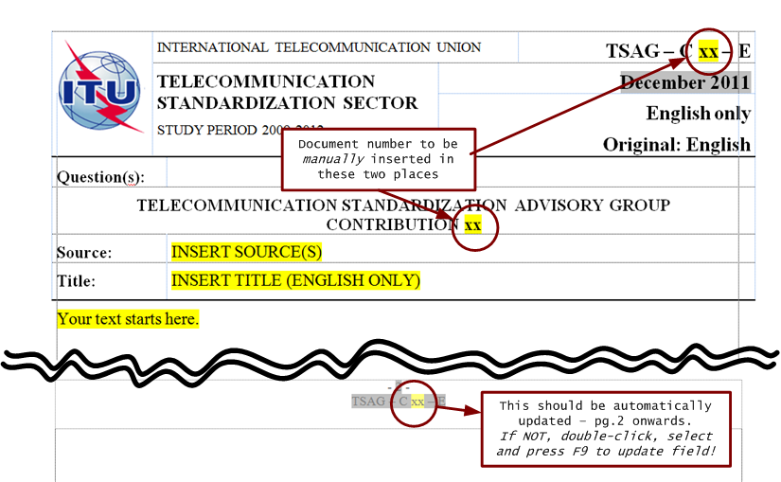
(2) Formatting and adding the number to the contribution

Slide 14
(2) Formatting and adding the number to the contribution
Document format:
Either a single Word document, or
A zip file in which one of the documents is a Word file bearing the template with the metadata (please use logical file naming)

Slide 15
(3) Uploading the contribution
This can be done either immediately after registration, or
Any time after registration but before the deadline.

Slide 16
(3) Uploading the contribution
Check the file before uploading it!!!

Slide 17
(3) Uploading the contribution immediately after registration

Slide 18
(3) Uploading the contribution any time

Slide 19
(3) Uploading the contribution
Notes:
Deadlines for submission of documents in a language other than English are necessarily longer: 2 months.

Slide 20
(3) Uploading the contribution
Once the contribution has been uploaded, you will receive an email confirming the uploading.
Make sure you keep the registration and uploading emails: you will need the password/document number if you want to make any modifications or upload a revision.

Slide 21
(3) Uploading the contribution

Slide 22
How to use DDP: uploading the contribution
Your contribution is now available on the web with the mention
“To be verified by TSB”.

Slide 23
How to use DDP – uploading revisions/corrigenda/addenda
The document has already been registered, you simply need to upload the file from the main DDP page

Slide 24
How to use DDP – uploading revisions/corrigenda/addenda

Slide 25
How to use DDP – uploading revisions/corrigenda/addenda

Slide 26
How to use DDP – uploading revisions/corrigenda/addenda

Slide 27
How to use DDP – uploading revisions/corrigenda/addenda
Revision ≠ corrigendum
A revision is the whole document, including the change(s)
A corrigendum is a one-pager that indicates where the change(s) take place and what it is/they are

Slide 28
How to use DDP – uploading revisions/corrigenda/addenda
An addendum is information that is additional to the contribution originally posted.
Notes:
In the case of arguments for or against the creation of a new Working Party. You send three arguments in and then you think of an additional one. That could be contained in an addendum.

Slide 29
For any questions or doubts, please contact the study group’s secretariat at tsbsg17@itu.int.
Thank you

