Slide 1
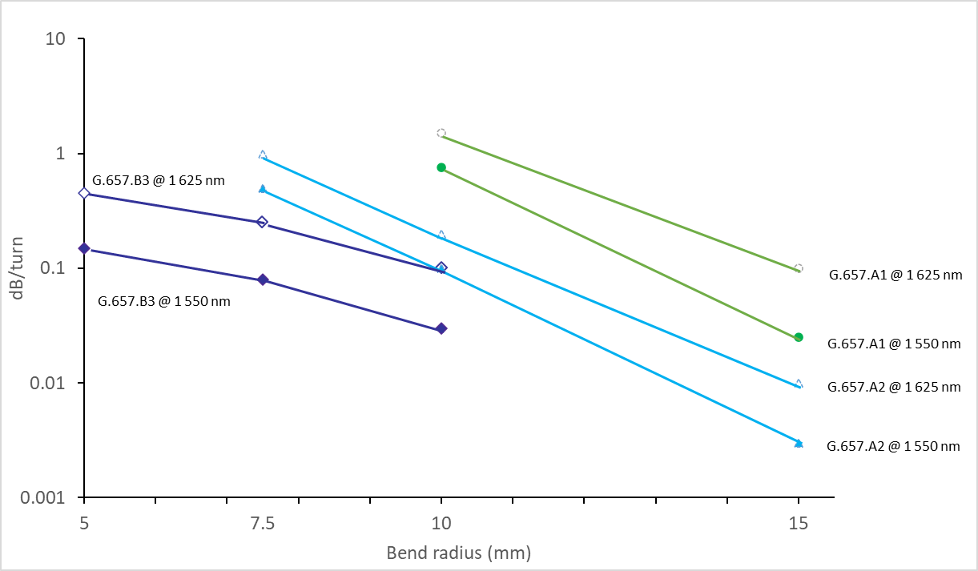
ITU-T Study Group 15
G.657 | Characteristics of a bending-loss insensitive single-mode optical fibre and cable
ITU-T G.657 fibre has been deployed extensively in access networks for over 15 years.
ITU-T G.657 fibre is now being utilized throughout terrestrial networks where bending-loss insensitive fibres are required to achieve installed performance requirements, e.g. datacenter networks and high fibre density cables.
The 5th edition of Recommendation ITU-T G.657 clarifies application spaces for ITU-T G.657 fibre to include datacenters.
It simplifies the standard by removing similar category B2.
It provides new guidance on cut-off wavelength testing sensitivity to bending-loss insensitive single-mode fibres.
To illustrate the different macrobending specifications of the various ITU-T G.657 subcategories, the recommended values are represented in Figure 1 below. In contrast, ITU-T G.652 fibre only specifies macrobending at 0.1 dB at 100 turns (0.001 dB/turn) at 30 mm radius at 1625 nm.
Figure 1 – Macrobending loss data, category ITU-T G.657
For more information, please visit the ITU-T Study Group 15 website at: www.itu.int/go/tsg15
© International Telecommunication Union 2024

