Slide 1
ITU-T search tools and MyWorkspace
November 2017

Slide 2
What’s new?
Updates to:
Global search engine: Deep search of public and member-only resources within ITU
Thematic search: Emerging concepts across ITU-T
MyWorkspace: Personalized web tools and services
Global search/ thematic search
MyWorkspace

Slide 3
ITU-T global search
More accurate and complete results
Richer information: Document history, references
Sector-specific searches (or all ITU)
Not just documents (Work Programme, webpages, etc.)
www.itu.int/net4/ITU-T/search/GlobalSearch/Landing

Slide 4
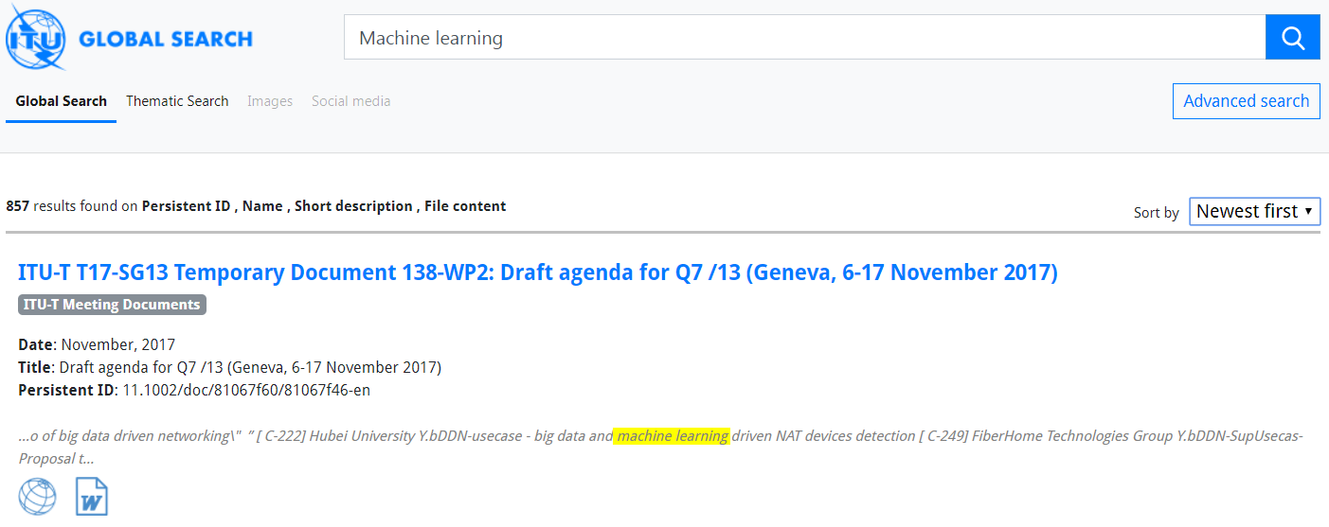
ITU-T global search:
Look inside TIES-protected content
Search for anything (14 collections; 200k plus indexed documents)
Sort results by relevance or newness
Search probes inside the content of TIES-protected resources

Slide 5
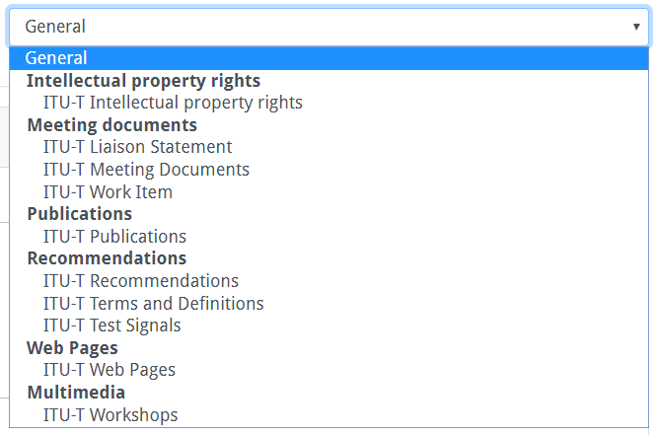
ITU-T global search:
Advanced search
Refine your search

Slide 6
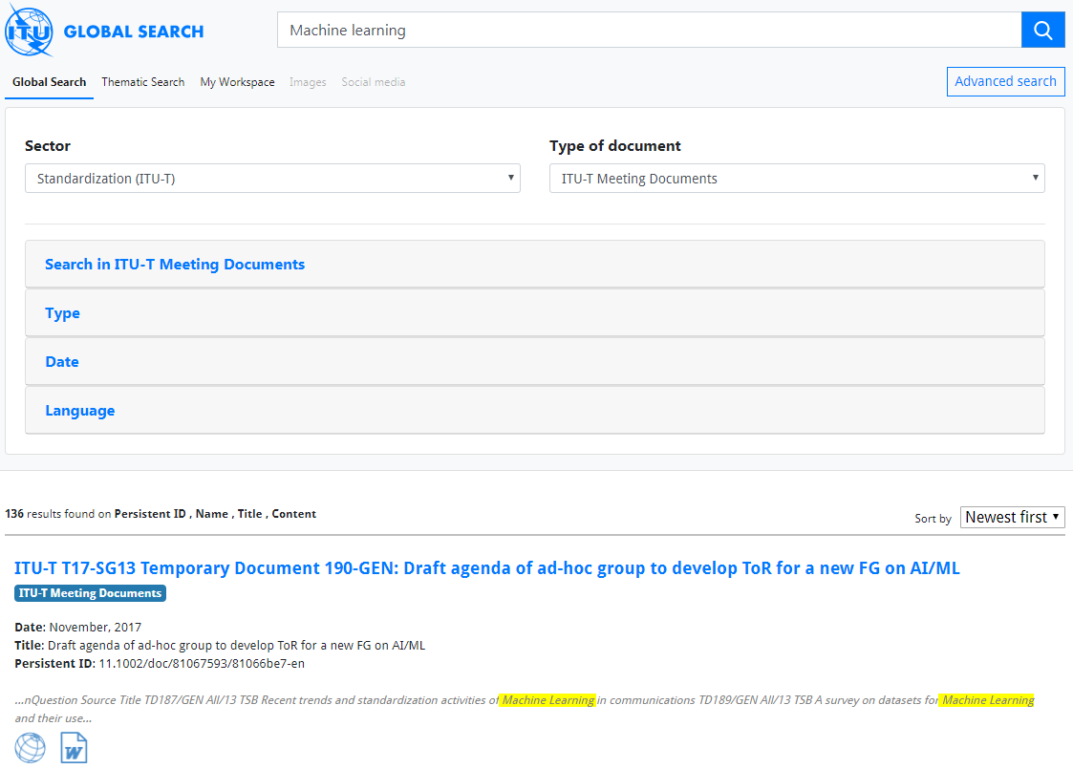
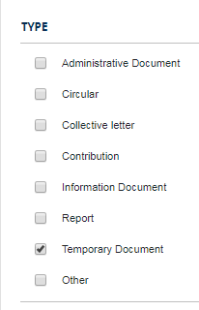
ITU-T global search:
Advanced search

Slide 7
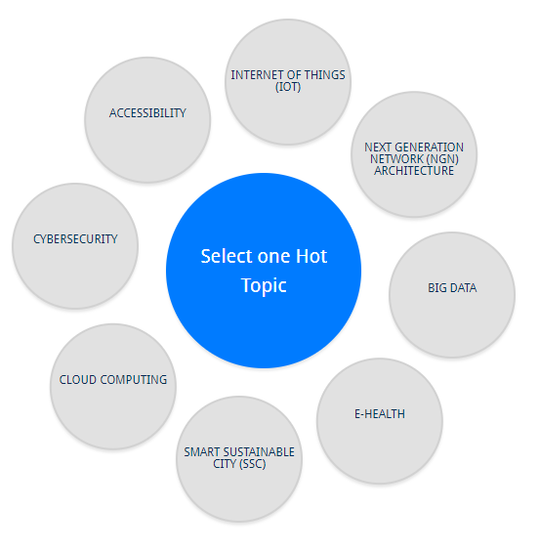
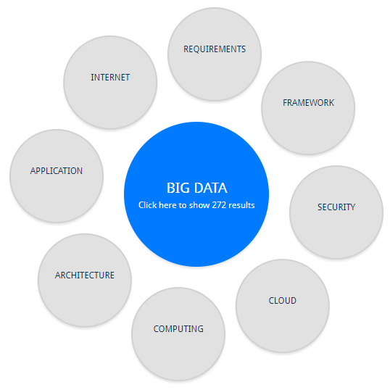
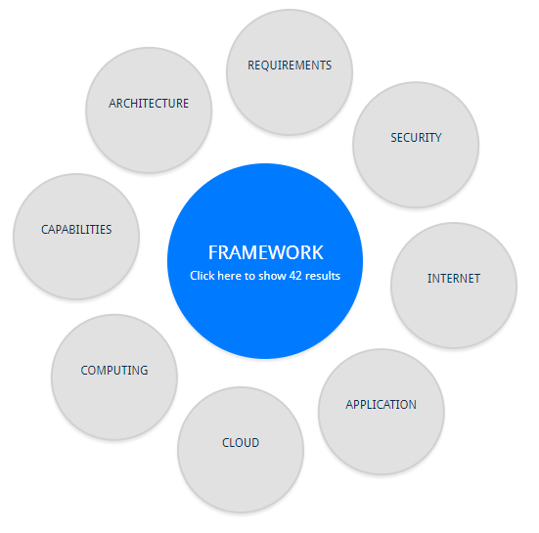
ITU-T thematic search
42 results… …click to list them

Slide 8
ITU-T MyWorkspace
www.itu.int/net4/ITU-T/myworkspace

Slide 9
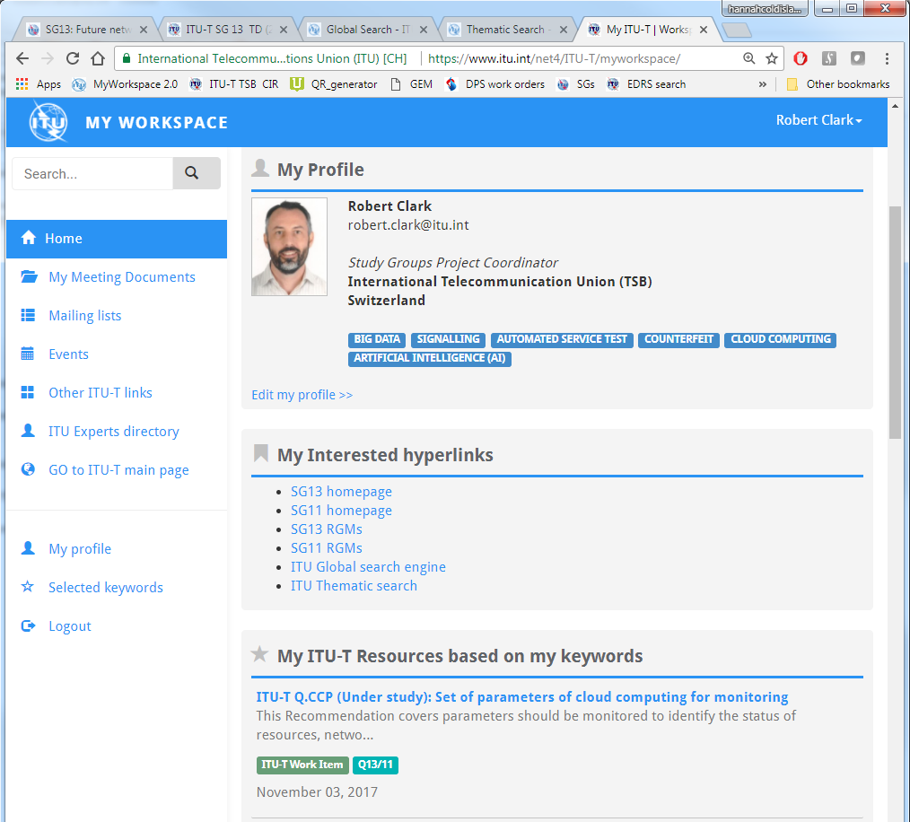
ITU-T MyWorkspace:
A personalized view of ITU-T
Define your own profile (groups, keywords, etc.)
Choose your own favourite URLs
Personalized view of ITU-T resources

Slide 10
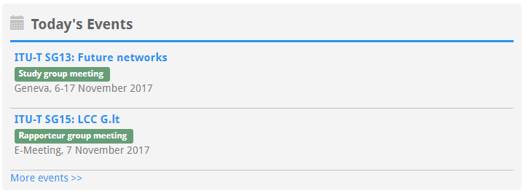
ITU-T MyWorkspace:
A personalized view of ITU-T
Personalized list of meeting documents
Find and subscribe to mailing lists
Today’s ITU-T events
Personalized view of events schedule
Selected forthcoming meetings of interest
Quick links to other tools/services
Network with other ITU-T experts
All forthcoming meetings

Slide 11
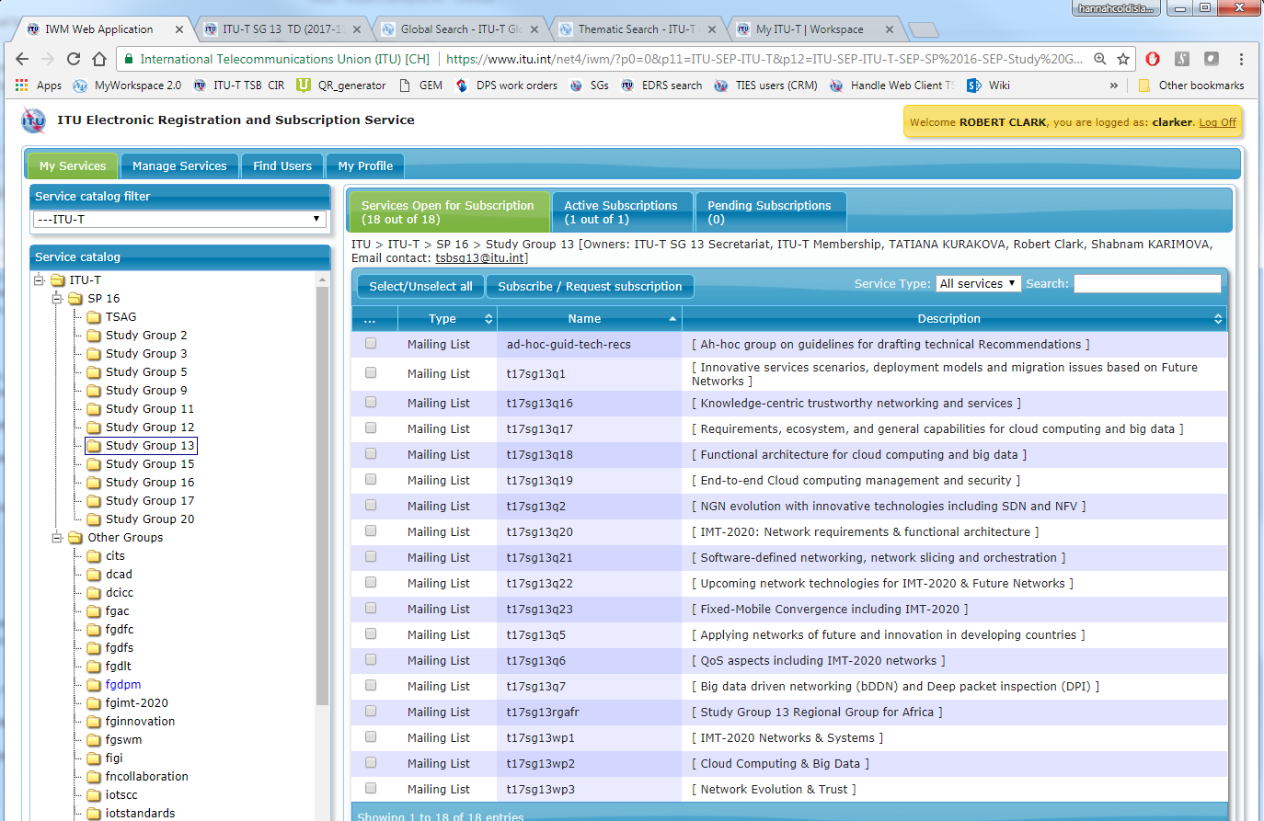
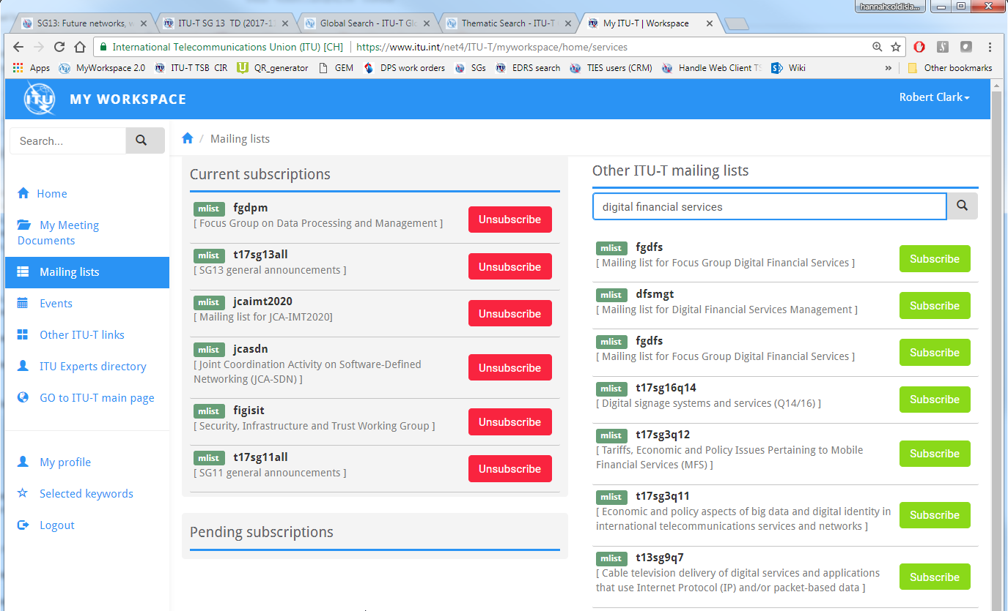
ITU-T MyWorkspace:
Manage mailing list subscriptions
Search by group name, key phrases, etc.
Unsubscribe from current services
Subscribe with one click
Coming soon – subscription directly from group websites

Slide 12
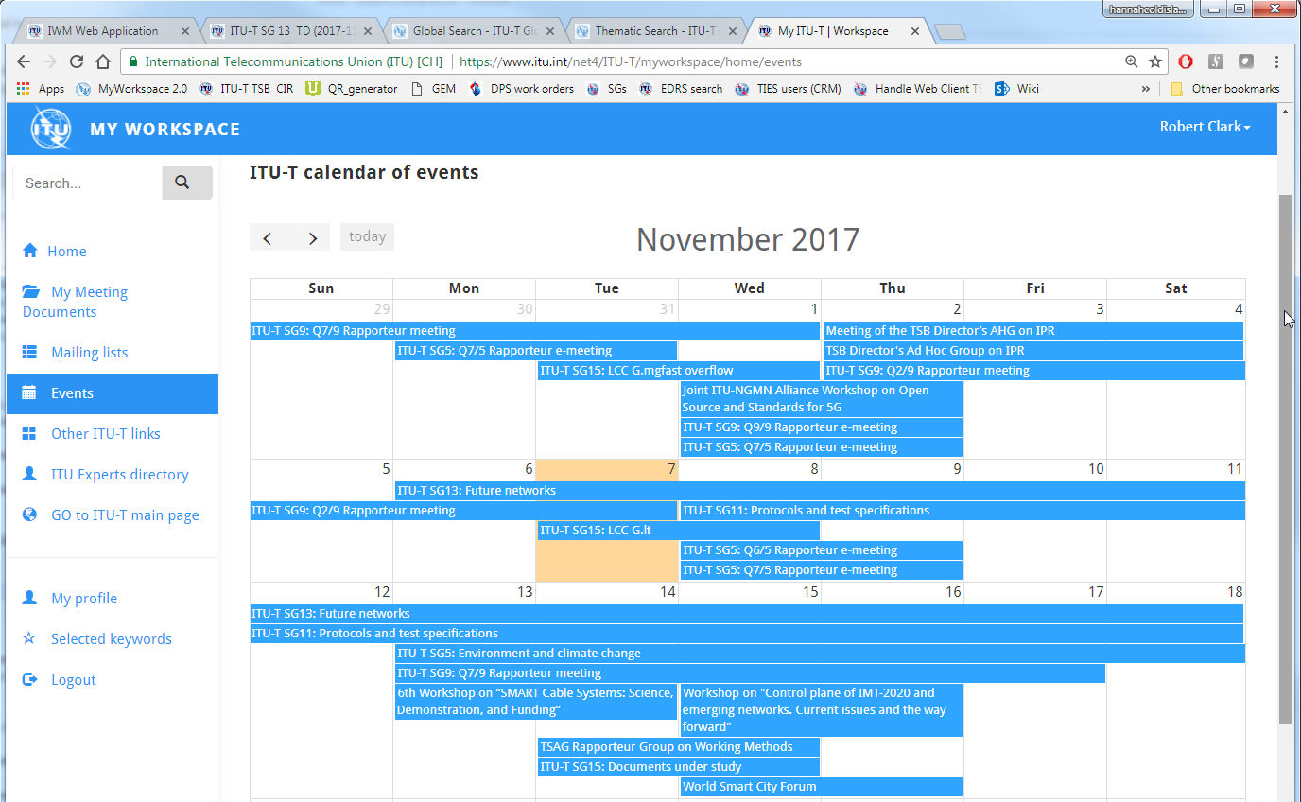
ITU-T MyWorkspace:
Events
Calendar view of all ITU-T events: study group, working party, regional group, rapporteur group, and non-statutory
Click on an event to see group- or meeting-specific information

Slide 13
Thank you
Any requests, feedback, or questions?
Email: tsbitdev@itu.int

