Slide 1
ITU-T Study Group 20: Internet of things (IoT) and smart cities & communities (SC&C)

Slide 2
International Telecommunication Union (ITU)
WHO WE ARE
WHAT OUR ROLE IS
ITU is the United Nations specialized agency for information and communication technologies (ICTs)
To facilitate peaceful relations, international cooperation between peoples, and economic and social development by means of efficient telecommunications services.
PROMOTING GLOBAL COLLABORATION FOR A CONNECTED WORLD

Slide 3
International Telecommunication Union
193 | 550 | 140 | 170
MEMBER STATES | SECTOR MEMBERS | ACADEMIA MEMBERS | ASSOCIATES
OUR MEMBERS
3 SECTORS
STANDARDIZATION
DEVELOPMENT
Each sector has separate mandate, but all work cohesively towards connecting the world
RADIOCOMMUNICATION

Slide 4
Why you should join ITU-T SG20?
SMEs pilot project
United Nations specialized Agency for ICTs
Share your knowledge with 193 Member States, 700 Private Sectors and over 140 Academia
Address broad market needs
Embody diverse perspectives
Leverage expert knowledge
Serve as building blocks for innovation
Open new markets and applications
Encourage market competition
Drive global innovation and advancement
Streamline development and implementation
Drive interoperability and scalability
Reduce cost
Notes:
The request of an SME to participate in the pilot project will be submitted via the concerned administration, which should confirm that it meets the national criteria to be recognized as an SME, including factors such as size of company and annual revenues. TSB informed the meeting that it will also notify an Administration when receiving direct requests from interested SMEs.
It was noted that this pilot project will run until PP-18. ITU secretariat will provide a progress report to the next session of Council in 2018, with a view towards presenting a full report for PP-18.
International standardization is critical to achieve:
Conformity and interoperability
Economy of scale
Global market
Affordable network/consumer equipment/service

Slide 5
ITU-T Study Group 20: Internet of things (IoT) and smart cities and communities (SC&C)
Lead study group on
Responsible for studies relating to IoT and its applications, and smart cities and communities (SC&C).
Internet of things (IoT) and its applications
It includes studies relating to Big data aspects of IoT and SC&C, e-services and smart services for SC&C
Smart Cities and Communities (SC&C), including its e-services
and smart services
4 Regional Groups
SG20 RG-AFR
SG20 RG-EECAT
IoT identification
SG20 RG-LATAM
SG20 RG-ARB
Notes:
ITU-T SG20 Regional Group for the Latin American Region
ITU-T SG20 Regional Group for the Africa Region
ITU-T SG20 Regional Group for the Arab Region
ITU-T SG20 Regional Group for Eastern Europe, Central Asia and Transcaucasia

Slide 6
ITU-T SG20 Structure
WP1/20 | Questions
Q1/20 | End to end connectivity, networks, interoperability, infrastructures and Big Data aspects related to IoT and SC&C
Q2/20 | Requirements, capabilities, and use cases across verticals
Q3/20 | Architectures, management, protocols and Quality of Service
Q4/20 | e/Smart services, applications and supporting platforms
WP2/20
Q5/20 | Research and emerging technologies, terminology and definitions
Q6/20 | Security, privacy, trust and identification
Q7/20 | Evaluation and assessment of Smart Sustainable Cities and Communities

Slide 7
ITU-T SG20 Regional Groups
SG20 RG-EECAT - ITU-T SG20 Regional Group for Eastern Europe, Central Asia and Transcaucasia
SG20 RG-LATAM - ITU-T SG20 Regional Group for the Latin American Region
SG20 RG-ARB - ITU-T SG20 Regional Group for the Arab Region
SG20 RG-AFR - ITU-T SG20 Regional Group for the Africa Region

Slide 8
Most recent approved ITU-T Recommendations (1)
Recommendation ITU-T Y.4101/Y.2067 "Common requirements and capabilities of a gateway for Internet of Things applications ".
Recommendation ITU-T Y.4101/Y.2067 provides the common requirements and capabilities of a gateway for Internet of things (IoT) applications. The provided common requirements and capabilities are intended to be generally applicable in gateway application scenarios.
Recommendation ITU-T Y.4116 "Requirements of transportation safety service including use cases and service scenarios "
This Recommendation describes requirements for providing transportation safety services. The use cases and related service scenarios which are used to extract requirements for various IoT services and applications are also described in this Recommendation.
Recommendation ITU-T Y.4117 “Requirements and capabilities of Internet of Things for support of wearable devices and related services ”.
The purpose of this Recommendation is to describe characteristics, specific requirements and capabilities of the IoT for support of wearable devices and related services.
Recommendation ITU-T Y.4455 “Reference architecture for IoT network service capability exposure ”.
This Recommendation introduces IoT network capability exposure (IoT NCE). The IoT NCE is a functional entity in network domain, and facilitates the Internet of things (IoT) applications and services to make full use of capabilities of their underlying networks. The IoT NCE can optimize user experience, improve network efficiency and expose network capability in order to optimize IoT applications and services.
Recommendation ITU-T Y.4806 “Security capabilities supporting safety of the Internet of Things”.
This Recommendation provides a classification of the security issues for the Internet of Things and examines how the security threats may affect safety, in order to determine which security capabilities specified in Recommendation ITU-T Y.4401/Y.2068 support safe execution of the Internet of Things.

Slide 9
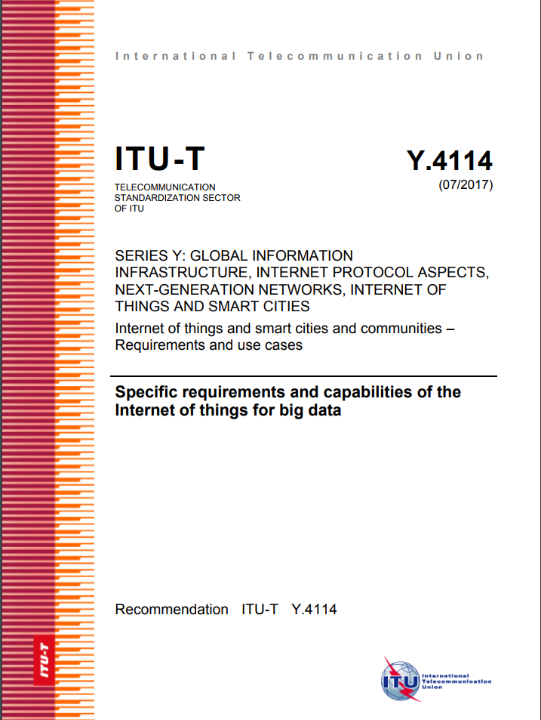
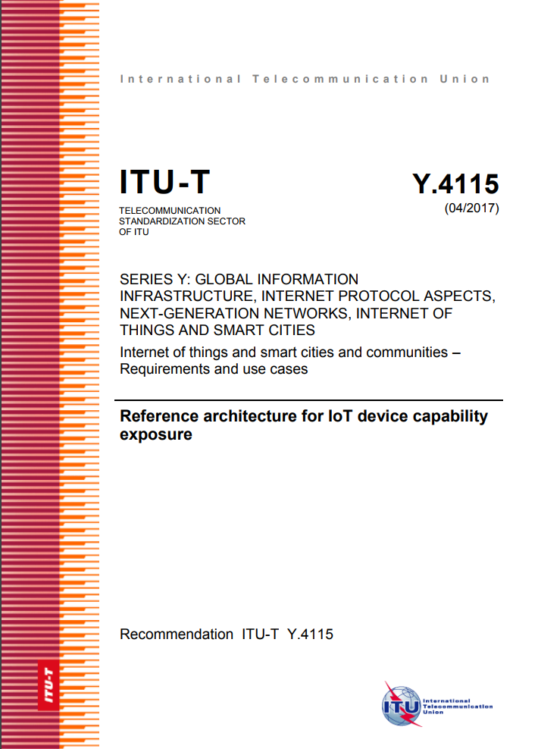
Most recent approved ITU-T Recommendations (2)
Recommendation ITU-T Y.4114 "Specific requirements and capabilities of the IoT for Big Data".
This Recommendation complements the developments on common requirements of the IoT [ITU-T Y.2066] and functional framework of the IoT [ITU-T Y.2068] in terms of the specific requirements and capabilities that the IoT is expected to support in order to address the challenges related to Big Data.
Recommendation ITU-T Y.4115 "Reference architecture for IoT device capability exposure"
This Recommendation specifies reference architecture of IoT device capability exposure (IoT DCE) which supports IoT applications in DCE devices (e.g., smart phones, tablets and home gateways) to access device capabilities exposed by IoT devices connected to the DCE device.
Recommendation ITU-T Y.4805 “Identifier service requirements for the interoperability of Smart City applications”.
This Recommendation explores the set of requirements for identifier services used in Smart City. An identifier service for Smart City must be scalable and secure, and not only promote interoperability among different Smart City applications, but also compatible with any existing practices in the application domain.

Slide 10
Focus Group on Data Processing and Management to support IoT and Smart Cities & Communities (FG-DPM)
Key priorities:
WG1 - Use Cases, Requirements and Applications/ Services
WG2 - DPM Framework, Architectures and Core Components
WG3 - Data sharing, Interoperability and Blockchain
WG4 - Security, Privacy and Trust including Governance
WG5 - Data Economy, commercialization and monetization
5 Working Groups
To propose mechanisms , frameworks and guidelines for supporting the security, privacy and interoperability of datasets and data-management systems within the IoT and smart city domain.
Notes:
The FG-DPM will also:
study trust in data management frameworks including digital identification and certification;
investigate the role of emerging technologies to support data management and emerging trends including blockchain;
identify challenges in the standardization activities for data processing and management.

Slide 11
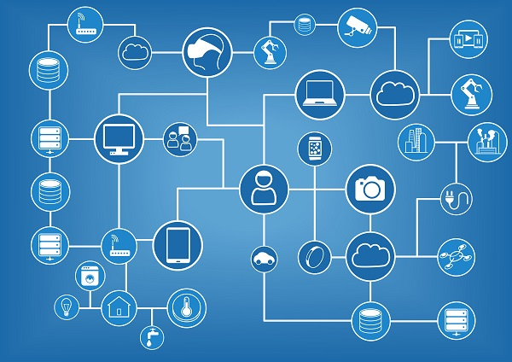
JCA – IoT and SC&C
To coordinate the activity on IoT & SCC across ITU-T Study Groups and to coordinate with ITU-R and ITU-D.
To provide a visible contact point IoT and SC&C activities in ITU-T, to seek co-operation from external bodies working in the field of IoT & SCC and enable effective two-way communication with these bodies.
Maintenance of a list of cross-SDO IoT & SCC standardization items and associated roadmap.
Co-Conveners:
Hyoung Jun Kim (ETRI, Korea)
Fabio Bigi (Italy)
Secretariat:
Contact: tsbjcaiot@itu.int
D.2r16 - IoT and SC&C standards roadmap (free download) – Send us your inputs!

Slide 12
Thank you
ITU-T, IoT and smart cities & communities http://itu.int/go/tsg20
tsbsg20@itu.int

Slide 13
Additional slides

Slide 14
Question | Working title | Title
Q2/20 | ITU-T Y.SCC-Reqts | Common requirements and capabilities of smart cities and communities from IoT and ICT perspectives
Q2/20 | Y.UCS-Reqts | Requirements and capabilities of user-centric work space service
Q2/20 | Y.IoT-UAS-Reqts | Use cases, requirements and capabilities of unmanned aircraft systems for Internet of Things
Q3/20 | Y.oneM2M.IWK.LwM2M | oneM2M- LwM2M Interworking
Q3/20 | Y.oneM2M.PB.WebSocket | oneM2M- WebSocket Protocol Binding
Q3/20 | Y.oneM2M.MAF.MEF | oneM2M- MAF and MEF Interface Specification
Q3/20 | Y.oneM2M.DG.DM | oneM2M- Developer guide of device management
Q3/20 | Y.oneM2M.DG.AppDev | oneM2M- Application developer guide: Light control example using HTTP binding
Q3/20 | Y.oneM2M.DG.CoAP | oneM2M- Developer Guide of CoAP binding and long polling for temperature monitoring
Q3/20 | Y.oneM2M.InteropTest | oneM2M- Interoperability Testing
Q3/20 | Y.oneM2M.CT | oneM2M- Common Terminology
Q3/20 | Y.oneM2M.PB.MQTT | oneM2M- MQTT Protocol Binding
Q3/20 | Y.oneM2M.PB.HTTP | oneM2M- HTTP Protocol Binding
Q3/20 | Y.oneM2M.SLCP | oneM2M- Service Layer Core Protocol Specification
Q3/20 | Y.oneM2M.SEC.SOL | oneM2M- Security Solutions
Q3/20 | Y.oneM2M.DG.SEM | oneM2M- Developer Guide of Implementing semantics
Q3/20 | Y.oneM2M.ARC | oneM2M-Functional Architecture
Q3/20 | Y.oneM2M.DM.OMA | oneM2M- Management Enablement (OMA)
Q3/20 | Y.oneM2M.PB.CoAP | oneM2M- CoAP Protocol Binding
Q3/20 | Y.oneM2M.TF | oneM2M- Testing framework
Q3/20 | Y.oneM2M.FDC | oneM2M- Field Device Configuration
Q3/20 | Y.oneM2M.HAIM | oneM2M- Home Appliances Information Model and Mapping
Q3/20 | Y.oneM2M.Ind.DE | oneM2M- Industrial Domain Enablement
Q3/20 | Y.oneM2M.BO | oneM2M Base Ontology
Q3/20 | Y.oneM2M.DM.BBF | oneM2M- Management enablement (BBF)" (New)
Q3/20 | Y.UIIS-IoT | Unified Identity/Identifier/Locator Split (UIIS) Services and Architecture in IoT Environment
Q3/20 | Y.oneM2M.UCC | oneM2M- Use Case Collection
Q3/20 | Y.oneM2M.REQ | oneM2M- Requirements
Q4/20 | Y.disaster_notification | Framework of the disaster notification of the population in Smart Cities and Communities
Q5/20 | Y.MEDT | Methodology for Building Sustainable Capabilities during Enterprises’ Digital Transformation
Q6/20 | Y.API4IOT | API for IoT Open Data in Smart Cities
Q6/20 | Y.LPWA | Security, interoperability and identification aspects for Low Power Wide Area (LPWA) systems
Q6/20 | Y.FW-IC-MDSC | Framework of identification and connectivity of Moving Devices in Smart City
Q7/20 | Y.SSC-IA | Smart Sustainable City Impact Assessment
Q7/20 | Y.SSC-MM | Smart Sustainable City Maturity Model
Q7/20 | Y.AFDTS | Assessment Framework for Digital Transformation of Sectors in Smart Cities
New work items

Slide 15
ITU-T SG20 main results October 2015 – August 2017
9 New Recommendations approved
9 New Supplements agreed
ITU-T Y.4113 “Requirements of the network for the Internet of Things”
ITU-T Y.4114 “Specific requirements and capabilities of the IoT for Big Data”
ITU-T Y.4115 “Reference architecture for IoT device capability exposure"
ITU-T Y.4451 “Framework of constrained device networking in the IoT environments”
ITU-T Y.4452 “Functional framework of Web of Objects”
ITU-T Y.4453 “Adaptive software framework for IoT devices”
ITU-T Y.4553 “Requirements of smartphone as sink node for IoT applications and services”
ITU-T Y.4702 “Common requirements and capabilities”
ITU-T Y.4805 “Identifier service requirements for the interoperability of Smart City applications”.
ITU-T Y.Supp.42 to ITU-T Y.4100 series “Use cases of User-Centric work Space (UCS) Service
ITU-T Y.Supp.34 to ITU-T Y.4000 series "Smart Sustainable Cities - Setting the stage for stakeholders' engagement"
ITU-T Y.Supp.33 to ITU-T Y.4000 series "Smart Sustainable Cities - Master plan"
ITU-T Y.Supp.32 to ITU-T Y.4000 series "Smart sustainable cities - a guide for city leaders“
ITU-T Y.Supp.31 to ITU-T Y.4550 series "Smart Sustainable Cities - Intelligent sustainable buildings“
ITU-T Y.Supp.28 to ITU-T Y.4550 series ”Integrated management for smart sustainable cities”;
ITU-T Y.Supp.29 to ITU-T Y.4250 series “Multi-service infrastructure for smart sustainable cities in new-development areas”;
ITU-T Y.Supp.30 to ITU-T Y.4250 series “Overview of smart sustainable cities infrastructure”;
ITU-T Y.Supp.27 to ITU-T Y.4400 series “Setting the framework for an ICT architecture of a smart sustainable city”.
Notes:
28 on-going Work Items under WP1/20

Slide 16
Publication on IoT and Smart Sustainable Cities
Flipbook on Shaping smarter and more sustainable cities: Striving for Sustainable Development Goals
Flipbook on Unleashing the potential of the Internet of Things
This compendium of Technical Reports and Specifications details policy and technical considerations relevant to the development of SSC, providing policymakers and engineers with valuable reference material to guide their pursuit of happier, safer life in our cities.
This flipbook presents a compendium of the first set of ITU international standards for IoT, providing a resource of great value to standards experts interested in contributing to the work of ITU-T Study Group 20.
Available on ITU website for free!

