Slide 1
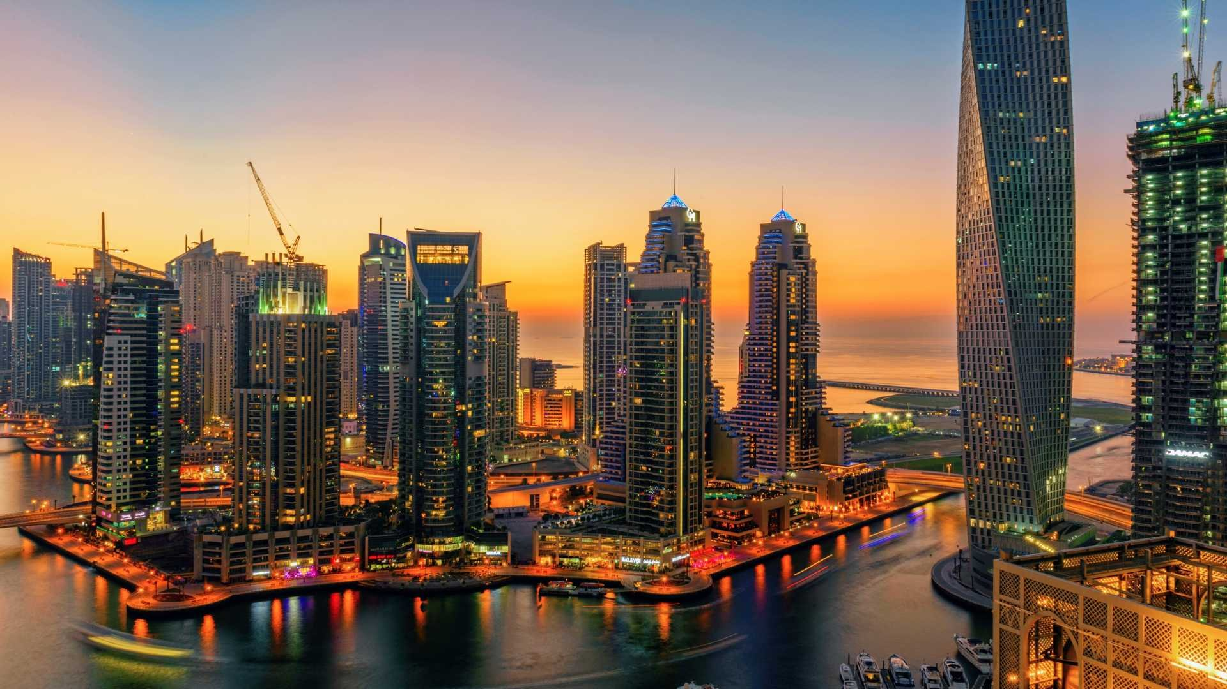
Meetings of ITU-T SG2RG-AFR, ITU-T SG2RG-ARB, and ITU-T SG3RG-ARB
Dubai, United Arab Emirates, 23-24 October 2019
Practical Information

Slide 2
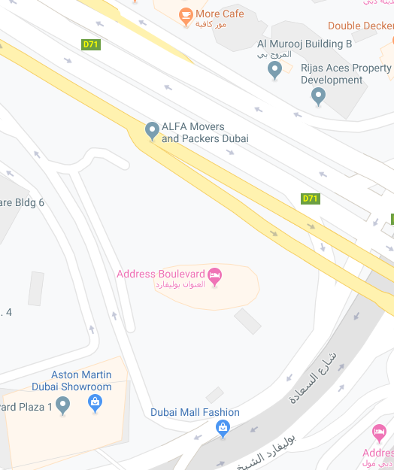
MEETING VENUE
Address Boulevard Hotel
Sheikh Mohammed Bin Rashed Boulevard
Downtown Dubai,
Dubai, United Arab Emirates
Transportation to/from Dubai International Airport:
The venue is approximately 15 km by car.
Estimated taxi fare:
Public taxis are readily available at all terminals at Dubai International Airport.
All taxis are metered. Fares must be charged according to the taxi meter, plus applicable surcharges.
More information can be found here: http://www.dubaiairports.ae/before-you-fly/to-from-the-airport/by-taxi

Slide 3
REGISTRATION
Please register online no later than 16 October 2019 at:
SG2RG-AFR: https://www.itu.int/net4/CRM/xreg/web/Registration.aspx?Event=C-00006407
SG2RG-ARB: https://www.itu.int/net4/CRM/xreg/web/registration.aspx?Event=C-00006409
SG3RG-ARB: https://www.itu.int/net4/CRM/xreg/web/Registration.aspx?Event=C-00006822
IMPORTANT: Please note that all badges must be collected personally for access control security. Badges are therefore strictly non-transferable.

Slide 4
VISA INFORMATION
Focal point: For any further information you may require or if you need a personal invitation letter or official document for your travel clearances, please contact either:
Name: Mr Saeed Al Warani E-mail: saeed.alwarani@tra.gov.ae
Name: Mr Khaled Alkalbani E-mail: khaled.alkalbani@tra.gov.ae
IMPORTANT: All invitation requests have to be sent to the above emails no later than 23 September 2019.

Slide 5
BANKS & CURRENCY
Currency: The name of the currency in the United Arab Emirates is the dirham (AED or Arab Emirate Dirham – also commonly abbreviated to Dhs or DH). Notes come in denominations of 5, 10, 20, 50, 100, 200, 500 and 1,000 dirhams. Online exchange rates are shown at: www.xe.com Banks: All banks operate from 8.00am to 1.00pm, Saturday through Wednesday and 8.00am to 12.00pm on Thursdays. Currency exchange houses are open until late in the evening.
Credit cards: All international credit and debit cards are widely accepted.

Slide 6
SERVICES AVAILABLE FOR PARTICIPANTS DURING MEETINGS
Communication center: Internet Access free of charge will be available at the event meeting room.
Security: For security reasons, all participants should be permanently using their badges during the meeting and in all social activities.

Slide 7
ADDITIONAL INFORMATION
Climate: Warm and dry. Temperatures range between 24 and 35 degrees Celsius
Clothing: Taking into consideration the temperature in Dubai for the month of October, casual business attire is recommended.
Time zone: The standard time in Dubai is 4 hours ahead of Greenwich Mean Time (GTM+4:00), and no seasonal time changes are made.
International access code to call in UAE: +971
Official Language: Arabic
Taxes: Restaurants and Hotels charge 10% service tax rate on the bill.
Tips: It is customary to leave 10-15% of the service amount in cafeterias and restaurants and give a tip.

Slide 8
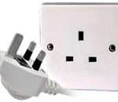
ADDITIONAL INFORMATION (2)
Electricity: In the United Arab Emirates, the power sockets are usually of type G. The standard voltage is 220/240 volts and the standard frequency is 50 Hz.
The electrical sockets used are:
Type G

Slide 9
ADDITIONAL INFORMATION (3)
About UAE: The United Arab Emirates is a constitutional federation of seven emirates; Abu Dhabi, Dubai, Sharjah, Ajman, Umm al- Qaiwain, Ras al-Khaimah and Fujairah. The federation was formally established on 2 December 1971.
The United Arab Emirates (UAE) occupies an area of 83,600 sq. km along the south-eastern tip of the Arabian Peninsula. Qatar lies to the west, Saudi Arabia to the south and west, and Oman to the north and east. The capital and the largest city of the federation, Abu Dhabi, is located in the emirate of the same name. Four-fifths of the UAE is desert, yet it is a country of contrasting landscapes, from awe-inspiring dunes to rich oases, precipitous Rocky Mountains to fertile plains. The United Arab Emirates, one of the world's fastest growing tourist destinations, has all the right ingredients for an unforgettable holiday, sun, sand, sea, sports, unbeatable shopping, top-class hotels and restaurants, an intriguing traditional culture, and a safe and welcoming environment.
Government | Federal Government
President | H.H Sheik Khalifa bin Zayed bin Sultan Al Nahyan
Prime Minister | H.H Sheik Mohammed Bin Rashid Al Maktoum
Area | 83,600 km2
Population | 8,264,000
Capital | Abu Dhabi
Official Language | Arabic
Country Code | +971 / .ae
Time Zone | GMT+4

Slide 10
CONTACTS
Focal persons:
Abdulla Bin Khadia
abdulla.binkhadia@tra.gov.ae; +971 4 777 4731
SG2 Secretariat: tsbsg2@itu.int
SG3 Secretariat: tsbsg3@itu.int
Here are some useful contacts to have at your fingertips while you are in UAE.
Police: 999
Ambulance: 998
Fire: 997
Telephone Directory Enquiries: 181

