Slide 1
Tutorial Conformance and Interoperability Key activities and main results of ITU-T SGs for the implementation of ITU C&I Programme
Denis Andreev, TSB

Slide 2
The present ICT Market state
Increasing number of ICT vendors (software plays the main role in ICT products)
Reducing the period of the development and implementation of new technologies and services (standardization remains behind)
Lack of unified standards - high probability of increasing barriers of trade
The increasing probability of incompatibility of equipment from different vendors

Slide 3
The approaches to solving issues
Standardization organization
Developing International standards and test suites to different technologies (e.g. NGN, BBA, SUN, IoT, M2M, SDN, etc.)
Network operators and ISP
Vendors
ICT’s
Perpetual motion
Developing requirements to network functionality, ICT services, QoS/NP/QoE, scalability, reliability, etc.
Developing equipment , protocols, codecs, functionality in accordance with International standards
Test labs
Testing an equipment, protocols, services, system-network solution for compliance with International standards and/or regional/operator’s additional requirements

Slide 4
ITU role
“Interoperability of international telecommunication networks was the main reason to create the International Telegraph Union in the year 1865, and that this remains one of the main goals in the ITU strategic plan”
WTSA-12 Resolution 76

Slide 5
The scope of conformance testing
Conformance testing is a procedure of product testing on compliance with requirements specified in applicable standards. The requirements should correspond to the common requirements for conformance testing with ISO/IEC 9646-1 and define some more criteria and characteristics in accordance with telecommunication features (ITU-T Handbook “Testing of Next Generation Networks”, 2011)
The main goal of conformance testing of ICT Products is to increase the probability that different implementations of the same standard will interoperate
ITU-T applied standards in the conformance testing area by defining testing procedures, scenarios and lists of tests for concrete telecommunication technology (ITU-T Handbook “Testing of Next Generation Networks”, 2011)
For instance, the conformance testing of signaling protocols is based on the checking the ability of system under test (SUT) to react to the commands which have been sent from the measurement equipment in a proper way. The basic methodological standards in the conformance testing of signaling protocols are the Rec. ITU-T X.290 and ETSI ETS 300 406 (PICS, PIXIT, ATS proforma)

Slide 6
The scope of interoperability testing
Interoperability is the ability of two or more systems or applications to exchange information and to mutually use the information that has been exchanged (Rec. ITU-T Y.101)

Slide 7
The scope of other type of testing is defined by ITU-T
Rec. ITU-T Q.3900, 2006
Handbook “Testing of Next Generation Networks”, 2011
testing of equipment and network functionality on conformance with functional NGN model, which is standardized by ITU-T
testing of QoS and QoE
services and service parameters testing, including Network Performance parameters (NP)
service interoperability testing, including roaming and nomadic features testing
benchmarking testing

Slide 8
Background of C&I activities in ITU

Slide 9
ITU business plan
Conformity and Interoperability Programme implementation in ITU
ITU PP-10 (Res.177). Tender was issued after Council-11 (INF/14)
The main reasons of implementation of ITU C&I Programme were:
towards knowledge and capacity enhancement in C&I activity worldwide
better usages of ICT equipment in developing countries
creating higher corporate incomes which enable more investment, in turn generating better communications
beginning of a virtuous development circle, in which the returns on members’ investment are found in every facet of ITU’s mandate

Slide 10
The Business Plan for the ITU C&I Programme in 4 “Pillars”
The Standardization Sector side
Pillar 1: Conformity Assessment
Pillar 2: Interoperability Events
The Development Sector side
Pillar 3: Capacity building
Pillar 4: Establishment of test centres and C&I programmes in developing countries

Slide 11
Authority for Action: ITU’s highest decision making bodies
Resolution 76: ITU World Telecommunication Standardization Assembly (WTSA-12)
Resolution 47: ITU World Telecommunication Development Conference (WTDC-10)
Resolution 177: ITU Plenipotentiary Conference
(PP-10)
Resolution 62: Radiocommunication Assembly 2012
Council Decisions: (2009, 2010, 2011, 2012, 2013)

Slide 12
Four routes to populate conformity DB
ISO/IEC Assessment Procedures
Recognized SDOs
Self-assessment
Route 1
Route 2
Route 3
Route 4
Conformity Assessment
& Certification
Tests performed in
a lab agreed by an Accredited
Certification Body
(ISO/IEC 17065)
(Rec. ITU-T X.290)
Tests performed in
a lab selected by
ITU-T A.5 agreed SDO/Forum/MoUs
(Rec. ITU-T X.290)
ITU Members Only
Tests performed in
1st party lab
Tests performed by an accredited lab
(ISO/IEC 17025)
(Rec. ITU-T X.290)
Recommendation(s) compliant test results
Self-Declaration of Compliance issued by the Supplier
Conformity Certificate issued by the Certification Body
Recommendation(s) compliant test results
ITU On-line Form
ITU C&I services
ITU Conformity
Database
12

Slide 13
WTSA-12/Council-12
WTSA-12 designated the ITU-T Study Group 11 as a lead group on test specifications, conformance and interoperability testing which coordinates ITU-T activities related to the ITU C&I programme across all SGs and review the recommendations in the Conformance and Interoperability Business Plan for the long term implementation of the C&I programme
Council-12 decided to agree the Action plan on the implementation of the ITU C&I Programme, including following tasks:
ITU-T to run a pilot of the conformity assessment programme for key technologies for which there is a market demand for such a programme
ITU-T study groups to identify further technologies for which there is a market demand for a conformity assessment programme and to identify whether test specifications are available and if not, to explore the provision of test specifications”
ITU-T to run a pilot of the conformity assessment programme for key technologies for which there is a market demand for such a programme

Slide 14
Action Plan (Council-13)
Pillar 1 – Conformity Assessment (1/2)
ITU Council decided to postpone route 4 (self-declaration SDoC)
Result: WP4/11 is going to discuss the approach of SDoC at the next meeting (November 2013)
ITU-T study Groups to identify further technologies for which there is a market demand for a C&I programme
Result: ITU-T SG11 prepared a living list of key technologies suitable for conformity and interoperability testing and requested all SGs to contribute to it
ITU-T to run a pilot of the C&I programme for key technologies
Result: ITU-T SG11 requested (March 2013) all ITU-T SGs to contribute to a living list of possible pilot projects of conformity assessment against ITU-T Recommendations

Slide 15
Action Plan (Council-13)
Pillar 1 – Conformity Assessment (2/2)
ITU Secretariat invite labs/forums/consortia/SDOs to join the C&I Programme
Result: ITU secretariat participated in meetings of the most relevant standardization bodies in the field of the conformity assessment (ISO, IECEE, DCMAS, ILAC, IAF, etc.). SG11 (March 2013) encouraged the TSB Director to explore possibilities to cooperate with IECEE
TSB to produce a report on measures against counterfeiting
Result: SG11 discussed a draft report on counterfeit equipment, suggested started new work item on Counterfeiting and organizing a workshop on best practice to combat counterfeiting

Slide 16
Action Plan (Council-13)
Pillar 2 – Interoperability
ITU Secretariat to consult study groups towards identifying and suggesting topics for future events
Result: Several interop events were organized for NGN, IPTV. In discussion are: G.9903, P.1100, P.1110, e-health (in partnership with Continua)
ITU-T Study Groups to develop system roadmaps, identify and define the interfaces across which interoperability is needed
ITU-T Study Groups should identify or develop use cases, application profiles and test plans to use for interoperability testing for Recommendations

Slide 17
Action Plan (Council-13)
Pillar 3 – Capacity building
BDT, in collaboration with TSB, to continue to offer C&I training courses for testing key technologies
BDT in cooperation with TSB to train technical staff and policy makers
Result: several training events which are devoted to different testing technologies and general approaches to set up of test labs in the regions were conducted during 2012-2013 (Tunis, Brasilia).
The ITU Secretariat continues to offer C&I training courses, workshops and forums possibly back to back with events of the regional organizations

Slide 18
Action Plan (Council-13)
Pillar 4 – Establishment of Test centres
The ITU Secretariat to continue to promote partnerships with external organizations for assisting countries to establish an appropriate C&I programme
Result: signed MoUs with TL (CERT, APqD, Sintesio, TiLab, ZNIIS), AB (IAF, ILAC)
Establishment of an appropriate C&I Programme in developing countries
Result: developed guidelines on building testing labs for C&I of equipment and systems in developing countries, drafted a feasibility study for a conformance testing center
Establishment, when possible, of MRAs (Mutual Recognition Agreements) to be discussed at regional and sub-regional levels
Result: The ITU Secretariat is providing a set of Guidelines for the development, implementation and management of MRAs

Slide 19
ITU-T SGs activities related to C&I

Slide 20
SG11 Action plan on C&I
to collect input from other ITU-T SGs about key technologies (ITU-T Recommendations) to be tested for conformance and/or interoperability
to collect the proposals from other ITU-T SGs concerning the status on possible pilot projects of conformance testing against Recommendations ITU-T
to update the reference table of ITU-T Recommendations and relevant parameters to be tested for conformance/interoperability and references to the applicable test suites (ITU/other SDOs) based on information provided by the SGs especially for key ITU-T Recommendations

Slide 21
SG11 Action plan
Principles of SG11 cooperation among other SGs
SGs
Key ITU-T Recs. suitable for C&I
SG11
WP4/11
Pilot projects which are
based on key ITU-T Recs. suitable for C&I
Reference table of all ITU-T Recs. and relevant test suites
SGs

Slide 22
The outcomes of ITU-T meetings related to C&I activities, 2013
SG11 (February 2013) – agreed its Action plan and forwarded requests to all SGs to update the relevant living lists
JCA-CIT (April 2013) – agreed to extend the list of conformance testing (conformance of ICT’s equipment, conformance of Telecommunication services, benchmarking, QoS/QoE/NP), encouraged relevant SGs to develop the framework and methodology of Internet speed quality measurement usable by end-users
TSAG-13 (June 2013) – agreed the revised ToR of JCA-CIT
Council-13 (June 2013) – agreed status report and action plan on C&I

Slide 23
Next ITU-T meetings
SG11 (November 2013) – is going to update the living lists, to present new test suites, including the methodology of Internet speed measurement and to discuss the criteria for Route 4 (SDoC), including relevant recognition procedure of TL’s competence for testing against ITU-T Recs.
JCA-CIT (November 2013) – is going to discuss a common terminology and methodology for C&I testing and proposals for organizing the pilot projects

Slide 24
The list of key Technologies for C&I
Network and equipment performance (benchmarking) – Req: Draft Q.39zz-1; TS:Q.3930, Q.3931.1-4, Q.3932.1-4,
QoS/QOE/NP – Req: Q.3925, Y.1541, Y.1542, Y.1543, draft Q.MSPQuality, Q.NP-req; TS:Q.QMS, Q.3930, Q.3931.1, Q.3931.2
NGN Functionality – Req: Y.2201, Y.2012; TS: Q.3909; TS: Q.3900; Q.3901
Functions of broadband network as a part of NGN – Req: Y.2012; TS: Q.3906.1
IMS architecture, signaling protocols, interfaces – Req: Y.2012; TS: Q.3904
IMS basic call – Protocol conformance testing – Req: Draft Q.39xx-1; TS: Q.3904
IMS supplementary services. Protocol specifications – Req: -; TS: Q.3943.1/2/4, Q.3942.1
IMS interconnection – Re: Q.3401; TS: -
Interoperability testing – Req: - ; TS: Q.3940, Q.3941.1-4
NGN monitoring system – Req: Q.3902, Q.3910, Q.3911, Q.3912; TS: -
Interworking of signaling protocols of NGN – Req: Q.1912.5, Q.3401, Q.3402; TS: Q.1912.5 B-F
RFID – Req: - ; TS: Q.3950
Internet speed access – Req: - ; TS: Q.InSpMs
Internet Access as perceived by user – Req: G.1000; TS: -

Slide 25
The pilot projects of conformance testing against ITU-T Recommendations
Title of planned/on going Pilot Project under C&I Programme | ITU-T Recs. | SGs focal point | Interested companies | Motivations | Short-term strategy
The title of planned or on-going Pilot Project which SG is going to start and maintain |  | The contact of responsible person/expert (rapporteur, editor, etc) | The companies are going or have already involved to the project | The reason and specify expecting results under ITU C&I Programme | The short-term strategy (one year) for achieving the goals of the Pilot Project

Slide 26
Latest outputs of JCA-CIT
JCA-CIT decided to extend the list of testing against ITU-T Recs. to:
ICT's equipment (signalling protocols, interfaces, codecs, etc.)
Benefit: the possibility to reduce the test attempts (tested once - accepted everywhere)
Telecommunication Services
Benefit: increasing type of interconnection among operators network (interconnection on the service level), to facilitate the distribution of nomadic services provided on the fixed and mobile networks
The performance of system/network/equipment (benchmarking)
Benefit: to reduce the operator's risk of the purchasing equipment with unexpected performance
QoS/QoE/NP
Benefit: to increase the level of customer loyalty for services provided by operators
Report of JCA-CIT (25 April 2013)

Slide 27
The possible data structure of C&I Product Database
Conformance
ITU ICT product/service code | Vendor | ICT product title | Software/patches | Type of ICT product | ITU-T Recs. (Req./TS) | Parameters (suppl.) | Value (suppl.)

Slide 28
The possible data structure of C&I Product Database
Interoperability
Side A
ITU ICT product/service code | Vendor 1 | ICT product title | Software/patches | Type of ICT product | Parameters (suppl.) | Value (suppl.)
Side B
Testing based on ITU-T Recs. (Req./TS)
ITU ICT product/service code | Vendor 2 | ICT product title | Software/patches | Type of ICT product | Parameters (suppl.) | Value (suppl.)

Slide 29
The application
of ITU ICT Product Databases
Operators may use it as a short list of selected equipment
Type of Equipment Vendor 1 | ITU ICT Product code Vendor 1 | Type of equipment Vendor 2 | ITU ICT Product code Vendor 2
MGC | ALTI-5698 | MG | ZHM-1534
ONU | SADR-4678 | OLT | CIST-4759
… | … | … | …
Certifiers may use it as a testing results against international standards
ITU ICT Product code | Type of ICT Product | ITU-T Recs.
ALTI | MGC | ITU-T Rec. Y.2012, ITU-T Rec. Q.3901

Slide 30
Conclusion
Conformance testing still remains one of the most important task for ICT market and in case of ITU means the compliance with ITU-T Recommendations
Interoperability testing gives ICT customers more credibility to ICT products
ITU Databases as a tool to facilitate identification of ICT products, Test Labs and NCBs working on ITU-T Recommendations
Following the definition, a conformance testing is an ability to test product against any standards, it is not limited by equipment and can cover different standardized issues (e.g. ICT services, QoS, benchmarking, etc.)
ITU-T has already standardized several technologies with the relevant test suites which market requested. Testing Laboratory can use it for testing and distributing the test results through the ITU C&I Programme (list of key ITU-T Recommendations/technologies is already available on the ITU web site)
The ICT customers can select the equipment, which might be integrated to their existing networks, based on the Interoperability testing results which have been achieved by ITU C&I Programme

Slide 31
Denis Andreev
JCA-CIT Secretariat
TSB C&I Programme coordinator
Fix. Tel: +41227305780
Mob.Tel: +41792494833
E-mail: denis.andreev@itu.int
TSB contacts
Conformance: conformity@itu.int
Interoperability: interop@itu.int
JCA-CIT: tsbjcacit@itu.int

Slide 32
Background slides

Slide 33
ITU web sources related to C&I Programme
ITU C&I resources
C&I Portal - http://www.itu.int/en/ITU-T/C-I/Pages/default.aspx
JCA-CIT - http://www.itu.int/en/ITU-T/jca/cit/Pages/default.aspx
SG11 (lead group on testing) - http://www.itu.int/en/ITU-T/studygroups/2013-2016/11/Pages/default.aspx

Slide 34
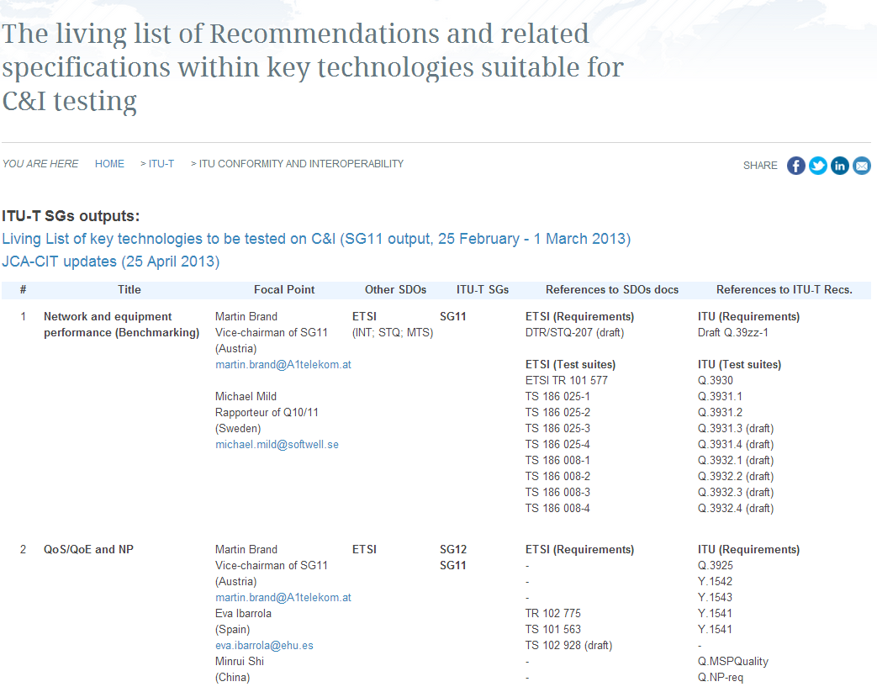
Living lists on the ITU-T C&I Portal (1/3)
http://www.itu.int/en/ITU-T/C-I/Pages/CI-living-list-table.aspx

Slide 35
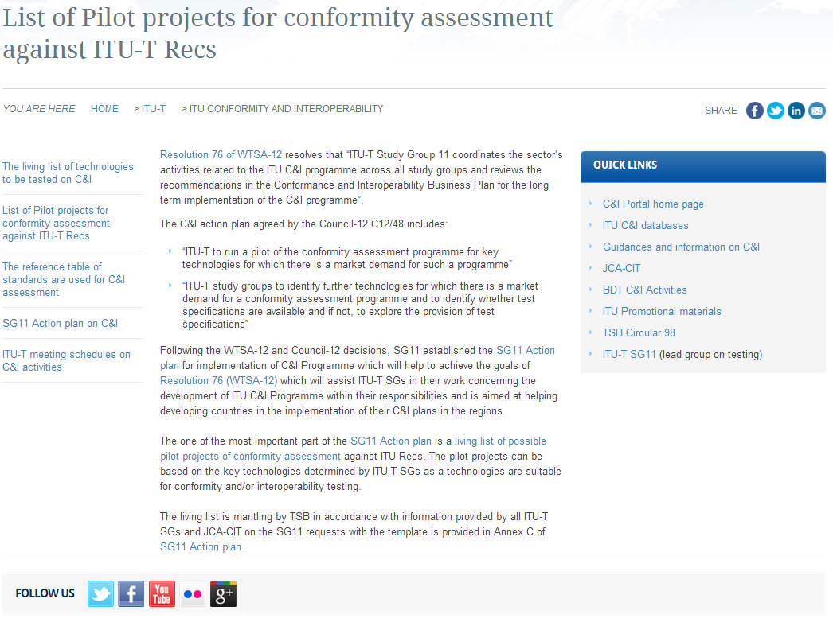
Living lists on the ITU-T C&I Portal (2/3)
http://www.itu.int/en/ITU-T/C-I/Pages/CI-projects.aspx

Slide 36
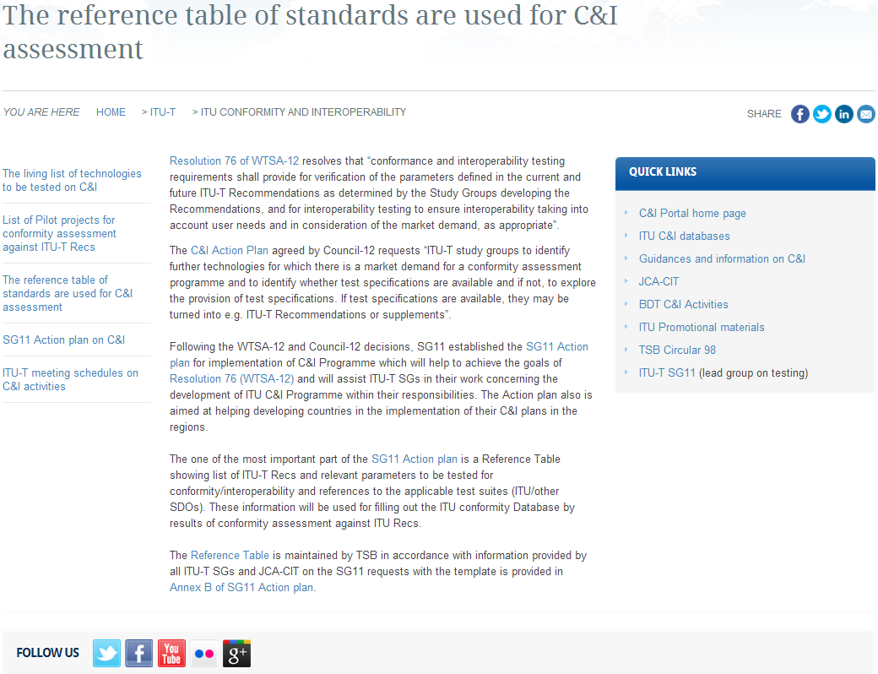
Living lists on the ITU-T C&I Portal (3/3)
http://www.itu.int/en/ITU-T/C-I/Pages/CI-reference.aspx

