Slide 1
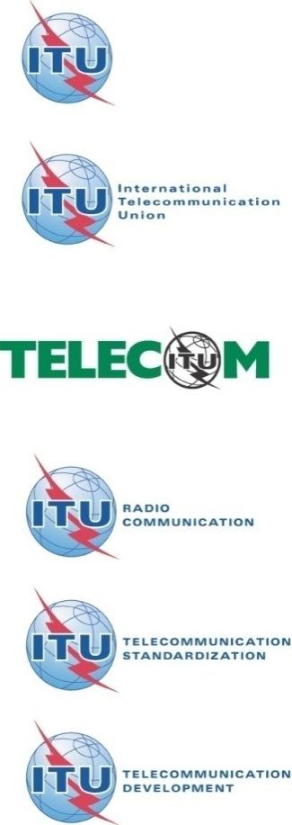
Tutorials of Q.8: cloud security related works in SG17
Liang Wei
Rapporteur of Q8/17

Slide 2
Contents
Cloud security related questions
Ongoing work items
Next study period(2017-2020)
Cloud security Recommendation structure
Notes:
The contents have four parts,
First one is ……
The second part is cloud security Recommendation structure
The third part is standardization activities in SG17
Then, the consideration on cloud computing security in SG17 for next study period

Slide 3
SG17 mandate established by World Telecommunication Standardization Assembly (WTSA-12)
WTSA-12 decided the following for Study Group 17:
Title: Security
  Responsible for building confidence and security in the use of information and communication technologies (ICTs). This includes studies relating to cybersecurity, security management, countering spam and identity management. It also includes security architecture and framework, protection of personally identifiable information, and security of applications and services for the Internet of things, smart grid, smartphone, IPTV, web services, social network, cloud computing, mobile financial system and telebiometrics. Also responsible for the application of open system communications including directory and object identifiers, and for technical languages, the method for their usage and other issues related to the software aspects of telecommunication systems, and for conformance testing to improve quality of Recommendations.
Lead Study Group for:
  Security
  Identity management
  Languages and description techniques
Responsible for specific E, F, X and Z series Recommendations
Responsible for 12 Questions

Slide 4
SG17 structure
  Q8 is the main question responsible for interoperability security and service portability in cloud computing.
WP1：Fundamental security | Q1：Telecommunication/ICT security coordination
 | Q2：Security architecture and framework
 | Q3：Telecommunication information security management
WP2：Network and information security | Q4：Cybersecurity
 | Q5：Countering spam by technical means
WP3：Identity management and cloud computing security | Q8：Cloud computing security
 | Q10：Identity management architecture and mechanisms
WP4：Application security | Q6：Security aspects of ubiquitous telecommunication services
 | Q7：Secure application services
 | Q9：Telebiometrics
WP5：Formal languages | Q11：Generic technologies to support secure applications
 | Q12：Formal languages for telecommunication software and testing

Slide 5
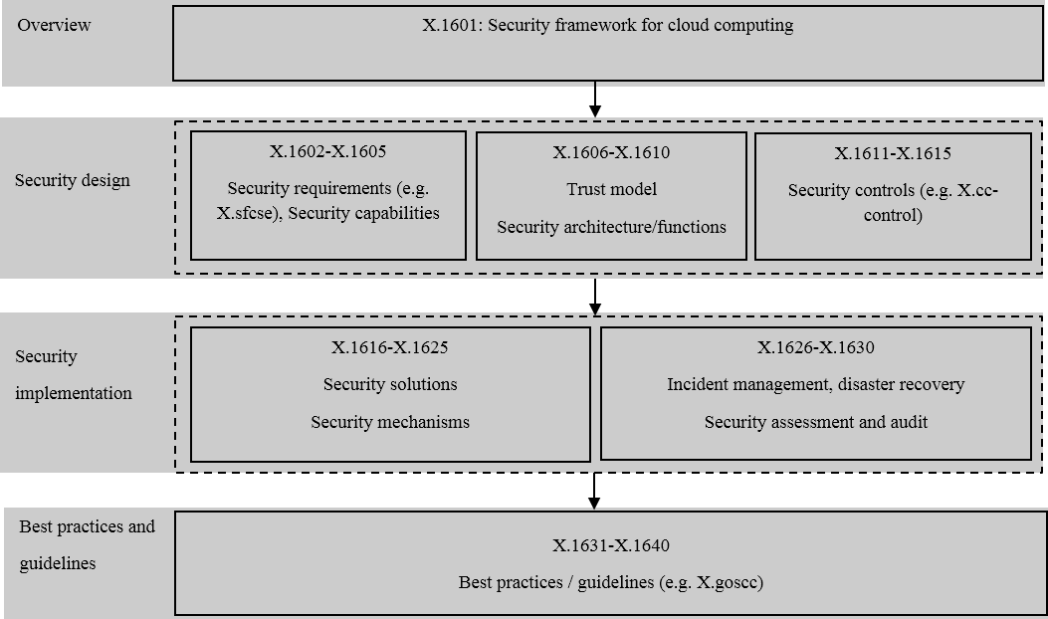
SG17 cloud security Recommendation structure
Notes:
we have a draft structure which is still under development.
It has four layers, overview, security designs, security implementations, best practices and guidelines.
For the security design layer, it may includes security requirements, security capabilities, trust model, security architecture, security functions, security controls and so on.
For the security implementation layer, it may includes security solutions, security mechanisms, incident management, disaster recovery, security assessment and audit.

Slide 6
SG17 cloud security work items
Published in 2014.1, revised in 2015.4
X.1601: Security Framework for Cloud Computing
X.1602: Security requirements for software as a service application environments
X.1642: Guidelines for the operational security of cloud computing
X.CSCdataSec(X.1641): Guidelines for Cloud Service Customer Data Security
X.1631: Information technology – Security techniques – Code of practice for information security controls for cloud computing services based on ISO/IEC 27002
X.dsms:Data security requirements for the monitoring service of cloud computing
X.SRIaaS: Security Requirements of Public Infrastructure as a Service (IaaS) in Cloud Computing
Common text with ISO/IEC
Published in 2016.4
Published in 2016.4
Determined in 2016.4
Established in 2015.9
Established in 2016.4

Slide 7
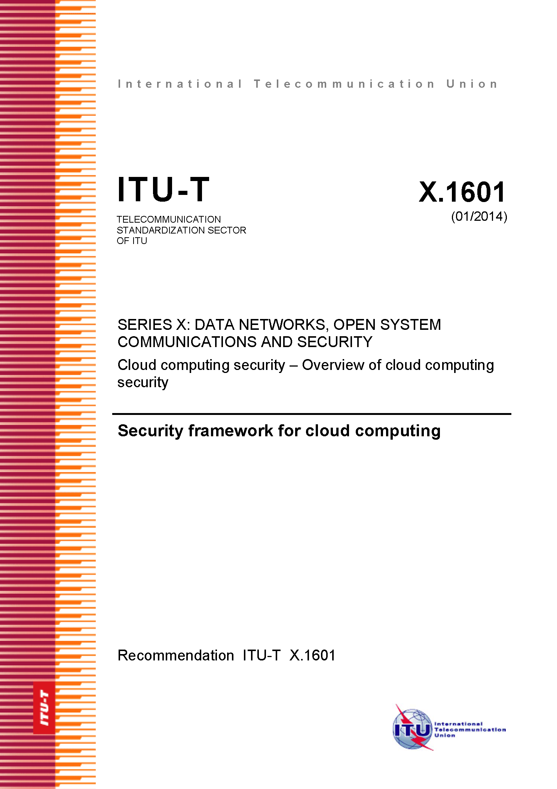
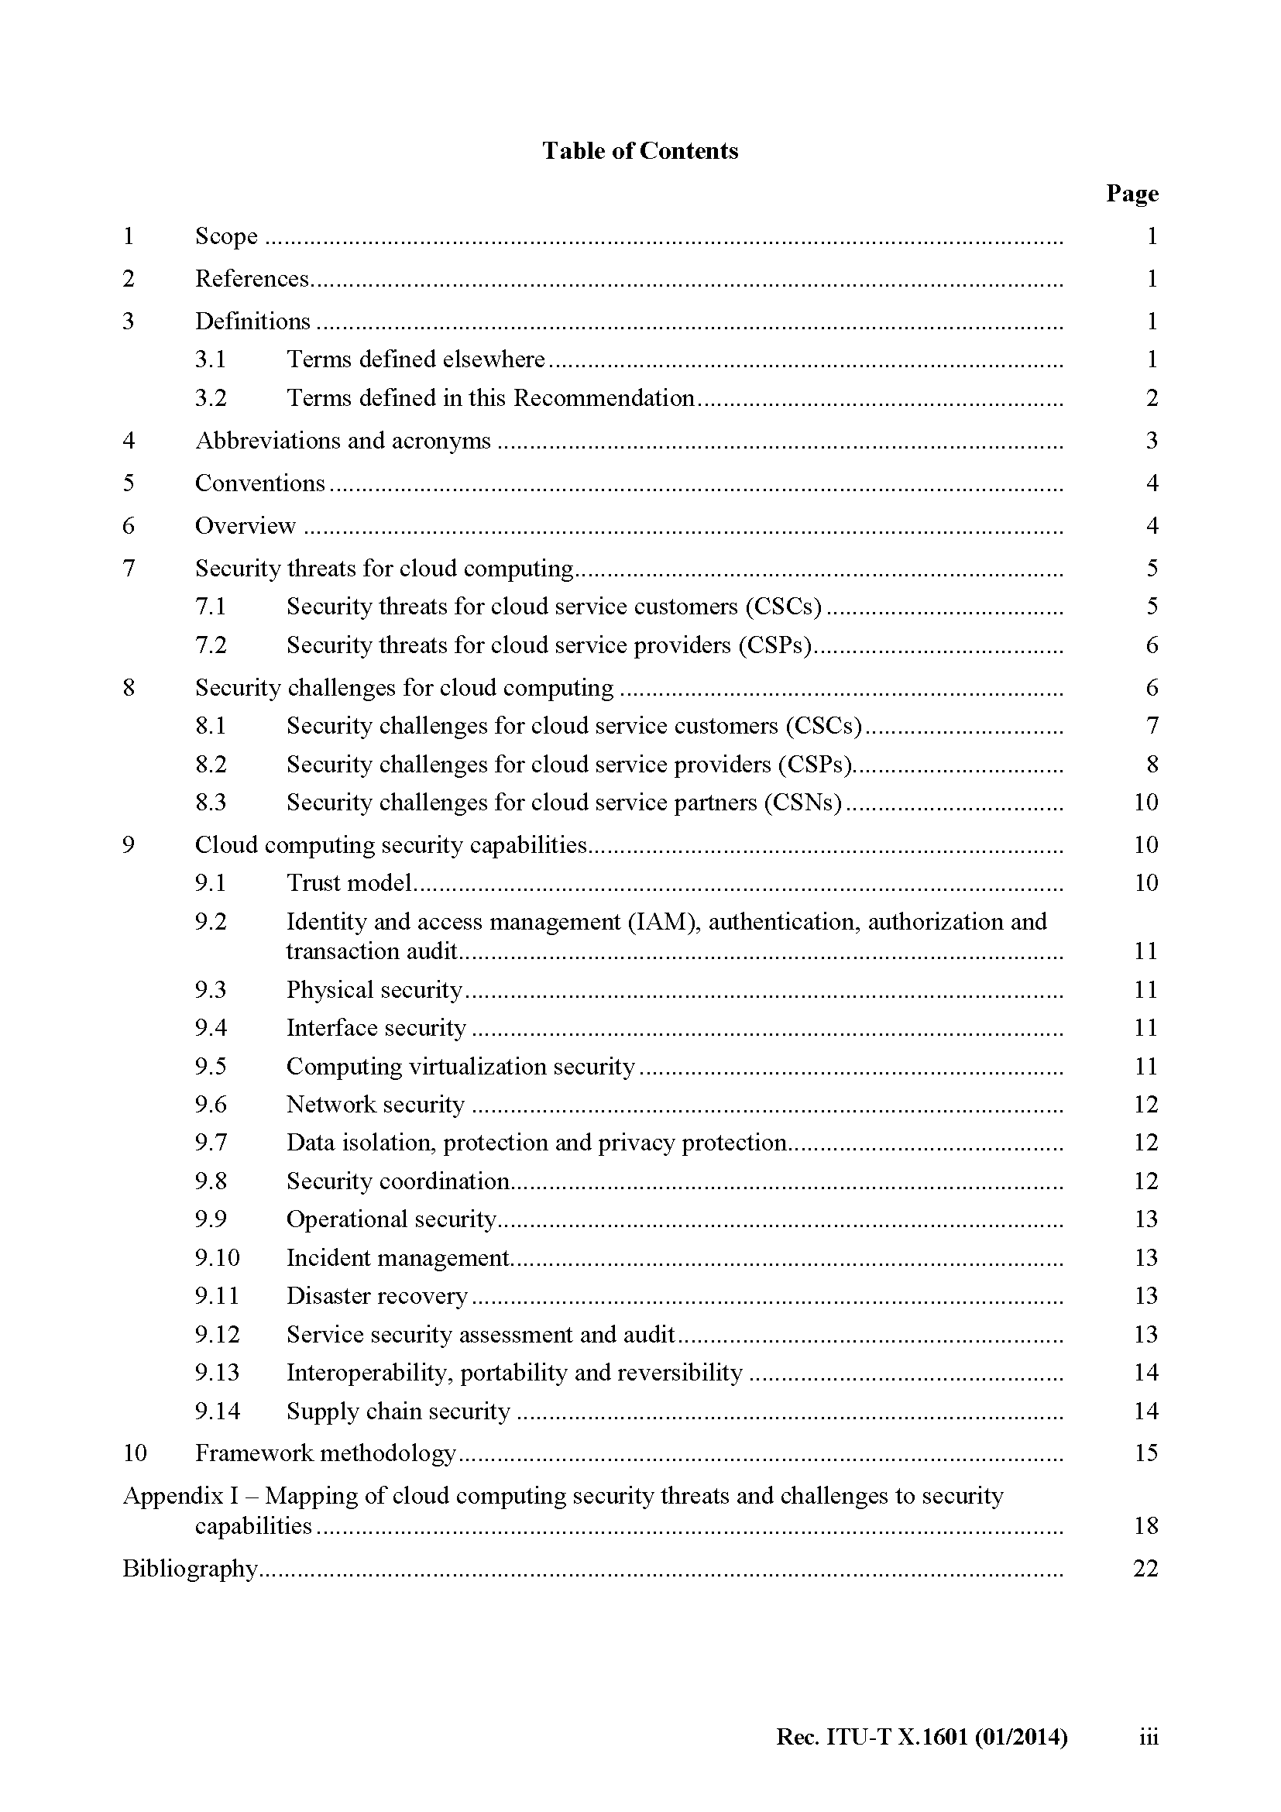
X.1601 Security framework for cloud computing
Notes:
These are the cover and table of contents of X.1601.

Slide 8
X.1601 Security framework for cloud computing
7. Security threats for cloud computing
8. Security challenges for cloud computing
9. Cloud computing security capabilities
10. Framework methodology
Notes:
The main body of this Recommendation has four parts.
Clause 7 security threats for cloud computing
Clause 8 Security challenges for cloud computing
Clause 9 cloud computing security capabilities
Clause 0 Framework methodology
Security threats and security challenges are separated base on US delegates suggestions.
Threats refers to Potential cause of an unwanted incident, which may result in harm to a system or organisation.
And security challenges refers to a security “difficulty” other than a direct security threat arising from the nature and operating environment of cloud services, including “indirect” threats.

Slide 9
X.1601——7. Security threats for cloud computing
7.1 Security threats for cloud service customers (CSCs)
7.1.1 Data loss and leakage
7.2.1 Unauthorized administration access
7.1.2 Insecure service access
7.1.3 Insider threats
7.2.2 Insider threats
7.2 Security threats for cloud service providers (CSPs)
Notes:
Security threats are stated from the views of cloud service customers and cloud service providers.

Slide 10
X.1601——8. Security challenges for cloud computing
8.1 Security challenges for cloud service customers (CSCs)
8.1.1 Ambiguity in responsibility
8.1.2 Loss of trust
8.1.3 Loss of governance
8.1.4 Loss of privacy
8.1.5 Service unavailability
8.1.6 Cloud service provider lock-in
8.1.7 Misappropriation of intellectual property
8.1.8 Loss of software integrity
8.2 Security challenges for cloud service providers (CSPs)
8.2.1 Ambiguity in responsibility
8.2.2 Shared environment
8.2.3 Inconsistency and conflict of protection mechanisms
8.2.4 Jurisdictional conflict
8.2.5 Evolutionary risks
8.2.6 Bad migration and integration
8.2.7 Business discontinuity
8.2.8 Cloud service partner lock-in
8.2.9 Supply chain vulnerability
8.2.10 Software dependencies
8.3 Security challenges for cloud service partners (CSNs)
8.3.1 Ambiguity in responsibility
8.3.2 Misappropriation of intellectual property
8.3.3 Loss of software integrity
Notes:
Security challenges for cloud computing are stated from the views of CSC, CSP and CSN

Slide 11
X.1601 ——9.Cloud computing security capabilities
9.1 Trust model
9.2 Identity and access management (IAM), authentication, authorization, and transaction audit
9.3 Physical security
9.4 Interface security
9.5 Computing virtualization security
9.6 Network security
9.7 Data isolation, protection and privacy protection
9.8 Security coordination
9.9 Operational security
9.10 Incident management
9.11 Disaster recovery
9.12 Service security assessment and audit
9.13 Interoperability, portability, and reversibility
9.14 Supply chain security
Notes:
Based on the analyse of security threats and security challenges. A series of security capabilities are proposed to mitigate the security risks caused by these identified threats and challenges.
For these 14 capabilities, the first one is

Slide 12
X.1601 ——10. Framework methodology
Step 1: Use clauses 7 and 8 to identify security threats and security implications of the challenges in the cloud computing service under study.
Step 2: Use clause 9 to identify the needed high level security capabilities based on identified threats and challenges which could mitigate security threats and address security challenges.
Step 3: Derive security controls, policies and procedures which could provide needed security abilities based on identified security capabilities.
Notes:
For clause 10 Framework methodology, it’s about the thres steps from security threats and challenges to security capabilities, and then to security controls, policies and procedures.

Slide 13
X.1631
Title:Information technology – Security techniques – Code of practice for information security controls for cloud computing services based on ISO/IEC 27002
Scope
  This International Standard provides guidelines supporting the implementation of Information security controls for cloud service providers and cloud service customers of cloud computing services. Selection of appropriate controls and the application of the implementation guidance provided will depend on a risk assessment as well as any legal, contractual, or regulatory requirements. ISO/IEC 27005 provides information security risk management guidance, including advice on risk assessment, risk treatment, risk acceptance, risk communication, risk monitoring and risk review.
Consent:2015-04
Notes:
For X.cc-control, it also name 27017, the title is “Code of practice for information security controls for cloud computing services based on ISO/IEC 27002”
It has the same skeleton as 27002. Based on 27002, it adds cloud specific security controls. It’s mainly to provide guidelines supporting the implementation of information security controls for cloud service providers and cloud service customers of cloud computing services.

Slide 14
X.1602: Security requirements for software as a service application environments
Title： Security requirements for software as a service application environments
Scope
  Recommendation ITU-T X.sfcse analyses the maturity levels of software as a service (SaaS) application and proposes security requirements to provide a consistent and secure service execution environment for SaaS applications. These proposed requirements originate from cloud service providers (CSP) and cloud service partners (CSN) as they need a SaaS application environment to meet their demands on security. The requirements are general and independent of any service or scenario specific model (e.g. web services, or representational state transfer (REST)), assumptions or solutions.

Slide 15
X.1602: Security requirements for software as a service application environments
6. Overview
8. Security requirements for SaaS application environment
7. Maturity levels of SaaS application

Slide 16
X.1602: Security requirements for software as a service application environments
7 Maturity levels of SaaS application
7.1 Level 1: Custom SaaS Application
8.1 Common security requirements
8 Security requirements for SaaS application environment
7.2 Level 2: Configurable SaaS application
7.3 Level 3: Multi-tenant SaaS application
7.4 Level 4: Scalable SaaS application
8.2 Security requirements of CSP
8.3 Security requirements of CSN

Slide 17
X.1642: Guidelines for the operational security of cloud computing
Title：Guidelines for the operational security of cloud computing
Scope
  Recommendation ITU-T X.goscc provides generic operational security guidelines for cloud computing from the perspective of cloud service providers (CSPs). It analyses the security requirements and metrics for the operation of cloud computing. A set of security measures and detailed security activities for the daily operation and maintenance are provided to help CSPs mitigate security risks and address security challenges for the operation of cloud computing.
  Determination:2015-09

Slide 18
X.1642: Guidelines for the operational security of cloud computing
6. Overview
8. Guidelines of daily operational security
7. Requirements of the security clause of the service level agreement

Slide 19
X.1642: Guidelines for the operational security of cloud computing
7 Requirements of the security clause of the service level agreement
7.1 Security responsibility between CSPs and CSCs
8.1 Identity management and access control
8 Guidelines of daily operational security
8.2 Data encryption and key management
7.2.2 Requirements of the security clause of SLA
7.2.1 General requirements
7.2 Requirements of the security SLA
8.3 System security monitoring
8.5 Security configuration management
8.6 Securing event management
8.7 Patch upgrade
8.8 Securing configuration management
8.4 Disaster recovery
8.9 Emergency response plans
8.10 Backup
8.11 Internal security audit
Notes:
7 Requirements of the security SLA
7.1 Security responsibility between CSP and CSC
7.2 Requirements of the security SLA
7.2.1 General requirements
7.2.2 Requirements and index of the security SLA
7.2.2.1 Business continuity and disaster recovery
7.2.2.2 Data security and privacy protection
7.2.2.3 Security monitoring and emergency response
7.2.2.4 Security measures
7.2.2.5 Security audit
7.2.2.6 SLA monitoring
7.2.2.7 Security certification
7.2.2.8 Security activity documentation
8 Guidelines of daily operational security
8.1 Identity management and access control
8.1.1 Identity management
8.1.2 Access control management
8.2 Flow of security event processing
8.3 Patch upgrade
8.3.1 Responsibilities
8.3.2 Process of upgrading security patch
8.4 System security monitoring
8.5 Security configuration policy management
8.6 Securing configuration management
8.7 Emergency response plans
8.7.1 Development phase
8.7.2 Testing and Implementation phase
8.7.3 Maintenance phase
8.8 Backup

Slide 20
X.CSCdataSec(X.1641): Guidelines for Cloud Service Customer Data Security
Title:Guidelines for Cloud Service Customer Data Security
Scope
  This Recommendation will provide guidelines for cloud service customer data security in cloud computing, for those cases where the CSP is responsible for ensuring that the data is handled with proper security. This is not always the case, since for some cloud services the security of the data will be the responsibility of the cloud service customer themselves. In other cases, the responsibility may be mixed.
  This Recommendation identifies security controls for cloud service customer data that can be used in different stages of the full data lifecycle. These security controls may differ when the security level of the cloud service customer data changes. Therefore, the Recommendation provides guidelines on when each control should be used for best security practice.
Determination: 2016-04

Slide 21
X.CSCdataSec(X.1641): Guidelines for Cloud Service Customer Data Security
6. Overview
8. Guidelines for using the Security Controls
7. Security Controls

Slide 22
X.CSCdataSec(X.1641): Guidelines for Cloud Service Customer Data Security
6 Overview
6.1 The scope of the data in this recommendation
7.1 Security Controls in Create Stage
7 Requirements of the security clause of the service level agreement
6.2 Data security threats for cloud service customers (CSCs)
6.3 The Existing international standard about data security
6.4 Data security lifecycle
7.2 Security Controls in Storage Stage
7.3 Security Controls in Use Stage
7.4 Security Controls in Share Stage
7.5 Security Controls in Archive Stage
7.6 Security Controls in Destroy Stage

Slide 23
X.dsms:Data security requirements for the monitoring service of cloud computing
Title: Data Security requirements for the monitoring service of cloud computing
Scope
  The Recommendation describes the data security requirements for the monitoring service of cloud computing. The Recommendation analyses data security threats and challenges of the monitoring service in the cloud computing environment, and describes data security requirements of the monitoring service including the data scope, data lifecycle, data acquisition and data storage. This work item can be used by CSPs who provide monitoring services to CSCs.
Planned determine: 2017-Q4

Slide 24
X.SRIaaS: Security Requirements of Public Infrastructure as a Service (IaaS) in Cloud Computing
Title: Security Requirements of Public Infrastructure as a Service (IaaS) in Cloud Computing
Scope
  This recommendation analyzes security challenges faced by infrastructure as a service (IaaS) environment, and provides security requirements of public IaaS in cloud computing. This Recommendation is applicable for public IaaS providers.
Planned determine: 2018-Q4

Slide 25
Consideration for next study period(2017-2020)
Develop Recommendations for main actors like service providers, service users and services partners, and other key industry stakeholders to advance cloud computing security.
Develop Recommendations for security architecture and security functionalities organization in line with the reference architecture
Develop Recommendations for assurance mechanisms, audit technologies, and associated risks assessment to establish trust among different actors?
How security as a service should be developed to protect telecommunication/ICT systems
Also be considered: develop Recommendations for security solutions, best practices or guidelines to secure big data in cloud computing.

Slide 26
Thanks

