Slide 1
ITU-T SG17 Q.7
Secure Application Services
An overview for newcomers
Jae hoon Nah, Lijun Liu
Q7/17 Rapporteur, Associate rapporteur
31 August 2016

Slide 2
Contents
Question text for Q7/17
  Motivation, Question, Tasks, and Relationships
Recommendations and Supplements related to Q7/17
Draft Recommendations on developing under Q7/17
Future Plan for Next Study Period (2017-2020)

Slide 3
Question text for 7/17 – Motivation
The telecommunications industry has been experiencing an exponential growth in TTP (Trusted Third Party) services. Security of telecommunication-based application service including social network service, P2P and TTP service is crucial for the further development of the industry.
Secure application protocols play a very critical role for providing secure application services. Standardization of the best comprehensive security solutions is vital for the industry and network operators that operate in a multi-vendor international environment. It is also required to study and develop other types of secure application services such as time stamping services, secure notary services, secure digital financial (e-payment, e-banking, e-commerce) services, data analytics services and malware detection/response services including analyzing the behaviour of malware in controlled environments; use of security assertions as a replacement to the use of certificates in PKI based protocols and PKI application services, etc. Security technologies such as security assertion and access control assertion become very critical in communication networks.

Slide 4
Question text for 7/17 – Motivation (cont’)
Recommendations ITU‑T X.1141, X.1142, X.1143, X.1144 provide a set of Recommendations on security tokens for authentication/authorization and security architectures for message of network services.
Recommendations ITU‑T X.1151, X.1152, X.1153, X.1154, X.1155, X.1156, X.1157, X.1158, X.1159 specify guidelines on secure password-based authentication with key exchange and various Trusted Third Party (TTP) services.
Recommendations ITU‑T X.1161, X.1162, X.1163, X.1164 specify a comprehensive framework and mechanisms for the security of P2P services. A continued effort to maintain and enhance these security Recommendations to satisfy the needs of emerging technologies and services is required.
Recommendations and Supplements under responsibility of this Question : X.1141, X.1142, X.1143, X.1144, X.1151, X.1152, X.1153, X.1154, X.1155, X.1156, X.1157, X.1158, X.1159, X.1161, X.1162, X.1164, and X.Suppl.17, X.Suppl.21, X.Suppl.22.
Texts under development: X.websec-6, X.websec-7, X.websec-8.

Slide 5
Question text for 7/17 – Question
Study items to be considered include, but are not limited to:
  How should threats behind secure application services be identified and handled?
  What are the security technologies for providing secure application services?
  How should secure interconnectivity between application services be kept and maintained?
  What security techniques or protocols are needed for secure application services?
  What security techniques or protocols are needed for emerging secure application services?
  What are the global security solutions for secure application services and their applications?

Slide 6
Question text for 7/17 – Tasks
Tasks include, but are not limited to:
  In collaboration with other ITU‑T Study Groups and Standards Development Organizations, especially with ISO/IEC JTC 1/SC 27, produce a comprehensive set of Recommendations for providing comprehensive security solutions for application communication services.
  Review existing Recommendations/Standards of ITU‑T and ISO/IEC in the area of secure application services.
  Study further to define security aspects of secure application services and for emerging new services.
  Study and develop security issues and threats in secure application services.
  Study and develop security mechanisms for secure application services.

Slide 7
Question text for 7/17 – Relationships
Recommendations:
  X.800 series and others related to security
Questions:
  ITU‑T Questions 1/17, 2/17, 3/17, 4/17, 5/17, 6/17, 8/17, 9/17, 10/17, 11/17, 7/13 and 13/16
Study Groups:
  ITU‑T SGs 2, 9, 11, 13 16, and 20
Standardization bodies:
  ISO/IEC JTC 1/SC 27, ISO/TC 68; OASIS, IETF, ETSI, W3C, Kantara Initiative, GSMA.
Other bodies:
  IMPACT, European Network and Information Security Agency (ENISA), Fast Identity Online (FIDO) Alliance, GCA, COE.

Slide 8
Contents
Question text for Q7/17
  Motivation, Question, Tasks, and Relationships
Recommendations and Supplements related to Q7/17
Draft Recommendations on developing under Q7/17
Future Plan for Next Study Period (2017-2020)

Slide 9
Recommendations related to Q7/17
Recomm. number | Title
X.1141 | Security Assertion Markup Language (SAML 2.0)
X.1142 | eXtensible Access Control Markup Language (XACML 2.0)
X.1143 | Security architecture for message security in mobile web services
X.1144 | eXtensible Access Control Markup Language (XACML 3.0)
X.1151 | Guideline on secure password-based authentication protocol with key exchange
X.1152 | Secure end-to-end data communication techniques using trusted third party services
X.1153 | Management framework of a one time password-based authentication service
X.1154 | General framework of combined authentication on multiple identity service provider environments
X.1155 | Guidelines on local linkable anonymous authentication for electronic services
X.1156 | Non-repudiation framework based on a one time password
X.1157 | Technical capabilities of fraud detection and response for services with high assurance level requirements
X.1158 | Multi-factor authentication mechanisms using a mobile device
X.1159 | Delegated non-repudiation architecture based on ITU-T X.813

Slide 10
Recommendations related to Q7/17 (cont’)
Recomm. number | Title
X.1161 | Framework for secure peer-to-peer communications
X.1162 | Security architecture and operations for peer-to-peer networks
X.1163 | Security requirements and mechanisms of peer-to-peer based telecommunication network
X.1164 | Use of service providers' user authentication infrastructure to implement public key infrastructure for peer-to-peer networks

Slide 11
Supplements (including Corrigendum) related to Q7/17
Recomm. number | Title
X.Supp.17 | Threats and security objectives for enhanced web-based telecommunication service
X.Supp.21 | Security framework for web mashup services
X.Supp.22 | Enhancements and new features in XACML 3.0

Slide 12
X.1141: Security Assertion Markup Language (SAML 2.0)
Problems
  Web-based commerce shows the need for federation, standardization, and a more cohesive user experience
SAML developed three “use cases” to drive its requirements and design:
  Single sign-on (SSO)
  Distributed transaction
  Authorization service

Slide 13
X.1141: Security Assertion Markup Language (SAML 2.0)
Single Sign-on

Slide 14
X.1141: Security Assertion Markup Language (SAML 2.0)
Distributed transaction

Slide 15
X.1141: Security Assertion Markup Language (SAML 2.0)
Authorization service

Slide 16
X.1141: Security Assertion Markup Language (SAML 2.0)
What’s needed to accomplish all these
  A standard XML message format
    It’s just data traveling on any wire
    No particular API mandated
    Lots of XML tools available
  A standard message exchange protocol
    Clarity in orchestrating how you ask for and get the information you need
  Rules for how the messages ride “on” and “in” transport protocols
    For better interoperability

Slide 17
X.1141: Security Assertion Markup Language (SAML 2.0)
SAML assertions
  Assertions are declarations of fact, according to someone
  SAML assertions are compounds of one or more of three kinds of “statement” about “subject” (human or program):
    Authentication: The assertion subject was authenticated by a particular means at a particular time.
    Attribute: The assertion subject is associated with the supplied attributes.
    Authorization decision: A request to allow the assertion subject to access the specified resource has been granted or denied.
  You can extend SAML to make your own kinds of assertions and statements
  Assertions can be digitally signed

Slide 18
X.1141: Security Assertion Markup Language (SAML 2.0)
SSO scenario

Slide 19
X.1142: eXtensible Access Control Markup Language (XACML 2.0)
XACML is an XML vocabulary for expressing access control policies
XACML concepts
Target
Target
Target
Condition
Effect
Rules
Obligations
Policies
Obligations
PolicySet

Slide 20
X.1142: eXtensible Access Control Markup Language (XACML 2.0)
XACML concepts
  Policy & PolicySet – combining of applicable policies using Combining Algorithm
  Target – Rapidly index to find applicable Policies or Rules
  Conditions – Complex boolean expression with many operands, arithmetic & string functions
  Effect – “Permit” or “Deny”
  Obligations – actions specified in a policy or policy set

Slide 21
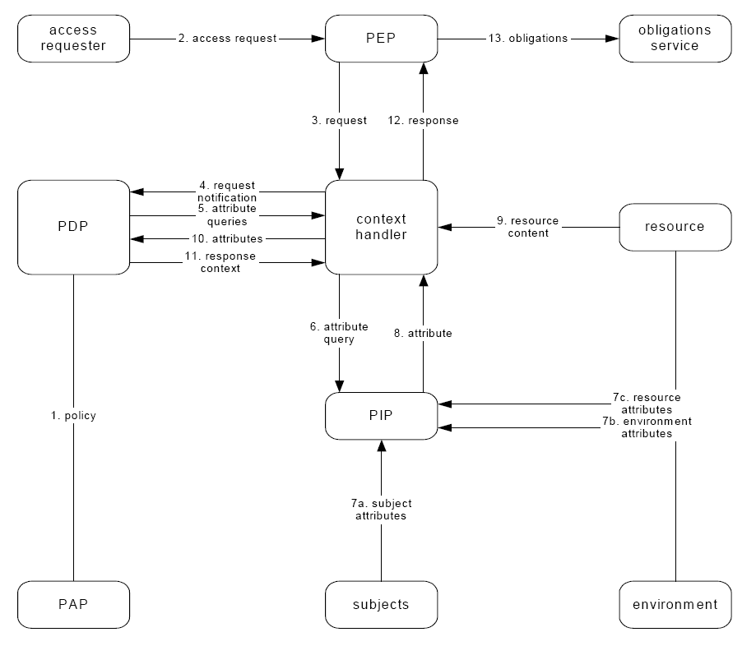
X.1142: eXtensible Access Control Markup Language (XACML 2.0)
Data flow

Slide 22
X.1142: eXtensible Access Control Markup Language (XACML 2.0)
Policy Enforcement Point (PEP): Responsible for making access control decision requests to PDP and the enforcement of the given decisions.
Policy Decision Point (PDP): Makes access decisions by evaluating the given request against matched policies.
Context Handler: Responsible for conversions between XACML canonical format and native formats
Policy Information Point (PIP): Source of content values for XACML attributes.
Policy Administration Point (PAP): Creates and manages the policy and policy sets.

Slide 23
X.1144: eXtensible Access Control Markup Language (XACML 3.0) & X.suppl.22
The changes occur in the XACML core specification OASIS eXtensible Access Control Markup Language (XACML) Version 3.0 which became an OASIS Standard on 22 January 2013.
  Ehancement :
    Advice element:
    Custom categories:
    Content element
    Improvement in XACML request and response
    Improvements in XML path language (XPath)
    Enhanced profiles (hierarchical resource profile, multiple decision profile, SAML profile)
  New features :
    attribute functions and datatypes
    New profiles (delegation profile, export compliance profile, intellectual property control profile)

Slide 24
X.1151: Guideline on secure password-based authentication protocol with key exchange
Authenticated key exchange using a human-memorable password
No need for other infrastructure, e.g., PKI
SPAK
  uses the DH (Deffie-Helman) algorithm to share the session key
  uses the hash algorithm to blind the public DH parameters using a password
X.1151
  Identify a set of requirements for password-based authentication protocols
  Define the guideline of the criteria for choosing an optimum SPAK protocol for applications

Slide 25
X.1152: Secure end-to-end data communication techniques using trusted third party services
Defines interfaces, interactions and security considerations for secure end-to-end data communication using on-line trusted third party (TTP) services

Slide 26
X.1152: Secure end-to-end data communication techniques using trusted third party services
Identifies online TTP services which can be used to support secure end-to-end data communication
  TTP services for establishment phase
    TTP services for identification process
    TTP services for authentication process
    TTP services for process of authorization and access control
    TTP services for process of policy determination and distribution
  TTP services for data transmission phase
    TTP services for data confidentiality process
    TTP services for data integrity process
    TTP services for audit trail process
  TTP services for termination phase

Slide 27
X.1152: Secure end-to-end data communication techniques using trusted third party services
Possibilities of using online TTP services
Processes of secure communication |  | Possible online TTP services
Establishment | Identification | Certificate management service, Directory service, Credential mapping service, Location service, Presence service
 | Authentication | Authentication service
 | Authorization and access control | Directory service, Access control service
 | Policy determination and distribution | Key management service (Key generation service, Key distribution service), Policy determination service
Data transmission | Data confidentiality | None
 | Data integrity | None
 | Audit trail | Time stamping service, Non-repudiation service, Electronic notary public service, Electronic digital archiving service
Termination |  | Key management service, Electronic notary public service

Slide 28
X.1153: Management framework of a one time password-based authentication service
Management frameworks of a one time password (OTP)‑based authentication service to support multi-factor authentication
  general management framework
  centralized management framework
  enhanced centralized framework
  cross-domain management framework

Slide 29
X.1153: Management framework of a one time password-based authentication service
Comparison of OTP management models
Model | Features | User convenience
For the general management framework | Consists of a single service provider managing the OTP validation server(s) internally. | Multiple OTP tokens for multiple service providers.
For the centralized management framework | Consists of multiple service providers and an OSP managing the OTP validation server(s) centrally. | Single OTP token for multiple service providers (multiple tokens in multiple domains).
For the enhanced centralized management framework | Consists of multiple service providers and an OSP managing the OTP validation server(s) centrally; the service providers can selectively manage the OTP validation server(s) internally. | Single OTP token for multiple service providers (multiple tokens in multiple domains).
For the cross- domain management framework | Consists of multiple service providers and multiple OSPs. | Single OTP token for multiple service providers in multiple domains.

Slide 30
X.1153: Management framework of a one time password-based authentication service
OTP management model for the general management framework

Slide 31
X.1153: Management framework of a one time password-based authentication service
OTP management model for the centralized management framework

Slide 32
X.1153: Management framework of a one time password-based authentication service
OTP management model for the enhanced centralized management framework

Slide 33
X.1153: Management framework of a one time password-based authentication service
OTP management model for the cross-domain management framework

Slide 34
X.1154: General framework of combined authentication on multiple identity service provider environments
The combinations of authentication methods provide multiple identity service providers (IdSPs) the ability to enhance the assurance of authentication
general framework of combined authentication in multiple IdSP environments for a service provider
three types of combined authentication methods are considered:
  multifactor authentication
  multi-method authentication
  multiple authentications

Slide 35
X.1154: General framework of combined authentication on multiple identity service provider environments
Types of combined authentication method
  Multifactor authentication that uses multiple credentials from two or more of the three categories of authentication factors. For example, authentication by the combination of one-time password authentication and biometric authentication.
  Multi-method authentication that uses multiple credentials from different authentication methods. For example, authentication by a combination of fingerprint authentication and finger vein authentication.
  Multiple authentications that use multiple credentials from the same authentication methods. For example, fingerprint authentication using multiple fingers.

Slide 36
X.1154: General framework of combined authentication on multiple identity service provider environments
Types of authentication factors
  Ownership factor is an authentication factor verifying something the user has. Some examples are the smart card, the security token, software token, fixed line phones and mobile phones.
  Knowledge factor is an authentication factor verifying something the user knows. Some examples include a password, a passphrase and personal identification number (PIN).
  Biometric factor is an authentication factor verifying something the user is or does. Fingerprints, finger veins and iris are such examples.

Slide 37
X.1154: General framework of combined authentication on multiple identity service provider environments
Basic authentication models (if IdSPs are categorized into one group)
 | # of IdSP | # of types of authentication method | Type of provided authentication method by one IdSPs | # of groups of IdSPs | Provided authentication method by combination of IdSPs
T-1 | One | One | Single factor | One | None
T-2 |  |  | Combined | One | Combined (Note 1)
T-3 | Multiple | One | Single factor | One | Multiple
T-4 |  |  | Combined | One | Combined (Note 1)
T-5 |  | Multiple (different methods) | Single factor | One | Multiple, multi-method (Note 2)
T-6 |  |  | Combined (multiple or multi-method) | One | Multiple, multi-method (Note 3)
T-7 |  | Multiple (different factors) | Single factor | One | Multiple, multi-method, multi-factor (Note 2)
T-8 |  |  | Combined | One | Combined (Note 3)
NOTE 1 − All three types of combined authentication can be provided. However, the provided authentication method depends on the type of authentication provided by an IdSP. NOTE 2 − All three types of combined authentication can be provided. However, the provided authentication method depends on the selection of IdSPs. NOTE 3 − All three types of combined authentication can be provided. However, the provided authentication method depends not only on the types of authentication provided by IdSPs but also on the selection of IdSPs.

Slide 38
X.1154: General framework of combined authentication on multiple identity service provider environments
Basic authentication models (if IdSPs are categorized into several groups)
 | # of IdSP | # of types of authentication method | Type of provided authentication method by one IdSP | # of groups of IdSPs | Provided authentication method by combination of IdSPs
T-9 | Multiple | One | Single factor | Multiple | Multiple
T-10 |  |  | Combined | Multiple | Combined (Note 1)
T-11 |  | Multiple (different methods) | Single factor | Multiple | Multiple, multi-method (Note 2)
T-12 |  |  | Combined (multiple or multi-method) | One | Multiple, multi-method (Note 3)
T-13 |  | Multiple (different factors) | Single factor | Multiple | Multiple, multi-method, multifactor (Note 2)
T-14 |  |  | Combined | Multiple | Combined (Note 3)
NOTE 1 − All three types of combined authentication can be provided. However, the provided authentication method depends on the type of authentication provided by an IdSP. NOTE 2 − All three types of combined authentication can be provided. However, the provided authentication method depends on the selection of IdSPs. NOTE 3 − All three types of combined authentication can be provided. However, the provided authentication method depends not only on the types of authentication provided by IdSPs but also on the selection of IdSPs.

Slide 39
X.1155: Guideline on anonymous authentication for e-commerce service
Anonymous authentication
  that allows users to be able to authenticate themselves without revealing their identity
  this Recommendation is intended to provide a guideline on local linkable anonymous authentication for electronic services
Linkability issues
  they are “linked” when someone can determine whether these transactions were performed by the same user, even if it is impossible to identify the specific user from these transactions.
  There are three levels for the linkability:
    Unlinkability: verifier cannot always link two or more anonymous authentication transactions.
    Local linkability: verifier can link two or more anonymous authentication transactions presented to him, but a verifier or colluding verifiers cannot link multiple signatures presented to different verifiers.
    Full linkability: verifier can always link all anonymous authentication transactions.
  Group signature & pseudonym

Slide 40
X.1156: Non-repudiation framework based on a one time password
a non-repudiation framework based on a one time password (OTP) to enhance trust between transaction entities.
describes the mechanisms for generating non-repudiation tokens.
  The originator of the transactions may request the trusted third party (TTP) to generate the non-repudiation token and the recipient may request TTP to generate the non-repudiation of delivery token.

Slide 41
X.1156: Non-repudiation framework based on a one time password
Expression z implies the request data for the non-repudiation token and consists of the following items:
  z = I || T || A
Identifier data field
  I = Pol || A || B || C || D || E
  Identifier data field I consists of the following data items:
  Pol: identifiers of the OTP-based non-repudiation policy and a type of non-repudiation service,
  A: identifier of a message originator that defines the OTP user,
  B: identifier of a message recipient that defines the service provider,
  C: identifier of the evidence generator that defines TTP,
  D: identifier of other entities involved with a non-repudiation service,
  E: identifiers of the OTP token (i.e., a serial number).

Slide 42
X.1156: Non-repudiation framework based on a one time password
Expression z implies the request data for the non-repudiation token and consists of the following items:
  z = I || T || A
Time data field
  T = T_{g} || T_{i}
  Time data field T consists of the following data items:
  T_{g}: a date and/or time when a non-repudiation token was generated,
  T_{i}: a date and/or time when a message was generated or delivered.
Authentication data field
  A = Q || Imp(m)
  Authentication data field A consists of the following data items:
  Q: optional data that need to be protected,
  Imp(m): the imprint of the message m.

Slide 43
X.1156: Non-repudiation framework based on a one time password
Non-repudiation tokens
  NRT = text || z || MAC_{ttp} (z), where z = I || T || A.
OTP-based non-repudiation of origin token (NROT)
  NROT = text || z || mac
  Where:
  z = I || T || A = (Pol || A || B || C || [D] || E) || (T_{g} || T_{i}) || ([Q] || Imp(m))
  And:
  mac = MAC_{ttp}(z) ; [] optional input
OTP-based non-repudiation of delivery token (NRDT)
  NRDT = text || z || mac
  Where:
  z = I || T || A = (Pol || A || B || C || [D] || E) || (T_{g} || T_{i}) || ([Q] || Imp(m))
  And:
  mac = MAC_{ttp}(z); [] optional input

Slide 44
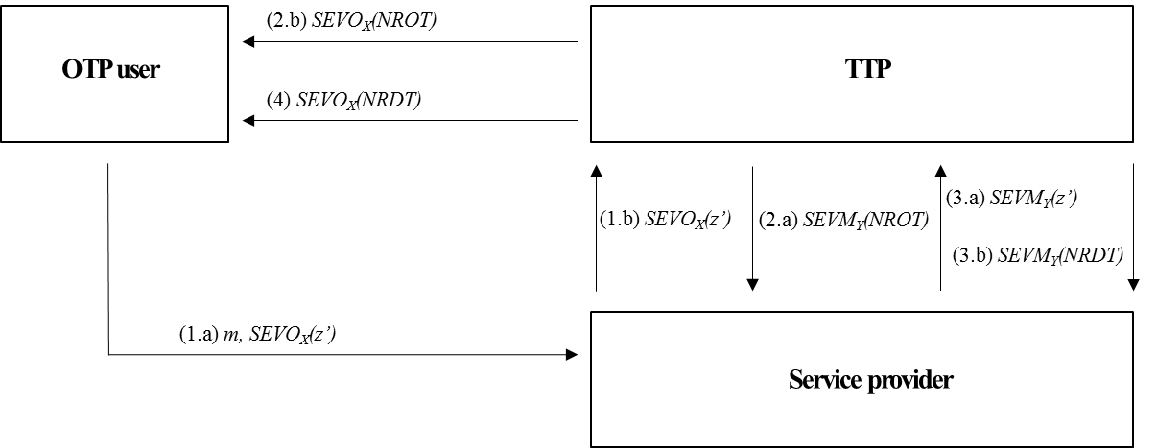
X.1156: Non-repudiation framework based on a one time password
Non-repudiation process
  Evidence generation
  Evidence transfer
  Evidence verification
  Dispute resolution
Service model for direct NROT and direct NRDT

Slide 45
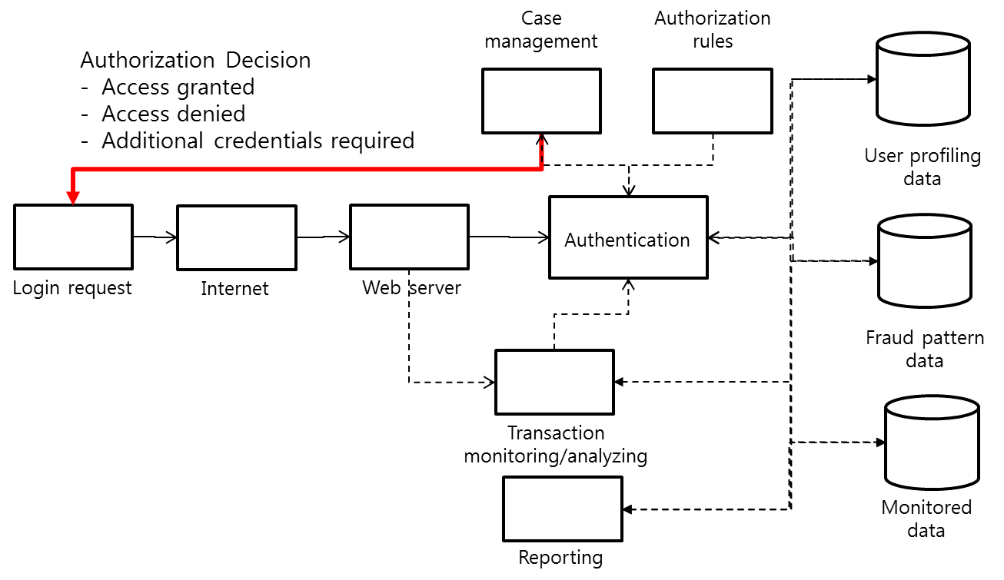
X.1157: Technical capabilities of fraud detection and response for services with high assurance level requirements
To provide capabilities required to support fraud detection and response service in security sensitive ICT application service.
Fraud detection and response service supports the detection, analytics and management of fraud across users, accounts, products, processes and channels.
Fraud detection process and components

Slide 46
X.1158: Efficient multi-factor authentication mechanisms using mobile devices
The proposed Recommendation basically provides a multi factor authentication mechanism using mobile devices. It describes a weakness of a single-factor authentication mechanism, a need for multi factor authentication mechanism and various combinations of the multi factor authentication mechanism using mobile devices, and threats for the two-factor authentication mechanism. In addition, security requirements to reduce threats of a single-factor authentication are provided including potential typical multi factor authentication mechanisms. It is to use mobile devices with SIM card capability, and should not exclude use of the virtual SIM cards. Specifically, it is applicable all applications using mobile devices. It will use the framework in the X.1154.

Slide 47
X.1159: Delegated non-repudiation architecture based on X.813
The proposed architecture can generate and verify the non-repudiation evidence for the transaction data by trusted third parity (TTP) that is the central sign authority (CSA).
The proposed architecture integrates multiple authentication devices to access the trusted third party that is the central signing authority (CSA). It also integrates multiple service providers to provide a non-repudiation service with a single authenticated device. The delegated non-repudiation architecture provides the ability to manage user authentication centrally. The service providers can provide the service of a user authentication and non-repudiation without additional construction of authentication systems.

Slide 48
Contents
Question text for Q7/17
  Motivation, Question, Tasks, and Relationships
Recommendations and Supplements related to Q7/17
Draft Recommendations on developing under Q7/17
Future Plan for Next Study Period (2017-2020)

Slide 49
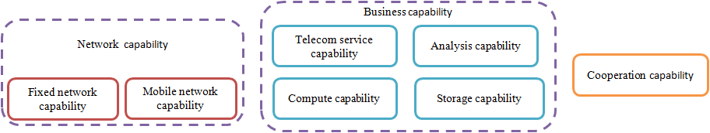
Draft Recommendation ITU-T X.websec-6
Security framework and requirements for open capabilities of telecommunication services
  provides security framework and requirements for open capabilities of telecommunication services.
  studies the challenges brought forward by open capabilities of telecommunication services, and hence the specific security requirements for the operators’ as well as the security framework.
  focuses on security requirements analysis, and security framework. The purpose is to safeguard operators’ capabilities of telecommunication services and the business paradigm of open capabilities of telecommunication services, to protect operators’ telecommunication systems, and enhance user experience
  Overview of open capabilities, in Draft Rec. ITU-T X.websec-6

Slide 50
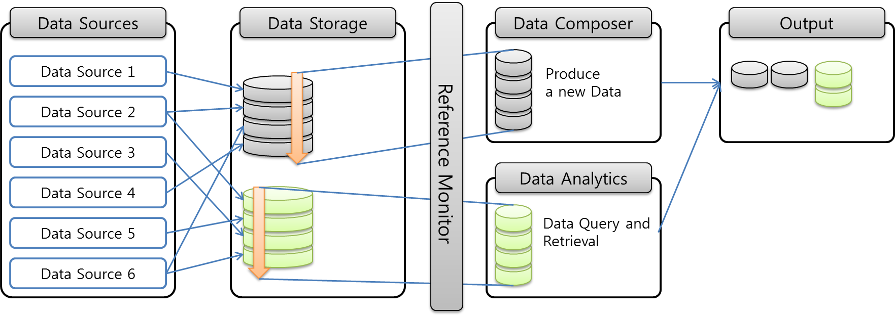
Draft Recommendation ITU-T X.websec-7
Reference Monitor for Online Analytics Services
  provides specification of common reference monitoring and rule set to prevent an illegal or unintended data composition or analysis.
  includes the operation of reference monitor and rule set for interoperability.
Reference Monitor for Network based Analytics Application, , in Draft Rec. ITU-T X.websec-7

Slide 51
Draft Recommendation ITU-T X.websec-8
Secure protection guidelines of value-added service for operators
  provides guidelines for secure protection of value-added service for operators.
  analyzes the typical service scenarios, security threats and attack methods, and provide technical measures to encounter them.
Value –Added Service
APP Store
Mobile Office
Automation
e-Reading
e-Commerce
Online Gaming
···
Basic Functions
Service Context
Electronic payment
Service Subscription
User Information Demonstration
External API
···
Wired/Wireless Networks: 2G/3G/4G/LAN/WLAN
Underlying network
Operators Networks
  Structure of Value-Added Service, in Draft Rec. ITU-T X.websec-8

Slide 52
Contents
Question text for Q7/17
  Motivation, Question, Tasks, and Relationships
Recommendations and Supplements related to Q7/17
Draft Recommendations on developing under Q7/17
Future Plan for Next Study Period (2017-2020)

Slide 53
Future Plan for Next Study Period (2017-2020)
Q7/17 will address various security aspects of ICT-based application services;
  Security of ICT applications
  (including Applications of basic security mechanisms)
  Social network services
  P2P (peer-to-peer)
  TTP (Trusted Third Party)
  Security and Access control assertions
  as a replacement to the use of certificates in PKI

Slide 54
Thank you!
Q7/17 Rapporteur: Jae Hoon Nah
Q7/17 Associate Rapporteur: Lijun Liu

