Slide 1
ITU-T SG17 Q.6 Security aspects of ubiquitous telecommunication services
An overview for newcomers Jonghyun Baek
Q6/17 Rapporteur
21 March 2016

Slide 2
Contents
Question text for Q6/17
Motivation, Question, Tasks, and Relationships
Recommendations and Supplements related to Q6/17
Draft Recommendations on developing under Q6/17
Future Plan for Next Study Period (2017-2020)

Slide 3
Question text for 6/17 – Motivation
The ubiquitous telecommunication service refers to the service that allows anyone to access to any desired information in a user-friendly way, anytime and anywhere using any devices.
The telecommunications industry has been experiencing an exponential growth in area of mobile technology based ubiquitous telecommunication services.
Specifically, security of domain-specific ubiquitous telecommunications among heterogeneous devices for the application-level technologies such as ubiquitous sensor network (including Internet of Things (IoT), Machine to Machine (M2M) and Intelligent Transportation Systems), home network, smart grid, mobile network (including Near Field Communication (NFC) and smartphone), multicast network, IPTV network, etc., are crucial for the further development of the industry, network operators and service providers.

Slide 4
Question text for 6/17 – Motivation (cont’)
Standardization of the best comprehensive security solutions is vital for the network operators and service providers that operate in a multi-vendor international ubiquitous environment. Due to some specific characteristics of the mobile telecommunications (e.g., over the air transmission, limited computing power and memory size of the small mobile devices), providing security is an especially challenging task that deserves special attentions and study.
Recommendations under responsibility of this Question
X.1101(Multicast), X.1111, X.1112, X.1113, X.1114(Home network), X.1121, X.1122, X.1123, X.1124, X.1125(Mobile), X.1171, X.1191, X.1192, X.1193, X.1194, X.1195, X.1196, X.1197, X.1198(IPTV), X.1311, X.1312, X.1313, X.1314(USN),
Texts under development
X.msec-9, X.sgsec-1, X.sgsec-2, X.itssec-1, X.itesec-2, X.iotsec-1, X.iotsec-2, and X.sdnsec-1

Slide 5
Question text for 6/17 – Question
Study items to be considered include, but are not limited to:
How should security aspects of ubiquitous telecommunication services be identified and defined in mobile telecommunication?
How should threats behind ubiquitous telecommunication services be identified and handled?
What are the security technologies for supporting ubiquitous telecommunication services?
How should secure interconnectivity between ubiquitous telecommunication services be kept and maintained?

Slide 6
Question text for 6/17 – Question (cont’)
Study items to be considered include, but are not limited to:
What security techniques, mechanisms and protocols are needed for emerging ubiquitous telecommunication services, especially for emerging digital content protection services?
What are the global security solutions for ubiquitous telecommunication services and their applications?
What are the best practices or guidelines for secure ubiquitous telecommunication services and their applications?
What enhancements to existing Recommendations under review or new Recommendations under development should be adopted to reduce impact on climate changes (e.g., energy savings, reduction of greenhouse gas emissions, implementation of monitoring systems) either directly or indirectly in telecommunication/ICT or in other industries?

Slide 7
Question text for 6/17 – Tasks
Tasks include, but are not limited to:
In collaboration with other ITU T study groups and standards development organizations, especially with IETF, ISO/IEC JTC 1/SCs 6, 25, 27 and 31, produce a set of Recommendations for providing comprehensive security solutions for secure ubiquitous telecommunication services.
Review existing Recommendations/Standards of ITU T, ISO/IEC and other standardization bodies in the area of home network, smart grid, mobile network (including smartphone security), mobile IoT service and ubiquitous sensor network to identify secure ubiquitous telecommunication services.
Study further to define security aspects of ubiquitous telecommunication services for a multi-vendor international ubiquitous environment, and for emerging new services.
Study and identify security issues and threats in secure ubiquitous telecommunication services.
Study and develop security mechanisms for secure ubiquitous telecommunication services.
Study and develop interconnectivity mechanisms for secure ubiquitous telecommunication services in a single or multi-vendor ubiquitous environment

Slide 8
Question text for 6/17 – Relationships
Recommendations
X-series and others related to security
Questions
ITU‑T Questions 1/17, 2/17, 3/17, 4/17, 5/17, 7/17, 8/17, 9/17, 10/17, 11/17, 8/13, 7/13, 13/16 and 21/16
Study Groups
ITU T SGs 9, 11, 13 and 16, JCA-SG&HN, JCA-IPTV and JCA-IoT; ITU-R
Standardization bodies
ISO/IEC JTC 1/SCs 6, 25, 27 and 31; IEC SMB WG3 and TC57; IETF; 3GPP; 3GPP2; OMA; GSMA
Other bodies
ETSI; ATIS; TTC; TTA; CCSA; OIPF; DVB; NFC Forum; NIST

Slide 9
Contents
Question text for Q6/17
Motivation, Question, Tasks, and Relationships
Recommendations and Supplements related to Q6/17
Draft Recommendations on developing under Q6/17
Future Plan for Next Study Period (2017-2020)

Slide 10
Recommendations related to Q6/17
X.1101, Security requirements and framework for multicast communication
X.1111, Framework of security technologies for home network
X.1112, Device Certificate profile for the home network
X.1113, Guideline on user authentication mechanisms for home network service
X.1114, Authorization framework for home network
X.1121, Security framework for mobile end-to-end data communication
X.1122, Guideline for implementing secure mobile systems based on PKI
X.1123, Differentiated security service for secure mobile end-to-end data communication
X.1124, Authentication architecture for mobile end-to-end data communication
X.1125, Correlative reacting system in mobile network
X.1171, Threats and requirements for protection of personally identifiable information in applications using tag-based identification
X.1191, Functional requirements and architecture for IPTV security aspects

Slide 11
Recommendations related to Q6/17 (cont’)
X.1192, Functional requirements and mechanisms for the secure transcodable scheme of IPTV
X.1193, Key management framework for secure internet protocol television (IPTV) services
X.1194, Algorithm selection scheme for service and content protection (SCP) descrambling
X.1195, Service and content protection (SCP) interoperability scheme
X.1196, Framework for the downloadable service and content protection system in the mobile IPTV environment
X.1197, Guidelines on criteria for selecting cryptographic algorithms for IPTV service and content protection
X.1198, Virtual machine-based security platform for renewable IPTV service and content protection
X.1311, Security framework for ubiquitous sensor network
X.1312, Ubiquitous sensor network (USN) middleware security guideline
X.1313, Security requirements for wireless sensor network routing
X.1314, Security requirements and framework of ubiquitous networking

Slide 12
Supplements (including Corrigendum) related to Q6/17
X.Suppl.19, Supplement to ITU-T X.1120 series – Supplement on security aspects of smartphones
X.1311 Cor.1, Security framework for ubiquitous sensor networks Technical Corrigendum 1
X.Suppl.24, ITU-T X.1120-X.1139 series - Supplement on a secure application distribution framework for communication devices

Slide 13
Contents
Question text for Q6/17
Motivation, Question, Tasks, and Relationships
Recommendations and Supplements related to Q6/17
Draft Recommendations on developing under Q6/17
Future Plan for Next Study Period (2017-2020)

Slide 14
Draft Recommendation ITU-T X.msec-9
Functional Security Requirements and Architecture for Mobile Phone Anti-theft Measures (Timing: 2016-09/ Determination)
Address the functional security requirements and architecture for the smartphone anti-theft measure (aka, a kill switch), which allows customers to delete remotely the user's personal data or disable remotely stolen or lost smartphone devices
Focus on the functional requirements, functional architecture, and mechanisms
Use the reference model consisting of the device owner, the authorized server, the back-up server, and lost/stolen devices
Describe Ant-theft specific threats (in the Appendix)
Not modify the general requirements for Smartphone anti-theft developed by GSMA
Reference model for anti-theft measures, in Draft Rec. ITU-T X.msec-9

Slide 15
Draft Recommendation ITU-T X.sgsec-1
Security functional architecture for smart grid services using telecommunication networks (Timing: 2016-03/ Consent)
Describes a security functional architecture for smart grid (SG) services using telecommunication networks
Identifies security risks and security requirements
Defines a security functional architecture for smart grid services using telecommunication networks based on a general functional model
Main contents
Reference architecture and smart grid services
Security risks categorization of smart grid services
Security requirements of smart grid services
Security functional architecture of smart grid services

Slide 16
Draft Recommendation ITU-T X.sgsec-2
Security guidelines for home area network (HAN) devices in smart grid systems (Timing: 2017-03/ Determination)
Provides security guidelines for Home Area Network (HAN) devices in Smart Grid systems
Main contents
Security risks of devices and communication
Security requirements for devices and communications in HAN
Security guidelines of HAN devices in Smart Grid systems
Target fields of X.sgsec-2, in Draft Rec. ITU-T X.sgsec-2

Slide 17
Draft Recommendation ITU-T X.itssec-1
Secure software update capability for intelligent transportation system communications devices (Timing: 2016-03/ Determination)
Provide a procedure of secure software updating for ITS communication devices for the application layer in order to prevent threats such as tampering of and malicious intrusion to communication devices on vehicles
Includes a basic model of software update, its threat and risk analysis, security requirements and controls for software update and a specification of abstract data format of update software module
Principal modules around a vehicle for a remote software update , in Draft Rec. ITU-T X.itssec-1

Slide 18
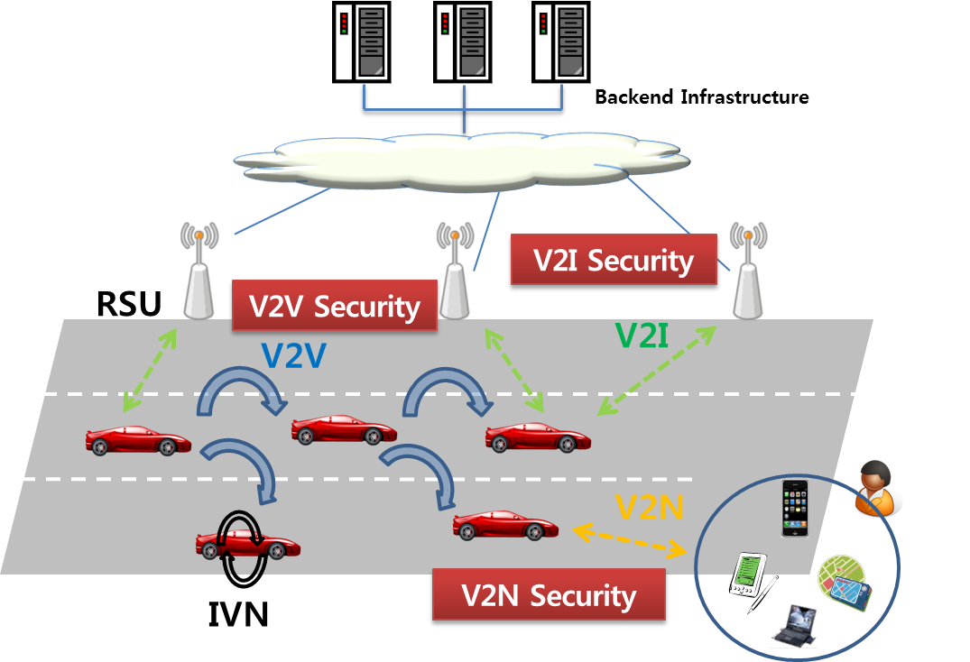
Draft Recommendation ITU-T X.itssec-2
Security guidelines for V2X communication systems (Timing: 2017-03 / Determination)
Provides security guidelines for V2X communication systems. V2X means Vehicle-to-Vehicle (V2V), V2I (Vehicle-to-Infrastructure) and/or V2N (Vehicle-to-Nomadic Devices)
Includes analysis of threat and vulnerability for V2X communication systems
Provides the security requirements for V2X communication systems
Overview of the vehicular communication, in Draft Rec. ITU-T X.itssec-2

Slide 19
Draft Recommendation ITU-T X.iotsec-1
Simple encryption procedure for Internet of Things (IoT) environments (Timing: 2016-03/ Determination)
Provides specification of encryption with associated mask data (EAMD) for the Internet of things (IoT) devices
Includes what EAMD does and how to provide a set of security services for traffic using it
Main contents
Introduction of encryption with associated mask data (EAMD)
How encryption with associated mask data does
How EAMD does with authenticated encryption
Guidance on the proper usage of initialization vectors, nonces, and SAMs
Overview of communication using EAMD, in Draft Rec. ITU-T X.iotsec-1

Slide 20
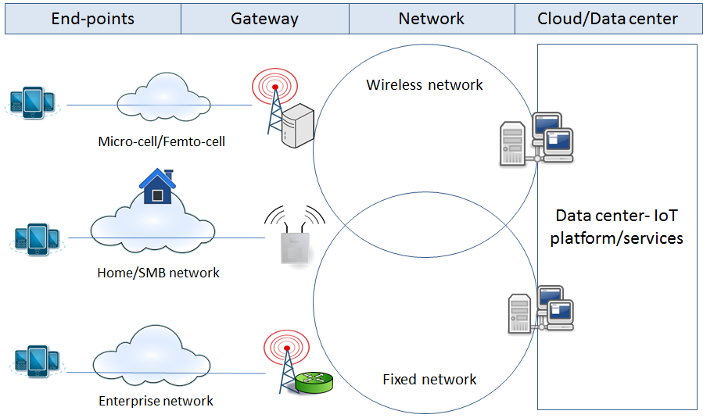
Draft Recommendation ITU-T X.iotsec-2
Security framework for Internet of Things (Timing: 2018-02/ Determination)
Analyses security threats and challenges in the Internet of Things environment, and describes security capabilities that could mitigate these threats and address security challenges
Framework methodology is provided for determining which of these security capabilities are required for mitigating security threats and addressing security challenges for Internet of Things.
Basically focuses on IoT security capabilities based on the Gateway Model
Consider the reference model described in Recommendation ITU-T Y.2068
Focus on technical aspects, not management aspects
Practical functional architecture, in Draft Rec. ITU-T X.iotsec-2

Slide 21
Draft Recommendation ITU-T X.sdnsec-1
Security services using the Software-defined networking (Timing: 2017-03/ Determination)
Support the protection of network resources using security services based on software-defined networking (SDN)
Classify the network resources for SDN-based security services
Define security services based on SDN
Specify how to implement SDN-based security services
Protection of network resources (e.g., router, switch, firewall and IDS) in security services based on SDN means
Prompt reaction to new network attacks (e.g., worms and DDoS attacks)
Construction of private networks to mitigate sophisticated network attacks
Automatic defense from network attacks without the intervention of network administrators
Dynamic network-load-aware resource allocation

Slide 22
Contents
Question text for Q6/17
Motivation, Question, Tasks, and Relationships
Recommendations and Supplements related to Q6/17
Draft Recommendations on developing under Q6/17
Future Plan for Next Study Period (2017-2020)

Slide 23
Future Plan for Next Study Period (2017-2020)
Q6/17 will address various security aspects of ubiquitous telecommunication services;
IoT security
ITS security
Smart Grid security
Mobile security
SDN security
Q6/17 will also have strong relationships with other stud groups and standardization bodies dealing with security aspects of ubiquitous telecommunication services;
Study Groups
ITU-T SGs 9, 11, 13, 15, 16 and 20, JCA-IoT, JCA-IPTV; ITU-R, CITS
Standardization bodies
ISO/IEC JTC 1/SCs 6, 25, 27 and 31; ISO TC 204, IEC SEG 6 (Micro Grid), IEC SMB WG3, IEC TCs 57 and 65; IETF; 3GPP; 3GPP2; OMA; GSMA

Slide 24
Thank you!
Q6/17 Rapporteur: Jonghyun Baek
Q6/17 Associate Rapporteur: Yutaka Miyake

