Slide 1
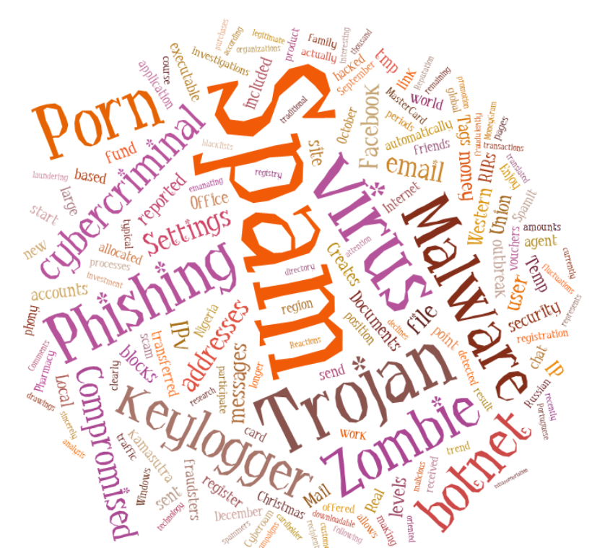
Countering Spam by Technical Means
Zhang Yanbin, SG17/Q5 Rapporteur
Geneva, Switzerland
March, 2016

Slide 2
Main Content
Chapter 1. Introduction of Spam
Chapter 2. The Objective and Mission for Q5
Chapter 3. The Position of Specific Projects in Q5

Slide 3
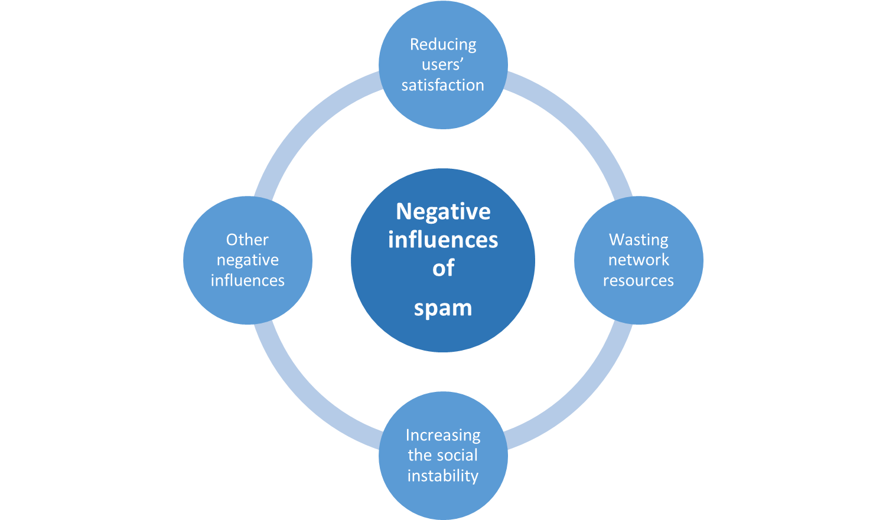
Brief Introduction to “spam”
Spam is a general designation of kinds of the information do damage or harass to public. Nowadays, the electronic spam is one of the most heated topic, which include spam fax, spamming, spam SMS message, nuisance call, malware application, etc.
Compare to other spam, with the higher efficiency and lower cost, electronic spam is the most beset to the public.

Slide 4
Brief Introduction to “spam”
Spam can described as unsolicited messages, most of the spam transmitted via ICT services, such as e-mail, SMS, social media, etc.
Most of the spam information is used for advertising purpose, some of other spam information is even used for malicious purposes;
The history of spam is one that is closely tied to the history and evolution of the ICT itself:
1978 - First email spam was sent out to users of ARPANET – it was an ad for a presentation by Digital Equipment Corporation (DEC)
1994 January, first large scale spam distributed across USENET – “Global Alert for All: Jesus is Coming Soon” was cross posted to every newsgroup
2000 As the popularity of mobile phones surged in the early 2000s, frequent users of text messaging began to see an increase in the number of unsolicited (and generally unwanted) commercial advertisements being sent to their telephones through text messaging.
2001 Code Red worm and Sircam virus infiltrate thousands of web servers and email accounts causing a spike in Internet bandwidth usage
2003 May 3rd – 25th anniversary of the first “spam” and the first time that the amount of spam email exceeded the amount of legitimate email
2008 The rise of SMS spam
2010 An estimated 88% of worldwide email traffic was spam (Symantec)
2012 The rise of social media spam
Notes:
Resources: WWW.INTERNETSOCIETY.ORG

Slide 5
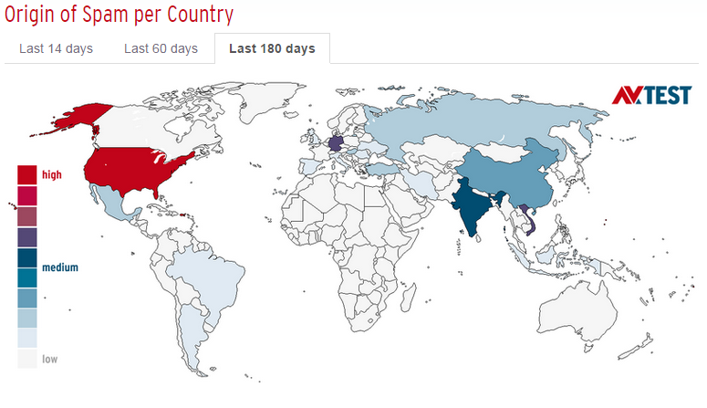
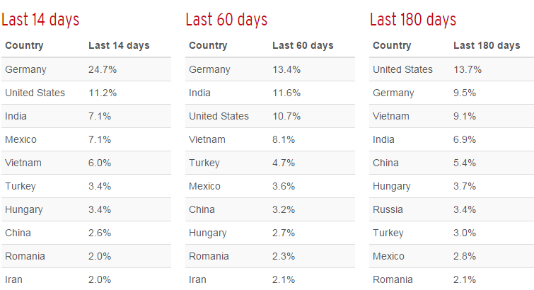
Status Quo of Spam by Region
The analysis procedure 'Spam maps' registers, categorises and maps messages that have been classified as spam.
On the basis of the extraction of malicious URLs, their contents and attachments, AV-TEST has developed an interactive database that can be used to archive cases of spam. The visualisation is presented in spam statistics displaying different time intervals, the focus of the spam content and its country-specific origin.

Slide 6
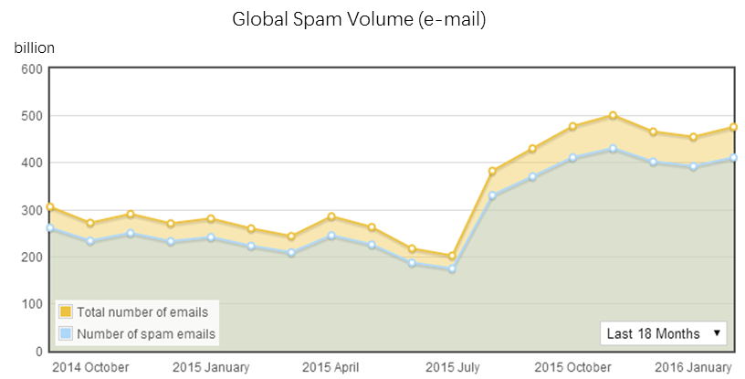
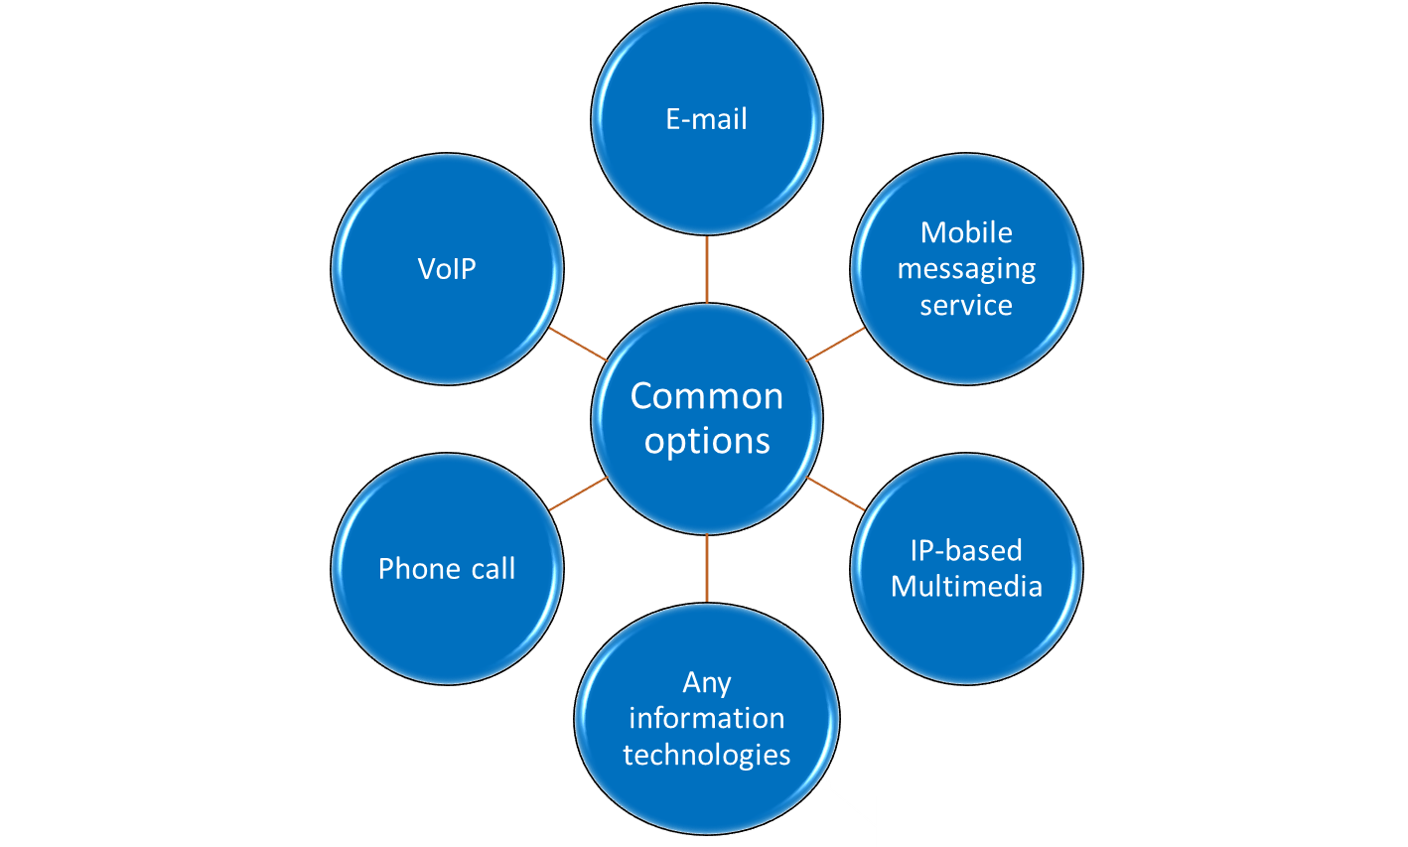
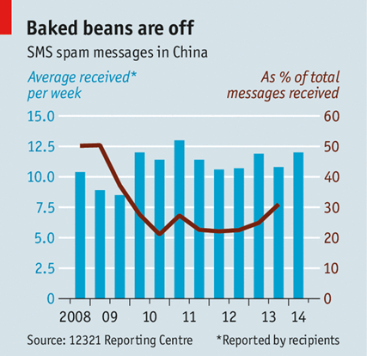
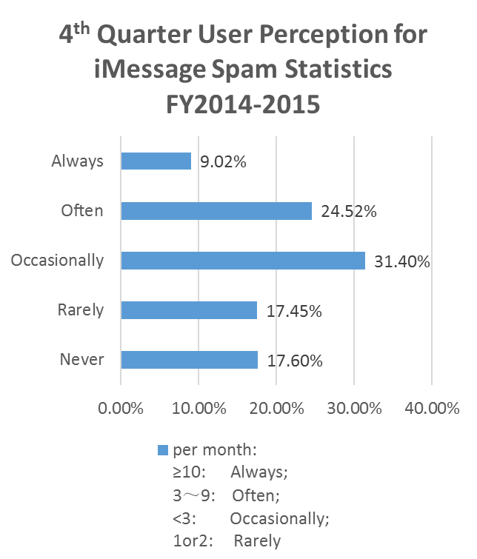
Status Quo of Spam by Service
Most of the spam is still transmitted by e-mail, the number of spam is over 200 billion per month.
Mobile phone spam is generally less pervasive than email spam. In North America, mobile spam has steadily increased from 2008 ed 2012, but remains below 1% of all sms as of December 2012. In parts of Asia up to 30% of messages were spam in 2012.
Nuisance calls are becoming a problem in many countries, as an unwelcome companion to the spread of (mobile) phones, cheap telecoms, and globalised e-commerce.
Telemarketing - that is, phone calls intended
to stimulate sales - is used by businesses of all sizes, from
household names to start-ups.
User Perception for iMessage in China
It can be predicted that the development of spam will follow the evolution of the ICT, such as RCS, IM, even IoT services in future.
Notes:
Email: Cisco Mobile Message: 12321 iMessage: CAICT

Slide 7
Laws and Regulations in Typical Counties and Regions
Countries& Region | Laws and Regulations
Australia | SPAM ACT 2003: The Spam Act covers email, mobile phone text messages (SMS), multimedia messaging (MMS), instant messaging (iM), and other electronic messages of a commercial nature. The penalty units referred to in the Spam Act are equal to $180 each.
E.U. | EU Directive 2002/58/EC on Privacy and Electronic Communications is consent-based legislation applying to messages for the purposes of direct marketing via e-mail or other electronic messaging systems (SMS, MMS, iM, etc.). It requires that prior consent of the recipient must be obtained before unsolicited commercial e-mail be sent to any natural person, unless contact details were obtained within the context of an existing customer relationship. Member states may chose to extend the requirements to legal persons.
P.R.C | Decision of the Standing Committee of the National People‘s Congress on Strengthening Information Protection on Networks （2012）： Any organization，private sector and Individual is banned to sent commercial electronic messages to fixed phone，mobile phone or personal e-mail without the consumers’ agreement or requirement. Provision on the Administration of SMS service: The penalty units referred to unwanted commercial SMS messages in the Provision are equal to 10,000 to 30,000 CNY each.
U.S | CAN-SPAM Act allows courts to set damages of up to $2 million when spammers break the law. Federal district courts are allowed to send spammers to jail and/or triple the damages if the violation is found to be willful.
Canada | CASL is a new anti-spam law that will apply to all electronic messages (i.e. email, texts) organizations send in connection with a “commercial activity.” Its key feature requires Canadian and global organizations that send commercial electronic messages (CEMs) within, from or to Canada to receive consent from recipients before sending messages. CASL does not apply to CEMs that is simply routed through Canada.

Slide 8
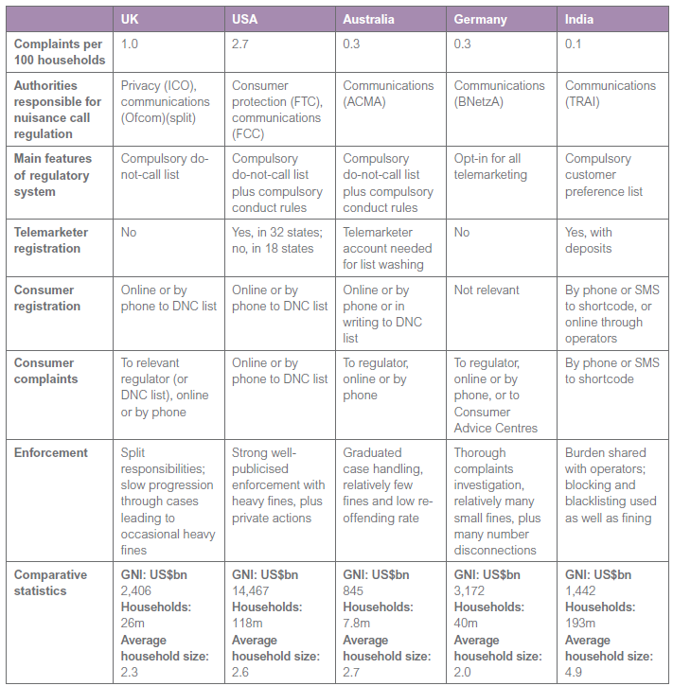
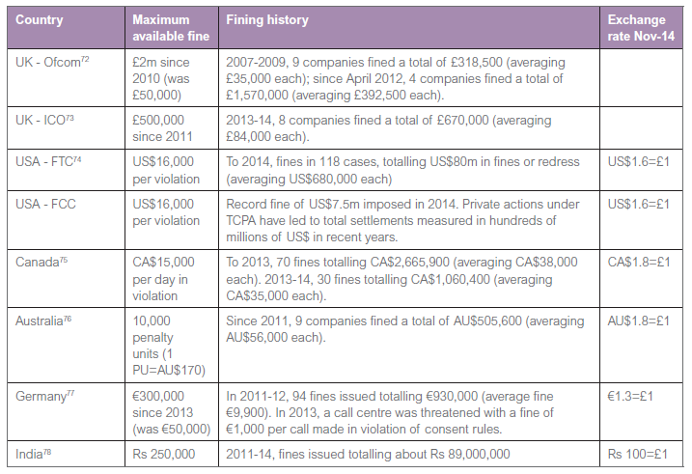
Laws and Regulations in Typical Counties and Regions
The common regulatory tool for controlling commercial phone calls is “Do Not Call Registers”, which enable consumers to register their phone numbers for exclusion from telemarketing.
People who sign up to Do Not Call registers have reported significant immediate improvements in the amount of unwanted calling that they receive.. An earlier US survey, conducted less than a year after the Do Not Call register was implemented, found that people who registered saw a reduction in telemarketing calls from an average of 30 calls per month to an average of 6 per month.
Notes:
Resource: A comparative policy study of practices in multiple countries
Claire Milne

Slide 9
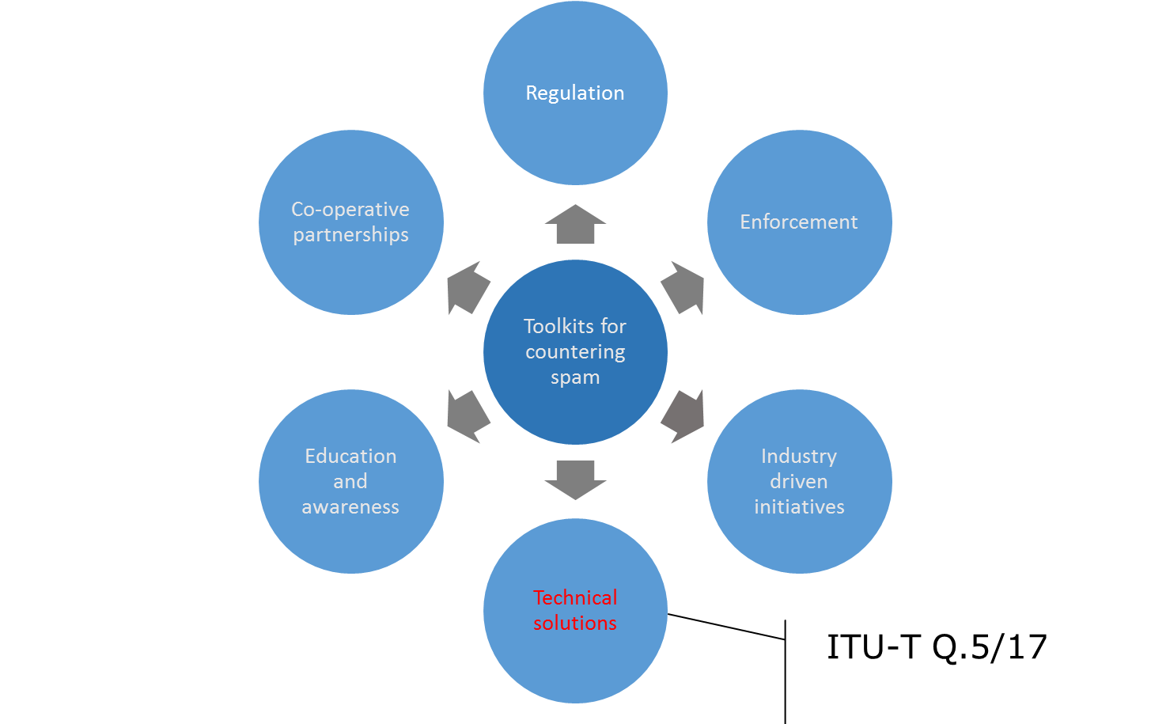
The Other Ways of Prohibiting from Spam
With the requirement of the rapidly development of the information society, our version is not rely on the traditional means (regulation, education and awareness, etc.)
We should improve and upgrade the supervision and management system with the innovative information and communication technologies, to solve the problems caused by electronic spam.
We attempt to promote the technical solutions to control the ever-increasing
volume of unsolicited spam.

Slide 10
Main Content
Chapter 1. Introduction of Spam
Chapter 2. The Objective and Mission for Q5
Chapter 3. The Position of Specific Projects in Q5

Slide 11
Brief Introduction to Q5
SG 17’s mandate is “Security”
Q5 is the lead group in ITU-T on countering spam by technical means in support of WTSA-08 Resolution 52 (Countering and combating spam)
X.tcs-2, Real-time blocking list based framework for countering VoIP spam
X.ics, Functions and interfaces for countering e-mail spam using botnet information
X.oacms, Overall aspects of countering messaging spam in mobile networks
Effective cooperation with ITU-D, IETF, ISO/IEC JTC 1, 3GPP, OECD, MAAWG , ENISA，GSMA and other organizations
Study Group 17
WP 1/17
Fundamental security
WP 2/17
Network and information security
WP 3/17
IdM + Cloud Computing Security
WP 4/17
Application security
WP 5/17
Formal languages
Q.1/17
Telecom./ICT security coordination
Q.4/17
Cybersecurity
Q.8/17
Cloud Computing Security
Q.6/17
Ubiquitous
services
Q.11/17
Directory,
PKI, PMI, ODP, ASN.1, OID, OSI
Q.2/17
Security architecture and framework
Q.5/17
Countering spam
Q.10/17
IdM
Q.7/17
Applications
Q.12/17
Languages and Testing
Q.3/17
ISM
Q.9/17
Telebiometrics

Slide 12




Brief Introduction to Q5
1. Viruses for spam spreading
Q.4/17
4. Information protection
Q.7/17
Q.10/17
Q.5
5. Other relationships
2. Personally identifiable information (PII) protection
Etc.
3. Terminal security against spam
Q.6/17

Slide 13
Standardization Roadmap to Q5:
Technical strategies on countering spam
(X.1231)
Technologies involved in countering e-mail spam
(X.1240)
Overall aspects of countering spam in IP-based multimedia applications
(X.1244)
Overall aspects of countering mobile messaging spam
(X-series Supplement 12 to ITU-T X.1240)
Technical framework for countering e-mail spam
(X.1241)
Framework for countering IP multimedia spam
(X.1245)
Framework based on real-time blocking list (RBL) for countering VoIP spam
(X-series Supplement 11 to ITU-T X.1245)
Technical framework for countering mobile messaging spam
(X.tfcmm)
Technical requirements for countering instant messaging spam (SPIM)
(X.cspim)
A practical reference model for countering e-mail spam using botnet information
(X-series Supplement 14 to ITU-T X.1243)
Technologies involved in countering voice spam in telecommunication organizations
(X.ticvs)
Supplement to ITU-T X.1245, Technical measures and mechanism on countering the spoofed call in the visited network of VoLTE
(X.ticsc)
Short message service (SMS) spam filtering system based on user-specified rules
(X.1242)
Supplement to ITU-T X.1242, Guideline for countermeasures against short message service (SMS) phishing incidents
(X.gcspi)
Interactive gateway system for countering spam
(X.1243)
Supplement on countering spam and associated threats
(X-series Supplement 6 to ITU-T X.1240 series)

Slide 14
Main Content
Chapter 1. Introduction of Spam
Chapter 2. The Objective and Mission for Q5
Chapter 3. The Position of Specific Projects in Q5

Slide 15
The Position of Specific Projects in Q5
Technical strategies
E-mail
Spam
Guideline
Framework
Technologies
SMS
Spam
Guideline
Framework
Technologies
IP-Based Multimedia
spam
Guideline
Framework
Technologies
Instant Message
Spam
Guideline
Framework
Technologies
Supplement
Technologies
  Technologies involved in countering e-mail spam (X.1240)
  Technical framework for countering e-mail spam (X.1241)
  A practical reference model for countering e-mail spam using botnet information
  (X-series Supplement 14 to ITU-T X.1243)

Slide 16
The Position of Specific Projects in Q5
Technical strategies
E-mail
Spam
Guideline
Framework
technologies
SMS
Spam
Guideline
Framework
technologies
IP-Based Multimedia
spam
Guideline
Framework
technologies
Instant Message
Spam
Guideline
Framework
technologies
Supplement
Technologies
  Overall aspects of countering mobile messaging spam (X-series Supplement 12 to ITU-T X.1240)
  Technical framework for countering mobile messaging spam (X.tfcmm)
  Short message service (SMS) spam filtering system based on user-specified rules (X.1242)
  Supplement to ITU-T X.1242, Guideline for countermeasures against short message service (SMS) phishing incidents (X.gcspi)

Slide 17
The Position of Specific Projects in Q5
Technical strategies
E-mail
Spam
Guideline
Framework
technologies
SMS
Spam
Guideline
Framework
technologies
IP-Based Multimedia
spam
Guideline
Framework
technologies
Instant Message
Spam
Guideline
Framework
technologies
Supplement
Technologies
  Overall aspects of countering spam in IP-based multimedia applications (X.1244)
  Framework for countering IP multimedia spam (X.1245)
  Framework based on real-time blocking list (RBL) for countering VoIP spam (X-series Supplement 11 to ITU-T X.1245)
  Technologies involved in countering voice spam in telecommunication organizations
  (X.ticvs)
  Supplement to ITU-T X.1245, Technical measures and mechanism on countering the spoofed call in the visited network of VoLTE (X.ticsc)

Slide 18
The Position of Specific Projects in Q5
Technical strategies
E-mail
Spam
Guideline
Framework
technologies
SMS
Spam
Guideline
Framework
technologies
IP-Based Multimedia
spam
Guideline
Framework
technologies
Instant Message
Spam
Guideline
Framework
technologies
Supplement
Technologies
  Technical requirements for countering instant messaging spam (SPIM)
  (X.cspim)

Slide 19

Thank you and Enjoy the Meeting

Slide 20
Standards on countering spam
ITU-T X.1231 (2008) :Technical strategies for countering spam
Summary:
  This Recommendation
  emphasizes technical strategies for countering spam
  includes general characteristics of spam and main objectives for countering spam.
  provides a checklist to evaluate promising tools for countering spam.
Notes:
从16至41页是各框架部分的相应文稿介绍、具体内容和技术框架

Slide 21
Standards on countering spam
ITU-T X.1231 (2008) :Technical strategies for countering spam
Filtering Strategies
Feedback Strategies
Service Strategies
Equipment
Strategies
Network Strategies

Slide 22
Standards on countering spam
ITU-T X.1231 (2008) :Technical strategies for countering spam
System evaluation
False positive
False negative
Cost
Conformance
Interoperability

Slide 23
Standards on countering spam
ITU-T X.1240 (2008): Technologies involved in countering e-mail spam
Summary
  This Recommendation
  specifies basic concepts, characteristics and effects of e-mail spam, and technologies involved in countering e-mail spam.
  introduces the current technical solutions and related activities from various standards development organizations and relevant organizations on countering e-mail spam
  provides guidelines and information to users who want to develop technical solutions on countering e-mail spam.

Slide 24
Standards on countering spam
ITU-T X.1241 (2008): Technical framework for countering email spam
Summary
  This Recommendation
  provides a technical framework for countering email spam, which describes one recommended structure of an anti-spam processing domain and defined function of major modules in it.

Slide 25
Standards on countering spam
ITU-T X.1241 (2008): Technical framework for countering email spam
Anti-spam processing entity
IC: SMTP
messages
IA: FTP and HTTP
Complaint reports and rules
Anti-spam processing sub-entity
Anti-spam processing sub-entity
IB: FTP and HTTP
Complaint reports and rules
IE: Web online, phone, email and client Software
Complaints
Email Server
Email Server
ID: POP3, IMAP4
Emails
Email Client
Email Client

Slide 26
Standards on countering spam
ITU-T X.1242 (2009): Short message service (SMS) spam filtering system based on user-specified rules
Summary
  This Recommendation
  describes the realization of the SMS spam filtering system based on user-specified rules.
  defines the structure of SMS spam filtering system, SMS spam filtering functions, users' service management, communication protocols and basic functional requirements of terminals with SMS functions.

Slide 27


Standards on countering spam
ITU-T X.1242 (2009): Short message service (SMS) spam filtering system based on user-specified rules
Messaging Service Center
Filtering
module
Filtering rules database
Filtered messages database
Web/MS/SS Management Platform

Slide 28
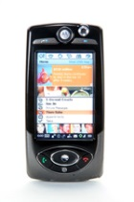

Standards on countering spam
ITU-T X.1242 (2009): Short message service (SMS) spam filtering system based on user-specified rules
Database for blocked SM
Filtering Center
Failed: Blocking and Saving
Filtering request
SM to B
SMSC
Filtering Module
Sender A
No
Yes
Yes/No response
Configuration Module
Passed: Deliver SM
User B
Filtering (Blocking) Process

Slide 29
Standards on countering spam
ITU-T X.1242 (2009): Short message service (SMS) spam filtering system based on user-specified rules
User-specified rules database (URD)
Filtered messages database (FMD)
User service management module (USMM)
SMS spam filtering module (SSFM)
Service control module (SCM)
Short Message Service Centre (SMSC)

Slide 30
Standards on countering spam
ITU-T X.1242 (2009): Short message service (SMS) spam filtering system based on user-specified rules

Slide 31
Standards on countering spam
ITU-T X.1242 (2009): Short message service (SMS) spam filtering system based on user-specified rules

Slide 32
Standards on countering spam
ITU-T X.1243 (2010): Interactive gateway system for countering spam
Summary
  This Recommendation
  specifies the interactive gateway system for countering spam as a technical means for countering inter-domain spam.
  enables spam notification among different domains
  prevents spam traffic from passing from one domain to another.
  describes basic entities, protocols and functions of the gateway system
  provides mechanisms for spam detection, information sharing and specific actions in the gateway system for countering spam.

Slide 33
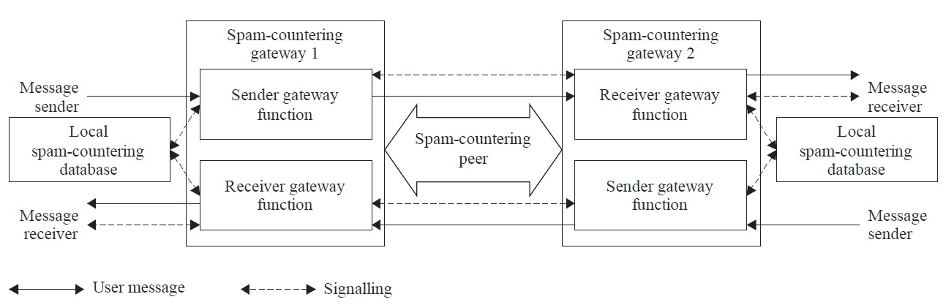
Standards on countering spam
ITU-T X.1243 (2010): Interactive gateway system for countering spam

Slide 34
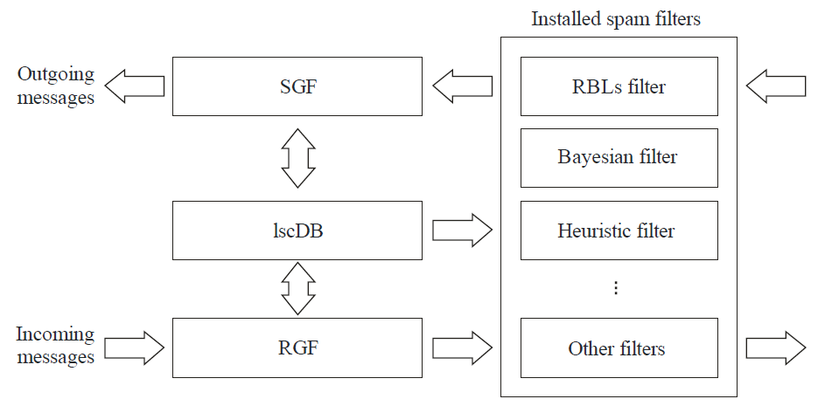
Standards on countering spam
ITU-T X.1243 (2010): Interactive gateway system for countering spam

Slide 35
Standards on countering spam
ITU-T X.1244 (2008): Overall aspects of countering spam in IP-based multimedia applications
Summary
  This Recommendation
  specifies the basic concepts, characteristics, and technical issues related to countering spam in IP multimedia applications
  describes various spam security threats that can cause IP multimedia application spam
  Introduce techniques which can be used in countering IP multimedia application spam
  analyses the conventional spam countering mechanisms and discusses their applicability to countering IP multimedia application spam.

Slide 36
Standards on countering spam
ITU-T X.1244 (2008): Overall aspects of countering spam in IP-based multimedia applications
Typical types of IP multimedia spam
typical types of IP multimedia spam
VoIP spam
IP multimedia message spam
Instant messaging spam
Chat spam
Multimodal spam
Website spam

Slide 37
Standards on countering spam
ITU-T X.1244 (2008): Overall aspects of countering spam in IP-based multimedia applications
Classification of IP multimedia spam
 | Text | Voice | Video
Real-time | • Instant messaging spam • Chat spam | • VoIP spam • Instant messaging spam | • Instant messaging spam
Non Real-time | • Text/multimedia message spam • Text spam over P2P file sharing service • Website text spam | •Voice/multimedia message spam • Voice spam over P2P file sharing service • Website voice spam | •Video/multimedia message spam • Video spam over P2P file sharing service • Website video spam

Slide 38
Standards on countering spam
ITU-T X.1244 (2008): Overall aspects of countering spam in IP-based multimedia applications
Technical issue for countering IP multimedia spam
Creation and delivery of spam
Collection of target list
Creation and delivery of spam
Detection and filtering of spam
Real-time communications
Difficulty of contents analysis of voice and video
Action for the received spam
add spammer's identifier to a blacklist
give a bad score to the spammer
Difficulty of spammer authentication
report illegal spam to punish spammers

Slide 39
Standards on countering spam
ITU-T X.1244 (2008): Overall aspects of countering spam in IP-based multimedia applications
Spam security threats
Attack techniques | Spam security threats
Malicious code/remote control | Spam Bot
Session hijacking | Session hijacking
SQL injection | SQL injection
Sniffing | Registration information sniffing
Spoofing | Sender spoofing, cache poisoning, routing control
Others | Identifier collection, vulnerable management system

Slide 40
Standards on countering spam
ITU-T X.1244 (2008): Overall aspects of countering spam in IP-based multimedia applications
Relationship between countermeasure and security threats
Countermeasures Threats | Authentication | Authorization | Security management
Identifier collection |  |  | X
Sender spoofing | X
Registration information sniffing | X
Session hijacking | X
SQL injection |  | X | X
Spam Bot |  |  | X
Cache poisoning | X
Routing control | X
Vulnerable management system |  | X | X

Slide 41
Standards on countering spam
ITU-T X.1244 (2008): Overall aspects of countering spam in IP-based multimedia applications
well-known mechanisms
Identification filtering
Address masking
Human interactive proof
Authentication by key exchange
Network-based spam filtering
Online stamp
Authorization-based spam filtering
Legal action and regulations

Slide 42
Standards on countering spam
ITU-T X.1244 (2008): Overall aspects of countering spam in IP-based multimedia applications
Considerations in countering IP multimedia application spam
Considerations
service subscriber
Service provider
Network operator
Public organization
Other considerations

Slide 43
Standards on countering spam
ITU-T X.1245 (2010): Framework for countering spam in IP-based multimedia applications
Summary
This Recommendation
  provides the general framework for countering spam in IP-based multimedia, which consists of four anti-spam functions
  describes the functionalities and the interfaces of each function for countering IP multimedia spam

Slide 44
Standards on countering spam
ITU-T X.1245 (2010): Framework for countering spam in IP-based multimedia applications
Technical methods
Source analysis method
Blacklist
Whitelist
Characteristics analysis method
Reputation system
Bulk analysis
Interactivity test
Spam labelling

Slide 45
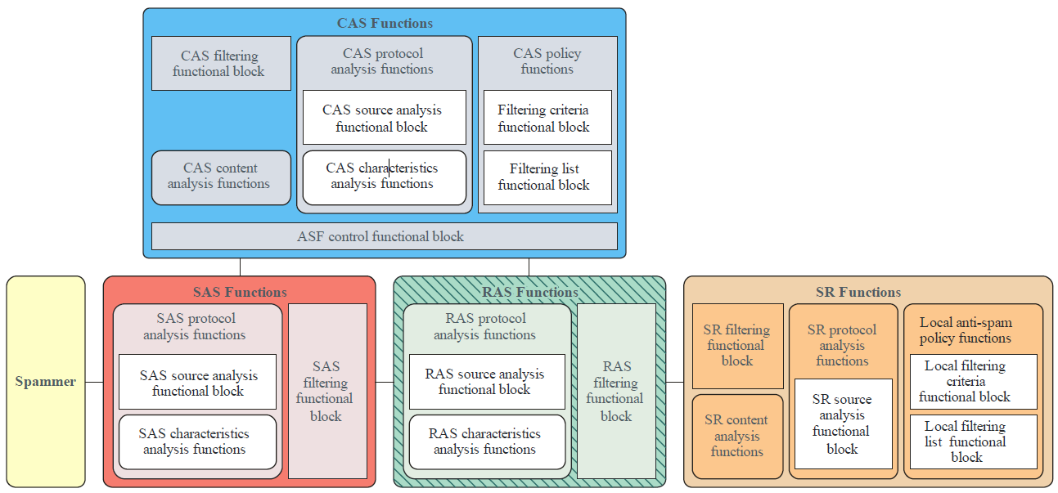
Standards on countering spam
ITU-T X.1245 (2010): Framework for countering spam in IP-based multimedia applications

