Slide 1
IPRs and ITU-T
Presentation at SG-17
Nikos Volanis – Legal Officer
10 September 2015

Slide 2
ToC
Overview of main forms of Intellectual Property
Common Patent Policy of ITU-T/ITU-R/ISO/IEC
ITU Software Copyright Guidelines
Guidelines on the inclusion of Marks in ITU-T Recommendations

Slide 3
Part 1 Overview of the main forms of intellectual property

Slide 4
Copyright
Rights given to creators for their literary and artistic works
Copyright protects the expression of an idea and not the idea itself
Worldwide protection

Slide 5
Main rights conferred upon the copyright owner
Reproduction
Publication
Distribution
Sale/lease
Translation
…

Slide 6
Main restrictions to copyright
Copies for private purposes
Copies for libraries/archiving purposes
Use for educational purposes
“Fair Use”
Quotations

Slide 7
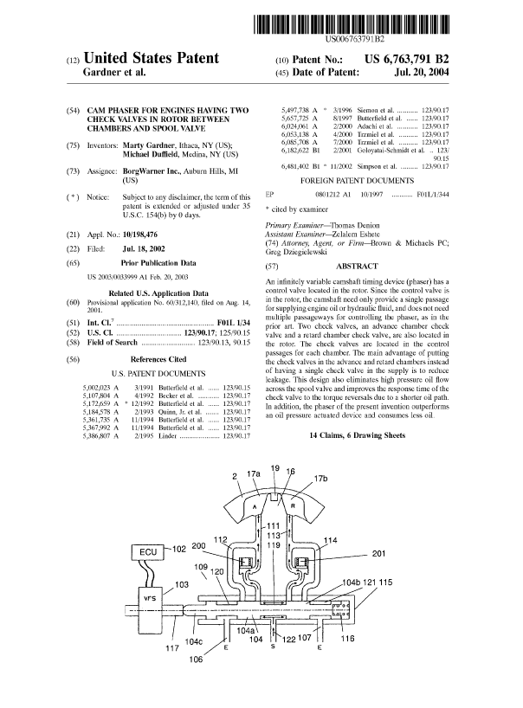
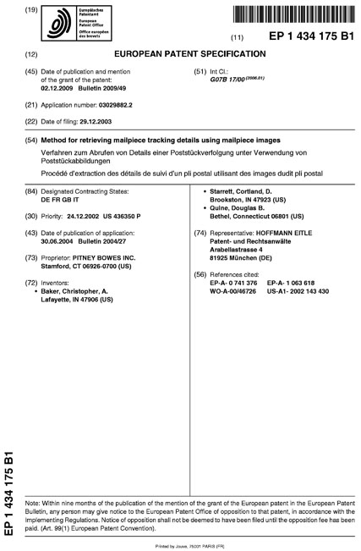
Patents
Rights granted for an invention, which is a product or a process that provides a new way of doing something, or offers a new technical solution to a problem

Slide 8
What can be patented?
Inventions
Must be new
Must be useful
Must be non-obvious
applications are evaluated by patent examiners
Patentable subject matter may vary from country to country

Slide 9
Protection granted by patents
Exclusive right to “use” (e.g. manufacture, import, export, sell, lend, commercialize, etc.) the invention, typically for a period of 20 years (subject to payment of patent annuities)
No protection on the description
Teritoriality

Slide 10
Trademarks
is a recognizable sign, design, or expression which identifies products or services of a particular source from those of others
A trademark is typically a name, word, phrase, logo, symbol, design, image, or a combination of these elements

Slide 11
Protection granted by trademarks
Exclusive right to use a mark to distinguish services or products
Term of protection: unlimited as long as the mark is used (for registered TMs, also subject to TM annuities)

Slide 12
Protection
Registration
Symbol
Term
Cost
Copyrights | the expression of an idea | life of the author + 50 years | none required | © but use of symbol not required for protection | nil
Patents | the monopoly on an invention | 20 years | required, includes review process | no symbol but patent number often seen on product | expensive
Trademarks | the symbol used to distinguish goods | unlimited | required, optional in common law jurisdictions | ® or ™, use of symbol not strictly required for protection | moderately inexpensive

Slide 13
Part 2 Overview of the Common Patent Policy for ITU-R/ITU-T, ISO/IEC and its related Guidelines and Forms

Slide 14
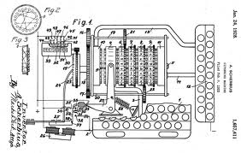
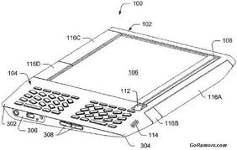
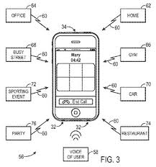
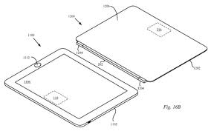
Patents in Standards
A standard may contain a number of patents which are necessary for its implementation (i.e. impossible to implement the standard without infringing such Standard Essential Patents)
Tensions between the legal monopoly granted to SEP owners to exclude others from using the patented invention, and the inherent purpose of the standard to be widely implemented by the industry

Slide 15
Patents in Standards
The inclusion of patented technology into standards raises very complex issues that can be addressed in a number of ways:
ITU, ISO, IEC, ANSI, ETSI, ATIS, CCSA, TIA, TTA, TTC, etc. have opted for the « RAND » approach
Other SDOs have chosen to address the same issues by requiring patent holders to grant royalty-free licenses
No consensus in the industry as to how best to address IPR issues in the context of ICT standardization
No « one-size-fits-all » solution; different approaches can work in different environments

Slide 16
RAND Patent Policies
This balancing is achieved through obligating SEP owners to:
declare such patents as SEPs to the SDO, and
make them available for the implementation of the standard on terms that are fair, reasonable and non-discriminatory (“FRAND” or “RAND”)
Aim to ensure that:
Industry players have access to SEPs in order to be able to enter and compete in the relevant market,
Innovators get a fair return on their R&D, in order to continue to innovate and participate in the standard making processes
RAND commitments tell implementers that they will not be prevented from using a standardized technology, so long as they obtain the required licenses for the patents declared as SEPs for that standard (on a royalty/royalty-free basis)
However, the actual terms of such licenses are left for bilateral negotiations between SEP owner and implementer

Slide 17
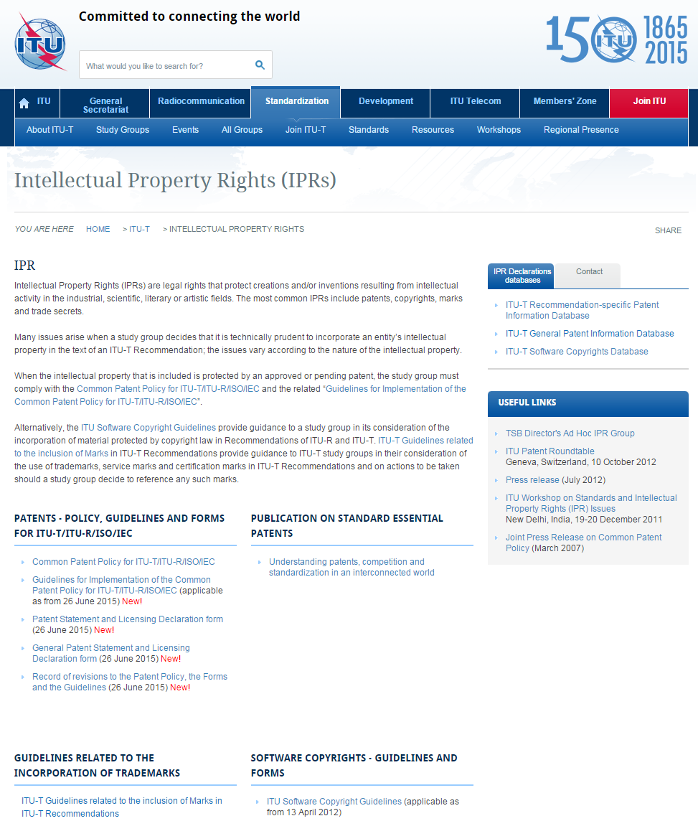
Common Patent Policy
Three documents to consider:
Common Patent Policy
Guidelines for implementation of the Common Patent Policy
Patent Statement and Licensing Declaration Forms
These documents may be found at: www.itu.int/ITU-T/ipr/
TSB Director's Ad Hoc Group on IPR (http://www.itu.int/en/ITU-T/ipr/Pages/adhoc.aspx)

Slide 18
Common Patent Policy
Fundamental Principles:
Early disclosure of essential patents
Accessibility of essential patents to everyone under reasonable and non-discriminatory conditions (“RAND”)

Slide 19
Common Patent Policy
To whom does the disclosure rule apply?
« Any party participating in the work of the ITU … »
Covers work undertaken in SGs and their subordinate groups
Parties not participating in ITU standardization work may also disclose Patents, but are under no obligation to do so
When should disclosure take place?
« from the outset » or « as early as possible »
Is disclosure mandatory?
Strictly speaking, NO.
Common Patent Policy uses the word « should » and not « shall »
The Guidelines use the word « encourage »
However, there may be severe consequences in case of failure to disclose a patent – Dell case

Slide 20
Common Patent Policy
What should be disclosed?
« essential patents », i.e. Patents (or patent applications) whose claim(s) are required to implement a specific Recommendation.
Is disclosure limited to my own patents?
No. Consistent with the Policy and Guidelines, Recommendation A.8, Article 3.6.1, stipulates that “any party…should draw the attention of the Director of TSB to any known patent…either of their own or of other organizations.”
Guidelines: “Any communication drawing the attention to any third party Patent should be addressed to the concerned Organization(s) in writing. The potential Patent Holder will then be requested by the Director/CEO of the relevant Organization(s) to submit a Declaration Form, if applicable”.

Slide 21
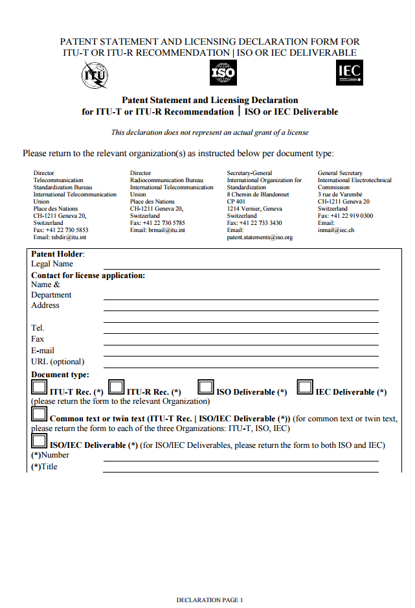
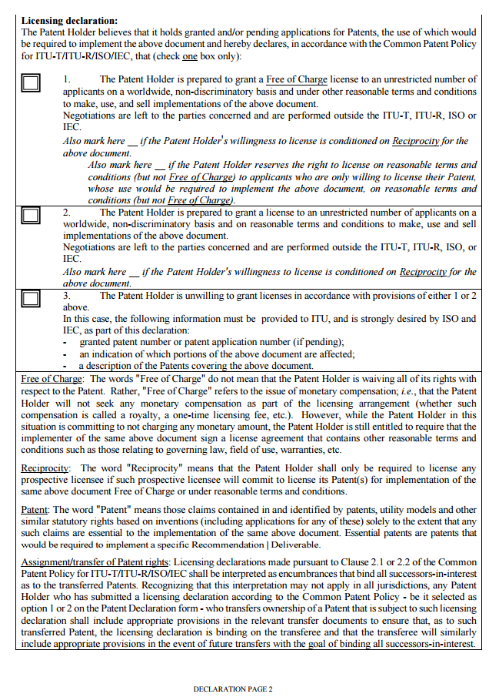
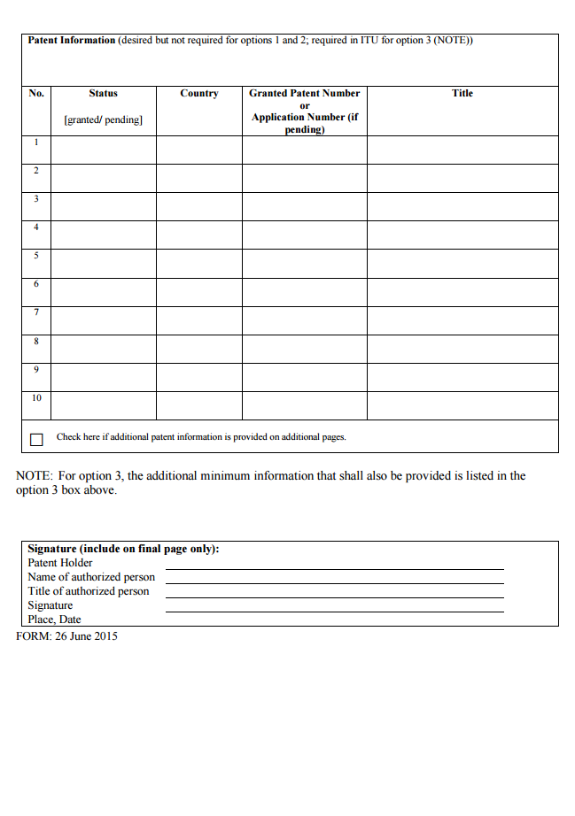
Common Patent Policy
Do I have to conduct patent searches?
information should be provided in good faith, on a best effort basis and there is no requirement for patent searches
How do I disclose my patents?
The then-current forms available on the ITU website must be used.

Slide 22
Common Patent Policy
Patent Statement and Licensing Declaration Form
The main purpose of the Declaration Form is to ensure that patent holders will agree to license their technology on a royalty-free basis or under RAND conditions
Despite its name, the Licensing Declaration Form is not a License Agreement between the patent holder and an implementer of the standard.
Generally speaking, the Declaration Form provides three options
Option 1 - Royalty-free
Option 2 - RAND
Option 3 - No license
General Patent Statement and Licensing Declaration Form
Covers material protected by Patents contained in any of their Contributions
It is not a replacement for the Patent Statement and Licensing Declaration Form, which is made per Recommendation

Slide 23
Common Patent Policy
In case Option 3 is selected (unwillingness to license), the patent holder must provide the following information
Patent number
An indication of which portions of the Recommendation is affected by the patent
A description of the pertinent patent claim(s)
As long as there is no indication of a patent holder selecting option 3, the Recommendation may be approved

Slide 24
Common Patent Policy
Patent Holders must use the Declaration Form
Declaration Forms must be sent to the attention of the TSB Director and not to the Study Group
Declaration Forms (licensing commitments) cannot be withdrawn
Two exceptions –
obvious errors; and
Superseded by another Declaration Form with more favorable licensing conditions
Recommendation A.1, Article 1.4.6: “Chairmen will ask, during each meeting, whether anyone has knowledge of patents the use of which may be required to implement the Recommendation…”.
An oral response (declaration) during a SG meeting is not sufficient to conform to the Policy – Declaration Form must also be filled-in and returned to the TSB Director
Guidelines: “The fact that the question was asked shall be recorder in the meeting report, along with any affirmative responses”

Slide 25
Common Patent Policy
A patent holder may not modify the Declaration form
A patent holder may submit multiple Declaration forms for the same Recommendation, if:
The patent holder wishes to identify several patents and would like them classified according to different options on the Declaration Form; or
The patent holder wishes to classify separate aspects of a complex patent according to different options on the Declaration Form
ITU’s Patent Information Database
ITU maintains a publicly available ‘Patent Information’ database composed of information communicated to ITU by means of Declaration Forms and General Forms submitted by patent holders
http://www.itu.int/net4/ipr/search.aspx?sector=ITU&class=PS

Slide 26
Common Patent Policy
Assignment or transfer of Patent Rights:
Affirmative licensing declarations bind all successors-in-interest as the transferred Patents;
A patent holder who has submitted an affirmative licensing declaration and transfers ownership of a patent that is subject to such licensing declaration shall include appropriate provisions in the relevant transfer document to ensure that, as to such transferred Patent, the licensing declaration is binding on the transferee and that the transferee will similarly include appropriate provisions in the event of future transfers of such Patent.

Slide 27
Common Patent Policy
The Policy does not forbid the disclosure of licensing terms – information may be provided by Patent Holders, if they so desire
However, the Policy does not allow SG to discuss these licensing terms or to take a position concerning the essentiality, scope, validity of any claimed patents
Discussions in SG as to whether or not patented material should be included in a Recommendation is allowed

Slide 28
Recurring questions on the interplay between patents and standards
What considerations, principles and guideposts should be provided to assist in the resolution of disputes regarding “reasonable” licensing terms?
Under which circumstances should the SEP owner be allowed to enjoin the implementer from commercializing its standard-compliant products?
Is this enforcement compatible with the SEP owner’s commitment to grant licenses on RAND terms?
When would such behavior constitute a violation of competition/anti-trust legislation?
What is the meaning of “non-discriminatory”?
Does a SEP owner have the ability to select the appropriate level of supply chain at which to license its SEPs, and refuse licenses to companies at other levels?
These questions constitute subjects of an ongoing debate among industry players, SDOs, regulators, and courts around the world.
For more information, see:
ITU [2014], Understanding patents, competition and standardization in an interconnected world, available at http://bit.ly/1x1ENo1

Slide 29
Part 3 Overview of the Software Copyright Guidelines

Slide 30
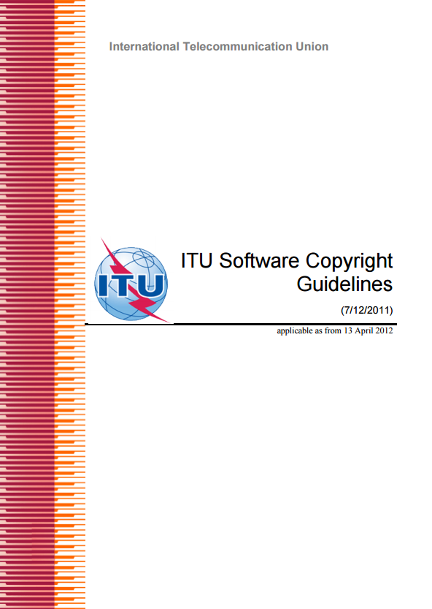
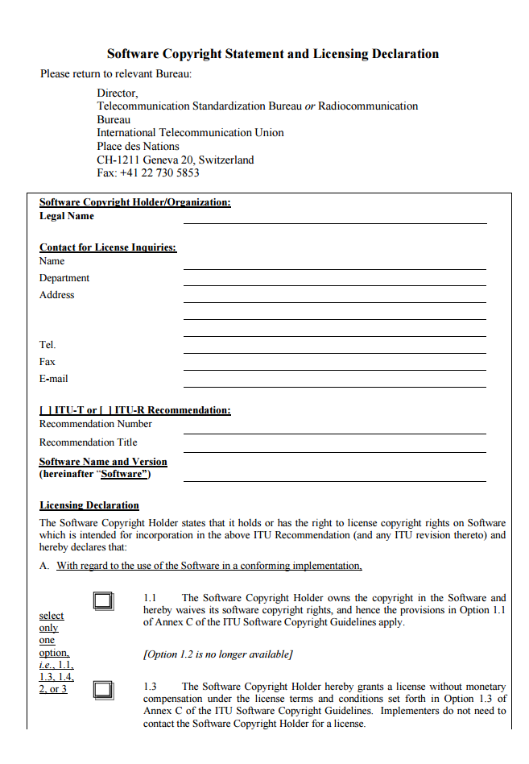
Software Copyright Guidelines
Two documents to consider
Software Copyright Guidelines
Software Copyright Statement and Licensing Declaration
These documents may be found at www.itu.int/ITU-T/ipr/
Unlike the Common Patent Policy, these Guidelines are specific to ITU-T/ITU-R

Slide 31
Software Copyright Guidelines
What is the objective of these Guidelines?
Provide guidance to a SG in its consideration of the incorporation of software code protected by copyright law in ITU Recommendations
To remind SG that ITU strongly discourages the inclusion of copyrighted software owned elsewhere than in ITU. Why?
The nature of copyright protection makes it possible to work around a copyright to develop alternative solutions – so including protected code in the Recommendation is not unavoidable (as it is the case for essential patents)
To provide a process in the exceptional situations where a Study Group still believes that software copyrighted outside ITU must be included in a Recommendation

Slide 32
Software Copyright Guidelines
There may be situations where it is technically appropriate to include software in a Recommendation:
To enhance the description of functionality required to be implemented in products or services to conform to the Recommendation;
As an example of how required functionality might be achieved
To test an implementation for conformance with the required functionality
To describe data structures, schema, etc.
In no cases, however, should software be included in an Recommendation in a way that there is a requirement to incorporate that software in a conformant implementation
If an implementer is interested in including any such software in its implementation on a voluntary basis, then such implementer should review any related Software Copyright Statement and Licensing Declaration(s) to find out which licensing-related option the Software copyright holder has selected

Slide 33
Software Copyright Guidelines
Software Copyright Statement and Licensing Declaration Form
Must be submitted by any member submitting software for incorporation in a Recommendation, before such contribution is included in the Recommendation.
Again, the main purpose of the Declaration Form is to ensure that copyright holders will agree to license their software on a royalty-free basis or under RAND conditions
Despite its name, the Licensing Declaration Form is not a License Agreement
Generally speaking, the Declaration Form provides three options
Free Licenses (waiver of copyright or royalty-free licenses)
RAND Licenses
No license
In this case, the ITU informs the relevant SG of the unavailability of the Software for inclusion in the Recommendation.

Slide 34
Part 4 Overview of the Trademark Guidelines

Slide 35
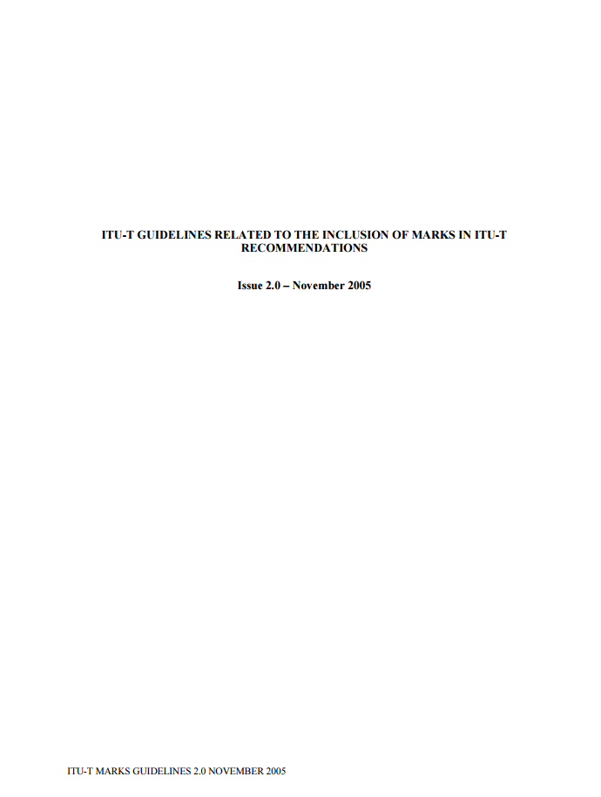
Trademark Guidelines
One document to consider
Guidelines related to the inclusion of Marks in ITU-T Recommendations
No Declaration Forms
May be found at www.itu.int/ITU-T/ipr/
Unlike the Common Patent Policy and the Software Guidelines, these Guidelines are specific to ITU-T

Slide 36
Trademark Guidelines
What is the objective of these Guidelines?
To provide SG with general information on the issues to be considered regarding the use of trademarks
To provide specific guidelines on how marks should be referenced

Slide 37
Trademark Guidelines
The primary concern relating to the use of a trademark in a Recommendation is whether it would appear as if the recommendation is endorsing one particular proprietary product or service over competing ones. Recommendations should not appear to endorse any particular product or brand.
All inclusions of trademarks in ITU-T Recommendations are subject to approval by TSB
Generally, if referenced properly, there is no need to obtain permission/license from the mark owner
No permission required to refer descriptively in a Recommendation to a third party’s technology
Examples:
“This protocol can be used for transport over Wifi infrastructure”
“This specification supports the use of an Access Point Services Router”

