Slide 1
Focus Group on Smart Sustainable Cities ITU-T
Cyber-security, data protection and cyber-resilience in
Smart Sustainable Cities
ITU-T SG17, 8 - 17 April 2015
Giampiero Nanni
Leader of the “Technical report on cyber-security, data protection & cyber-resilience in Smart Sustainable Cities”

Slide 2
Source and references
This document presents a brief summary of the “Technical Report on Cyber-security, Data protection & Cyber-Resilience in smart sustainable Cities” that is being developed by the ITU-T’s Focus Group on Smart Sustainable Cities (FG-SSC).
Please also refer to the following documents submitted to ITU-D SG2, as contributions: 26, 27, 28, 29, 30 and 34.
Notes:
ITU has taken a leadership position to bring the multitude of technologies that target urban problems into the forefront. ITU is working on standards for a multitude of technologies that can target urban problems, including intelligent transport that can be applied to make city streets safer and cleaner; smart water and smart grid to create greater efficiency in these vital utilities; faster broadband technologies to ensure equitable access; cloud computing that offers to power many future applications.
To address the specific issue we have established a new Focus Group on Smart Sustainable Cities to assess the standardization requirements of cities aiming to boost their social, economic and environmental sustainability through the integration of ICTs in their infrastructures and operations.
FG SSC is trying to respond to key unsolved questions such as: what do we mean by smart sustainable city? what are the key performance indicators (KPIs) to gauge the success of smart city ICT deployments? Who are the key stakeholders in developing smart sustainable cities (SSC)? To what extend should we consider a city ‘sustainable’?
Essentially, how should we standardize the development of SSC? Where do we find a set of standards that acts as the foundation of SSC development which cities around the globe could develop upon?
This “Focus Group on Smart and Sustainable Cities” contributes to leverage the role of the ICT sector to foster the growth of smart and sustainable cities worldwide.
2

Slide 3
Overview
Smart and sustainable city deployments will be carried out by a diverse ecosystem of providers in innovative domains, involving state-of-the-art technology, including critical and complex ICT implementations.
These deployments can address different components and city systems, like Intelligent Transportation, Connected Healthcare, Public Safety and Security, Emergency Services, Smart Grid and Smart Metering, Intelligent Buildings, etc.
Increasing ICT complexity, hyper-connectivity, namely through 'Internet of Things' environments, as well as the generation of significant amounts of data, will also mean increasing vulnerability, both to malicious attacks and unintentional incidents. By conceiving interconnected urban systems with Cyber-Security and Data Protection in mind, city administrators will be able to ensure service continuity, safety and well-being for citizens and businesses alike.
This draft Technical Report details these Cyber-Security and Data Protection considerations in Smart and sustainable city developments. It will explore the requirements and challenges of creating a secure, reliable and resilient smart and sustainable city. It will consider how administrations and the overall city ecosystems will need to provide innovative, resilient 'smart' solutions that leverage digital information while protecting against malicious violations, unintentional damage and natural disasters.
Notes:
ITU has taken a leadership position to bring the multitude of technologies that target urban problems into the forefront. ITU is working on standards for a multitude of technologies that can target urban problems, including intelligent transport that can be applied to make city streets safer and cleaner; smart water and smart grid to create greater efficiency in these vital utilities; faster broadband technologies to ensure equitable access; cloud computing that offers to power many future applications.
To address the specific issue we have established a new Focus Group on Smart Sustainable Cities to assess the standardization requirements of cities aiming to boost their social, economic and environmental sustainability through the integration of ICTs in their infrastructures and operations.
FG SSC is trying to respond to key unsolved questions such as: what do we mean by smart sustainable city? what are the key performance indicators (KPIs) to gauge the success of smart city ICT deployments? Who are the key stakeholders in developing smart sustainable cities (SSC)? To what extend should we consider a city ‘sustainable’?
Essentially, how should we standardize the development of SSC? Where do we find a set of standards that acts as the foundation of SSC development which cities around the globe could develop upon?
This “Focus Group on Smart and Sustainable Cities” contributes to leverage the role of the ICT sector to foster the growth of smart and sustainable cities worldwide.
3

Slide 4
Definition of SSC
“A smart sustainable city is an innovative city that uses information and communication technologies (ICTs) and other means to improve quality of life, efficiency of urban operation and services, and competitiveness, while ensuring that it meets the needs of present and future generations with respect to economic, social and environmental aspects”.
Notes:
ITU has taken a leadership position to bring the multitude of technologies that target urban problems into the forefront. ITU is working on standards for a multitude of technologies that can target urban problems, including intelligent transport that can be applied to make city streets safer and cleaner; smart water and smart grid to create greater efficiency in these vital utilities; faster broadband technologies to ensure equitable access; cloud computing that offers to power many future applications.
To address the specific issue we have established a new Focus Group on Smart Sustainable Cities to assess the standardization requirements of cities aiming to boost their social, economic and environmental sustainability through the integration of ICTs in their infrastructures and operations.
FG SSC is trying to respond to key unsolved questions such as: what do we mean by smart sustainable city? what are the key performance indicators (KPIs) to gauge the success of smart city ICT deployments? Who are the key stakeholders in developing smart sustainable cities (SSC)? To what extend should we consider a city ‘sustainable’?
Essentially, how should we standardize the development of SSC? Where do we find a set of standards that acts as the foundation of SSC development which cities around the globe could develop upon?
This “Focus Group on Smart and Sustainable Cities” contributes to leverage the role of the ICT sector to foster the growth of smart and sustainable cities worldwide.
4

Slide 5
The SSC cyber-equation
“Smart and Sustainable Cities” have ICT as key enabler
This implies:
Highly complexity of the ICT systems
Highly interconnected components
High volume of data generated
Hyper-connectivity +
Hyper-complexity +
Hyper-volume of data
_______________________________________________
=High vulnerability
Notes:
ITU has taken a leadership position to bring the multitude of technologies that target urban problems into the forefront. ITU is working on standards for a multitude of technologies that can target urban problems, including intelligent transport that can be applied to make city streets safer and cleaner; smart water and smart grid to create greater efficiency in these vital utilities; faster broadband technologies to ensure equitable access; cloud computing that offers to power many future applications.
To address the specific issue we have established a new Focus Group on Smart Sustainable Cities to assess the standardization requirements of cities aiming to boost their social, economic and environmental sustainability through the integration of ICTs in their infrastructures and operations.
FG SSC is trying to respond to key unsolved questions such as: what do we mean by smart sustainable city? what are the key performance indicators (KPIs) to gauge the success of smart city ICT deployments? Who are the key stakeholders in developing smart sustainable cities (SSC)? To what extend should we consider a city ‘sustainable’?
Essentially, how should we standardize the development of SSC? Where do we find a set of standards that acts as the foundation of SSC development which cities around the globe could develop upon?
This “Focus Group on Smart and Sustainable Cities” contributes to leverage the role of the ICT sector to foster the growth of smart and sustainable cities worldwide.
5

Slide 6
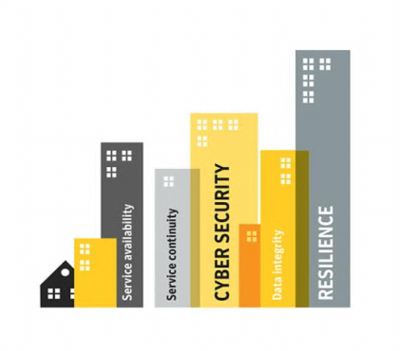
A resilient Smart and Sustainable City…
…needs to be designed, from inception, with…
Cyber security
Privacy
Integrity
Compliance
Reliability
Resilience
…in mind.
High vulnerability
Notes:
ITU has taken a leadership position to bring the multitude of technologies that target urban problems into the forefront. ITU is working on standards for a multitude of technologies that can target urban problems, including intelligent transport that can be applied to make city streets safer and cleaner; smart water and smart grid to create greater efficiency in these vital utilities; faster broadband technologies to ensure equitable access; cloud computing that offers to power many future applications.
To address the specific issue we have established a new Focus Group on Smart Sustainable Cities to assess the standardization requirements of cities aiming to boost their social, economic and environmental sustainability through the integration of ICTs in their infrastructures and operations.
FG SSC is trying to respond to key unsolved questions such as: what do we mean by smart sustainable city? what are the key performance indicators (KPIs) to gauge the success of smart city ICT deployments? Who are the key stakeholders in developing smart sustainable cities (SSC)? To what extend should we consider a city ‘sustainable’?
Essentially, how should we standardize the development of SSC? Where do we find a set of standards that acts as the foundation of SSC development which cities around the globe could develop upon?
This “Focus Group on Smart and Sustainable Cities” contributes to leverage the role of the ICT sector to foster the growth of smart and sustainable cities worldwide.
6

Slide 7
Definitions: resilience and cyber-resilience
Resilience
ITU-T SG17 defines resilience as the "Ability to recover from security compromises or attacks."
Complementing this focus, a recent ITU report on 'Resilient Pathways' defines resilience as "The ability of a system or a sector to withstand, recover, adapt, and potentially transform in the face of stressors such as those caused by climate change impacts".
b. Cyber –security
This concept refers to the discipline of ensuring that ICT systems are protected by attacks and incidents, whether malicious or accidental, threatening the integrity of data, their availability or confidentiality, including attempts to illegally 'exfiltrate' sensitive data or information out of the boundaries of an organisation.
c. Data protection
This notion refers to the tools and processes used to store data relevant to a certain ICT system or environment, as well as recover lost data in case of an incident - be it fraudulent, accidental or caused by a natural disaster.
Notes:
ITU has taken a leadership position to bring the multitude of technologies that target urban problems into the forefront. ITU is working on standards for a multitude of technologies that can target urban problems, including intelligent transport that can be applied to make city streets safer and cleaner; smart water and smart grid to create greater efficiency in these vital utilities; faster broadband technologies to ensure equitable access; cloud computing that offers to power many future applications.
To address the specific issue we have established a new Focus Group on Smart Sustainable Cities to assess the standardization requirements of cities aiming to boost their social, economic and environmental sustainability through the integration of ICTs in their infrastructures and operations.
FG SSC is trying to respond to key unsolved questions such as: what do we mean by smart sustainable city? what are the key performance indicators (KPIs) to gauge the success of smart city ICT deployments? Who are the key stakeholders in developing smart sustainable cities (SSC)? To what extend should we consider a city ‘sustainable’?
Essentially, how should we standardize the development of SSC? Where do we find a set of standards that acts as the foundation of SSC development which cities around the globe could develop upon?
This “Focus Group on Smart and Sustainable Cities” contributes to leverage the role of the ICT sector to foster the growth of smart and sustainable cities worldwide.
7

Slide 8
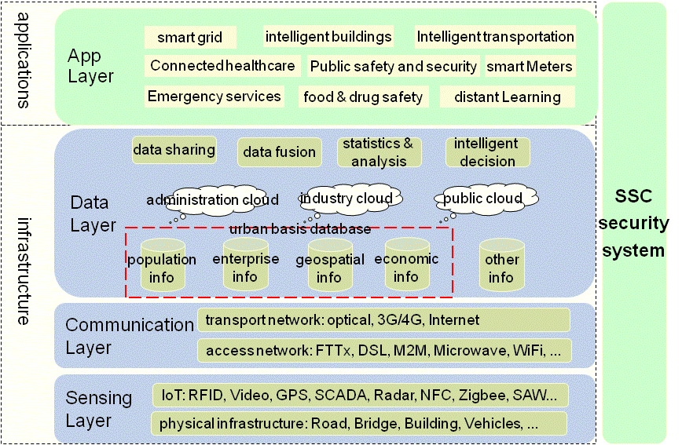
Layered view, and architecture…
Notes:
ITU has taken a leadership position to bring the multitude of technologies that target urban problems into the forefront. ITU is working on standards for a multitude of technologies that can target urban problems, including intelligent transport that can be applied to make city streets safer and cleaner; smart water and smart grid to create greater efficiency in these vital utilities; faster broadband technologies to ensure equitable access; cloud computing that offers to power many future applications.
To address the specific issue we have established a new Focus Group on Smart Sustainable Cities to assess the standardization requirements of cities aiming to boost their social, economic and environmental sustainability through the integration of ICTs in their infrastructures and operations.
FG SSC is trying to respond to key unsolved questions such as: what do we mean by smart sustainable city? what are the key performance indicators (KPIs) to gauge the success of smart city ICT deployments? Who are the key stakeholders in developing smart sustainable cities (SSC)? To what extend should we consider a city ‘sustainable’?
Essentially, how should we standardize the development of SSC? Where do we find a set of standards that acts as the foundation of SSC development which cities around the globe could develop upon?
This “Focus Group on Smart and Sustainable Cities” contributes to leverage the role of the ICT sector to foster the growth of smart and sustainable cities worldwide.
8

Slide 9
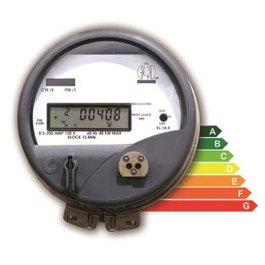
Smart grids and energy efficiency
Cities consume between 60 and 80% of world’s energy
Smart Grid, smart metering with IP address and sensors allow monitoring and adjust generation and delivery based on consumption models
Reduce cost and environmental impact

Slide 10
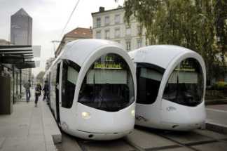
Intelligent transportation: keeping the city moving
Real-time traffic flow information
Telco, Global Positioning Systems (GPS)
M2M communication, Wi-Fi and RFID technologies
Data analytics and prediction techniques

Slide 11
Connected Healthcare
Secure collaborative access for authorised medical services, to Electronic Patient Records, in a way, at any time, from anywhere, from any accredited device
Telemedicine solutions for remote areas or in case of natural disaster
Ageing population: assisted living and monitoring service for independence at home
All require privacy, identification and cyber security

Slide 12
Public safety and security
Protecting against crime, natural disasters, accidents or terrorism.
Tele-surveillance systems to help emergency services
First respondents to benefit from secure connectivity
Secure data access and sharing

Slide 13
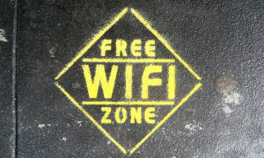
Wireless communications & hotspots
Increasingly popular service, with increasing vulnerability
Unsecure access to sensitive and personal data (online banking, social network, etc.)
Younger population particularly exposed
Cyber-crime increasingly active in these environments

Slide 14
Technologies involved & vulnerabilities
Network Infrastructure
Cloud Computing (availability, security)
Internet of Things (sensors, RFID, M2M, Standards…)
Data and Big Data (embed security with data, confidentiality, integrity, authentication, availability)
Legislation increasingly prescriptive, nationally and EU

Slide 15
Ensuring continuity of critical services
City governance to ensure that ICT strategies are strongly interwoven into the fabric of the wider city evolution strategy
Technology to enable policy
City CIOs increasingly part of strategic policy discussions
Systems/IoT, need to be standardised, interoperable and open, but also secure
Cyber-security and resilience to be embedded from inception
Cyber-security + backup and recovery systems for mission-critical administration data (& Big Data)
Legislation increasingly prescriptive, nationally and EU

Slide 16
Recommendations (1)
Establish Governance - Identify and organise key stakeholders
Governance, Risk and Compliance (GRC) - Fulfil through policies and processes, enabled by ad hoc IT suites: stay compliant and mitigate risks
Service continuity - Solutions and methodologies on Cyber-security, backup, data loss prevention, archiving and disaster recovery.
Protect information proactively
Information-centric approach
Embed security within data
Utilise encryption
Authenticate users with Strong Authentication
This also prevents from accidental disclosing of credentials and from attaching unauthorised devices to the infrastructure.

Slide 17
Recommendations (2)
Threat intelligence - In order to understand the major trends in terms of potential attackers, through analysing trends on malware, security threats, and vulnerabilities
Managed security services - Outsourcing security services to providers. The ICT leadership can in that way focus on their functional duties of running the city systems
Rely on their national Computer Emergency Response Teams (CERT), in order to be aligned with national coordination on cyber-incidents and security, and benefit from the international visibility this provides these entities provide.
Protect the infrastructure by securing endpoints, messaging and web environments.
Ensure 24x7 availability of the critical infrastructure
Develop an information management strategy

Slide 18
Links & Additional Information
ITU-T and Climate Change itu.int/ITU-T/climatechange
ITU Focus Group on Smart Sustainable Cities itu.int/en/ITU-T/focusgroups/ssc/
ITU Symposia & Events on ICTs and Climate Change itu.int/ITU-T/worksem/climatechange
Internet Security Threat Report www.symantec.com/threatreport
Thank you
tsbfgssc@itu.int
giampiero_nanni@symantec.com

