Slide 1
ENISA and standards
Sławomir Górniak
European Union Agency
for Network and Information Security
ITU SG17 meeting
Geneva, 17th September 2014

Slide 2
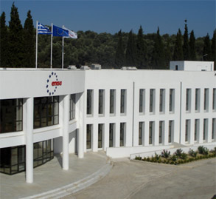
European Union Agency for Network and Information Security
Established in 2004
Centre of expertise: Writing reports that analyse data on security practices in Europe and on emerging risks (e.g. cloud computing, exercises, national contingency plans)
Supporting the European Commission & Member States in their policy initiatives (e.g. setting up and training CERTs, seminars for national exercises)
Facilitating cross-border cooperation (e.g. supporting cyber security exercises)
Ensuring a coherent pan-European approach (e.g. supporting the implementation of article 13a)

Slide 3






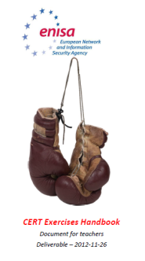


ENISA activities
Policy
Implementation
Recommendations
Mobilising
Communities
Hands on
Notes:
Think Tank
Recommendations// deliverables.. Link to the enisa website
Community Building
Art 14 Requests
Financial ISACs
NIS Platform
Cyber Security Coordination Group
Legislation
Hands on
Cyber exercises
CERT training

Slide 4
ENISA efforts
Identification of risks associated with new technologies affecting the daily life of citizens
Cyber crisis cooperation at EU and international level and development of capabilities
Facilitating Public-Private cooperation
Improving transparency of security incidents
Enabling communities to improve NIS: capacity building with regard to the CERT community and application of good practice for CERTs
Ensuring a strong EU response to cybercrime
Supporting R&D investments and strengthen the competitiveness of EU’s security industry
Promote personal data protection

Slide 5
ENISA and standards
Regulation (EC) 460/2004
  Art. 3 – In order to ensure that the scope and objectives set out in Articles 1 and 2 are complied with and met, the Agency shall perform the following tasks:
    (g): to track the development of standards for products and services on network and information security
However
  (12) The exercise of the Agency's tasks should not interfere with the competencies and should not pre-empt, impede or overlap with the relevant powers and tasks conferred on:
    the European standardisation bodies, the national standardisation bodies and the Standing Committee as set out in Directive 98/34/EC of the European Parliament and of the Council of 22 June 1998 laying down a procedure for the provision of information in the field of technical standards and regulations and of rules on Information Society Services(14),

Slide 6
ENISA and standards
Regulation 526/2013, Art.3.1d
Support research and development and standardisation, by:
  (i) facilitating the establishment and take-up of European and international standards for risk management and for the security of electronic products, networks and services;
  (ii) advising the Union and the Member States on research needs in the area of network and information security with a view to enabling effective responses to current and emerging network and information security risks and threats, including with respect to new and emerging information and communications technologies, and to using risk-prevention technologies effectively;

Slide 7
ENISA approach to standards
Aim: promotion of best practices through SDOs
ENISA role: interface between private sector, public sector, SDOs
Short- and mid-term goals
  Formal cooperation with SDOs and specific WGs
  Working collaboration with SDOs
Long-term goal
  Review of and participation in NIS standardisation activities
  Proposal of standards, via means of proposals for standardisation mandates.

Slide 8
ENISA and SDOs
Established collaboration agreements with:
  ISO SC27 (Liaison)
  ETSI (MoU)
    Exchange of information of mutual interest
    Organisation of joint meetings and workshops
    ENISA to channel standardisation activities to ETSI, if appropriate
    Exchange of working documents, within well defined frames
    ENISA to nominate observers for ETSI Technical Bodies
  CEN CENELEC (MoU)
  ITU (MoU started!)
  ENISA aligns key activities with the work of SDOs
  ETSI TISPAN on CIIP, ESI on eID, CLOUD on cloud certification
  CEN CENELEC on smart grids;
  ISO SC 27 in the area of privacy;

Slide 9
Challenges from EU perspective
Lack of consistent strategy towards standards
Recognized shortcomings of the current approach
Need establishing a small number of key initiatives at EU level
Improve coordination between EU funded R&D and SDOs
Possible ‘vehicles’ for such a coordination:
  ETSI CEN CENELEC CSCG
  Horizon 2020

Slide 10
ETSI CEN-CENELEC Cyber Security Coordination Group (CSCG)
  Give strategic advice to the technical committees of CEN, CENELEC and ETSI
  Develop a gap analysis of European and International Standards on cyber security
  Define of joint European requirements for European and International Standards on cyber security
  Establish a European roadmap on standardization of cyber security
  Act as contact point for all questions of EU institutions relating to standardization of cyber security
  Suggest a joint US and European strategy for the establishment of a framework of International standards on cyber security

Slide 11
CSCG Action Plan
#1 – Governance Framework
#2 – Common Understanding Of “Cyber Security”
#3 – Trust In The European Digital Environment
#4 – European Pki And Cryptographic Capabilities
#5 – European Cyber Security Label
#6 – European Cyber Security Requirements
#7 – European Cyber Security Research
#8 – Eu Industrial Forum On Cyber Security Standards
#9 – Eu Global Initiative On Cyber Security Standards

Slide 12
Governance framework
Strategic options
General recommendations
  Lack of consideration from stakeholders
Recommendations targeting organisations
  Examples: ISO 27k, 31k
  Regulated environment
  EU framework for requiring a lot of resources (research, following-up activities)
Recommendations for products and services
  Similarities: Common Criteria
  Problem in definition of ‘products’ and ‘services’ in the converging world
Recommendations targeted on (classes of) functions, products or services
  “Mash-up" approach – “ad hoc” solution
  Functions, products, services to be selected following an appropriate process

Slide 13
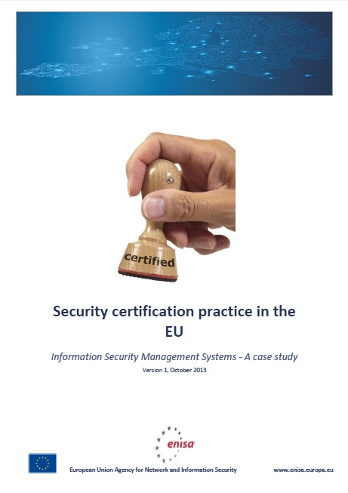
European Cyber-Security Label

Slide 14
Example: ETSI ESI “Algo paper”
ETSI TR 119 312
  Business Guidance on Cryptographic Suites
ETSI TS 119 312
  Cryptographic suites
ENISA reports 2013
  Recommended cryptographic measures
  Algorithms, Key Sizes and Parameters
Collaboration 2014 –>

Slide 15
Example: Security measures for smart grids - conceptual model
Milestones:
  1st version, ENISA publication, Dec 2012
  2nd version, EG2 security measures, April 2014
  Mapping between security measures and M/490 SGIS security levels
Approach
  Risk instead of compliance based approach
  Three level approach
    Risk assessment (by operators)
    Appropriate measures (baseline)
    3 Sophistication levels per each measure (implementation sophistication)
11 control domains
42 measures

Slide 16
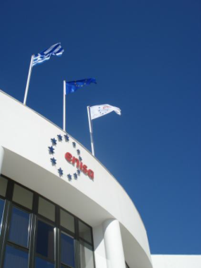





European Union Agency for Network and Information Security
Science and Technology Park of Crete
P.O. Box 1309
71001 Heraklion
Crete
Greece
Follow ENISA
http://www.enisa.europa.eu

