Slide 1
Digital Object Architecture
Tutorial
Christophe Blanchi
DONA Foundation
ITU March 18 2016

Slide 2
Why the Digital Object Architecture?
The Digital Object Architecture’s goal is to provide a solution to the following digital information management issues:
  Provide standard access to heterogeneous information.
    Identification
    Search and retrieval
    Security and trust
    Typing
  Interoperability across heterogeneous information systems.
    Independent of the specific underlying technologies that host and serve the information.
  Interoperability over long periods of time.
    10 – 100 – 10000 years?
    Active management of the systems that the information resides on.
  Very large level of scalability.
    Distributed architecture
    Open architecture framework
    Standard protocols and procedures

Slide 3
A Trip Through the Internet Memory Lane
The development of the Internet was about how to get digital packets reliably routed from computer A to B.
Early routing information in the DARPANET was based on wire numbers.
Later routing information was done using IP addresses and targeted individual machines.
IP addresses where given DNS names for ease of human use.
The web simplified the manner in which someone could access information by rendering it and making a “click” automate command line instructions.
  The web is an application of the Internet but not an Internet extension.

Slide 4
What is the “Internet”?
Is it a network?
Is it a global Information System?
Is it a generic logical abstraction?
None of the above?
All of the above?
Bob Kahn is of the opinion that the Internet is really a set of Protocols and Procedures that describes how networks can interact with each other.
  The underlying networks are replaceable.
  Its is independent of the hardware it operates on.
  It has scaled in a massive way.
  There has been little change to the networks that required changes to the the Internet protocol and procedures.

Slide 5
The Root of the Digital Object Architecture
Information is more than packets.
Information needs to be a “First Class Citizen” on the Internet.
  Information is complex, it has context, uses, monetary value, etc…
  Information needs to be locatable.
  Information needs to be understandable and reusable.
  Information needs to be protected, secure, and trusted.
  Information needs to persist over time.
The Web has made information widely available but there are many issues that remain when dealing with information management.
  Big Data
  IoT

Slide 6
Digital Object Architecture’s Origins
The Digital Object Architecture had its roots in a digital library project CS-TR project (Computer Science – Technical Report) funded by DARPA.
The Digital Object Architecture was first described in a paper: A Framework for Distributed Digital Object Services by Kahn/Wilensky.
The work was developed to be publicly available.
The underlying philosophy: build the minimum that is needed to achieve the desired functionality.
Define a series of protocols and procedures that are technology independent.

Slide 7
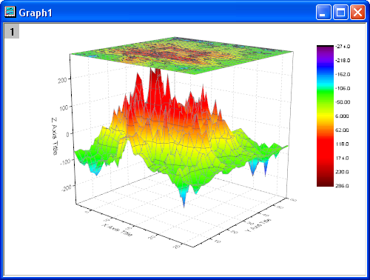


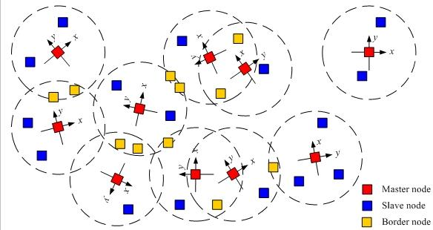
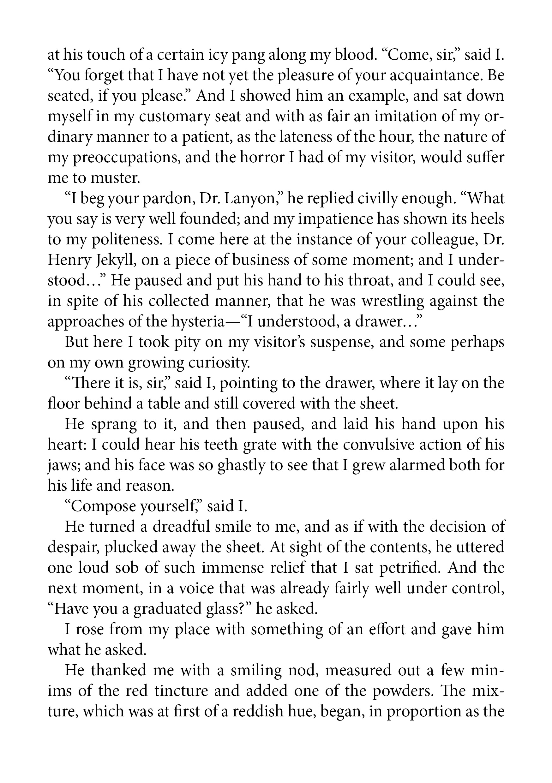

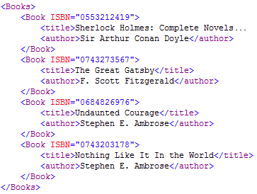
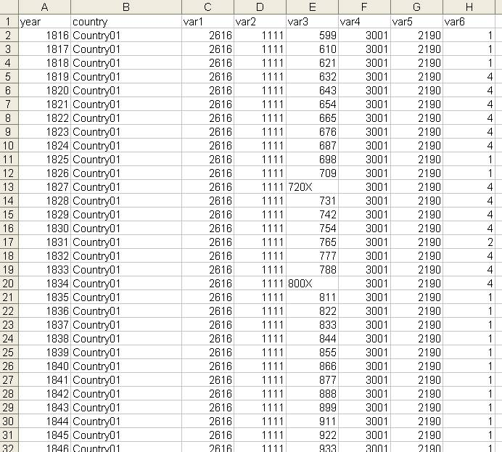
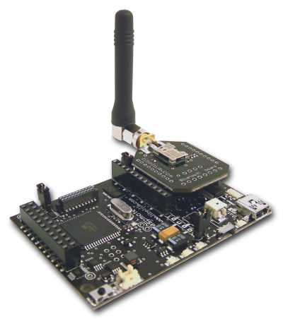





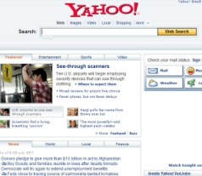
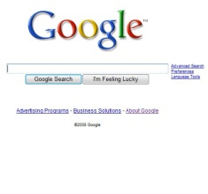
DOA - Information Management on Networks
Client
Repositories
Resource Discovery
Identifier Resolution Service
Search Engines, Metadata Databases, Catalogues, Registries, etc.

Slide 8
What is a Digital Object?
Handle Identifier
The minimum set of attributes needed to exist on a network.
A persistent, globally unique, secure identifier.
State metadata about the object.
Zero of more Data Elements.
A Data Element has a unique identifier.
A Data Element has state metadata about itself.
Date Created
12-10-2014
Date Last Modified
12-11-2015
Type
0.TYPE/DS1
Author
20.200/00
Data Element Identifier
Data Element Identifier
Date Created
12-10-2014
Date Created
12-10-2014
Date Last Modified
12-10-2014
Date Last Modified
12-10-2014
Size
134124
Size
134124
Type
0.TYPE/T1
Type
0.TYPE/T2
Checksum
e044b32a…
Checksum
0e9d7928b…
Payload
Payload

Slide 9

Digital Object Interactions
Digital Object Access Protocol
All Digital Objects are accessible using the Digital Object Protocol.
  Independent of the underlying technical systems.
Each Digital Object describes itself and its contents.
  Metadata – to find them
  Types – to process its data
  Source and integrity
Each Digital Object specifies and contains its own access control rules.

Slide 10
The Digital Object Registry
Provides a infrastructure based search system
  Find Digital Objects by their attributes and targeted contents.
  Find Handles by their values.
Open source software.
Supports access control based searches.
Light weight interface for registration.
Light weight interface for searches.
Registries can be federated.
Registries can be Digital Objects.

Slide 11
What is a Handle?
2304568.40/12345678
Prefix
Suffix
Naming Authority
Item ID
(any format)
A Handle is a globally unique and resolvable identifier
  Prefix is resolvable by the Global Handle Registry to a Local Handle System (LHS).
  The identifier is resolvable by Local Handle System into set of typed values.
Character Set: Unicode 2.0
Encoding: UTF-8
Prefix: Currently allocating only numeric values.
Suffix: No restrictions.

Slide 12
Handles Resolve to Typed Data
Handle
Data Type
Handle Data
10.1525/b.2009.59.5.9
handle=0.na/10.1525; index=200;
[delete hdl,add val,read val,modify val,del admin,add admin,list]
HS_ADMIN
URL
http://caliber.ucpress.net/doi/abs/10.1525/bio.2009.59.5.9
<locations chooseby="locatt, country, weighted">
<location id="1" cr_type="MR-LIST" href="http://mr.crossref.org/
iPage?doi=10.1525%2Fbio.2009.59.5.9" weight="1" />
<location id="2" cr_src="unca" label="SECONDARY_BIOONE"
cr_type="MR-LIST" href="http://www.bioone.org/doi/full/10.1525/
bio.2009.59.5.9" weight="0" />
</locations>
10320/loc
HS_PUBKEY
0000000B4453415F5055425F4B4559000000000015009760508F15230B….
HS_SIGNATURE
eyJhbGciOiJSUzI1NiJ9.eyJkaWdlc3RzIjp7ImFsZyI6IlNIQS0yNTYiLCJkaWdlc….

Slide 13
Handle System
Provides basic identifier resolution system for the Internet.
  Resolve an object identifier to its current state data.
  Identifier persists even if location and other attributes of the object changes.
Logically a single system, but physically and organizationally distributed.
Highly scalable.
Associates one or more typed values, e.g., IP address, public key, URL, to each identifier.
Optimized for speed and reliability.
Secure resolution with its own PKI as an option.
Open, well-defined protocol and data model.
Provides infrastructure for application domains, e.g., digital libraries & publishing, e-research, id mgmt.

Slide 14
Handle Resolution
MPA 2
MPA 4
MPA 1
DONA
MPA 6
Resolution request
For 10.1525/59.5.9
MPA 3
MPA 6
Global
Handle
Registry
Local
Handle
Service
Local
Handle
Service
Local
Handle
Service
Local
Handle
Service
The Handle System is
a collection of Handle
Services, each of which
consists of one or more
replicated sites, each of
which may have one or
more servers.
Site 2
Site 1
Site 2
Site 1
Site 3
…...
Site n
#1
#2
#1
#2
#3
#4
#n
...
10.1525/59.5.9
URL
4
http://www.acme.com/
URL
20
http://www.acme.com/

Slide 15
Handle Clients
1. Client sends request any MPA GHR Service in the GHR to resolve 0.NA/12.34 (prefix handle for 12.34/56)
Global Handle Registry
hdl:12.23/56
Client gets request
to resolve hdl:12.34/56

Slide 16
Handle Clients
2. An MPA GHR service Responds with Service Information for 12.34
Global Handle Registry
hdl:12.34/56
IP
xc
xc
xc
...
xcccxv
xc
xc
xc
..
xccx
xc
xc
xc
..
Client gets request
to resolve hdl:12.34/56
xccx
xc
xc
xc
..
xcccxv
xc
xc
xc
..
xccx
xc
xc
xc
..
xccx
xc
xc
xc
..
xcccxv
xc
xc
xc
..
xccx
xc
xc
xc
..
xccx
xc
xc
xc
..
Service Information
Acme Local Handle Service

Slide 17
Handle Clients
xcccxv
xc
xc
xc
...
xcccxv
xc
xc
xc
..
xccx
xc
xc
xc
..
xccx
xc
xc
xc
..
xcccxv
xc
xc
xc
..
xccx
xc
xc
xc
..
xccx
xc
xc
xc
..
xcccxv
xc
xc
xc
..
xccx
xc
xc
xc
..
xccx
xc
xc
xc
..
IP Address
Port #
Public Key
...
Primary Site
Server 1
123.45.67.8
2641
K03RLQ...
...
Server 2
123.52.67.9
2641
5&M#FG...
...
Secondary Site A
Server 1
321.54.678.12
2641
F^*JLS...
...
Server 2
321.54.678.14
2641
3E$T%...
...
Server 3
762.34.1.1
2641
A2S4D...
...
Secondary Site B
Server 1
123.45.67.4
2641
N0L8H7...
...
Service Information - Acme Local Handle Service

Slide 18
Handle Clients
xcccxv
xc
xc
xc
...
xcccxv
xc
xc
xc
..
xccx
xc
xc
xc
..
xccx
xc
xc
xc
..
xcccxv
xc
xc
xc
..
xccx
xc
xc
xc
..
xccx
xc
xc
xc
..
xcccxv
xc
xc
xc
..
xccx
xc
xc
xc
..
xccx
xc
xc
xc
..
IP Address
Port #
Public Key
...
Primary Site
Server 1
123.45.67.8
2641
K03RLQ...
...
Server 2
123.52.67.9
2641
5&M#FG...
...
Secondary Site A
Server 1
321.54.678.12
2641
F^*JLS...
...
Server 2
321.54.678.14
2641
3E$T%...
...
Server 3
762.34.1.1
2641
A2S4D...
...
Secondary Site B
Server 1
123.45.67.4
2641
N0L8H7...
...
Service Information - Acme Local Handle Service

Slide 19
Handle Clients
xcccxv
xc
xc
xc
...
xcccxv
xc
xc
xc
..
xccx
xc
xc
xc
..
xccx
xc
xc
xc
..
xcccxv
xc
xc
xc
..
xccx
xc
xc
xc
..
xccx
xc
xc
xc
..
xcccxv
xc
xc
xc
..
xccx
xc
xc
xc
..
xccx
xc
xc
xc
..
IP Address
Port #
Public Key
...
Primary Site
Server 1
123.45.67.8
2641
K03RLQ...
...
Server 2
123.52.67.9
2641
5&M#FG...
...
Secondary Site A
Server 1
321.54.678.12
2641
F^*JLS...
...
Server 2
321.54.678.14
2641
3E$T%...
...
Server 3
762.34.1.1
2641
A2S4D...
...
Secondary Site B
Server 1
123.45.67.4
2641
N0L8H7...
...
Service Information - Acme Local Handle Service

Slide 20
Handle Clients
Global Handle Registry
hdl:123/456
3. Client queries Server 3
in Secondary Site A
for 12.34/56
Client gets request
to resolve hdl:12.34/56
#1
#1
#2
Secondary Site B
#2
#1
#3
Primary Site
Secondary Site A
Acme Local Handle Service

Slide 21
Handle Clients
Global Handle Registry
hdl:123/456
4. Server responds with handle data
Client gets request
to resolve hdl:12.34/56
#1
#1
#2
Secondary Site B
#2
#1
#3
Primary Site
Secondary Site A
Acme Local Handle Service

Slide 22



Handle Clients
http://hdl.handle.net/12.34/56
Resolution With a Web Browser
HTTP Get
Proxy/Web Server
LHS
GHR
LHS
Handle
Resolution
LHS
LHS
LHS
LHS
LHS
LHS
LHS
Handle System

Slide 23
Handle Clients
http://acme.com/index.html
Resolution With a Web Browser
HTTP Redirect
Proxy/Web Server
LHS
GHR
LHS
Handle
Data
LHS
LHS
LHS
LHS
LHS
LHS
LHS
Handle System

Slide 24
Handle Clients
hdl:12.34/56
Resolution with a Handle Client Plug-in
Handle
Data
Handle
Resolution
LHS
GHR
LHS
LHS
LHS
LHS
LHS
LHS
LHS
LHS
Handle System

Slide 25
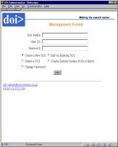
Handle Clients
Handle Admin via Web Form
Web Server and/or Admin
Servlets
LHS
GHR
LHS
LHS
LHS
LHS
LHS
LHS
LHS
LHS
Handle System

Slide 26
Handle Clients
Handle Admin via Web Form
Web Server and/or Admin
Servlets
LHS
GHR
LHS
LHS
LHS
LHS
LHS
LHS
LHS
LHS
Handle System

Slide 27
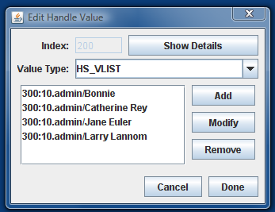
Handle Clients
Custom Admin Client
LHS
GHR
LHS
LHS
LHS
LHS
LHS
LHS
LHS
LHS
Handle System

Slide 28
Handle Clients
Handle Resolution
Embedded in
Another Process
Handle Administration
Embedded in
Another Process
LHS
GHR
LHS
LHS
LHS
LHS
LHS
LHS
LHS
LHS
Handle System

Slide 29
Who is responsible for operating the GHR?
The original GHR was operated by CNRI in Reston VA in the US since the mid to late 1990s.
Until recently, CNRI had the sole credential and authorization to create all new prefixes.
The user community requested that the prefix creation be decentralized across multiple organizations.
Development of a new Multi-Primary GHR architecture.
  Multi-Primary Administrators (MPA): organizations / entities that are credentialed and authorized by DONA to create derived prefixes.
  Each MPA is allotted a single prefix (e.g. 0.NA/21)
  Every MPA can create an unlimited number of derived prefixes from its allotted prefix and allot them to whomever they see fit.
  All MPA verify and replicate any and all valid prefix creations from all other MPAs.
DONA and the MPAs coordinate the operations of the GHR.
The new GHR maintain backwards compatibility with legacy GHR.

Slide 30

Legacy – CNRI as sole GHR administrator.
CNRI GHR
CNRI
Primary
CNRI
Mirror
CNRI
Mirror
CNRI
Mirror
Organization A
Prefix 123
Organization B
Prefix 234
Organization N
Prefix xyz
Could create handles
123/suffix on their LHS
Could create handles
234/suffix on their LHS
Could create handles
xyz/suffix on their LHS

Slide 31
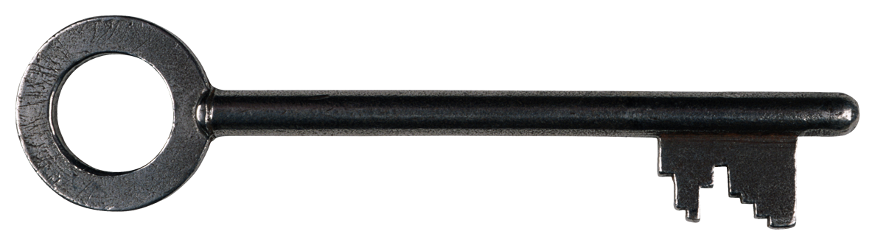
New GHR – Coordinated Across MPAs
Multi Organizational Coordinated
GHR
DONA
GHR SVC
MPA Org A
GHR SVC 20
MPA Org N
GHR SVC 99
LHS 20.1
LHS 20.10
LHS 99.1
LHS 20.1.1

Slide 32
The Role of the DONA Foundation
Based in Geneva Switzerland.
Provide coordination, software, software development, and other strategic services for the technical development, evolution, application, and other uses in the public interest around the world of the Digital Object Architecture (DOA) with a mission to promote interoperability across heterogeneous information systems.
DONA will promote the X.1255 standard and the use of the DOA across many different countries, domains, and industries.
Make the developed DOA standards and/or software accessible to the community to further their development and adoption.

Slide 33
DONA Foundation’s GHR Operations
DONA coordinates with all Multi-Primary Administrators (MPA) to maintain the stable and secure operation of the the Global Handle Registry (GHR).
DONA credentials and authorizes new MPAs.
The DONA Foundation will work in collaboration with the MPAs to improve the architectural, technical, and performance of the GHR.
The Multi-Primary GHR Operations started on the 9th of December 2015.

Slide 34
Questions?

