Slide 1
Automotive Security
Security aspects on Intelligent Transportation Systems (ITS) and how to keep cars secure
Jürgen Frank | Sr. System Engineer
Sep.12.2014

Slide 2
Agenda
Introduction
Automotive Security Use-Case
Security Timeline
Standards
EVITA
SHE
HSM
TPM
Security Modules

Slide 3
Introduction

Slide 4
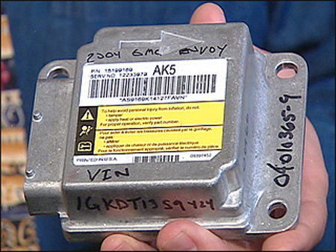
Security Use Cases
In-Vehicle Security
Immobilizer / Component Protection
Mileage Protection
Secure Boot and Chain of Trust
Secure Communication
DRM - eCars
Connected Vehicle Security
Application download
DRM for content download/streaming
Remote ECU firmware update
Black-box for due government or insurance
Car-to-X communication

Slide 5
Automotive Security - Timeline
HIS
1st SHE implementation
EVITA
Hardware Security Module
HIS–HSM Specification
CSE2 (CobraC55 / Halo)
CSE3
Next Gen. Security Module
 | 2008 |  |  |  | 2009 |  |  |  | 2010 |  |  |  | 2011 |  |  |  | 2012 |  |  |  | 2013 |  |  |  | 2014
HIS-SHE
MPC564x - CSE
EVITA - Low/Medium/High Sec. Modules
1st device MPC5746M - HSM
?
HIS - HSM
CSE2
CSE3
N.G. HSM

Slide 6
The Standards

Slide 7
HIS – SHE Specification
Created by some German Car OEMs
Published as a official HIS standard (HIS => Herstellerinitiative Software, German for 'OEM software initiative')
Re-view of the Spec. by Freescale in an early phase
Key features of the SHE specification:
A secure storage for crypto keys
Crypto algorithm acceleration (AES-128)
Secure Boot mechanism to verify custom firmware after reset
Offers 19 security specific functions
Up to 10 general and 5 special purpose crypto keys
juergen.frank@freescale.com

Slide 8
Evita a project co-funded by the European Union http://www.evita-project.org
The objective of EVITA is to design, verify, and prototype an architecture for automotive on-board networks where security-relevant components are protected against tampering and sensitive data are protected against compromise.
High-Level
Medium-Level
Low-Level
UTC Clock
AES-128
Internal RAM
64 KBytes
Internal Core
50-250 MHz
ECC-256
NIST FIPS GF(p)
AES-PRNG
EVITA HW-IF
Internal NVM
32+10 KBytes
Sec. Counter
AES based HASH
EVITA Security Modules
Comment:
No OEM request EVITA modules → OEMs reference to SHE or HSM
Is not a specification, it’s a guidance
Already outdated on some aspects

Slide 9
Trusted Platform Module
 | Auto Security | TPM 1.2 | TPM 2.0
Specified | 2009 HIS-SHE; 2011 HSM | 2003/4 TCG Spec.; 2009 ISO/IEC11889 | DRAFT
Target Market | Automotive | PC | Embedded Systems, Automotive Profile available since 2 weeks
Algorithm | AES-128, CMAC HSM is prog. by customer | RSA, SHA1, HMAC, AES (optional) | RSA, ECC, SHA-1 /-256, HMAC, AES, other possible by supplier
Interfaces | on-die peripherals with master access and high clock | ext. SPI, I²C or LPC (28 / 32 pin package) / embedded in chips sets (e.g. Ethernet) / virtualized TPM
Clock | CSE ≥120 MHz / HSM ≥80 MHz | Typical 33 – 50 MHz
Internal core | SHE: SM or 32bit / HSM: 32bit | mainly 8/16 bit ; rarely 32 bit
Performance for 64bytes | SHE/HSM CMAC ~1µs | SHA1 155µs (TPM with 32bit-SC300™ core)
Main arguments against TPM:
High costs caused by integrating an external, additional chip inside an ECU
Sensitivity to attacks on the communication interface between ECU application core and HSM / replacing the TPM
The non-existence of debug/testing interfaces if a malfunctioned device needs to be analyzed
The high temperature range an automotive qualified product needs to satisfy (e.g. FLASH memory)
Is TPM2.0 able to fulfill the Car2x performance requirements (verify signature of >1000/sec) ?

Slide 10
NIS – National Institute of Standards
No automotive focus
Specifies most of the crypto algorithm (AES, SHA-1/2/3 etc.)
Use several time the championship approach (e.g. AES & SHE3)
Worries in the market (since Snowden), NSA- Dual_EC_DRBG issue

Slide 11
Standards in the Regions
EMEA (mainly Germany)
EVITA
Initiator: EU- funded Europe CAR companies
Published via Project web-page, guide not a spec.
SHE Specification
Initiator: German Car OEMs
Published via HIS (Herrsteller Initiative Software) web-page
Hardware Security Module
Initiator: German Tier1 & Car OEM
Published: not public available
US
Technical acceptance of the SHE Specification (with small enhancements)
See legal issues due HIS → SAE specification group
HSM to complex for actual use-cases
ASIA
Re-use of the SHE and HSM
TPM still in discussion

Slide 12
Security Modules

Slide 13
Cryptographic Services Engine (CSE) Qorivva MPC564xB/C
CSE module implements the official HIS SHE-Specification
32-bit secure core working at 120 MHz
AES-128
Supported crypto modes: ECB & CBC
Throughput 100 Mbit/sec
Latency 2μs per one encoding/decoding ops
CSE module interfaces:
Crossbar master interface
Configuration interface
Secure flash blocks assigned to the CSE module. Accesses from other masters are impossible.
PRNG seed generation via TRNG
CSE Core not programmable by customer
juergen.frank@freescale.com

Slide 14
CSE2 Enhancements to CSE
Introduce new security flag per GPR-keys
Increased number of GPR-keys from 10 to 20
Secure Boot result storage in NVM (configurable by customer)
Reset Generation on Secure Boot Fail (configurable by customer)
juergen.frank@freescale.com

Slide 15
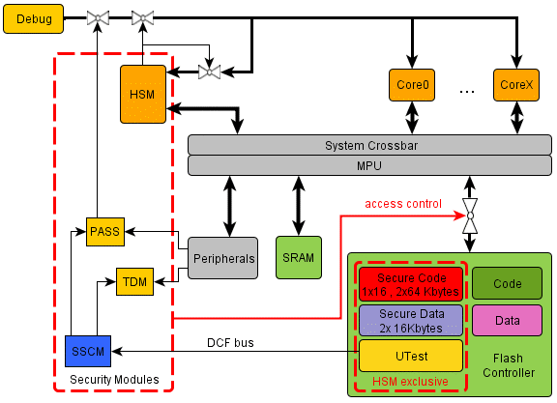
Qorivva HSM Security Architecture
Features:
Device life cycle scheme
Unique ID for each device
Debugger restrictions
Flash Protection
OTP
read / write & erase
diary to log erasing-steps
SSCM: System Status Configuration Module
PASS: Password And Device Security Module
TDM: Tamper Detection Module
HSM: Hardware Security Module
MPU: Memory Protection Unit
DCF: Device Configuration Format
Freescale Production
Customer Delivery
OEM Production
In-Field
Failure Analysis

Slide 16
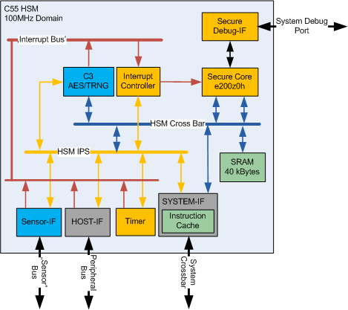
Hardware Security Module (HSM) v1: MPC5746M / MPC5777M & v2: MPC5748G / MPC5746C
HSM is free programmable by the customer, additional security algorithm could implemented in software
Features:
e200z0h core (v1: 100MHz / v2: 80 MHz)
4Kbytes Instruction cache
Secure Debugger Interface
Cryptographic Modules with AES-128, Random Number Generator, DMA
Sensor Interface – monitor for voltage, temperature and clock (v1)
Memory
SRAM (v1: 40 Kbytes / v2: 32 Kbytes)
Flash code: 2 x 64 Kbytes + 1 x 16KBytes data : 2 x 16 Kbytes
juergen.frank@freescale.com

Slide 17
Flash Reprograming Security
MCU
OTP Flash (Configuration)
LifeCycle State n
Password 3
256 bits
Configuration
Password 2
256 bits
LifeCycle State 1
Password 1
256 bits
LifeCycle State 0
Password 0
256 bits
Pass Module
Write/Erase Flash (Application)
Boot code (Password 0)
MCAL (Password 1)
OEM Code (Password 2)
Calibration (Password 3)
OEM Code (Password 2)
Debug Enable/Disable
Flash Program Enable/Disable
256 bit Challenge Register
Flash Program Enable
CPU

Slide 18
TDM - One Time Programable
One Time Programable (OTP) definition:
A Flash block assigned as OTP cannot be erased.
Programming can only be done on an erased location.
Overprogramming is not possible.
Erase/Pgm
TDM
Flash Controller
DCF records

Slide 19
i.MX Trust Architecture Features
Trusted Execution
Isolates execution of critical SW from possible malware
TrustZone® Secure & Normal Worlds (processor modes)
Hardware firewalls between CPU & DMA masters and memory & peripherals
High Assurance Boot
Authenticated boot: prevents unauthorized SW execution
Encrypted boot: protects SW confidentiality
Digital signature checks embedded in on-chip boot ROM
Run every time processor is reset
HW Cryptographic Accelerators
i.MX family dependent
Symmetric: AES-128, AES-256, 3DES, ARC4
Message Digest & HMAC: SHA-1, SHA-256, MD-5

Slide 20
i.MX Trust Architecture Features (continued)
Secure Storage
Protects data confidentiality and integrity
Off-chip: cryptographic protection including device binding
On-chip: self-clearing Secure RAM
HW-only keys: no SW access
HW Random Number Generation
Ensures strong keys and protects against protocol replay
On-chip entropy generation
Cryptographically secure deterministic RNG
Secure Clock
Provides reliable time source
On-chip, separately-powered real-time clock
Protection from SW tampering

Slide 21
i.MX Trust Architecture Features (continued)
Secure Debug
Protects against HW debug (JTAG) exploitation for:
Security circumvention
Reverse engineering
Three security levels + complete JTAG disable
Tamper Detection
Protects against run-time tampering
Monitoring of various alarm sources
Debug activation
External alarm (e.g. cover seal)
SW integrity checks
SW alarm flags
HW and SW tamper response

Slide 22
CSE, HSM and the Security Standards
Security Standards | EVITA- Low | HIS-SHE | EVITA-Medium (HIS-Medium) | EVITA-High
Main features | UID Crypto engine | NVM is mandatory Fix function set | Programmable by customer | Public Key HASH
CSE/CSE2
CSE3
HSM (v1/v2)
next generation security module*
*feature set, still in discussion

Slide 23
Freescale Devices with Security
Freescale Security Solution for Automotive products
 | Device | Platform | Module
MCU ( internal flash) | MPC564xB/C | Power Architecture® e200 | CSE
 | MPC5746M / MPC5777M |  | HSMv1
 | MPC5748G / MPC5746C |  | HSMv2
 | MPC5777C |  | CSE2
MPU (flash-less) | Vybrid ARM® Controller Solutions | ARM® Cortex®-Ax/Mx & ARM9/11 | TrustZone® + Sahara / CAAM
 | i.Mx ARM® 2x / 3x / 5x / 6x / 7x
Automotive
Consumer
no automotive standards available
juergen.frank@freescale.com

Slide 24
Summary
Accepted Specifiction(s) for all regions (EMEA, US and ASIA)
Actual, no international standards
Actual, no public standards
Specification of the cryptographic functions
Functions & Algorithm
Performance (bandwidth, latency)
Additional security requirements
e.g. protection schemes required

