Slide 1
Authoring Recommendations
Tips for streamlining editing
ITU-T SG17 meeting
29 August 2013
Aníbal Cabrera
anibal.cabrera@itu.int
Engineer-Editor
TSB/OPD
International Telecommunication Union

Slide 2
Objectives
Foster a closer working relationship between study group rapporteurs and editors and the TSB editing unit
Identify ways in which SG authors, editors and rapporteurs could contribute to shortening the publication delay while at the same time enhancing the quality of Recommendations

Slide 3
Agenda
Standardizing at a faster pace
Prepublication, editing at TSB, publication
Editing tips
Pre-approval assessment and editing

Slide 4
Streamlining Editing
In the past
CCITT used to issue Recommendations every 4 years

Slide 5
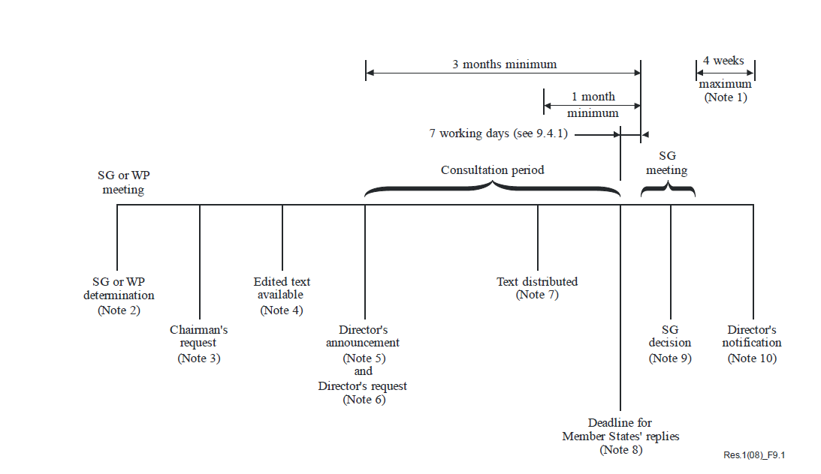
ITU-T
TAP approval procedure

Slide 6
ITU-T
AAP approval procedure

Slide 7
Streamlining Editing
In 2012
TSB published 340 Recommendations and amendments throughout the year (over 14000 pages)

Slide 8
TSB editing and publication unit
Has ambitious publication objectives
On-going adaptation of procedures
Introduced new electronic working methods
Introduced editorial assessment and pre-approval editing (for stable texts)

Slide 9
Editing a Recommendation
The SG author/editor/rapporteur writes the Recommendation and defines:
Scope
Presentation
Content
Length
Level
Organization
References:
WTSA Resolution 1
Recommendation ITU-T A.8
Author’s guide
English Language style guide
Clause 2.3.3.8 of ITU-T A.1 states:
"Rapporteurs are responsible for the quality of their texts, submitted by the study group for publication. They shall be involved in the final review of that text prior to it being submitted to the publication process."
After approval, the Recommendation is sent to the TSB Editing Unit who verifies figures and checks for consistency and sense
Checks for consistency
Language
House style
Abbreviations
Cross-references
References
Bibliography
Numbering of tables, notes, clauses, figures, annexes, appendices, equations
Checks for sense
Ambiguity
Contradiction
Descriptive text of tables
and figures
Figure redrawing
House style
Clarity
Precision

Slide 10
Publication timeline
Consented/
Determined
New Rec. is
approved
Revision or amendment
is approved
Revision/
amendment
Prepublished
Published
TSB editing
Revision is developed based on
the published version
(latest snapshot)
Written specification is ‘frozen’ between snapshots

Slide 11
Publication timeline
Revision drafted based on prepublished (not published) text
Revision or amendment is consented
before previous edition is published
Consented/
Determined
New Rec.
is approved
The standard continues to be developed
New Rec.
Prepublished
Rev.
Prepubl.
New Rec.
Published
Rev.
Published
TSB editing
Revision was not based
on published version
(publication takes longer)

Slide 12
Reducing publication delay
A bigger editing team
Not likely
Approve less documents
Hopefully never
Streamline further editing procedure
Yes!
Spiral effect
Making Recommendations publicly available soon after approval allows for the development of revisions based on the previously published version,
which allows the revision to be made publicly available soon after approval,
which allows for the development of new revisions based on the previously published version,
which allows the new revision…

Slide 13
Reduce the publication delay?
SG counsellor
Editing assistants
SG assistants
We can do it together!
TSB editor
SG editors
SG rapporteurs
Authors
Draftspersons

Slide 14
Help reduce the delay
Fact
The dynamism of the market may require continuous development of a standard, including parallel development of several parts of a Recommendation. However, having multiple revisions or texts not based on latest published version may lead to confusion.
Build on the latest published version when drafting revisions and amendments.
Ensure that parallel developments are introduced into the text in a sequential manner and that modifications introduced earlier amendments and corrigenda have been included.
Tips

Slide 15
Help reduce the delay
Fact
Recommendations are written by experts in the field using highly technical language. When needed, TSB editors contribute to the end result by aligning the text to the English language house rules (English Style guide).
The amount of editing done by TSB editors is limited by the fact that Recommendations have already been seen and approved by the Members.
Ensure that ideas and concepts have been expressed in a clear, unambiguous manner before the text is submitted for approval.
Tip

Slide 16
Help reduce the delay
Fact
Many Recommendations, especially amendments, are developed by several authors who introduce revision marks in text that already contains revision marks introduced by other authors.
Ensure that only the final intended changes to the base text are reflected in revision marks.
Tip

Slide 17
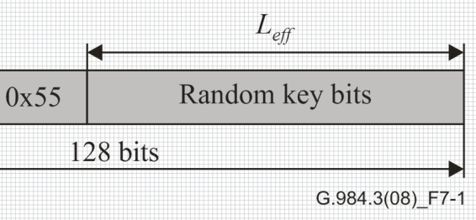
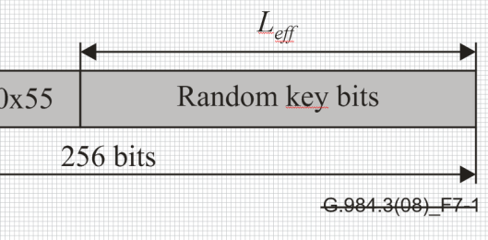
Help reduce the delay
Fact
TSB redraws figures that require text editing or that depart too much from the TSB editorial style. This drawing stage takes time and often results in long publication delays, especially if figures have to be drawn from scratch.
Whenever possible, submit figures in a vector format, which TSB will be able to use for editing.
If a new figure is actually a revision to a figure that had been previously drawn by TSB, cross-out the TSB figure identifier, or add “(MOD)” after the identifier.
Tips

Slide 18
Help reduce the delay
English style guide: “Too many capital letters in a sentence or column of type tend to distract the reader's attention. For this reason, and contrary to many authors’ tendency, as few initial capitals as possible should be used in ITU documents and publications.”
Fact
There is a tendency to use many initial capitals in technical texts; TSB editors will make them lower case from a grammatical point of view. However, it is not always clear which capital letters are actually required by the protocol.
Use initial capitals only when required by English grammar or by a convention (e.g., for protocol elements, names of commands, variables, etc.)
Indicate in clause 5 (Conventions) any naming conventions for protocol elements, entities, etc.
Tips
…. When ASN.1 types and values are referenced in normal text, they are differentiated from normal text by presenting them in the bold Courier New typeface. The names of procedures are differentiated from normal text by displaying them in bold Times New Roman. Access control permissions are presented in italics….

Slide 19
Help reduce the delay
Fact
Recommendations sometimes include text or figures extracted from sources external to ITU.
Before submitting a Recommendation for approval, ensure that we have the necessary copyright permissions for publishing text and figures extracted from external sources.
Tip
IPR page: http://www.itu.int/en/ITU-T/
19

Slide 20
Help reduce the delay
Fact
TSB cannot publish Recommendations that contain references to draft documents or to documents that are not publicly available.
Before submitting a Recommendation for approval, verify that all normative (clause 2) and bibliographic references are valid, stable and accessible by external readers.
Verify that clause 2 references are actually being used normatively and that bibliographic references are being used in a non-normative manner.
It’s a good idea to include links to documents that are not easy to find on the web.
Tips
20

Slide 21
Help reduce the delay
Use conventional sequential numbering for annexes, appendices, clauses, figures and tables.
Good practice: Start numbering anew for each top-level clause
(Table 6-5, then Table 7-1, Figure 8-2 then Figure 9-1, etc.). This will allow for an easier insertion of new figures and tables without having to shift numbering too much.
Annexes are numbered sequentially using capital letters (A, B, C…), except I, to avoid confusion with Appendix I.
Appendices are numbered sequentially using Roman numerals (I, II, III…).
Tips
21

Slide 22
Pre-approval assessment and editing (AAP)
Procedure put in place in October 2012 that allows the Editing Unit to provide editorial advice or to edit a Recommendation before it is submitted for approval.
Applied to stable text
The counsellor, in agreement with the editor/rapporteur, initiates the procedure
Depending on the stability of the text, the counsellor may request global editorial advice or full-text editing from the Editing Unit
Fully-edited Recommendations are published soon after approval

Slide 23
Pre-approval assessment and editing (AAP)
Stable texts
SG, WP or Rapp meetings
Initial
draft
Preferred
B₁
A
B
C
2-3
months
SG or WP meeting
Draft is
modified by
contributions
Draft
Stable?
Y
0 weeks
Modified
further
TD Plen
is generated
Consent
N
AAP
LC
+
AR
4+
weeks
A/AT/AC
Rec. is
prepublished
Prepubl Req
SG
secretariat
Dispatch
Publ Req
Rec. is
published
Rec. is
edited

Slide 24
Reference documents:
Author’s guide (http://www.itu.int/oth/T0A0F000004/en)
English Language style guide (www.itu.int/SG-CP/docs/styleguide.doc)
ITU-T A.5
If you are drafting a Recommendation and have editorial questions, you can always ask the TSB editor
anibal.cabrera@itu.int
The editing team will reply!

Slide 25

http://www.itu.int/en/ITU-T
Notes:
Thank you.

