Slide 1
Overview of
ITU-T Study Group 5 “Environment and Climate Change”
Cristina Bueti, Adviser, ITU

Slide 2
ITU
ITU-T Study Group 5
Working Party 1
Working Party 2
Working Party 3
Regional groups
Related groups
Joint Coordination Activity on ICT and Climate Change
Focus Group on Smart Sustainable Cities (concluded)
Focus Group on Smart Water Management (concluded)
Work with us

Slide 3
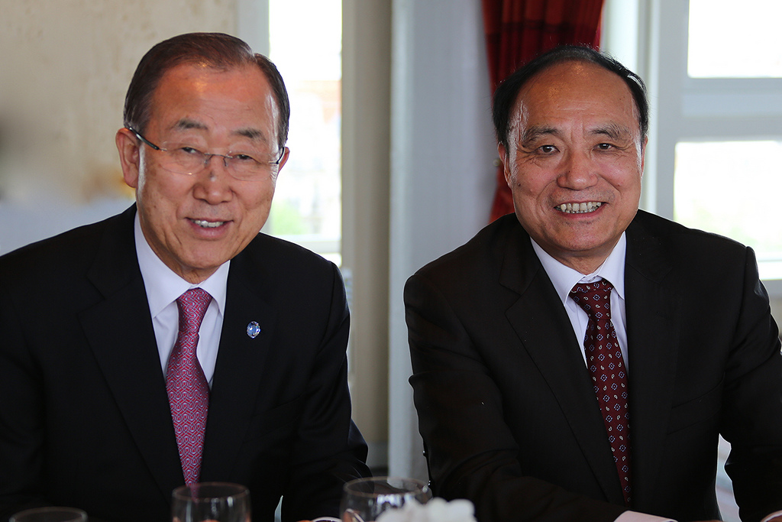
ITU
UN specialized agency for ICTs
standards developing organization
unique public/private partnership
Members:
193 Member States (Governments and regulatory bodies)
Over 700 Private Sector (Sector Members and Associates)
Over 90 Academia

Slide 4
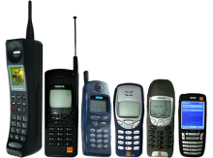
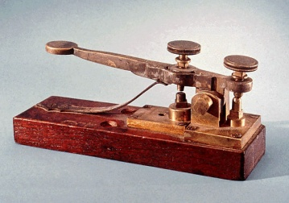
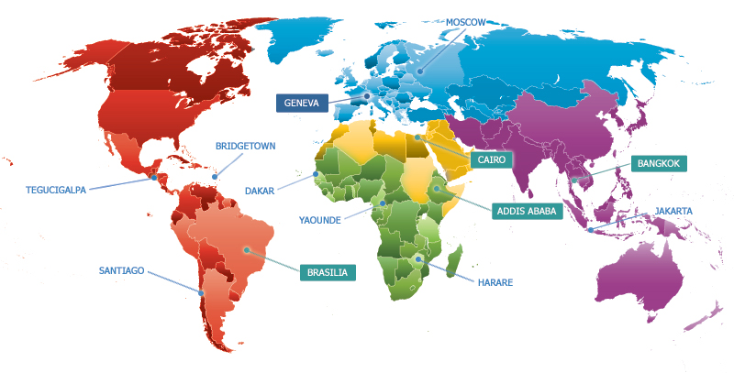
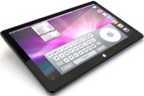
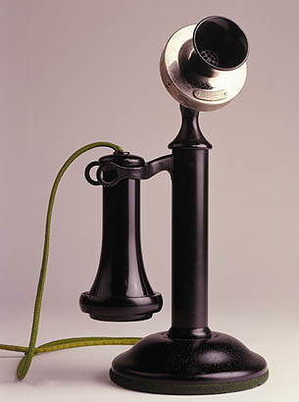
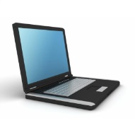
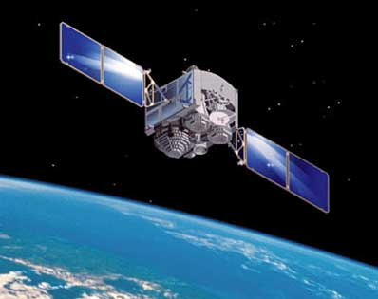
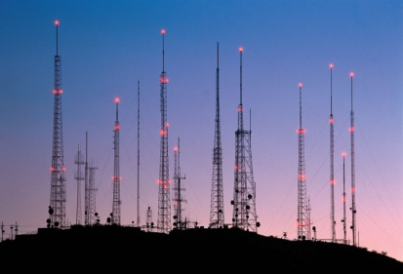
ITU’s structure
Standardization (ITU-T) produces interoperable technical ICT standards
Radiocommunication (ITU-R) coordinates global wireless communication
General Secretariat provides coordination
for the whole organization
Development (ITU-D) provides assistance to the un-connected

Slide 5
ITU-T Study Group 5
Mandate
Lead study group for:
environment and climate change;
electromagnetic compatibility and electromagnetic effects.
Structure
7 Questions
WP1/5
Damage prevention and safety
WP3/5
ICT and climate change
4 Questions
Question 12 Terminology
WP2/5
Electromagnetic fields: emission, immunity and human exposure
New
6 Questions
5

Slide 6
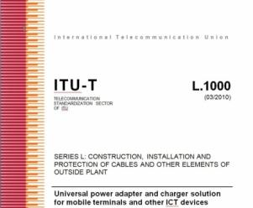
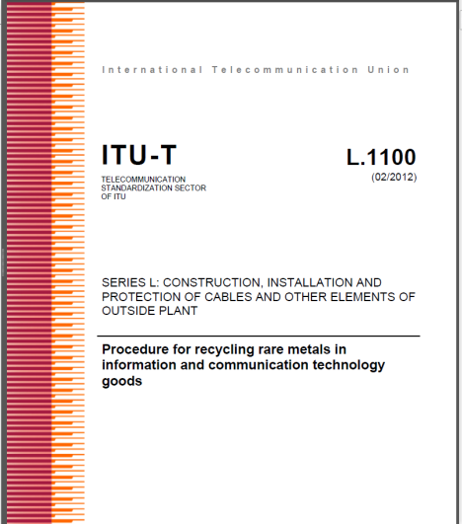
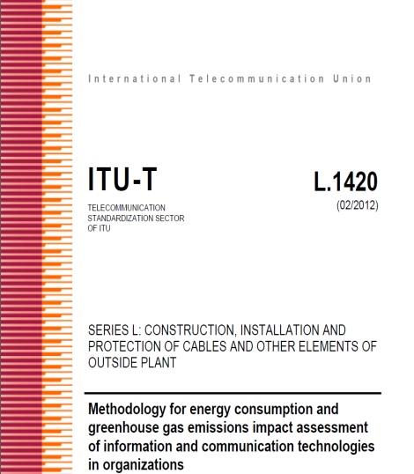
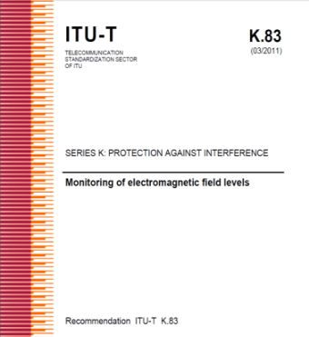
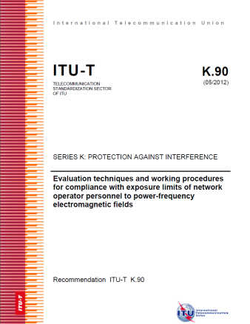
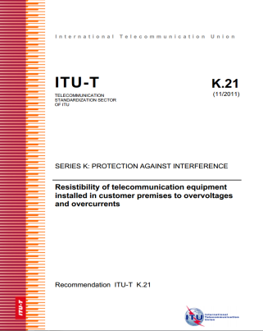
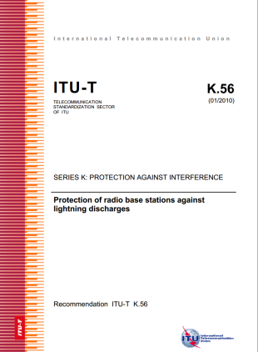
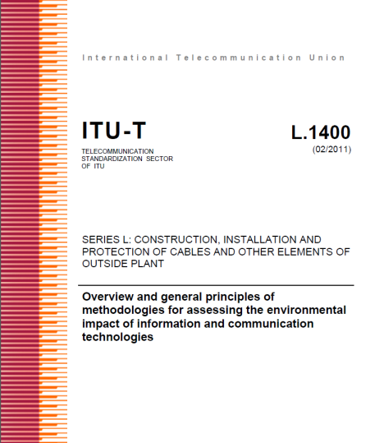
Tasks and objectives
Study and identify standards needs;
Develop non-discriminatory international standards (ITU-T Recommendations), technical reports, best practices and implementation guides;
Ensure interoperability and reduce technical barriers;
Facilitate international cooperation between international and regional standardization bodies;
Reduce the gap in standards between the developed and developing countries.

Slide 7
Working Party 1 (WP1/5)
Work areas:
Q2/5 - Protective components and assemblies
Q3/5 - Interference to telecommunication networks due to power systems and electrified railway systems
Q4/5 - Resistibility and safety in telecommunications
Q5/5 - Lightning protection and earthing of telecommunication systems
WP1/5
Damage prevention and safety
4 Questions

Slide 8
WP1/5: damage prevention and safety
Highlights on deliverables:
ITU-T K.12 - Characteristics of gas discharge tubes for the protection of telecommunications installations
ITU-T K.21 - Resistibility of telecommunication equipment installed in customer premises to overvoltages and overcurrents
ITU-T K.27 - Bonding configurations and earthing inside a telecommunication building
ITU-T K.56 - Protection of radio base stations against lightning discharges
Guide on the Use of the overvoltage resistibility recommendations
http://itu.int/rec/T-REC-K/en
8

Slide 9
Working Party 2 (WP2/5)
Work areas:
Q6/5 - EMC issues arising from the convergence of IT and communication equipment
Q7/5 - Human exposure to electromagnetic fields (EMFs) due to radio systems and mobile equipment
Q8/5 - EMC issues in home networks
Q9/5 - Generic and product family EMC recommendations for telecommunication equipment
Q10/5 - Security of telecommunication and information systems concerning the electromagnetic environment
Q11/5 - EMC requirements for the Information Society
WP2/5
Electromagnetic fields: emission, immunity and human exposure
6 Questions
9

Slide 10
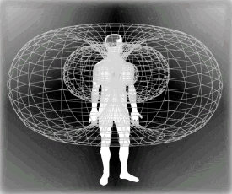
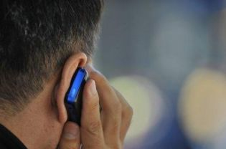
WP2/5: electromagnetic fields: emission, immunity and human exposure
Highlights on deliverables:
ITU-T K.48 - EMC requirements for telecommunication equipment - Product family Recommendation
ITU-T K.83 - Monitoring of electromagnetic field levels
ITU-T K.87 - Guide for the application of electromagnetic security requirements – Overview
ITU-T K.91 - Guidance for assessment, evaluation and monitoring of human exposure to radio frequency electromagnetic fields
ITU-T K.92 - Conducted and radiated electromagnetic environment in home networking
http://itu.int/rec/T-REC-K/en
10

Slide 11
Working Party 3 (WP3/5)
Work areas:
Q13/5 - Environmental impact reduction including e-waste
Q14/5 - Setting up a low cost sustainable telecommunication infrastructure for rural communications in developing countries
Q15/5 - ICTs and adaptation to the effects of climate change
Q16/5 - Leveraging and enhancing the ICT Environmental sustainability
Q17/5 - Energy efficiency for the ICT sector and harmonization of environmental standards
7 Questions
WP3/5
ICT and climate change
Q18/5 - Methodologies for the assessment of environmental impact of ICT
Q19/5 - Power feeding systems
11

Slide 12
WP3/5: ICT and climate change
Highlights on deliverables:
ITU-T L.1000 - Universal power adapter and charger solution for mobile terminals and other ICT hand held devices
ITU-T L.1001 - External universal power adapter solutions for ICT equipment for stationary use
ITU-T L.1002 - External universal power adapter solutions for portable information and communication technology devices
ITU-T L.1005 - Test suites for assessment of the universal charger solution
ITU-T L.1300 - Best practices for green data centres
ITU-T L.1310 - Energy efficiency metrics and measurement methods for telecommunication equipment
ITU-T L.1400 - Overview and general principles of methodologies for assessing the environmental impact of information and communication technologies
ITU-T L.1410 - Methodology for the assessment of the environmental impact of information and communication technology goods, networks and services
ITU-T L.1420 - Methodology for energy consumption and greenhouse gas emissions impact assessment of information and communication technologies in organizations
ITU-T L.1430 - Methodology for assessment of the environmental impact of information and communication technology greenhouse gas and energy projects
http://itu.int/rec/T-REC-L/en
12

Slide 13
Regional groups
Study Group 5 Regional Group for the Americas
Study Group 5 Regional Group for Asia and the Pacific
Study Group 5 Regional Group for the Arab Region
Study Group 5 Regional Group for Africa

Slide 14
Related groups
United in diversity to shape a better future through global ICT standards
Activities open to all

Slide 15
Focus Group on Smart Sustainable Cities
Shaping the city we want
Established at the Study Group 5 meeting in Geneva (February 2013)
Concluded in May 2015
21 technical reports and specifications approved
As an open platform for smart-city stakeholders to exchange knowledge in the interests of identifying the standardized frameworks needed to support the integration of ICT services in smart cities.
http://www.itu.int/go/fgssc

Slide 16
Focus Group on Smart Water Management
Addressing the world water crisis
Established by the ITU-T TSAG meeting in Geneva (June 2013)
Concluded in May 2015
4 deliverables approved
A multi-stakeholder approach to the development of smart water-management systems.
http://www.itu.int/go/fgswm

Slide 17
Importance of global standards
Promote environmental sustainability, combat climate change and tackle e-waste;
Avoid health risks from electromagnetic fields (EMF) produced by telecommunication devices and installations;
Protect telecommunication equipment and installations against damage and malfunction due to electromagnetic disturbances, such as those from lightning;
Ensure safety of personnel and users of networks against current and voltages used in telecommunication networks.
Work with us!

Slide 18
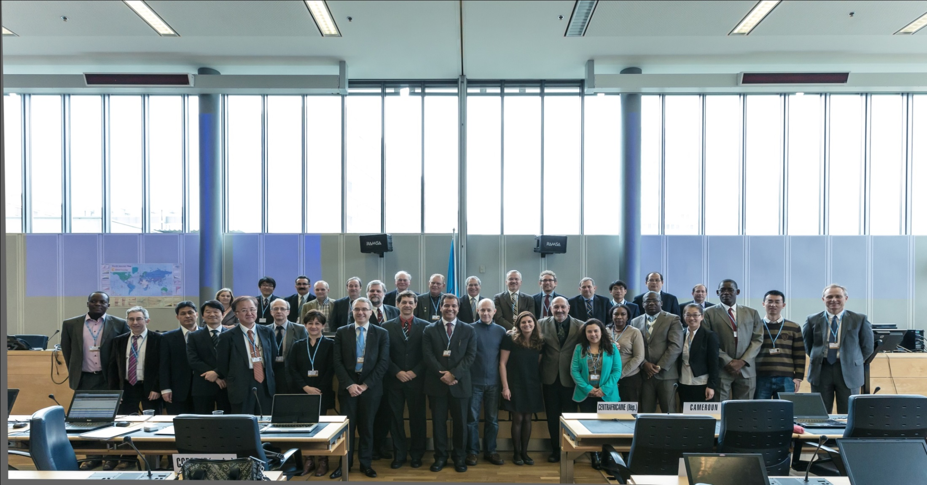
THANK YOU
ITU-T SG5 “Environment & Climate Change” itu.int/go/tsg5
ITU-T and Climate Change itu.int/go/ITU-T/climate
tsbsg5@itu.int

