Slide 1
Making Our Cities Smarter and More Sustainable

Slide 3
“To support future city strategies, we need to understand the benefits of the embedded ubiquitous technologies and smart city developments in our everyday lives”

Slide 4
United 4 Smart Sustainable Cities (U4SSC)
U4SSC is a United Nations Initiative coordinated by ITU, UNECE and UN-Habitat that advocates for public policy to encourage the use of ICTs to facilitate and ease the transition to smart sustainable cities.
U4SSC contributes to the achievement of the Sustainable Development Goal 11: "Make cities and human settlements inclusive, safe, resilient and sustainable
Supported by:

Slide 5
U4SSC current work
U4SSC is currently working on the following deliverables:
Guidelines on tools and mechanisms to finance SSC projects
Guidelines on strategies for circular cities
City science application framework
Guiding principles for artificial intelligence in cities
Blockchain 4 cities
Thematic Group on "The Impact of Frontier Technologies in Cities“:
The impact of Sensing technologies and IoT in Cities
The impact of Artificial Intelligence and Cognitive Computing in Cities
The impact of Data Processing and Computation in Cities
Join the U4SSC now and participate in the online discussions

Slide 6
U4SSC publications
Available for free on the U4SSC website: http://itu.int/go/U4SSC

Slide 7
U4SSC Key performance indicators for Smart Sustainable Cities
The U4SSC Initiative has developed a set of international key performance indicators (KPIs) for Smart sustainable cities (SSC) to establish the criteria to evaluate ICT´s contributions in making cities smarter and more sustainable, and to provide cities with the means for self-assessments.

Slide 8
KPIs Project for Smart Sustainable Cities to Reach SDGs
More than 50 cities are participating in the project
Dubai
Montevideo
Singapore
Maldonado
To support cities in the implementation and use of the SSC KPIs
To test and verify the applicability of SSC-KPIs in several cities of the world.
To develop a global Smart Sustainable Cities (SSC) Index.
Valencia
Manizales
Wuxi
Pully
Foshan
Guangshan
Kairouan
Moscow
and many others…

Slide 9
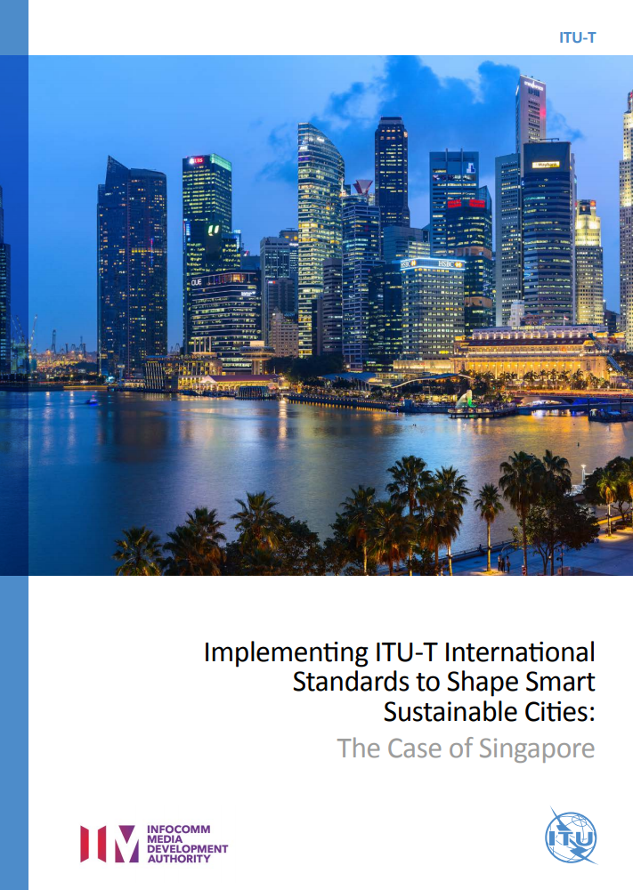
Implementing ITU-T International Standards to Shape Smart Sustainable Cities
The case of Dubai
The case of Singapore
The case of Moscow
These case studies show Dubai’s, Singapore’s and Moscow’s journeys towards becoming a Smarter and more Sustainable City
Available for free on the ITU-T SSC website: http://itu.int/go/ITU-T-SSC

Slide 10
KPIs Structure
Measure your city’s progress
54 Core Indicators + 37 advanced Indicators
20 Smart + 32 Structural + 39 Sustainable
132 Data Collection Points
Dimension
Economy
Environment
Society and Culture
ICT Infrastructure
Water and Sanitation
Drainage
Electricity Supply
Transport
Public Sector
Innovation
Employment
Waste
Buildings
Urban Planning
Air Quality
Water and Sanitation
Waste
Environmental Quality
Public Space and Nature
Energy
Education
Health
Culture
Housing
Social Inclusion
Safety
Food Security
Category
Notes:
This case study details Dubai’s ambitious and trailblazing journey towards becoming a smart city, a venture worthy of emulation by other aspiring smart cities around the world.
The principle of the KPIs are:
Comprehensiveness: The set of indicators should cover all the aspects of SSC.
Availability: The KPIs should be quantitative and the historic and current data should be either available or easy to collect.
Independence: The KPIs in the same dimension should be independent or almost-orthogonal i.e., overlap of the KPIs should be avoided as much as possible.
Simplicity: The concept of each indicator should be simple and easy to understand for the urban stakeholders.
Timeliness: This refers to the ability to produce KPIs with respect to emerging issues in SSC construction.

Slide 11
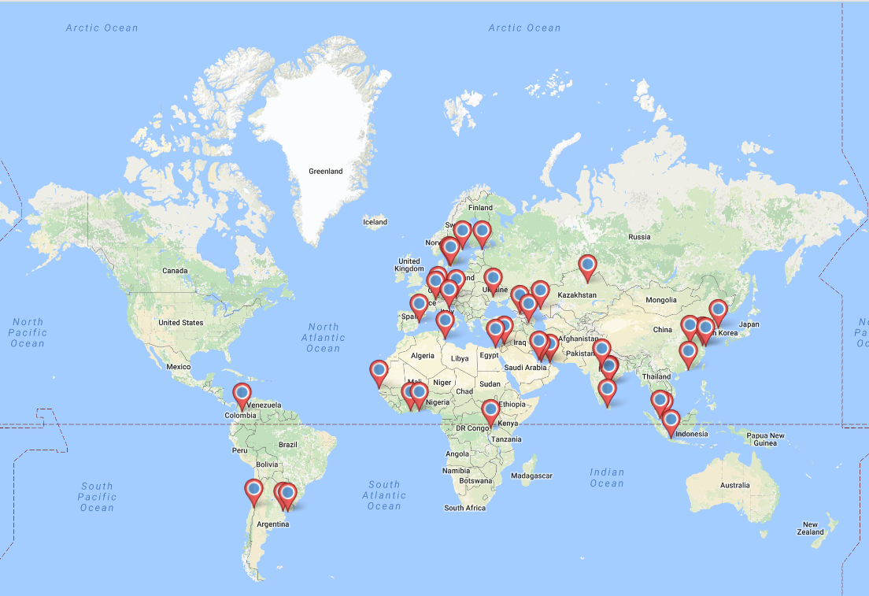
Implementing Key Performance Indicators for Smart Sustainable Cities Worldwide
The U4SSC welcomes all cities that would like to start their SSC journey!

Slide 12
Thank you!
For more information, please contact:
u4ssc@itu.int

Slide 13
Additional Information

Slide 14
KPIs Principles
Comprehensiveness: The set of indicators should cover all the aspects of SSC.
Availability: The KPIs should be quantitative and the historic and current data should either be available or easy to collect.
Simplicity: The concept of each indicator should be simple and easy to understand for the urban stakeholders.
Timeliness: This refers to the ability to produce KPIs with respect to emerging issues in SSC construction.

Slide 15
ECONOMY
ICT – Core Indicators
Household Internet Access Percentage of households with Internet access.
Dynamic Public Transport Information Percentage of urban public transport stops for which traveller information is dynamically available to the public in real time
Smart Water Meters Percentage implementation of smart water meters.
Fixed Broadband Subscriptions
Percentage of households with fixed (wired) broadband.
Traffic Monitoring Percentage of
major streets monitored by ICT.
Smart Electricity Meters Percentage implementation of smart electricity meters.
Wireless Broadband Subscriptions Wireless broadband subscriptions per 100 000 inhabitants.
Wireless Broadband Coverage
Percentage of the city served by wireless broadband (3G and 4G).

Slide 16
ECONOMY
ICT – Advanced Indicators
Availability of WIFI in Public Areas Number of public WIFI hotspots in the city.
Intersection Control
Percentage of road intersections using adaptive traffic control or prioritization measures.
Demand Response Penetration Percentage of electricity customers with demand response capabilities.
Open Data Percentage and number of inventoried open datasets that are published.
Water Supply ICT Monitoring Percentage of the water distribution system monitored by ICT.
e- Government
Number of public services delivered through electronic means.
Drainage / Storm Water System ICT Monitoring Percentage of drainage / storm water system monitored by ICT.
Public Sector e-Procurement Percentage of public sector procurement activities that are conducted electronically.
Electricity Supply ICT Monitoring Percentage of electricity supply system monitored by ICT.

Slide 17
ECONOMY
Productivity – Core Indicators
R&D Expenditure Research and Development expenditure as a percentage of city GDP.
Unemployment Rate
Percentage of the total city labour force that is unemployed.
Patents
Number of new patents granted per 100 000 inhabitants per year.
Youth Unemployment Rate Percentage of the city youth labour force that is unemployed.
Productivity – Advanced Indicators
Small and Medium-Sized Enterprises
Percentage of small and medium-sized enterprises (SMEs).
Tourism Sector Employment Percentage of the city labour force working in the tourism sector.
ICT Sector Employment Percentage of the city labour force working in the ICT sector.

Slide 18
ECONOMY
Infrastructure – Core Indicators
Basic Water Supply Percentage of households with access to basic water supply.
Electricity System Outage Frequency Average number of electrical interruptions per customer per year.
Public Transport Network Length of public transport network per 100 000 inhabitants.
Wastewater Collection Percentage of households served by wastewater collection.
Potable Water Supply
Percentage of households with a safely managed drinking water service.
Electricity System Outage Time Average length of electrical interruptions.
Bicycle Network Length of bicycle paths and lanes per 100 000 population.
Household Sanitation Percentage of households with access to basic sanitation facilities.
Water Supply Loss Percentage of water loss in the water distribution system.
Access to Electricity Percentage of households with authorized access to electricity.
Solid Waste Collection Percentage of households with regular solid waste collection.

Slide 19
ECONOMY
Infrastructure – Advanced Indicators
Public Transport Network Convenience Percentage of the city population that has convenient access (within 0.5 km) to public transport.
Shared Bicycles
Number of shared bicycles per 100 000 inhabitants.
Public Building Sustainability Percentage area of public buildings with recognized sustainability certifications for ongoing operations.
Pedestrian Infrastructure Percentage of the city designated as a pedestrian / car free zone.
Transportation Mode Share
Percentage of people using various forms of transportation to travel to work (public transportation, personal vehicles, bicycles, walking, paratransit)
Shared Vehicles
Number of shared vehicles per 100 000 inhabitants.
Integrated Building Management Systems in Public Buildings Percentage area of public buildings using integrated ICT systems to automate building management
Urban Development and Spatial Planning Existence of urban development and spatial planning strategies or documents at the city level
Travel Time Index
Ratio of the travel time during the peak periods to travel time at free flow periods.
Low-Carbon Emission Passenger Vehicles
Percentage of low-carbon emission passenger vehicles.

Slide 20
ENVIRONMENT
Environment – Core Indicators
Air Pollution Air Quality Index based on reported value for: Particulate matter (PM2.5) ;
NO2 (nitrogen dioxide);
SO2 (sulphur dioxide); and,
O3 (ozone).
Drinking Water Quality Percentage of households covered by an audited Water Safety Plan.
Wastewater Treatment Percentage of wastewater receiving treatment.
Green Areas
Green areas per 100 000 inhabitants.
GHG Emissions
Greenhouse gas (GHG) emissions per capita.
Water Consumption Water consumption per capita.
Solid Waste Treatment Percentage of solid waste.
EMF Exposure Percentage of mobile network antenna sites in compliance with EMF exposure guidelines.
Freshwater Consumption Freshwater consumption.

Slide 21
ENVIRONMENT
Environment – Advanced Indicators
Noise Exposure
Percentage of inhabitants exposed to excessive noise levels.
Green Area Accessibility
Percentage of inhabitants with accessibility to green areas.
Protected Natural Areas
Percentage of city area protected as natural sites.
Recreational Facilities
Area of total public recreational facilities per 100 000 inhabitants.

Slide 22
ENVIRONMENT
Energy – Core Indicators
Renewable Energy Consumption Percentage of renewable energy consumed in the city.
Electricity Consumption Electricity consumption per capita.
Residential Thermal Energy Consumption Residential thermal energy consumption per capita.
Public Building Energy Consumption Energy consumption of public buildings.

Slide 23
Society and Culture
Education, Health and Culture – Core Indicators
Student ICT Access Percentage of students with classroom access to ICT facilities.
Life Expectancy
Average life expectancy.
Cultural Expenditure Percentage expenditure on cultural heritage.
School Enrollment Percentage of school-aged population enrolled in schools.
Maternal Mortality Rate
Maternal deaths per
100 000 live births.
Higher Education Degrees Higher level education degrees per 100 000 inhabitants.
Physicians Number of physicians per
100 000 inhabitants.
Adult Literacy Adult literacy rate.

Slide 24
Society and Culture
Education, Health and Culture – Advanced Indicators
Electronic Health Records Percentage of city inhabitants with electronic health records.
In–Patient Hospital Beds
Number of in-patient public hospital beds per 100 000 inhabitants.
Health Insurance/Public Health Coverage Percentage of inhabitants covered by basic health insurance or a public health system.
Cultural Infrastructure Number of the cultural institutions per 100 000 inhabitants.

Slide 25
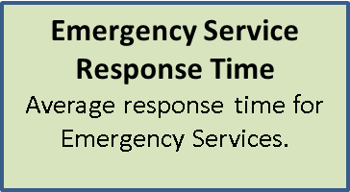
Society and Culture
Safety, Housing and Social Inclusion – Core Indicators
Informal Settlements Percentage of inhabitants living in slums, informal settlements or inadequate housing.
Gender Income Equity
Ratio of average hourly earnings of female to male workers.
Natural Disaster Related Deaths Number of natural disaster related deaths per 100 000 inhabitants.
Police Service Number of police officers per 100 000 inhabitants.
Gini Coefficient
Income distribution in accordance with Gini coefficient.
Disaster Related Economic Losses Natural disaster related economic losses as a percentage of the city’s GDP.
Fire Service Number of firefighters per 100 000 inhabitants.
Poverty Percentage of inhabitants living in poverty.
Violent Crime Rate Violent crime rate per
100 000 inhabitants.
Voter Participation Percentage of the eligible population that voted during the last municipal election.
Traffic Fatalities
Traffic fatalities per 100 000 inhabitants.

Slide 26
Society and Culture
Safety, Housing and Social Inclusion – Advanced Indicators
Housing Expenditure
Percentage expenditure of income for housing.
Resilience Plans
Implementation of risk and vulnerability assessments for disaster mitigation.
Local Food Production
Percentage of local food supplied from within
100 km of the urban area.
Child Care Availability
Percentage of pre-school age children (0-3) covered by (public and private)
day-care centres.
Population Living in Disaster Prone Areas
Percentage of inhabitants living in a zone subject to natural hazards.

