Slide 1


Meeting of ITU-T SG3 Regional Group
for Asia and Oceania (SG3RG-AO)
PRACTICAL INFORMATION
New Delhi, India, 10 to 12 September 2025

Slide 2
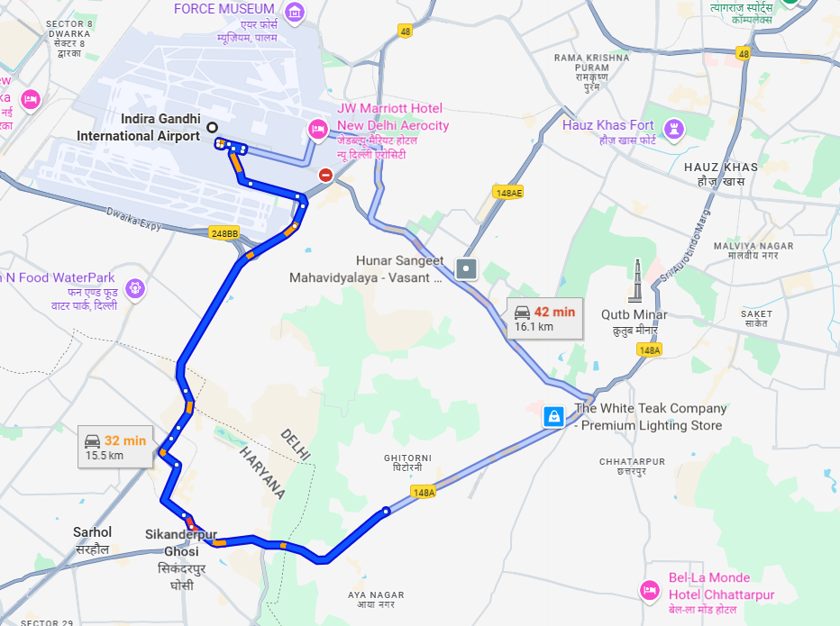
Meeting Venue
Practical Information
Venue: National Institute of Communication Finance
Address:
Mehrauli-Gurgaon Rd, opposite Metro Pillar No. 152,
Anand Gram, Ghitorni,
New Delhi, Delhi 110047, India
Transportation to/from Indira Gandhi International Airport:
The venue is approximately 16.5 km by car.
Taxi fare:
Public taxis are readily available at all terminals at Indira Gandhi International Airport.
All taxis are metered. Fares must be charged according to the taxi meter, plus applicable surcharges.

Slide 3
Transportation and Registration
Practical Information
Assistance:
Delegates are advised to share the travel programme to New Delhi to facilitate their pickup and drop arrangements at following contacts:
  Mr. Amarnath Ojha, Amar.ojha@gov.in; +91 9811075586
  Mr. Ankit Arora, Ankit.arora1990@gov.in; +91 8899096340
Please register online for the meeting of ITU-T SG3RG-AO:
https://www.itu.int/net4/CRM/xreg/web/Login.aspx?src=Registration&Event=C-00015636
IMPORTANT: Please note that all badges must be collected personally for access control security. Badges are therefore strictly non-transferable.

Slide 4
Visa Information
Practical Information
Visa information for India can be accessed here:
Visa Waiver applicants: https://www.mea.gov.in/bvwa-menu.htm
e-Visa applicants: https://indianvisaonline.gov.in/evisa/tvoa.html
All other applicants who are not covered under Visa wavier and e-visa country list, may apply through Indian Embassy.
If you require a personal invitation letter or official document for your travel clearances:
Please fill in the visa support form available on the SG3RG-AO webpage and send the completed form to
Mr. Amarnath Ojha (amar.ojha@gov.in), with copy to ITU (​tsbsg3@itu.int), bearing the words “Letter of support for visa” as the e-mail subject.
All requests are to be sent by 25 August 2025 at the latest.
For other questions, please contact the Focal Points:
Mr. Amarnath Ojha, amar.ojha@gov.in; +91 9811075586
Mr. Ankit Arora, ankit.arora1990@gov.in; +91 8899096340

Slide 5
General Information: Banks and Currency
Practical Information
Currency: The name of the currency in India is the Indian Rupee (INR). Notes come in denominations of ₹10, ₹20, ₹50, ₹100 ₹200, ₹500, and ₹2000. Online exchange rates are shown at: www.xe.com
Banks: All banks operate from 10 AM to 4 PM, on Monday through Saturday (except 2nd & 4th Saturday and bank holidays).
Currency exchange houses are open until late in the evening.
Credit cards: All international credit and debit cards are widely accepted.
ATM: An ATM is located inside the NCA-F Campus.

Slide 6
General Information: Services available in NCA-F
Practical Information
Communication Centre: Internet Access free of charge will be available at the event meeting room.
Security: For security reasons, all participants should be permanently using their badges during the meeting and in all social activities.
Boarding: NCA-F has air-conditioned single-occupancy bedrooms measuring approximately 37 sq mt with an attached balcony & washroom.
Dining: NCA-F’s Dining Room serves fresh vegetarian & non-vegetarian meals (Breakfast, Lunch, Tea & Dinner).
Recreation: NCA-F has a sprawling Sports Complex with facilities for Sports like Badminton, Squash, Table Tennis, Basketball, Volleyball, Lawn Tennis, Cricket, etc.

Slide 7
General Information: Accommodation
Practical Information
NCA-F has air-conditioned single-occupancy bedrooms measuring approximately 37 sq mt with an attached balcony & washroom.
Boarding and lodging for the delegates will be provided by NCA-F on a complimentary basis.
To book a room, please contact the Host Focal Points:
  Mr. Amarnath Ojha, Amar.ojha@gov.in; +91 9811075586
  Mr. Ankit Arora, Ankit.arora1990@gov.in; +91 8899096340
  Mr. Santosh Kumar Singh, Aaoit.nicf@gov.in; +91 9523096341
Hotels nearby NCA-F
Fortune Select Global, Gurgaon - https://www.itchotels.com/in/en/fortuneselectglobal-gurugram
Le Méridien Gurgaon, Delhi NCR - https://www.marriott.com/en-us/hotels/deldm-le-meridien-gurgaon-delhi-ncr/overview

Slide 8
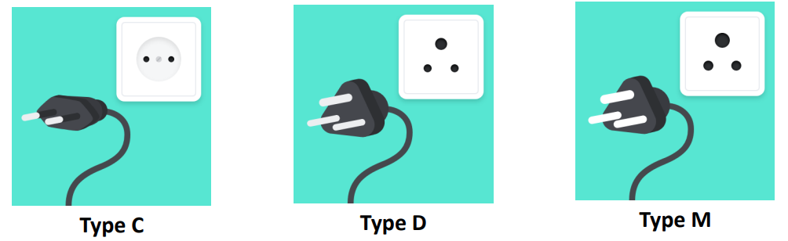
General Information
Practical Information
In India, there are three associated plug types, types C, D, and M. The standard voltage is 230 volts and the standard frequency is 50 Hz.
The electrical sockets used are:

Slide 9
Additional Information
Practical Information
Climate: Pleasant. Temperatures range between 25 to 34 degrees Celsius.
Clothing: Taking into consideration the temperature in New Delhi for the month of September, business attire is recommended.
Time Zone: The standard time in New Delhi is 5 hours and 30 minutes ahead of Greenwich Mean Time (GTM+5:30), and no seasonal time changes are made.
International access code to call in India: +91
Official Languages: Hindi and English
Taxes: Restaurants and Hotels charge 5% (2.5%+2.5%) GST on the bill.
Tips: It is customary to leave a tip in cafeterias and restaurants.

Slide 10
Host Focal Points
Practical Information
Mr. Amarnath Ojha, Amar.ojha@gov.in; +91 9811075586
Mr. Ankit Arora, Ankit.arora1990@gov.in; +91 8899096340
Mr. Santosh Kumar Singh, Aaoit.nicf@gov.in; +91 9523096341
Here are some useful contacts to have at your fingertips while you are in New Delhi, India.
Police: 100
Ambulance: 102
Fire: 101

