Slide 1
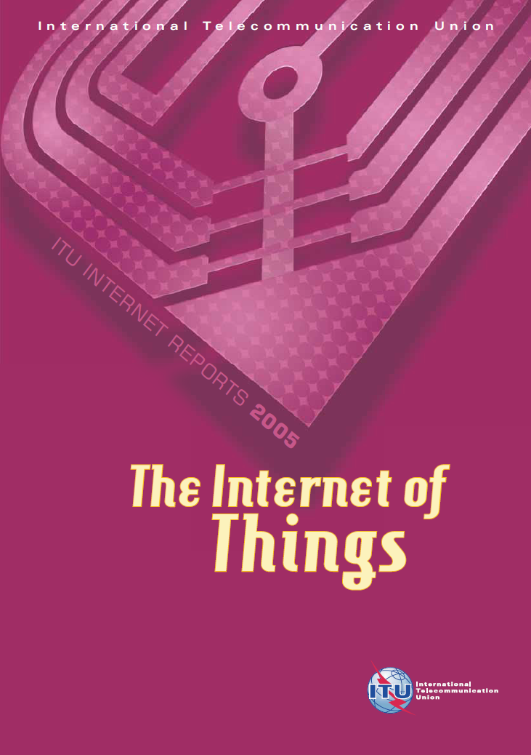
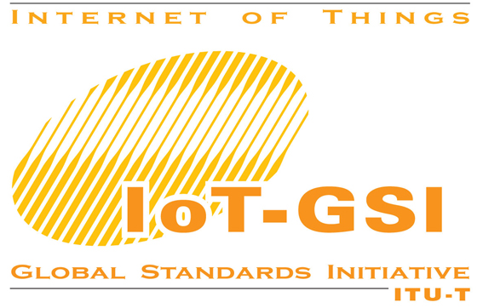
Addressing the Challenges, Harnessing the Opportunities of
Bilel Jamoussi
Chief Study Groups Department
Telecommunication Standardization Bureau International Telecommunication Union
Notes:
The presentation will address some Challenges as well as Opportunities of the Internet of Things.
Overview:
To do so, we will first have a brief look at ITU and its structure. Universities and academia are an important partner in ITU’s work. I will highlight aspects of ITU’s new initiatives for academia.
ITU has been discussing the Internet of Things since publishing a widely-recognized report in 2005. We were one of the first organization using the term IoT.
In the following we will look at challenges and opportunities that have been identified for the Internet of Things, and how ITU’s activities are related to these.

Slide 2
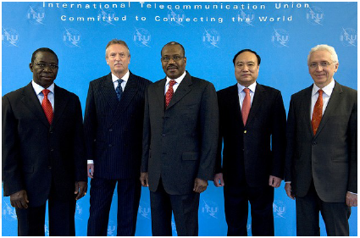
ITU: Committed to Connecting the World
Founded in 1865, it is oldest specialized agency of the UN system
Standards making one of the ITU’s first activities
HQ Geneva, 5 regional offices and 8 area offices, 760 staff / 80 nationalities
Named as one of the world’s ten most enduring institutions by Booz Allen
Plenipotentiary Conference
General Secretariat
ITU Council
ITU TELECOM
ITU-T Standardization
ITU-R Radiocommunication
ITU-D
Development

Slide 3
ITU and its Membership
192 Member States, 700+ private sector entities
New: Companies from LDCs can join ITU-T and ITU-R sectors at a reduced fee (LDC Sector Membership: CHF 3,975)
New: Academia, universities and research labs can join ITU sectors at a reduced fee (Developing Countries: CHF 1,987.50)
ITU welcomes its Academia Members:
Learn more at www.itu.int/members

Slide 4
ITU and the Internet of Things
Major ITU report in 2005: The Internet of Things
Describes the visions underlying the IoT
Examines enabling technologies
Explores the market potential
Contemplates the challenges and wider implications
Sets out some of the benefits of IoT for developing countries
www.itu.int/internetofthings
Source: BBC News, 17 November 2005
Notes:
Key Message: We’ve been doing IoT for years …across ITU
As early as in 2005 at WSIS in Tunis, Tunisia, the ITU secretariat launched “The Internet of Things” - the seventh publication in a series of “ITU Internet Reports”.
The report introduced the wider public to the next step in “always on” communications, in which technologies like RFID and smart computing promise a world of networked and interconnected devices that provide relevant content and information whatever the location of the user. Everything from tires to toothbrushes will be in communications range, heralding the dawn of a new era, one in which today’s Internet (of data and people) gives way to tomorrow’s Internet of Things.

Slide 5
Challenge: Definition
ITU Report in 2005: IoT adds a new dimension to the ICT world (“4A Vision”) - from ‘traditional’ anytime, any place connectivity for anyone, the Internet of Things brings connectivity for anything
2011: many different, competing definitions, regional approaches
Common understanding at international level required
ITU Standardization Sector is harmonizing IoT definitions at a global level
Notes:
Defining the Internet of Things

Slide 6
Challenge: Work Plan
International coordination is essential for the success of IoT Standardization
A harmonized work-plan for IoT Standardization must be developed in coordination with the concerned SDOs
The IoT-GSI is developing a work plan
The IoT-GSI is working on a new Recommendation IoT-Overview which aims to cover:
High level concept (vision)
Business and social drivers, ecosystem and business models
Essential terminology
Scope (applications/services, networks, M2M, devices, security, enabling technologies, etc.)
Very High Level Requirements
Key features / key areas / key components
High level IoT diagrams
Taxonomies
Target for approval: 02-2012

Slide 7
Challenge: Radio Spectrum
Radio-frequency spectrum: a scarce natural resource, increasingly in demand from a large and growing number of services
Indispensable for the functioning of the IoT
Can the RF spectrum handle 50 billion connected devices?*
ITU Radiocommunication Sector responsible for the global management of the RF spectrum
WRC-12: World Radiocommunication Conference (23 Jan-17 Feb 2012, Geneva, Switzerland)
* GSMA estimate for 2025. The World Wireless Research Forum estimates “7 trillion wireless devices serving 7 billion people by 2017”
Notes:
Indispensable for the functioning of the IoT, the ITU Radiocommunication Sector is responsible for the global management of the radio-frequency spectrum, a scarce natural resource, which is increasingly in demand from a large and growing number of services such as fixed, mobile, broadcasting, amateur, space research, emergency telecommunications, etc.
Spectrum crunch?

Slide 8
Challenge: Numbering and Addressing
How to address 50 billion objects?
Different technical solutions proposed:
Electronic Product Codes (RFID tags)
‘Traditional’ Uniform Resource Identifiers (URI)
IPv6: address space supports 2¹²⁸ addresses
Issues beyond technology:
Standards for numbering and addressing schemes (ITU-T)
Harmonization, policies, regulation
All countries should be involved in the development and benefit from the IoT
A presentation on “Identifiers in the Ubiquitous Network” will be given by China on Wed 24 August at 12:30 during IoT-GSI

Slide 9
Challenge: Security and Privacy
IoT may also connect transportation, electricity grids and other critical infrastructure
Security risks and concerns
Users are concerned about privacy and socio-ethical implications of the use of tracking and geo-location
ITU has a Global Cybersecurity Agenda
Legal measures
Technical & procedural measures
Organizational structures
Capacity building
International cooperation
The current IoT-GSI event is scheduled in parallel to Study Group 17 (security) to encourage working on IoT-Security and privacy

Slide 10
Challenge: Global Standards
Increasingly fragmented IoT standardization landscape
Notes:
Key Messages: We are IoT experts. This is what we’ve learnt through extensive experience in IoT…
IoT standardization landscape is fragmented, consists of national, regional, international SDOs, an increasing number of industry consortia and fora. This slide shows many of the key players. Each actor has its own scope of work and membership, which should theoretically avoid overlap with other actors, but…
Most of the areas do not have clear boundaries and activities do overlap and are influenced by each other, in fields such as chip technology, radio technology, networking technology, application specific technology, etc.
In addition, it remains difficult to oversee the whole landscape, as new fora and consortia emerge, others disappear, or merge their activities.
Given the increasing fragmentation, efforts to coordinate and harmonize become increasingly important. Given that the technologies enabling the IoT aim at global and ubiquitous connection and usage, this coordination should take place at international level.
And in this regards, ITU-T is the place to be.

Slide 11
Challenge: Global Standards – ITU’s tools to meet the challenge (1)
IoT Joint Coordination Activity
Coordinates ITU-T work related to the IoT, network aspects of identification of things and ubiquitous sensor networks (USN), for instance:
SG 2: Numbering, naming, addressing
SG 13: NGN requirements and architecture for applications and services using tag-based identification
SG 16: Requirements and architecture for multimedia information access triggered by tag-based identification
SG 17: Security and privacy of tag-based applications
Maintains list and roadmap of ITU-T IoT standardization items
Acts as a single point of contact within ITU-T with other SDOs in order to avoid duplication of work
Notes:
ITU-T initiatives to meet the IoT standards challenge
SG 2 Operational aspects of service provision and telecommunications management
SG 13 Future networks including mobile and NGN
SG 16 Multimedia coding, systems and applications
SG 17 Security

Slide 12
Challenge: Global Standards – ITU’s tools to meet the challenge (2)
IoT Global Standards Initiative
Provides a visible single location for information on and development of global IoT standards
Harmonizes different approaches to the IoT architecture worldwide, e.g. definitions
Participation in first meeting (May 2011): industry, government entities and SDOs
ETSI TC M2M, GSC MSTF, ISO/IEC JTC1, TIA
Regional SDOs including CCSA are invited and some expressed interest
Next meeting: 21-25 November 2011, Geneva, Switzerland
www.itu.int/en/ITU-T/gsi/iot/
Your organization?
Notes:
ITU-T initiatives to meet the IoT standards challenge
ETSI TC M2M – ETSI Technical Committee for Machine-to-Machine communications (Europe)
GSC MSTF – Global Standards Collaboration Machine-to-Machine Standardization Task Force
ISO/IEC JTC1 – ISO/IEC Joint Technical Committee 1 (Information Technology)
TIA – Telecommunications Industry Association

Slide 13
Challenge: Global Standards – ITU’s tools to meet the challenge (3)
SG13 | Y.2213, NGN service requirements and capabilities for network aspects of applications and services using tag-based identification | Approved
SG13 | Y.2016, Functional requirements and architecture of the NGN for applications and services using tag-based identification | Approved
SG16 | F.771, Service description and requirements for multimedia information access triggered by tag-based identification | Approved
SG16 | H.621, Architecture of a system for multimedia information access triggered by tag-based identification | Approved
SG17 | X.1171, Threats and Requirements for Protection of Personally Identifiable Information in Applications using Tag-based Identification | Approved
SG16 | H.IDscheme, ID schemes for multimedia information access triggered by tag-based identification | On going work
SG16 | H.IRP, ID resolution protocols for multimedia information access triggered by tag-based identification | On going work
SG11 | Q.nid-test-arch, Testing architecture for tag-based identification systems and functions | On going work
Joint effort | IoT-Overview; IoT-Definition/ IoT-workplan | On going work
Notes:
Sample List of ITU-T work related to IoT standardization

Slide 14
Opportunity: Smart Grid
Smart Grids: One of the most expected applications of the IoT:
Electricity networks that can intelligently integrate the behavior and actions of all users connected to it (generators, consumers and those that do both) in order to efficiently deliver sustainable, economic and secure electricity supplies
Buildings can be made more energy efficient, reducing CO₂ emissions
ITU-T has been working on Smart Grids since 2010
Scope of ITU-T Focus Group:
Identify potential impacts on standards development
Investigate future ITU-T study items and related actions
Familiarize ITU-T and standardization communities with emerging attributes of smart grid
Encourage collaboration between ITU-T and smart grid communities

Slide 15
Opportunity: Intelligent Transport and Logistics
Connecting vehicles and road-side infrastructure can enable:
Effective journey management, avoiding congestion, improving traffic control and reducing emissions
Automatic emergency calls in case of accidents, saving lives in emergency situations
Remote diagnostics of systems, improving fleet management and reducing maintenance costs
Tracking of vehicles, improving logistics and reducing number of stolen vehicles
Frequent topic at annual ITU/ISO/IEC Fully Networked Car workshop at Geneva Motor Show (join us next year, 7-8 March 2012)
ITU-T Focus Groups on Car Communication and Driver Distraction
ISO/ITU Joint Task Force on ITS Communications
Notes:
ITS = Intelligent Transportation Systems

Slide 16
Conclusion
The promise of an “Internet of Things” has been in the spotlight for a long time – ITU involved from the very beginning
Besides many opportunities, there are some challenges that need to be addressed
ITU can provide a platform to discuss these challenges, produce global standards and find global solutions to advance the Internet of Things and extend its benefits globally.
More information at www.itu.int/ITU-T/go/IoT

