Slide 1
Global Legal Entity Identifier Foundation
Visibility. Stability. Integrity.
Clare Rowley, Head of Business Operations GLEIF
ITU-T JCA-IdM meeting, 31 August 2016

Slide 2
GLEIF Mission Statement
Each business should have one and only one identity:
GLEIF manages a network of partners to provide trusted services and open, reliable data for unique legal entity identification worldwide

Slide 3
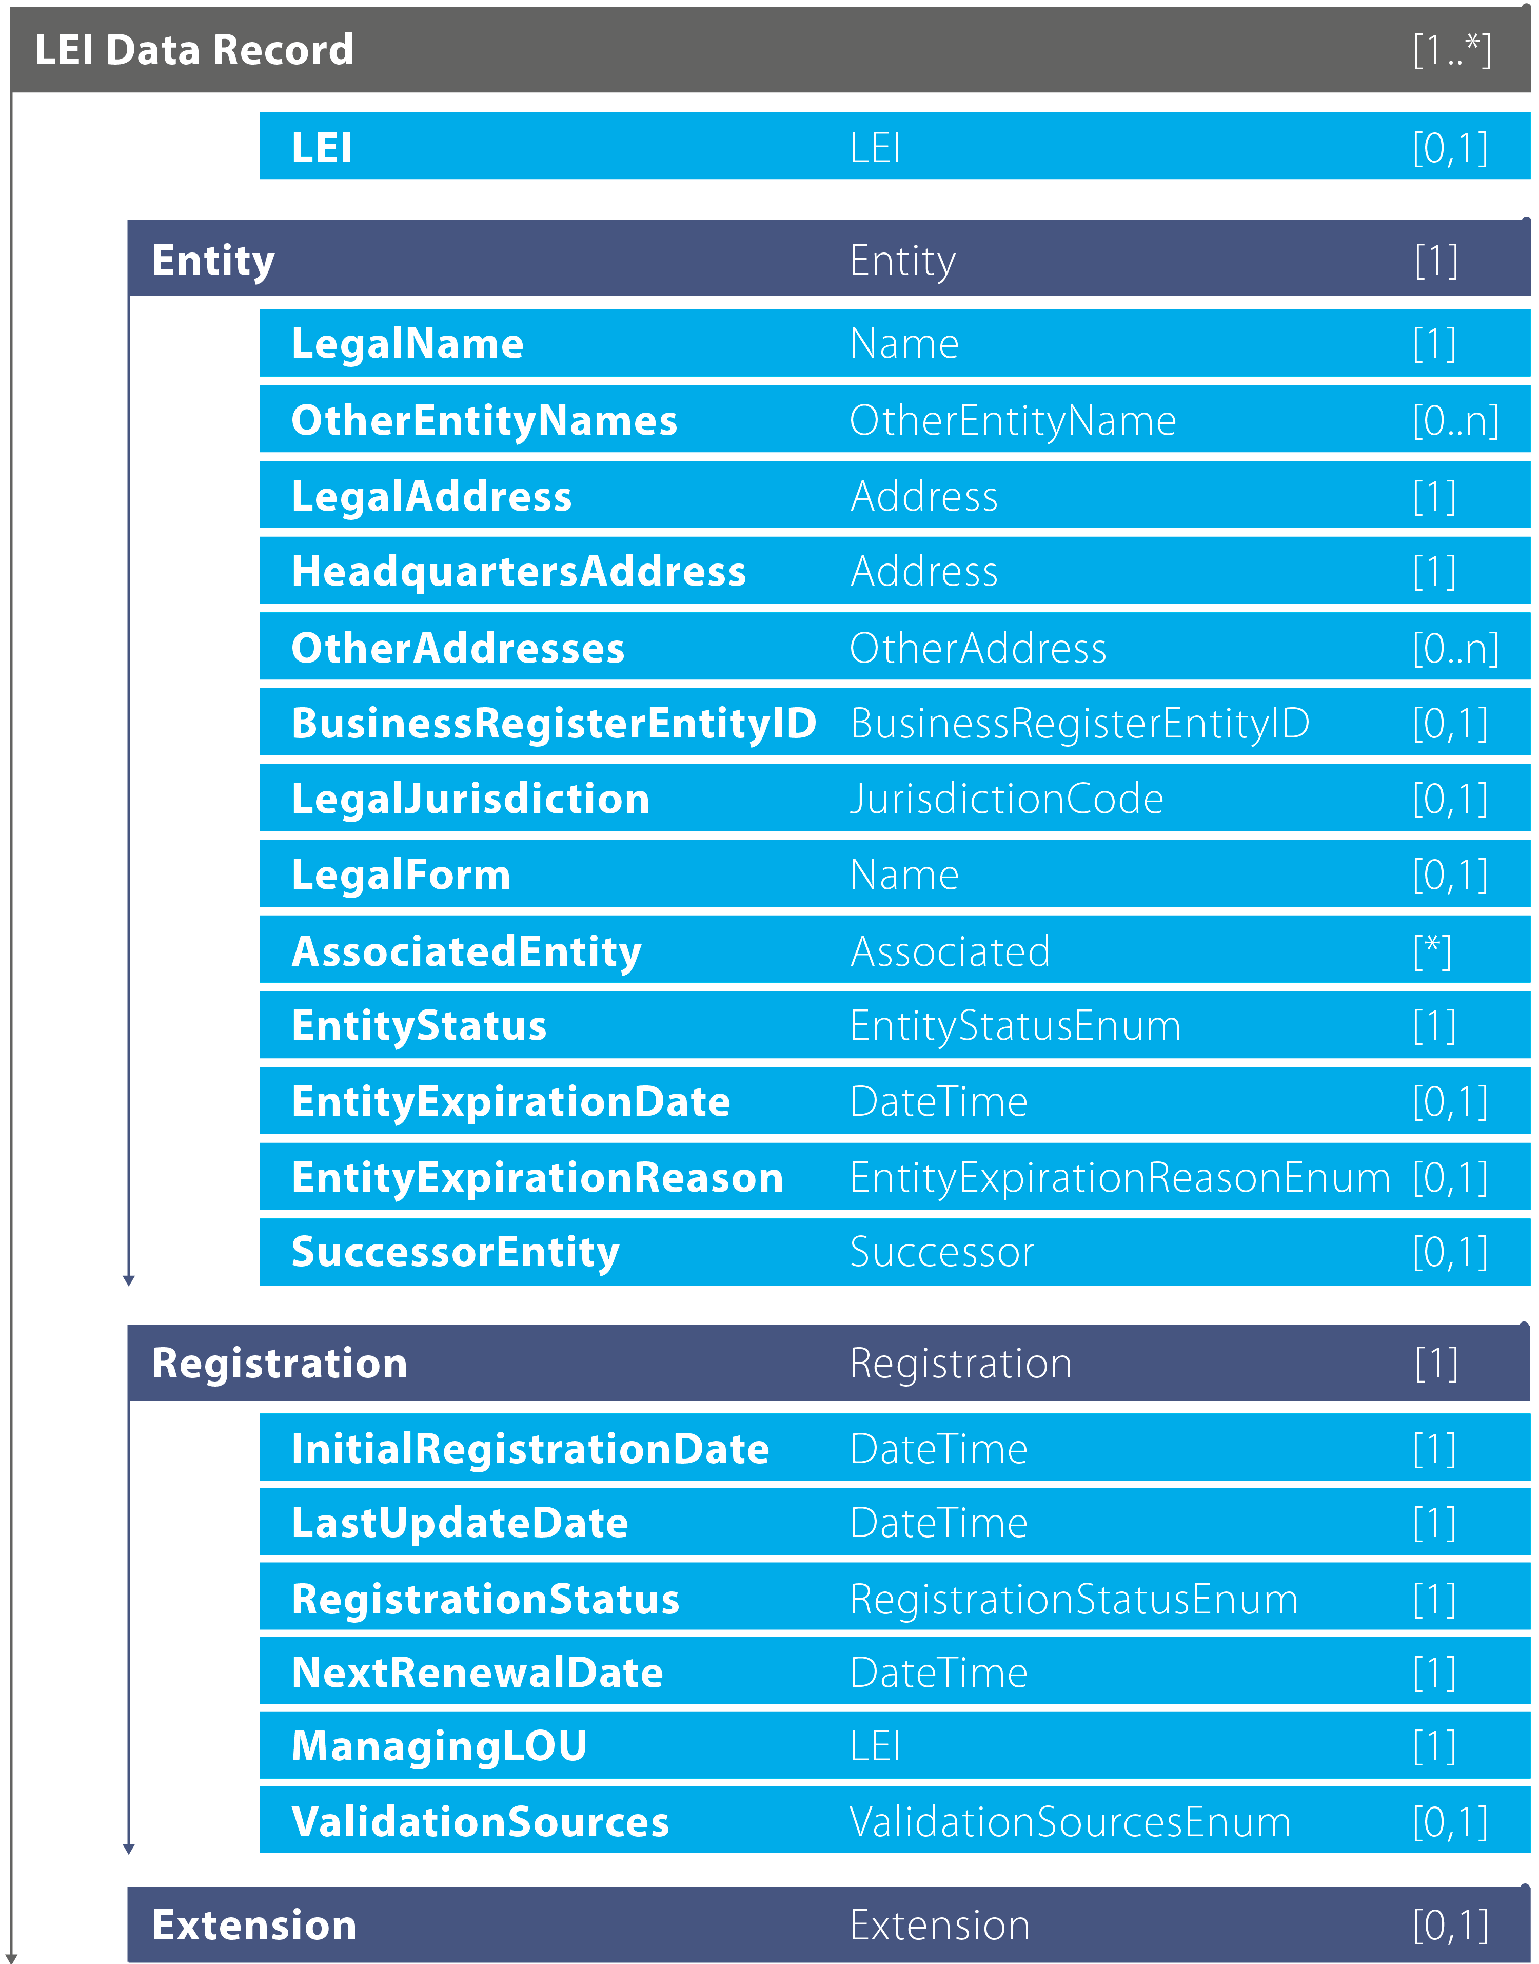
Defining “Who is Who” Register and Legal Form
Add standardized reporting of the Registration Authority to the Common Data File (the Registration Authority list is available at gleif.org)
Add ‎the Entity Legal Form (ISO 20275) to the Common Data File in 2016

Slide 4
Launch of GLEIF Challenge Facility
In July GLEIF launched its public Challenge Facility of the LEI data. It offers any interested party an easy and convenient means to trigger the verification and, where required, speedy update of Legal Entity Identifier (LEI) records including related reference data.
This centralized online service, which is part of GLEIF’s data quality management program, further contributes to ensuring that the publicly available LEI data pool remains a unique key to standardized information on legal entities worldwide.
The new online service is designed to further enhance the reliability and usability of the Legal Entity Identifier data pool
Further information is available at: https://www.gleif.org/en/lei-data/challenge-lei-data

Slide 5
LEI in Financial Reports
Linking to financial reporting information through XBRL for evaluation of investment opportunities and for monitoring of financial condition and analysis.
XBRL.ORG and GLEIF have engaged to jointly develop and promote a XBRL-Taxonomy for embedding the LEI in any reporting of financial statements.
Presentation of the new taxonomy is scheduled for the annual XBRL meeting in November.

Slide 6
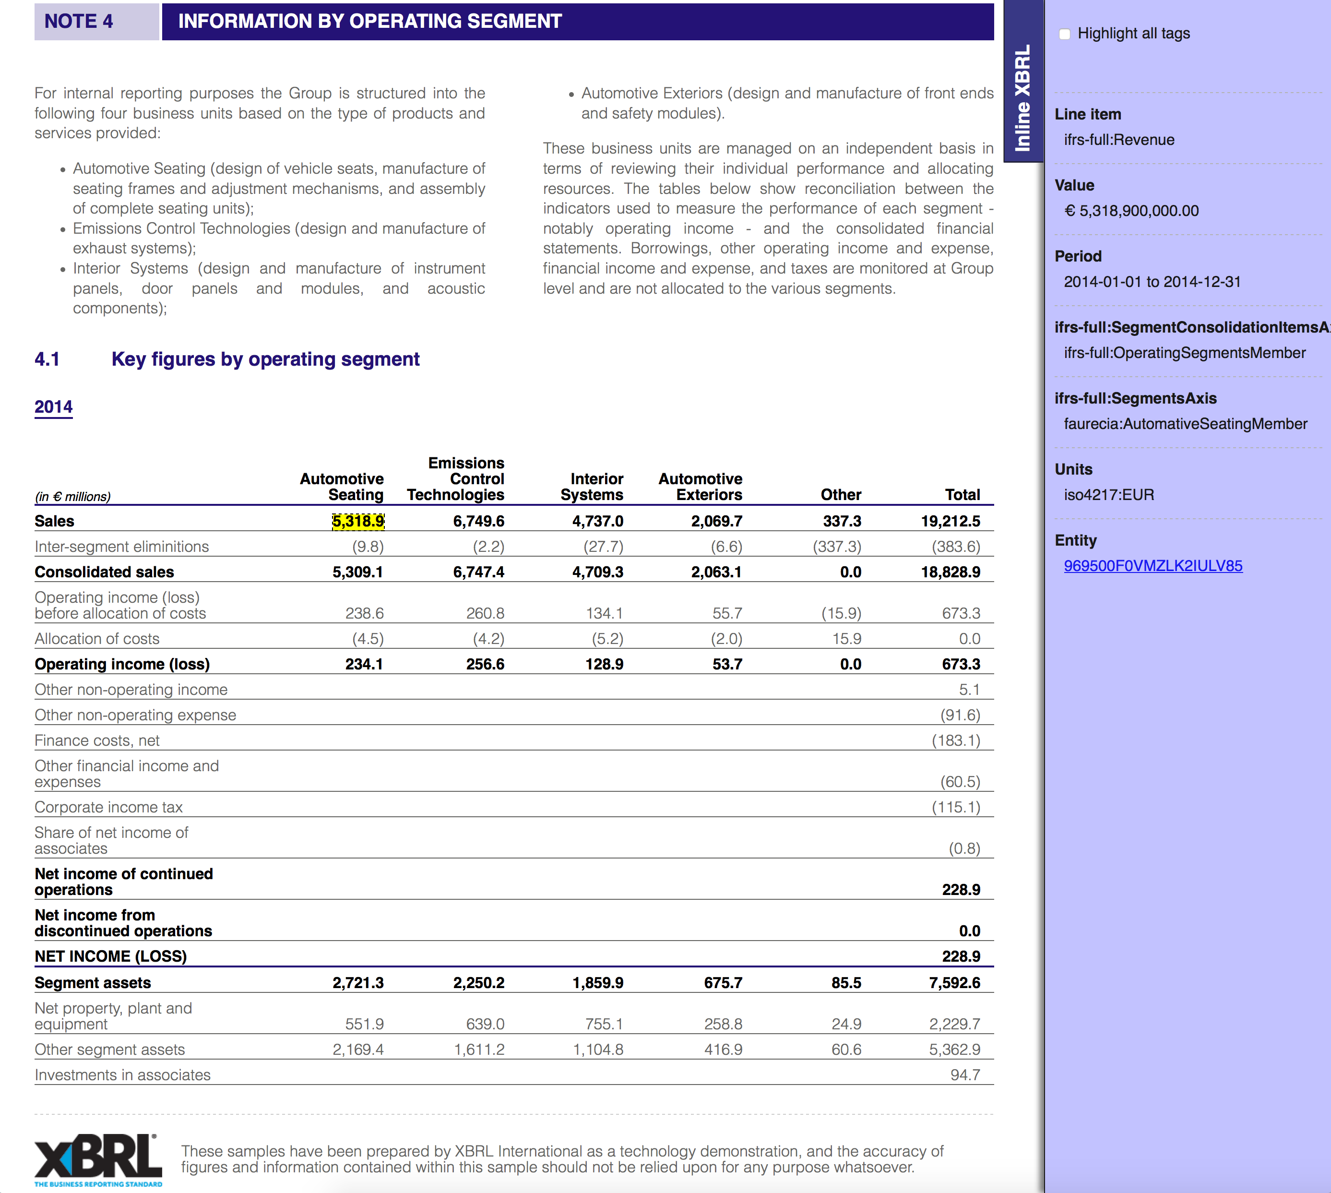
XBRL Example

Slide 7
Limitations
This presentation contains confidential and proprietary information and/or trade secrets of the Global Legal Entity Identifier Foundation (GLEIF) and/or its affiliates, and is not to be published, reproduced, copied, or disclosed without the express written consent of Global Legal Entity Identifier Foundation.
Global Legal Entity Identifier Foundation, the Global Legal Entity Identifier Foundation logo are service marks of Global Legal Entity Identifier Foundation. ISO and the ISO logo are service marks of International Organization for Standardization. Other products and services and company names mentioned here in are the property of and may be the service mark or trademark of their respective owners.

