Slide 1
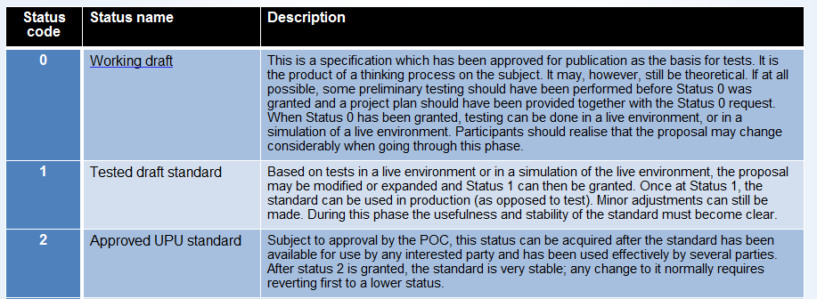
Approved during last POC meeting and currently with status 0.
Include a description of a Trusted network and different levels of assurance

Slide 2
Post ID and .post
.post PostID
Certified cloud services
E-shop
Financial services
Secure register
E-mail
Global postal services
Trusted crossborder e-commerce services
e-government

Slide 3
Functional specifications for secure e-mail content
Internal (SMTP )
Domestic (SMTP )
Cross border (SMTP )
Worldwide exchange (S52)*
PostID
*S52 test Suite to test compliance with standard available third quarter 2014.

