Slide 1


Green ICT services in cities.
Building Smart & Sustainable Cities
Daniela Torres E.
Geneva
February, 2013

Slide 2
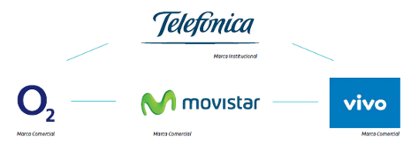


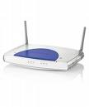






00
The best profile to approach the future
2012
Customers
312 millon customers
Services
Integrated ICT services for customers
Countries
Presence in
26 countries
Employees
Around 285.000 professionals
CO2 &
Energy
Energy: 4,2 TWh€
1,8 mT CO2 e
Notes:
- Central America includes Guatemala, Panama, El Salvador, Nicaragua and Costa Rica
- Total accesses figure includes Narrowband Internet accesses of Terra Brazil and Terra Colombia, and Broadband Internet accesses of Terra Brazil, Telefónica de Argentina, Terra Guatemala and Terra Mexico
Notes:
2
2
Let´s me show a quick overview about Telefonica.
Telefonica is a telecommunication company that offer integrated services. Present in 26 countries and an average of 285,000 professionals. Consolidated revenues of 30,980 million euros and more than 312 million customer at June 2012: more than 243 million mobile phones accesses; more than 40 million fixed telephony accesses; more than 19.34 million Internet and data accesses and 3.3 million pay TV accesses.
Telefónica as a brand will play a corporate and institutional role all over the world with Movistar , O2 and Vivo. The brands under which the commercial offer will be structured in its respective countries are Movistar for Spain and Latin American and O2 in the UK, Ireland, Germany, Czech Republic and Slovakia.

Slide 3
Content
Resource efficiency for sustainable urban development
01
Telefonica´s vision and value of Smartcities
02
Green ICT services in cities.
03
Challenges for greener & smarter cities
04

Slide 4


01
Why resource efficiency is key for sustainable urban development?

Slide 5
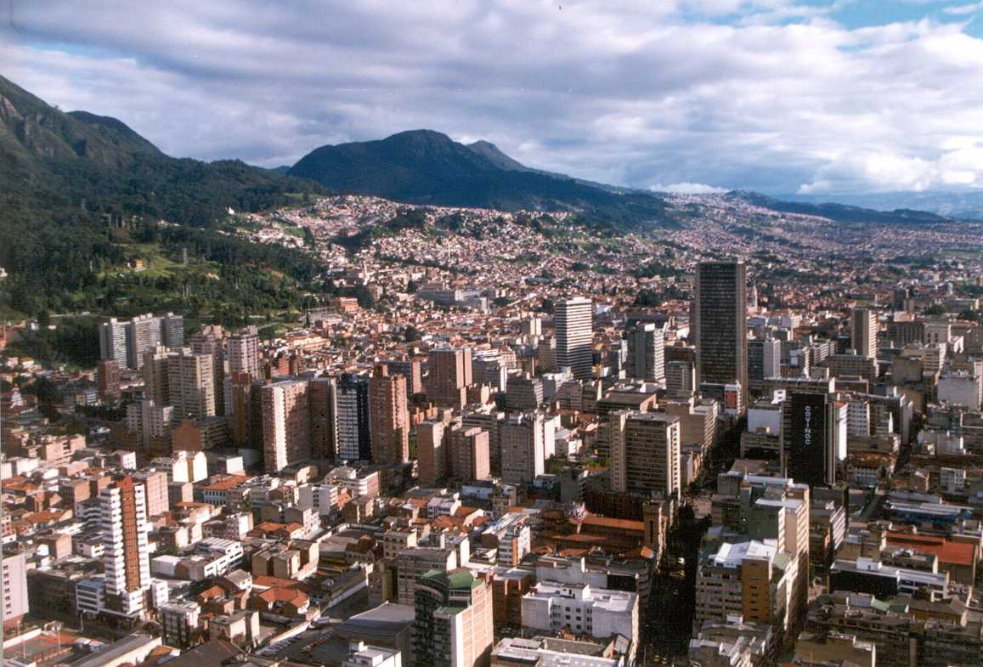


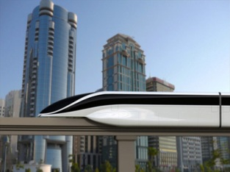


The evolution of cities
01
Population
Energy
CO2 &
Environment
Connectivity
Mobility
In 2050 70% of the population will live in cities. Today more than 50%
Cities consume high amounts of energy. About 75%
80% of emissions of greenhouse gases are generated in cities
In 2020, expect more than 50 billion connected devices.
The transportation Sector is expected to grow more than any other in 2020
Source: International Energy Agency,
Notes:
¿Qué es lo que está pasando en las ciudades? What is happening in the cities?
Currently 49% of world population lives in cities and generates more than 80% of global GDP.
Más del 50% de la población vive en ciudades y en 2050 se calcula que prácticamente el 70% de la población mundial será urbana.
Las ciudades consumen el 75% de los recursos y de la energía mundial. Generan el 80% de los gases responsables del efecto invernadero, ocupando tan sólo el 2% del territorio mundial
Al mismo tiempo demanda eficiencia, apuestan por el desarrollo sostenible, la calidad de vida, la gestión racional de los recursos…
En definitiva, si el siglo XIX fue el siglo de los imperios, el siglo XX ha sido el siglo de las naciones, el siglo XXI se dice que será el siglo de las ciudades.
The 19th century was a century of empires, the 20th century was a century of nation states, the 21th century will be a century of cities.

Slide 6

In this context it´s necessary to transform of local government model
01
Service improvement
Efficiency
Sustainability
Notes:
Pero en este escenario, vemos que se produce nuevamente un desequilibrio entre los tres elementos que decíamos que regían el buen funcionamiento de los seres vivos: materia y energía han aumentado de manera notable en el entorno de las ciudades, mientras que la gestión de la información vuelve a ser insuficiente.
Aquí está el porqué de la Smart City.
Es preciso introducir las tecnologías de la información y las comunicaciones en el entorno de las ciudades.
Este contexto enfrenta a las AAPP a dos retos:
A corto plazo, recortar gastos aumentando la eficiencia y buscando la sostenibilidad en los modelos
A medio plazo, relanzar la actividad productiva con modelos alternativos sostenibles que vuelvan a generar empleo y nuevas empresas (en sectores alternativos a la construcción), reactiven el consumo y generen nuevos ingresos tributarios para reducir el déficit.
In this scenario, we see that there is a miss-balance between the elements that guarantee development: energy & materials which have huge growth consumption in cities, while there is a lack of information management. That is why smart cities are important. And ICT Technology has to be introduced in cities
Local administrations have 2 challenges now:
Short Term:, reduce expenses by increasing efficiency and fining sustainable models.
Long term: foster and re-launch productive activities to generate job and new businesses (alternative to buildings); to foster consumption and generate tax incomes to reduce deficit.

Slide 7
Yes, we need Smart Cities! To built resource efficient cities

Slide 8
02
Telefonica´s vision and value of Smartcities

Slide 9







The Smart City is an undefined heterogeneous concept
02
efficient
green
sustainable
Politicians
Environmentalists
automated
more humane
IT providers
smart grid
energy efficiency
new businesses
Utilities
enabler
electric vehicle
Consultancy companies
Car Industry

Slide 10
03
Green & Sustainability ICT services in cities

Slide 11


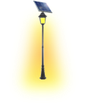

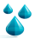




03
Telefónica has an integrated smart city model…
Fleet Management
Smart Building
Smart Mobility
EV Infrastructure
Elec. Smart Meter/Grid
Energy & Environment
Services focused on decreasing city traffic density and citizen driving times, and optimizing public services routes.
Smart Parking
Water Smart Meter
Services to reduce energy consumption (electricity, oil and gas, water, etc.), to better manage waste or to improve environment indicators.
Traffic management
Smart Urban Lighting
Intelligent Transport
Waste Management
Community biking
Energy &
Environment
Watering Manag.
Smart Mobility
Smart Taxi
Noise
detec.
SMART CITY
PLATFORM
SC
Dashboard
City Economy
City Management
NFC Services
Data Collection &
Analysis
SC Op Center
Services focused on modernizing public administration through IT and mobile solutions to better allocate city resources, prioritize investments thanks to an integrated view of the city.
Services focused on modernizing how city businesses are performing and enabling city growth
City Economy
City Management
City maintenance
Digital Signage
M2M Transactions
Open Data
e-Tourism
Others
Security
& e-Health
e-Government, e-Vote, e-Learning
connected universities, cloud,
Virtual hosting, smart
computing
Connected Retailer
Video surveillance
Tele-Health & Tele.Care
Hospital Capacity Tracking
Security & e-Health
Emergency Management
Fire Detection
Services focused either on crime prevention and prosecution and health care system quality and efficiency.
Notes:
Telefonica created this model which can fit any city in the world. Services are global.
Most of them are based in M2M technology.
In Telefónica most of the services of cities will be based d on M2M technology, in this sense i invite you to watch this video that summarizes how green ICT services are embedded in the smart city model of Teléfónica

Slide 12
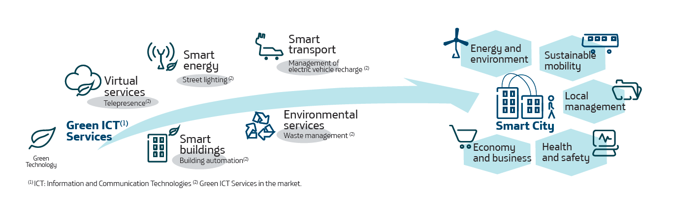
Energy & environment comprises services whose main motivation is to reduce resource consumption (electricity, oil and gas, water, etc.), to better manage waste or to improve environment indicators
03
Energy & environment
Green ICT services are part of the model
Smart building
Smart meter elec / grid
Smart Meter Water
Smart urban lighting
Waste Management
Watering management
Noise detection
Notes:
In this sense, we believe that despite their carbon footprint and related energy consumption, ICTs are key player in the efforts of talking climate change in cities and strategic sectors of the economy. This can be achieved by the introduction of energy-efficient devices, applications and networks; and by the development of new Green ICT technologies.

Slide 13
04
Challenges for greener & smarter cities

Slide 14
04
Different types of challenges…
Vision and Roadmap of the ICT Sector Need for accelerating innovation and Green ICT solutions portfolio Leveraging the interest of citizens Demonstrate that Green ICT solutions are good business Technology is there, what is required are business models. Need of standards to assess benefits.
Notes:
14
14

Slide 15


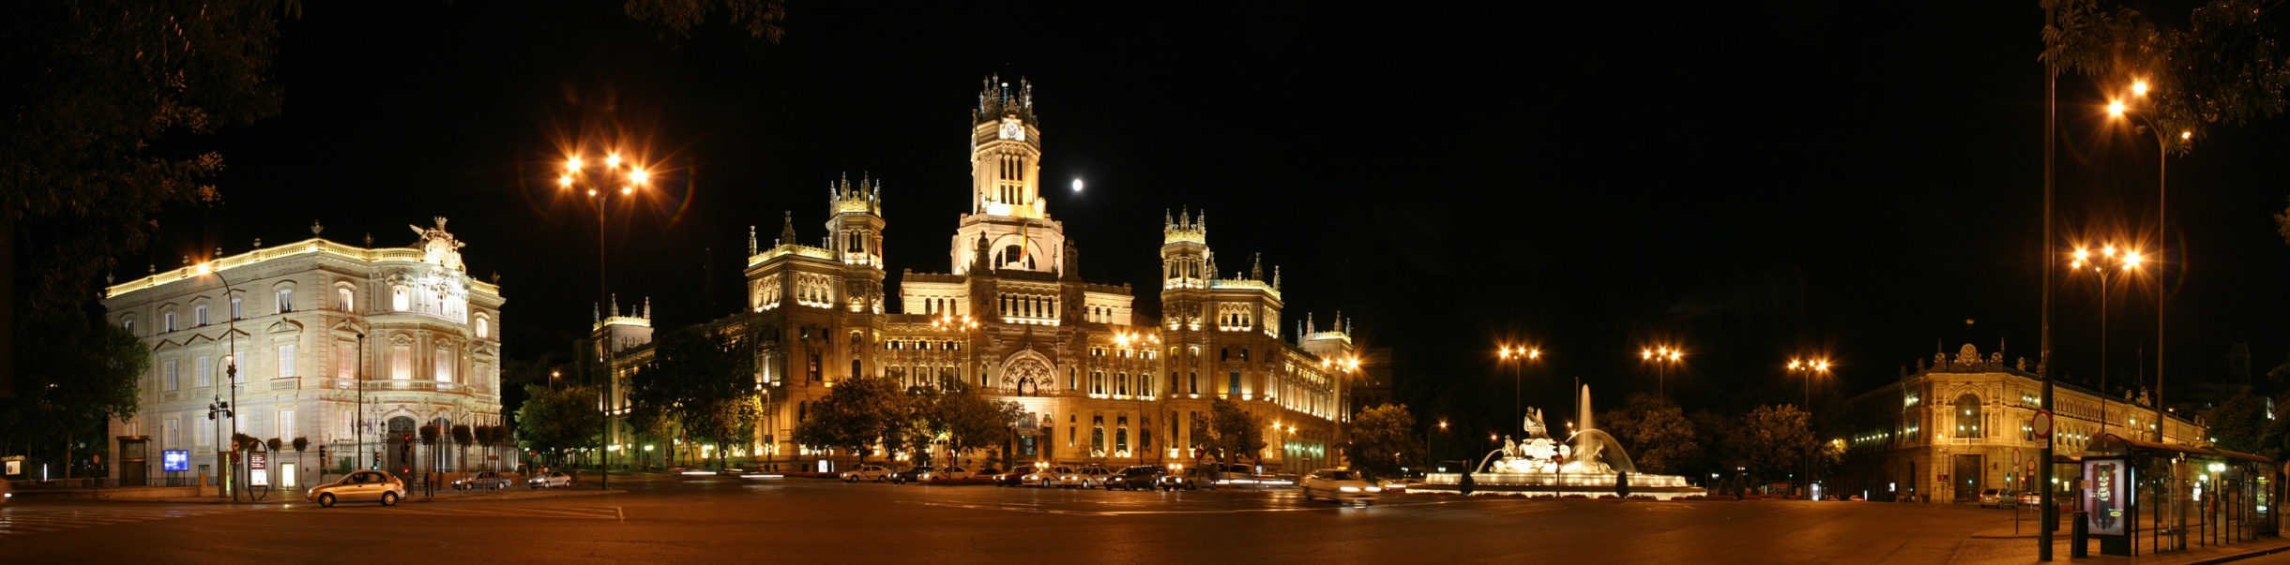


3rd Green ICT App. Challenge @Madrid
GREEN ICT ON
SMART
SUSTAINABLE CITIES
GLOBAL @Madrid
3RD ITU/TEF
Green ICT app.
Challenge
III Green Standard Week
http://www.itu.int/en/ITU-T/climatechange/greenict/2013/Pages/greenict-submission.aspx
20 DIC. 2012 – 30 JUN. 2013
  GREEN ICT APPLICATION CHALLENGES
2013

Slide 16

Notes:
16

