Slide 1
ICT Accessibility issues during the pandemic situation
ICTS and Accessibility for Persons with Disabilities and Specific Needs Special track:
Accessible ICT during the COVID-19 Pandemic
4 May 2021.
Masahito KAWAMORI
Co-Chair, IRG-AVA, ITU Rapporteur, ITU-T SG16 Q26 (Accessibility)
Project Professor, Keio University

Slide 2
Digital Transformation and New Normal
COVID-19 Pandemic has accelerated the digitalization of society with a “quantum leap”
Companies have accelerated the digitalization of their business operations by three to four years.
Many companies believe this is of lasting nature, staying in the Post-COVID
This is also true for healthcare: at the beginning of 2020, digital strategy initiatives around telehealth and digitalization were something “nice to have”.
But the COVID-19 pandemic has made them absolutely essential for healthcare organizations.

Slide 3
Quantum Leap in digitalization

Slide 4
ICT for fight against COVID-19
“COVID-19 is the first pandemic in human history, where technology and social media are being used on a massive scale to keep people safe, productive and connected, while being physically apart.” (ITU/WHO)
Information and Communication Technology (ICT) has now become an essential tool in providing vital services wider population
this is especially true for persons with disabilities.
ITU is also working with persons with disabilities worldwide

Slide 5
Vulnerable people are most severely affected
But this is a "double-edged sword" for Persons with Disabilities:
They are potentially the most vulnerable segment,
They could be "left out" of this new trend of rapid digitalization.
“It is the vulnerable segment of the people that are most severely affected, in particular those with disabilities. “the world’s 1 billion people living with disabilities are among the hardest hit by COVID-19 (UN Secretary-General Mr Antonio Guterres)
Persons with disabilities face a lack of accessible public health information, significant barriers to implement basic hygiene measures

Slide 6
ICT Accessibility is essential
If almost everything goes digital and “online”, persons with disabilities should not be left behind -- digitalization should be inclusive
The rapid pace of digitalization of society calls for rapid adoption of ICT accessibility
ICT Accessibility is an absolute necessity, not something "nice to have" in the post-COVID-19 "New Normal"

Slide 7
Care/Welfare and ICT Accessibility
COVID-19 forces everyone to keep “social distancing”
Many, if not most, services go “distant”, ”online”, and “remote”
Many heretofore "face-to-face" professions such as healthcare, welfare, etc., should accelerate the adoption of ICT and embrace ICT accessibility
With society going digital, healthcare and welfare too should go digital so that no one will be left behind

Slide 8
Need for Digital Healthcare and Welfare ICT
Healthcare and welfare need to be “digitized” and go online to provide necessary information and care to persons with disabilities and other vulnerable segments of the population
Related areas, such as sign language interpretation, should also be available online
Framework of digital healthcare and welfare ICT as well as for related services should be established
guidelines for use of digital technology and ICT should be defined and improvement of digital literacy should be made
International bodies and cooperation among them are needed

Slide 9
VRI as a Tool for Total Conversation
VRI is a service that provides interpretation and assistance remotely using video, audio and text communication
For deaf person – Sign language interpretation
Hard of hearing – Text communication (sometimes using ASR)
Blind person – Audio description and guidance
(For foreigners – spoken language translation can also be provided)

Slide 10
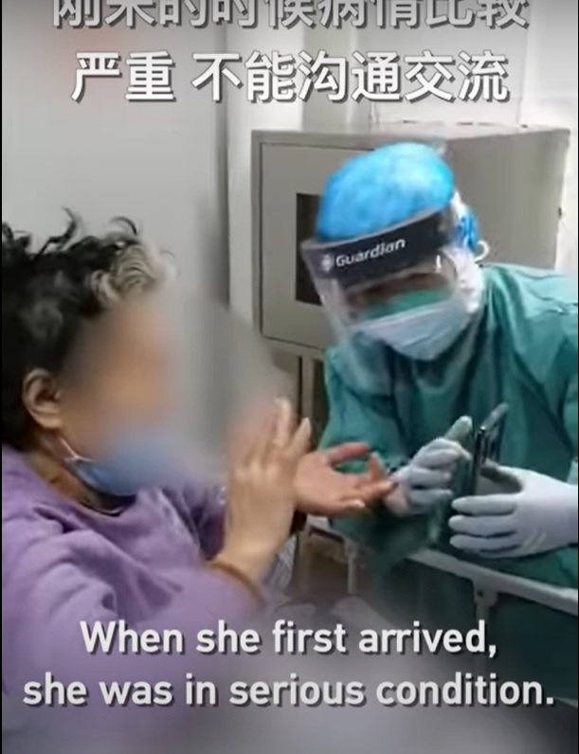
Accessibility as Prime Necessity
The picture shows a nurse using a smart phone to provide make-shift VRI to a deaf patient with COVID-19, via a sign language interpreter in a remote place.
VRI is an essential tool for in-hospital (deaf) patients

Slide 11
Video Remote Interpretation (VRI) for Sign Language

Slide 12
Video Remote Interpretation (VRI) in Emergency

Slide 13
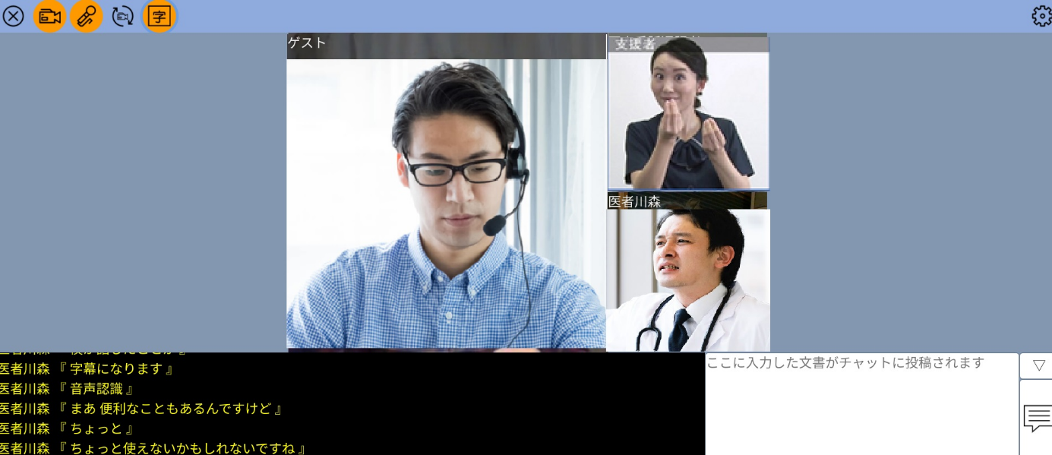
An Example of VRI System
Sign Language and other assistance
Persons with Specific Needs
Video communication
Captioned Text

Slide 14
Some requirements on VRI
Security
VRI needs to be secure, protecting the privacy, even in medical setting, of the participants with e.g., EE2E
Useability
Should be very easy for PWD, including blind people, to use, avoiding complicated set-up, registration, etc. as much as possible
Affordability
As it is used daily, it should not be costly
Availability
Should be widely available, not requiring any special hardware a/o devices, preferably workable on any browsers

Slide 15
Importance of Interoperability and Standards
Non-interoperable devices and services are esp. difficult for persons with disabilities
Standards based universal design will help accessibility
e.g., a single raised dot on the 5 key of a telephone terminal
ICT should also be standardized
Emergency call number --112, 911, etc.
Standardized ICT will enhance accessibility for persons with disabilities
Standards will make services more affordable --Open source,
International organizations, like ITU, and governments can play an important role in this respect

Slide 16
Conclusion
COVID-19 Pandemic has accelerated the digitalization of society
But this is a "double-edged sword" for Persons with Disabilities: They are potentially the most vulnerable segment,
They could be "left out" of this new trend of rapid digitalization.
ICT Accessibility is an “must have”, not something "nice to have" during COVID-19
Many heretofore "face-to-face" professions should accelerate the adoption of ICT and ICT accessibility
One example is VRI, as a universal “Total conversation” Tool for especially during COVID-19
Security, useability, affordability, wide availability are key
Key to success is standardization:

Slide 17
Thank you

