Slide 1
Accessibility situation for Persons who are hard of hearing during the pandemic.
Lidia Best
Vice Chairman
ITU Joint Coordinating Activities on Accessibility and Human Factors

Slide 2
Accessibility of ICT’s during the Covid-19 Pandemic
During COVID-19, reliance on virtual environments, remote services and digital information has grown exponentially – Web sites, virtual meetings, mobile apps and services, television, telecommunication, and information
The trend excludes one billion Persons with Disabilities who experience a variety of barriers to perceive, understand and interact with digital environments
The solutions and standards exist to overcome most digital barriers, their implementation is still limited around the world
Impacts COVID-19 related services, education, employment, e-government, telecommunication, health and emergency services and ultimately the realization of the SDGs

Slide 3
Access to public services during pandemic?
Most health and public services services moved to telephone contacts only
Email communication is not routinely offered
Video Telehealth appointments not often offered and captioning is not enabled
Two way conversation
SMS rarely offered
Some businesses offer webchats
During the pandemic, people over the age of 70, were deemed as having a greater risk for severe illness after contracting COVID-19 : many live alone

Slide 4
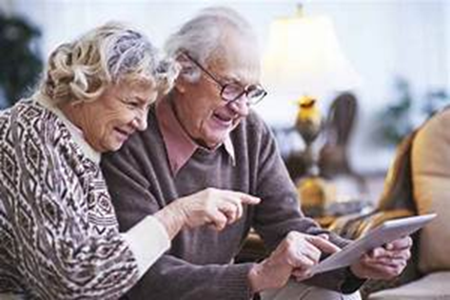
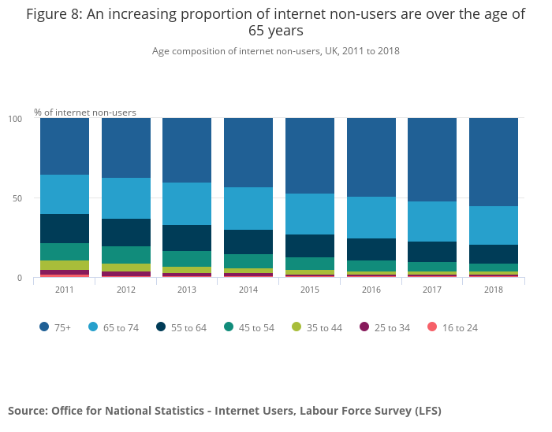
Is current system matching users needs?
Approximately one third of people over 65 years of age are affected by disabling hearing loss. (source: WHO)
76% of those with zero basic digital skills aged over 65 years in 2018 ( source UK ONS (PDF, 3.16MB)

Slide 5
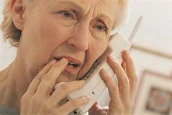
Do hard of hearing people need captioned telephone services?
It is often assumed that all hard of hearing and deafened people rely on amplified phones and hearing devices alone.
Hearing loss and how it affects an individual may change over their lifetime.
Accents, strangers’ voices and misunderstanding callers’ messages are familiar issues hard of hearing people deal with.
Q: Are persons who are deafened or hard of hearing in UK and elsewhere able to use the telephone in same unrestricted manner as hearing people?
NO, with a few exceptions.

Slide 6
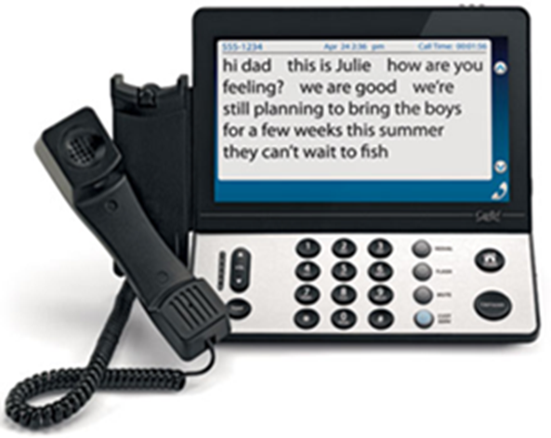
What is the solution?
Captioned Telephones follow Universal Design principles by supporting wide range of users:
Those who struggle to understand callers
Those struggling with digital skills
Using telecare and public services
Those with cognitive issues and disabilities
People experiencing memory loss
Combats loneliness
Improves employability and independence
Provision of captioned telephony benefits society, employers and the individual

Slide 7
Implementing captioned relay services
Development of funding models (no additional cost to users)
Relay Services provision enshrined in the national laws
Services developed with user's involvement
Development of relay services KPI’s including usability – making and receiving calls
ITU-T Recommendation F.930 Multimedia Telecommunication Relay
Services
Beware of providing Automated Speech Recognition ( ASR) without any human intervention. It can fail minimum accuracy needed for a successful call.

Slide 8
Work and education is now online….
Events/ work meetings/ teaching moved online, and often do not use services of professional captioners
Lack of awareness of online platforms accessibility features left many people struggling to participate fully
Only some online platforms are offering automated captioning
…solutions and guidance exist

Slide 9
ITU-T accessibility guidance – technical papers
FSTP-ACC-RemPart - Guidelines for supporting remote participation in meetings for all
FSTP-ACC-RCS - Overview of remote captioning services
Specifies the requirements for ensuring that meetings are accessible to all remote participants including Persons with Disabilities
Guidance for chairs and moderators
Guidance for participants
Guidance on inclusion of persons with disabilities and those using assistive technologies
Guidance for follow up actions – provision of transcript
Outlines the benefits of remote captioning
Covers the technical aspects of remote-captioning equipment.
Data-protection regulation compliance
Encryption and security
Defines the quality of remote captioning including minimum accuracy

Slide 10
Building back a better future
Accessibility solutions exist, they must be made available to build an inclusive, accessible society
There is heightened awareness of lack of ICT accessibility
To translate those points into actual progress:
Involve Persons with Disabilities in national ICT accessibility policy making and development of services
Ensure diversity of user's representation in policy development
Adoption of accessibility standards and procurement policies – a must

Slide 11
THANK YOU FOR YOUR ATTENTION
Email contact : best.lidia@gmail.com

