Slide 1
Telecommunications Relay Service and Before and After Its Beginnings
WSIS 2021
ITU Standards for ICT Accessibility for the Deaf and Hard of Hearing
Andrea J. Saks: Chairman
ITU-T Joint Coordination Activity on Accessibility and Human Factors (ITU-T JCA-AHF)
CODA (Child of Deaf Adults)

Slide 2
Why do we now need relay?
When we have:
Computers with video cameras
Video phones
email
Mobile phones and SMS
Pads/Tablets
Instant messaging
Let’s go back to the very beginning of independence for Deaf people, the Mid 1960’s in the USA and see History.

Slide 3
Overview
A Quick Historical View of events
1960’s the first USA Deaf Telephone Network starts with 5 stations, one with Grandma!
For the Deaf by the Deaf working together reconditioning teleprinters/telex machines.
TDI: Teletypewriters for the Deaf Inc. allowed to receive surplus telex machines.
Compatibility without Standards so far so good as only in the USA.
Beginning of 1973: The British Post Office gives permission for 5 Stations!

Slide 4
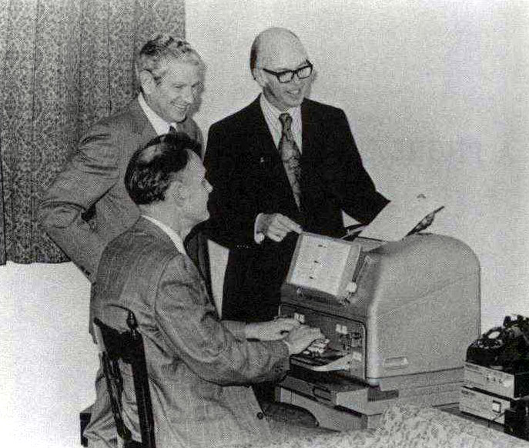
The Beginning
Three Deaf Men Changed the World
Robert Weitbrecht Andrew Saks James C Marsters
Liberated the Telephone and that enabled deaf people to have a political voice that is now heard around the world!

Slide 5
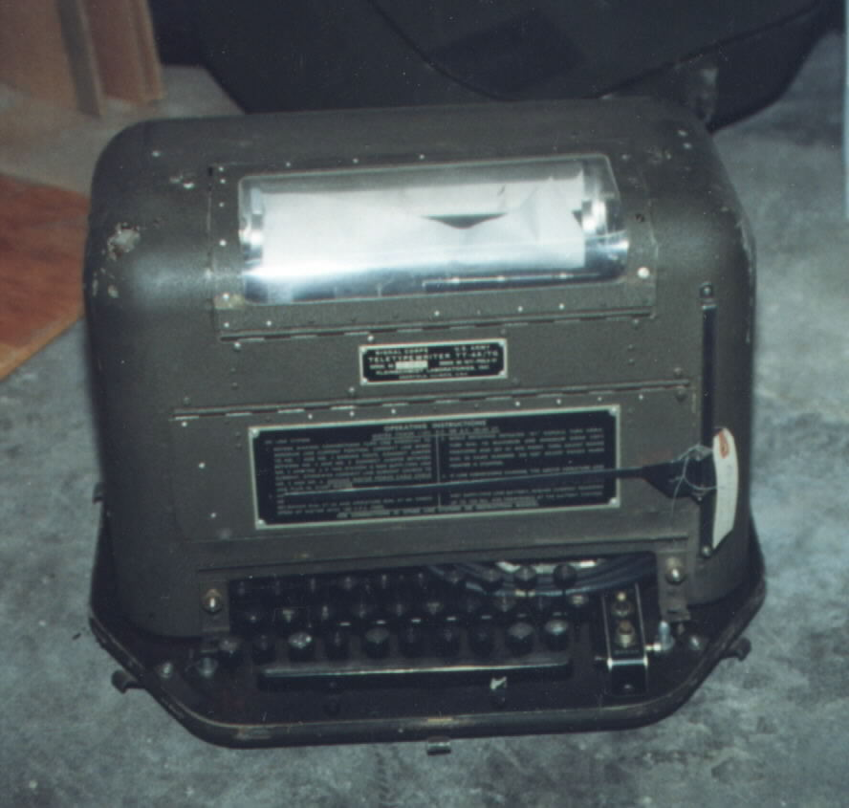
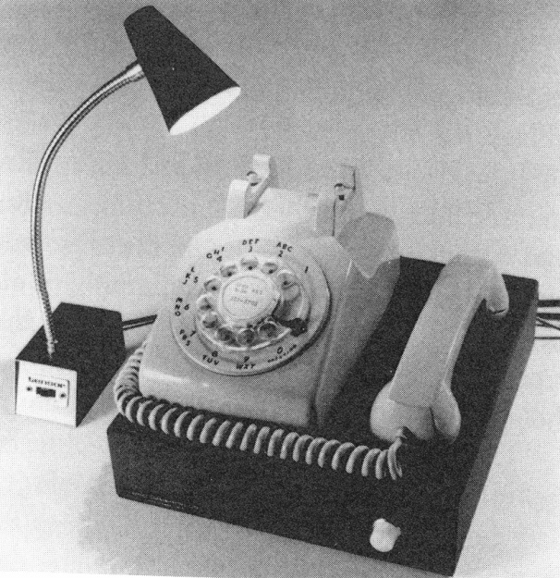
A Historical View of events
In the 1960’s they and their tiny company, Applied Communications Corporation (APCOM) created the first successful deaf telephone network with a modem and a surplus TTY.
Surplus model 15 Phonetype acoustic coupler

Slide 6
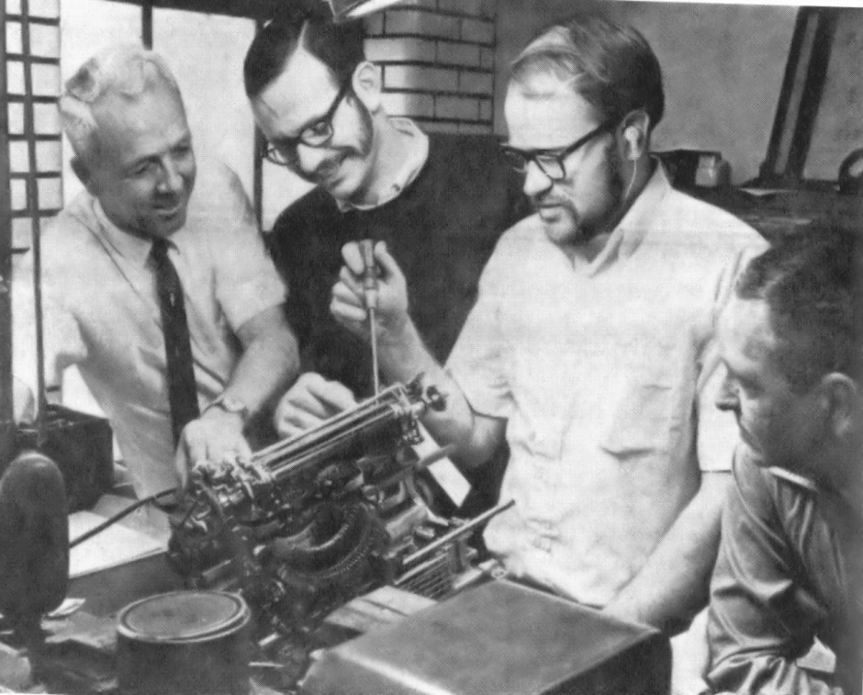
USA: The first Deaf Telephone Network
The Deaf created and made their system work themselves long before relay services started
Photo: Sally A. Taylor wife of Paul Taylor founder of relay services pictured below
Reconditioning teleprinters/telex machines donated to TDI Inc.
It was by the Deaf for the Deaf working together with Western Union Volunteers and the Telephone Pioneers of America

Slide 7
The beginning of Relay Services
The first idea with a normal answering service using two telephones and two textphones (TTY).
Result? Andrew Saks ordering room service in a Hotel via TTY. Breakfast is served in New York but ordered from a California answering service.
In the USA, Paul Taylor starts the First Relay Service, enabling many deaf people to subscribe and “talk” to hearing people in the early 70’s.
All relay services have human beings as the interface. They are called CA’s, Communication Assistants or Relay Service Operators.

Slide 8
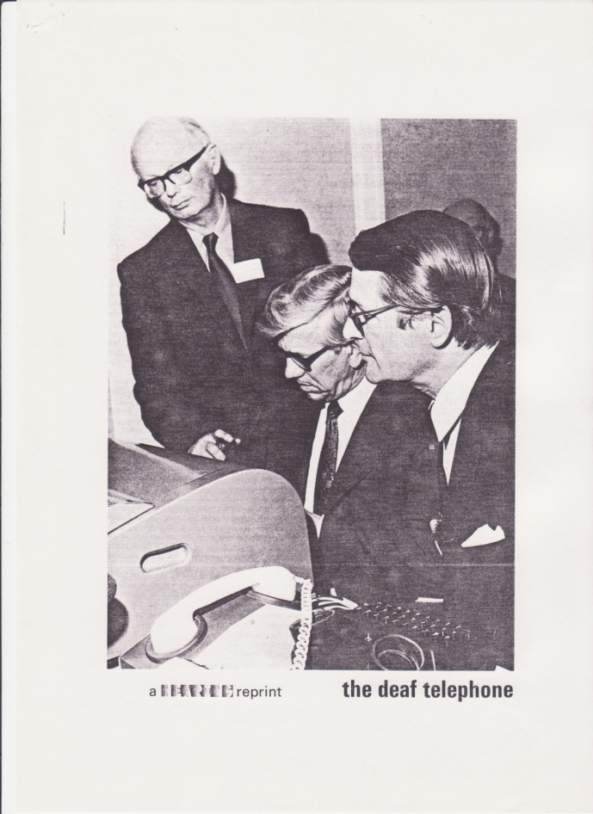
The First Transatlantic Call 1975
Lord Jack Ashley (deaf) who was at the time a British MP
Then USA Ambassador to
the UK, Elliot Richardson
with Michael Kingbeer a
deaf engineer, looking on
at US Trade Center Building in
London to Washington D.C

Slide 9
First TTY Transatlantic Call 1975 when we had compatibility
Due to anti-trust regulation, data was not allowed across the transatlantic voice network. FCC waived the rule for this call for one day only.
What it meant to USA and UK Deaf people could “talk” (text) over the trans-Atlantic- voice telephone network, using data or i.e. text long before email or SMS.
Faxing across the transatlantic network was now legal because of the Deaf, by proving that data was personal communication.
We thought we were going to be international. Sadly it was broken by UK misguided by the new!

Slide 10
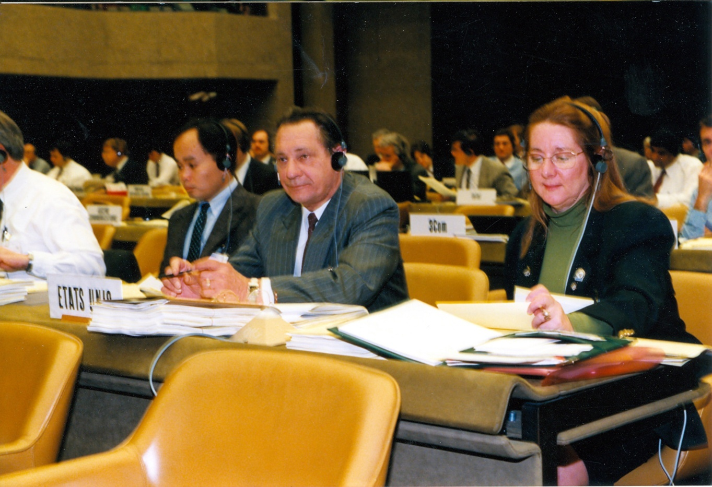
The beginning at ITU: 1991
Gary Fereno, US State Department & AJS
No personal computers just lots of paper!

Slide 11
Types of Relay Services
Text Relay Service using a typing device, with or without VCO (voice carry over) and often called “TRS” as the T stood for TEXT.
Video Relay Service for sign language with facial expressions and some lip reading.
CapTel/Web CapTel Relay: the user with his own voice, speaking directly (VCO) to whom he calling but receiving reply in text so no need to type. This is transparent!
Speech to Speech Relay for those who may have hearing but speak with difficulty.
Notes:
Describe the types and why they are separate..

Slide 12
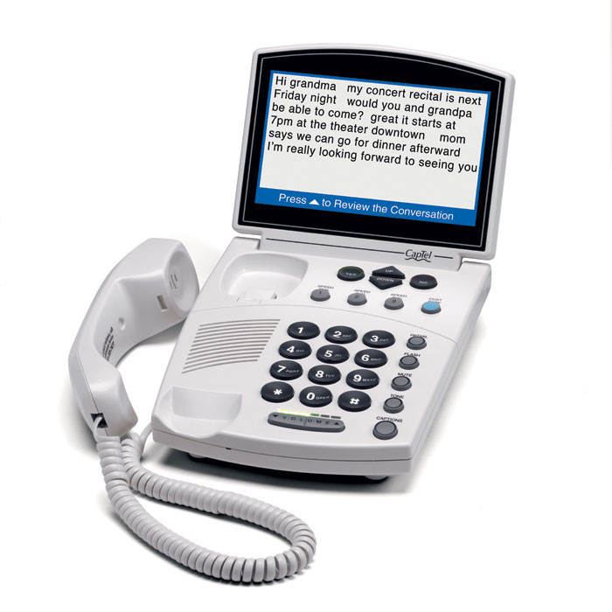
For those wish to use their Voice
Captel Relay device for speaking and
receiving text for
people who wish to speak
speak directly to
whom they are
calling. It is a
transparent
Process.

Slide 13
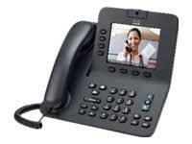
Video Phone
Video phone for signing and voice
without text
How many
hearing People
have them?
Used with
VRS and direct
Calls

Slide 14
Why People need relay Services
Relay Services connect people to the hearing world in real time.
Establishing independence & not having to rely on children, family, friends or strangers.
A personal private phone call with a doctor, lawyer or their child’s teacher via a relay.
Everyone answers the phone in real time.
Email, instant messaging and SMS not real time and not reliable for real time tasks.
Jobs and Education changes with Relay.
Relay Services connect people to Real Life!

Slide 15
Why People need Relay on the Go
In the USA some Relay providers use apps for Mobile phones.
Some use Android platforms others use Apple based apps for relay on the move.
Portability for Relay Services in real time for real time situations.
One major category of importance is real time emergency serivces

Slide 16
Who needs Relay Services?
Deaf People and Hard of Hearing People
People who use sign language with or without speech and there are as many sign languages as countries on the planet if not more.
Some deaf people do not sign or who are in a country where they do not know the sign.
People who are deafened later life either medically or through age and who mostly likely do not sign and most can speak.
People who have severe hearing impairment but can speak and do not sign.

Slide 17
Who needs Relay Services?
Deaf Blind People
There are no two people alike.
It is not total darkness and total silence.
It is possible to use Text Relay Services and Video Relay services with assistive technology.
Famous deaf/blind Helen Keller could speak.
People with Voice impairments
Specially trained communication assistants or relay operators who listen and can understand distorted voices and speak for people who wouldn’t otherwise be understood.

Slide 18
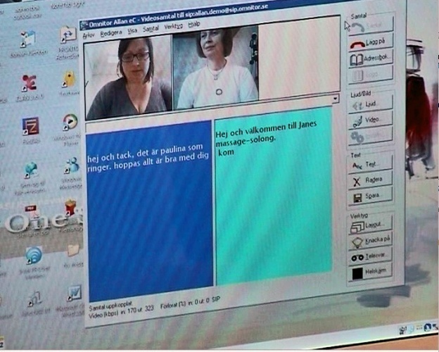
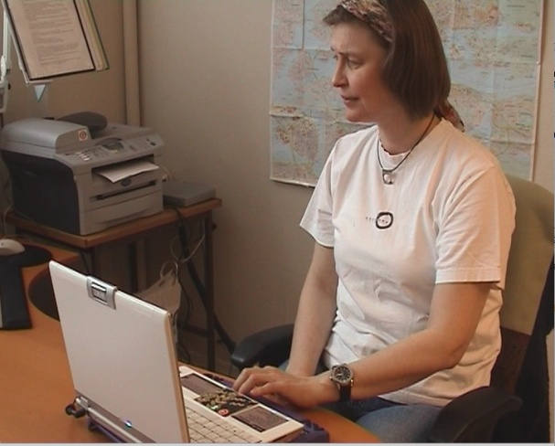
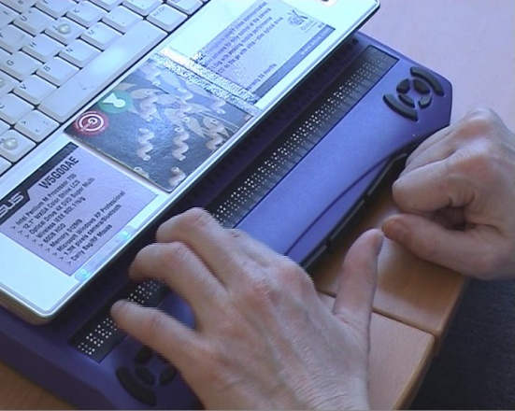
Embracing total conversation
A deaf-blind woman uses multimedia communication (ITU-T F.703 service description):
She uses sign-language
She receives text
Also for emergency services (Outreach 112)
Voice, video, text relay
refreshable Braille device

Slide 19
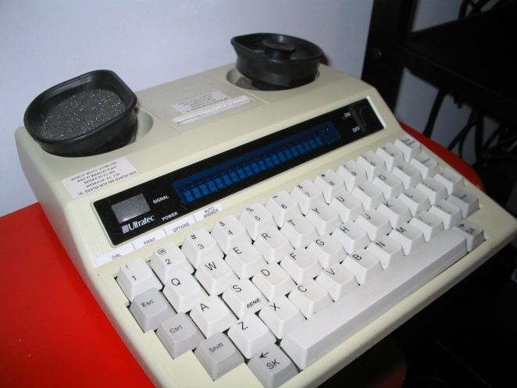
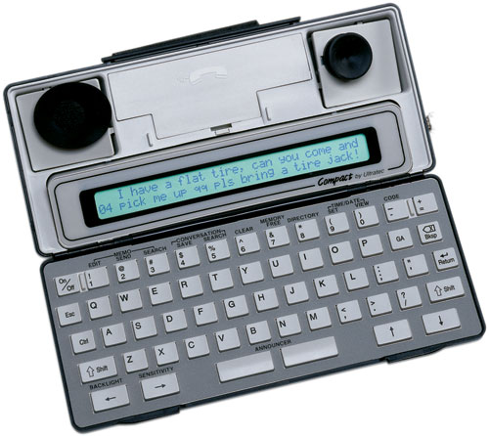
Older Text Phones still needed
Portable Textphones that the deaf blind still use because of Light emitting diode.
These are both Ultratec Textphone products and (now usable with mobile phones)
Other companies follow some deaf owned make
Hard copy Compacts often dual coded (photos: Ultratec)

Slide 20
What is next to Discuss ?
Future Global inclusion
Standards: Every relay service should be international like the hearing phone.
How we presently access relay services
International numbering for access.
Who should pay and equivalent service under article 9 of the UNCRPD.
ITU’s involvement and inclusive Policy.

Slide 21
Why promote and create accessible ICTs, Assistive Technology and International Relay Services?
It is a human right recognized in the UN Convention on the Rights of Persons with Disabilities (UNCRPD):Enshrined in Article 9
Article 9 of the UNCRPD defines ICT accessibility as an integral part of accessibility rights on par with transportation and the physical environment.
Article 9 concerns all ICT products and ICT based applications and services, with a far-reaching implication for industry, governments and civil society
All of us who age will have age-related disabilities, We all (100%) can benefit from more accessible devices and services. We will need relay services.
Notes:
Why is there so much attention given to promoting accessible ICTs for persons with disabilities?
Accessibility is a human right recognized in the United Nations Convention on the Rights of Persons with Disabilities which has now been signed by 147 countries and ratified by 95! Chances are good that your country is a signatory.
The Convention puts rights to ICT accessibility on a par with well-recognized rights to accessibility to transportation and the physical environment, such as ramps to buildings for those in wheelchairs.
Provisions on ICT accessibility are enshrined in Article 9 of the CRPD.
It has been shown that all too often, few persons with disabilities in have good access to education. As a result, they remain illiterate and have no viable job skills.
Accessible ICTs can provide a path out of poverty and ensure an inclusive education for persons with disabilities.

Slide 22
We Need Persons with Disabilities to play a part in society
Relay Services need strong non-proprietary International Standards for transparent international access
Simple international numbering for usage globally so that any person with disabilities can access them anywhere in the world
All countries and relay services providers are invited participate in the work of Q26/ Study Group 16
Mobile phones and pads should be included
There needs to be easy access to relay services with simple short numbers Q4/ Study Group 2
Interoperability and access, Global connectivity in all countries to enable all to be a part of society.
Notes:
Today, these technologies operate as isolated functions, but H.325 will tie them all together quite naturally. Life will be a whole lot simpler with H.325.

Slide 23
New Standards Need Persons with Disabilities to Participate
Engineers and standard writers need Disability scenarios from the very people who require the accessibility features to write good Standards
New Standards need industry assistance and implementation for globalization and PWD’s in put
Persons with disabilities now participate in person or remotely with captioning and sign language in the ITU standards processes.
ITU-T in Q26/16 is working on two technical papers for relay services with the participation of PWDs

Slide 24
Persons with Disabilities
Created their own Deaf Telephone Network
They want International Access that is transparent
They must be involved and their needs listen to.
Their participation and creativity in the past must be regarded with respect.
Their experience must be respected.

Slide 25
Real Time text conversation
User A
User B
Why do you need character by character transmission?
Because then you get a live conversation suitable for a real time call. Yes, I see, I can read your thoughts at the
moment you express them. No waiting. Good!

Slide 26
Without International Standards there cannot be Accessibility for Persons with Disabilities
Without the involvement of Persons with Disabilities in the standardization process, it will be more difficult to create good Relay Services that actually work.
Without Universal Design being used from the very beginning of the standard writing process, implementation becomes expensive with retro refitting.
Notes:
Today, these technologies operate as isolated functions, but H.325 will tie them all together quite naturally. Life will be a whole lot simpler with H.325.

Slide 27
Standardizing Relay Services
ITU-T F.930 (03/2018) - Multimedia telecommunication relay services
SG 16 the lead Study Group in accessibility
Q26/16 leading the work in Relay Services and Guidelines for PWDs
Relay Service Providers participating in the work and welcome and needed
Standard Writers Participating in many other questions that apply to Relay

Slide 28
Final Message
Accessibility difficulty is expressed everyday with new barriers that are being created by new technology especially those with proprietary standards.
Countries unfortunately practice “Not invented Here!”
Relays need Gateways or Session Border Controllers to be updated to have international interoperability.
If industry, all standards organizations and regulators will work together, then it is possible to have globalized Accessible ICTs, Telecommunications, and transparent accessible International Relays.
People need relays to have full lives for work, family, friends, education and to contribute back to society and in real time.

Slide 29
Contact
Andrea J. Saks
Chairman, ITU-T Joint Coordination Activity on Accessibility and Human Factors, (JCA-AHF)
)
TDI Representative to ITU (website) G3ict Representative to ITU http://g3ict.org/about/management
Accessibility Advisor to USA delegations attending ITU-T and ITU-D Study Groups.
E-mail: Andrea@andreasaks.onmicrosoft.com

