Slide 1
Communication Access through Telephone Relay Service

Slide 2
Deaf and Hard of Hearing
Invisible Disability – Largely Underestimated
World wide:
- 70 Millions Deaf Persons
- 466 Millions Hard of Hearing Persons
or about 15+% of population
- 1.1 billion young people at risk of hearing loss
due to exposure to noise in recreational settings.
https://wfdeaf.org/
http://www.who.int/mediacentre/factsheets/fs300/en/
Copyright © 2018 procom
www.procom-deaf.ch

Slide 3
Deaf and Hard of Hearing
Consequences of Hearing loss:
Closed out from - communication
- information
- education
- job opportunities
- entertainment
- social inclusion
Copyright © 2018 procom
www.procom-deaf.ch

Slide 4
Deaf and Hard of Hearing
Visual Tools for Accessibility:
Sign language interpreters live/Video/TV
Captioning/Subtitling live/Video/TV
Telephone Relay Services for Sign language
and for Text
👎🏿 Avatars or Signing Robots
Copyright © 2018 procom
www.procom-deaf.ch

Slide 5
Technical Standards for Relay Services
International Telecommunication Union: ITU-T (F.700)
European Telecom Standards Institute: ETSI TS 126 114
Standards RFC 3261for SIP and RFC 4103 for text using SIP
Total Conversation StandardsVideo: H.263, H.264, H.265, VP8
Voice: G.711 as adopted in RFC3550, G.722, G.722.1
Text: RFC 4103, Real Time Text, Presentation according to ITU-T T.140
Encryption: Secure audio and video communication protocol (SRTP), RFC 3261, RFC 3711, RFC 4568 (Session description protocol)
Copyright © 2018 procom
www.procom-deaf.ch

Slide 6
Operational Standards for Relay Services
Latest ITU-T Recommendation :
F.930
«Multimedia telecommunication relay services»
Consent date February 16, 2018
ETSI ES 202 975
«Human Factors (HF); Requirements for relay services»
September 2015 (V2.1.1)
https://www.itu.int/rec/T-REC-F.930
http://www.etsi.org/deliver/etsi_es/202900_202999/202975/02.01.01_60/es_202975v020101p.pdf
Copyright © 2018 procom
www.procom-deaf.ch

Slide 7
Where are the Relay Services?
Despite - international standards
- national laws for equal rights for persons with disabilities
- UN Convention on the Rights for Persons with Disabilities
... there are worldwide less than 20 national telephone relay services
with full functionality
Raise awareness for deaf and hard of hearing population
Cooperate with organizations of the deaf
Copyright © 2018 procom
www.procom-deaf.ch

Slide 8
History of Swiss Relay Service
1985: Start of first Text Relay Service (TRS)
1998: TRS included in Swiss law on Telecommunication
2008: Video Relay Service (VRS) refused by Swiss OFCOM
2008 – 2017: Political lobbying + pilot trial to introduce VRS
2018: VRS included in revised law on Telecommunication
Copyright © 2018 procom
www.procom-deaf.ch

Slide 9
procom – Swiss Relay Services
Accessible in three spoken languages (German, French and
Italian) and three corresponding sign languages
VRS: Video Relay – mornings to late evenings
TRS: Text Relay – 24/7
SMS: SMS Relay – 24/7
Call via the web (PC Windows and Mac), smartphones and tablets (Android and iOS), Text-Telephones (EDT) and SMS
Copyright © 2018 procom
www.procom-deaf.ch

Slide 10
Accessible Relay Services
Financed by Swisscom – based on equal rights for PwD
Accessible for free to everyone in Switzerland
Registration not necessary if customers use the web applications (text relay and video relay) and SMS-relay
Registered customers can download apps and get an individual telephone number
Copyright © 2018 procom
www.procom-deaf.ch

Slide 11
Individual Telephone Numbers
A telephone number is an important identity: it is used to make and to receive calls
Telephone numbers provided free of charge to Deaf and Hard of hearing consumers
Calls to/from hearing people are automatically connected to the preferred Relay Service as selected during registration: Text or Video with Sign Language Interpreter
Copyright © 2018 procom
www.procom-deaf.ch

Slide 12
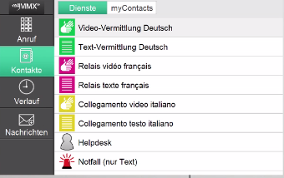
Calling Made Easy
Menu adjusted for language and service preferences as given in Registration
Call directly using the dial pad or phone book
Calls from hearing people are re-directed to relay services
Picture: www.nwise.se
Copyright © 2018 procom
www.procom-deaf.ch

Slide 13
Total Conversation
Full adaption to different forms of communication
Simultaneous use of
- video
- text
- sound
Picture: www.nwise.se
Copyright © 2018 procom
www.procom-deaf.ch

Slide 14
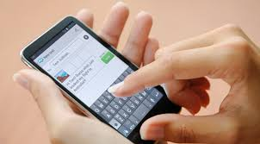
SMS Service for Simple Access
Customers write simple SMS from their cellphones
Text relay (TRS) receives the text message and takes
necessary action (call 112, call a number, etc.)
The customer is contacted back with the answer/further action
Copyright © 2018 procom
www.procom-deaf.ch

Slide 15
Text Relay and Video Relay Combined
Same platform is used for both services
Training and customer support is easier to be provided.
Customers can use Total Conversation apps to dial to both services.
When VRS is closed, automatic switch to TRS
Copyright © 2018 procom
www.procom-deaf.ch

Slide 16
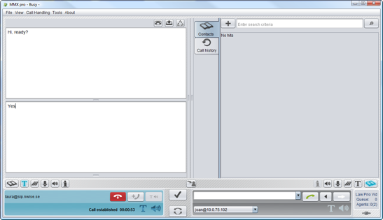
Text Relay Service
All calls are connected to the same agent position
SMS-Relay, Text Relay, calls to emergency services
Queue priority defines which calls come first – special alert for emergency
Picture: www.nwise.se
Copyright © 2018 procom
www.procom-deaf.ch

Slide 17
Video Relay Service
One workstation is used
Few keystrokes are necessary – ergonomic for the interpreter
All information needed is available in the same window
Queue information, agents logged in, other important information
Picture: www.nwise.se
Copyright © 2018 procom
www.procom-deaf.ch

Slide 18
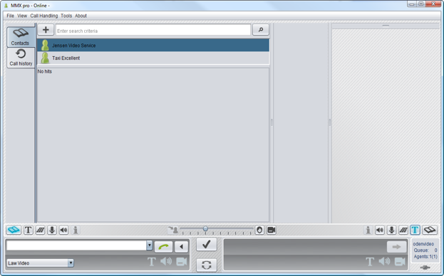
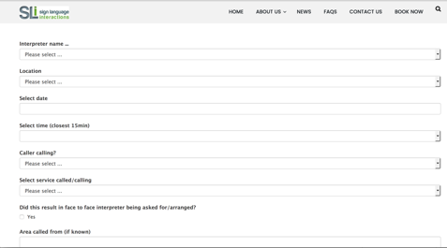
Post-call Reporting
Follow up of call types and quality parameters
Understand trends in usage of relay services
Gain from experience!
Picture: www.nwise.se
Copyright © 2018 procom
www.procom-deaf.ch

Slide 19
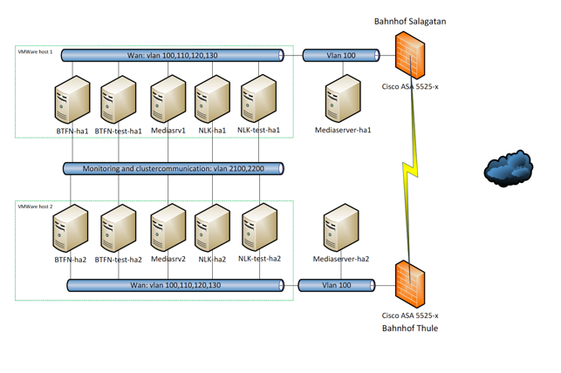
Accessibility, Capacity and Scalability
Cluster solution - no downtime if sides are changed
Database is redundant and backed up
Interpreters in different cities to ensure uptime
Picture: www.nwise.se
Copyright © 2018 procom
www.procom-deaf.ch

Slide 20
Contact Information
Beat Kleeb
Expert Group on Accessibility
World Federation of the Deaf WFD
President procom
Swiss Telephone Relay Service
Tannwaldstrasse 2, CH-4600 Olten
bkleeb@procom-deaf.ch
Total Conversation Relay platform MMX 7 developed by
nWise AB, SE-753 30 Uppsala / Sweden
Copyright © 2018 procom
www.procom-deaf.ch

