Slide 1
Standardization efforts at ITU for Inclusive ICT Society
World Summit on the Information Society
Achieving an inclusive society by designing and implementing accessible ICTs
22 March 2018, Geneva, Switzerland
Masahito Kawamori
Keio University
ITU-T SG16 Q26, Rapporteur
ITU Intersector Rapporteur Group on Audio-Visual Accessibility

Slide 2
Why is standardization of Accessibility important?
Improved Interoperability
Products from different companies, countries can be used in the same way
Especially important in time of emergency
Better accessibility to services
Standardized ICT will be easier to use, without peculiar “surprises”
Lowered cost of operation, purchase, etc.
More competition makes prices go down
More affordable to the user
Lowered barrier to development and market entry
A wider market
More availability

Slide 3
Some New Recommendations
ITU-T F.791 (11/2015)
Accessibility terms and definitions
ITU-T H.702 (11/2015)
Accessibility profiles for IPTV systems
ITU-T F.921 (03/17) Audio-based network navigation system for persons with vision impairment
ITU-T Rec. F.930 (2/18)
Multimedia telecommunication relay services
Notes:
ITU-T F.791 (11/2015) Accessibility terms and definitions This is the first consented UN standalone recommendation giving the correct definitions based on the UNCRD with consultation with persons with disabilites to be used by standard writers and others to be used in all respective documents in English.
ITU-T H.702 (11/2015) Accessibility profiles for IPTV systems This recommendation makes it possible for accessibility features like captioning, sign language, and audio description to be added to Internet Protocol TV and that this can be deployed globally interoperably.
FSTP-ACC-RemPart - Guidelines for supporting remote participation in meetings for all This is the first approved UN standalone technical paper giving instructions on how to organize and run an accessible remote participation meetings to include persons with disabilites taking into account both the accessible and in accessible aspects of the existing remote participation tools.
FSTP-AM - Guidelines for accessible meetings this is the first approved UN standalone technical paper giving instructions on how to organize and run an accessible meetings to include persons with disabilities.

Slide 4
ITU-T Rec. F.790
general guidelines for planning, developing, designing and distributing telecommunications equipment, software and services to ensure accessibility for people with various abilities.
gives guidance on .. the ways that accessibility may be incorporated in products and services.
Harmonized with ISO (ISO 13407) and ETSI standards

Slide 5
ITU-T Rec. H.702
Defines the basic functions of accessibility services on IPTV
Includes actual implementation examples using available ITU-T Standards
The world’s first global standard for accessibility services for IPTV -- Approved in 2015
Defines the 3 profiles (Main, Enhanced, and Basic) for captioning, sign-language, and audio description
With European Broadcasting Union and ITU-R, it is communicated to be adopted by broadcasting and cable TV standard

Slide 6
ITU-T Rec. H.702 (cont.)
Basic profile defines the accessibility services that can immediately be provided by IPTV terminals available in the market
E.g. changing the size, color, position, of captions;
Providing multiple captions (e.g., Slovene and English; easy Slovene for the Intellectually challenged)
Personalized service
“Do now what can be done now”

Slide 7
IPTV Accessibility features
ITU-T standard IPTV and H.702 can support many Accessibility features:
Closed captioning in multiple languages
With different font size, positions and colors
Audio guidance (audible Electronic Program Guide)
Audio description
Accessible Emergency alert over live-channel as well as Video-On-Demand

Slide 8
ITU-T Rec. H.702
ITU-T Rec. H.702 has already been implemented as TV sets and set-top boxes
It has already been adopted by some governments (e.g., Mongolia, Ecuador, Japan) and is expected to be globally adopted
Presented at United Nations Head Quarters New York on 1 Dec 2017 as part of the International Day of Persons with Disabilities.

Slide 9
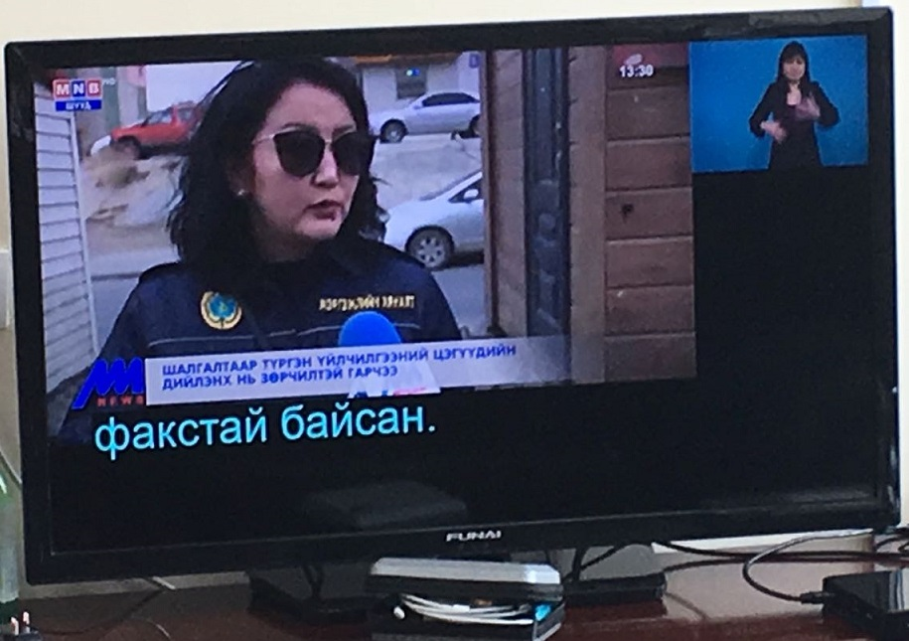
STB for H.702
H.702 requires closed signing and IPTV enables this
Mongolia government has decided to adopt H.702
Test service is expected to start early 2018

Slide 10
ITU-T Rec. F.921 Audio-based network navigation system for persons with vision impairment
Describes how audio-based network navigation systems can be designed to ensure that they are inclusive and meet the needs of persons with visual impairments.
Targeted especially for indoor-navigation, which cannot depend on GPS.
Based on contributions from Wayfindr, which is currently used in London underground,
More follow up documents are expected

Slide 11
ITU-T Rec. F.930
Recommendation on the Framework of Telephone Relay Service.
Describes the basic framework for making telephone services accessible
Several related works such as Key Performance Indicator for Relay Services are also being discussed

Slide 12
Importance of Interoperability
Interoperable ICT allows persons with specific needs to participate in the society more easily
Interoperability requires standards
Therefore Inclusive ICT should be based on standards as much as possible
Coordination among standardization efforts is necessary

Slide 13
Standard-based policy for Inclusive Society
Design and planning of an inclusive society should be done with standard ICT in mind
E.g., standardized IPTV will give PWDs better access to ICT,
Standard-based policy will enhance reasonable accommodation in Society
With standards, reduced inefficiency in part of society will improve efficiency in other parts
Inclusive, “smart” society need standards-based policy

Slide 14
Proposed actions
Cooperation and coordination among ICT SDOs
E.g. Agreement on vocabulary
Creation of “Inclusive ICT Society” index, the KPI to show how inclusive a society/community/country is, taking UN-CRPD as the first reference
E.g. whether a country has atelephone relay service for its citizens
Whether a community supports a navigation guidance for those with visual impairment
Whether a country has a standard-based policy on ICT-inclusive society

Slide 15
Conclusion
ITU is creating global standards for an accessible global future
Standards provide better interoperability, thus better accessibility
These standards provide good ways to satisfy “reasonable accommodation” required by UN-CRPD
Standard-based policy is important for inclusive society
Coordination among standardization efforts should be promoted

Slide 16
Thank you!!
Contact:
kawamori@sfc.wide.ad.jp

