Slide 1

Presentation Title | 5GMF progress towards 2020 and beyond
Presenter | Takaharu NAKAMURA, Fujitsu, ARIB
Session | 6.2 Strategic Topic #2: 5G
Document Name/Version | GSC20_Session#6_5G_Takaharu_ARIB Rev 1 Submission/Revision date: 22 April 2016
Notes:
1

Slide 2
5GMF progress towards 2020 and beyond
6.2 Strategic Topic #2: 5G
  Takaharu NAKAMURA, Fujitsu, ARIB
Overview of 5GMF
Pre-studies on the 5G mobile
5G mobile concept
Progresses towards ‘5G’
Updated action plan toward 5G mobile
Global collaboration on 5G
Summary
Notes:
2

Slide 3
1. Overview of 5GMF
Roadmap towards implementation of 5G mobile in Japan
Action plan (mid-term) of 5GMF
Organizational Structure of the 5GMF
5GMF Members
Notes:
3

Slide 4
Roadmap towards implementation of 5G mobile in Japan
Notes:
4

Slide 5
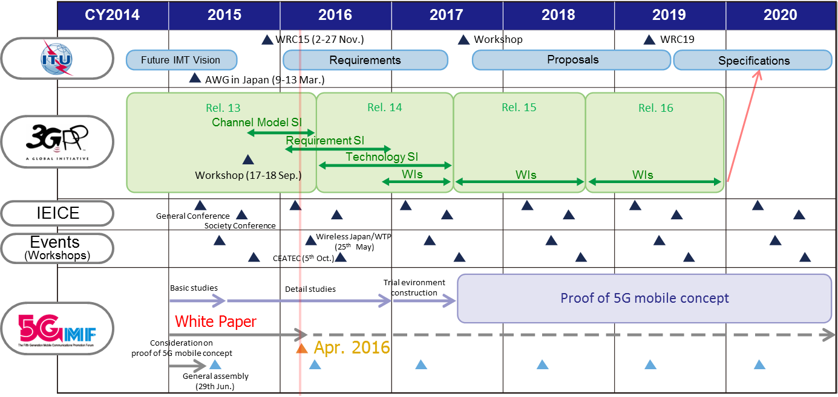
Action plan (mid-term) of 5GMF
IEICE: The Institute of Electronics, Information and Communication Engineers
Notes:
5

Slide 6
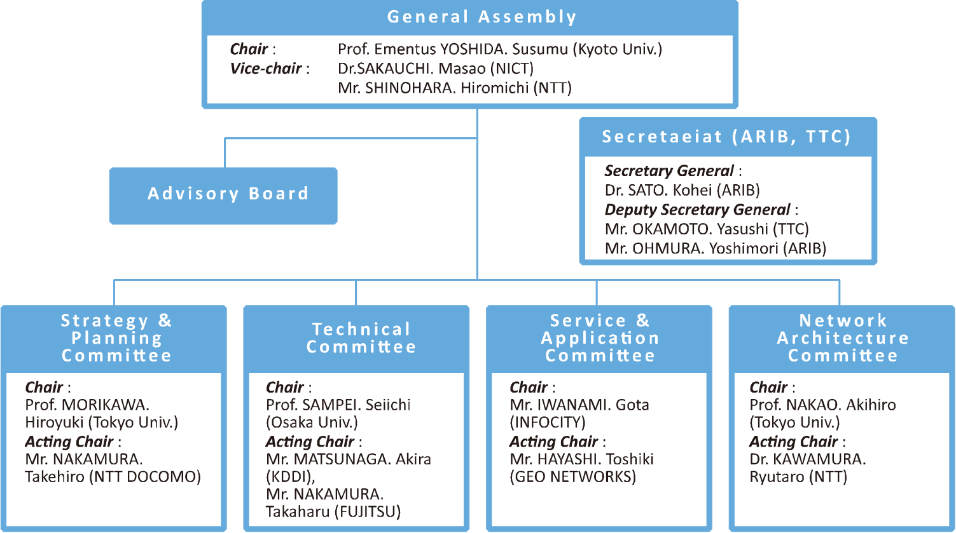
Organizational Structure of the 5GMF
Notes:
6

Slide 7
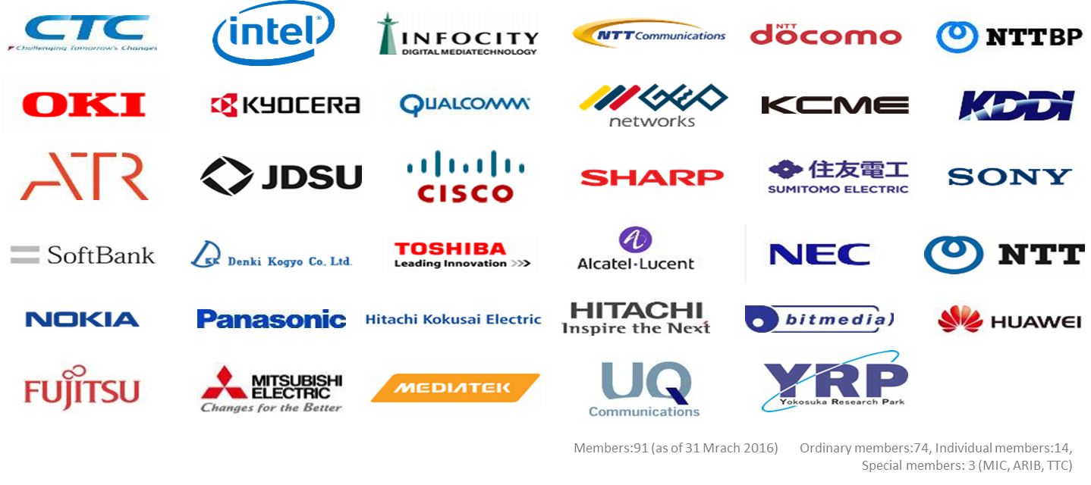
5GMF Members
Notes:
7

Slide 8
2. Pre-studies on the 5G mobile
Organization and output of the ARIB 2020 and Beyond Ad Hoc
Market and user trends
Road to 5G mobile
Maximum system capabilities
Required capabilities
Notes:
8

Slide 9
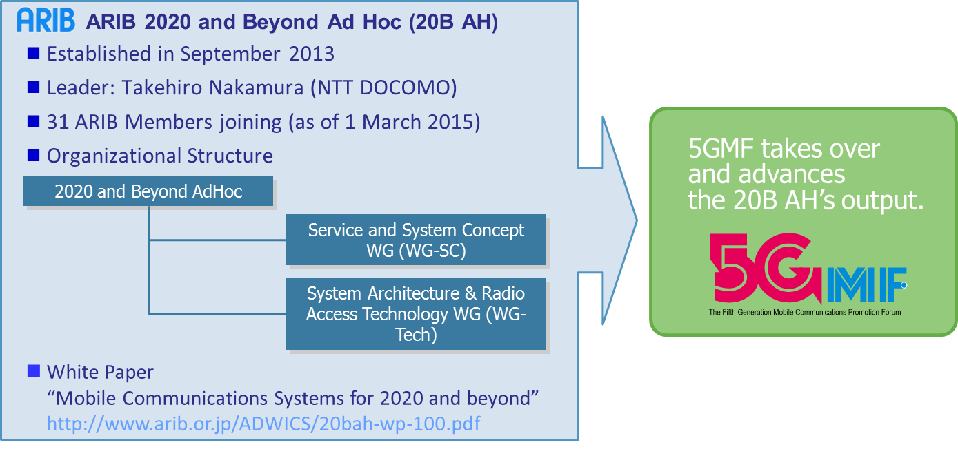
Organization and output of the ARIB 2020 and Beyond Ad Hoc
Notes:
9

Slide 10
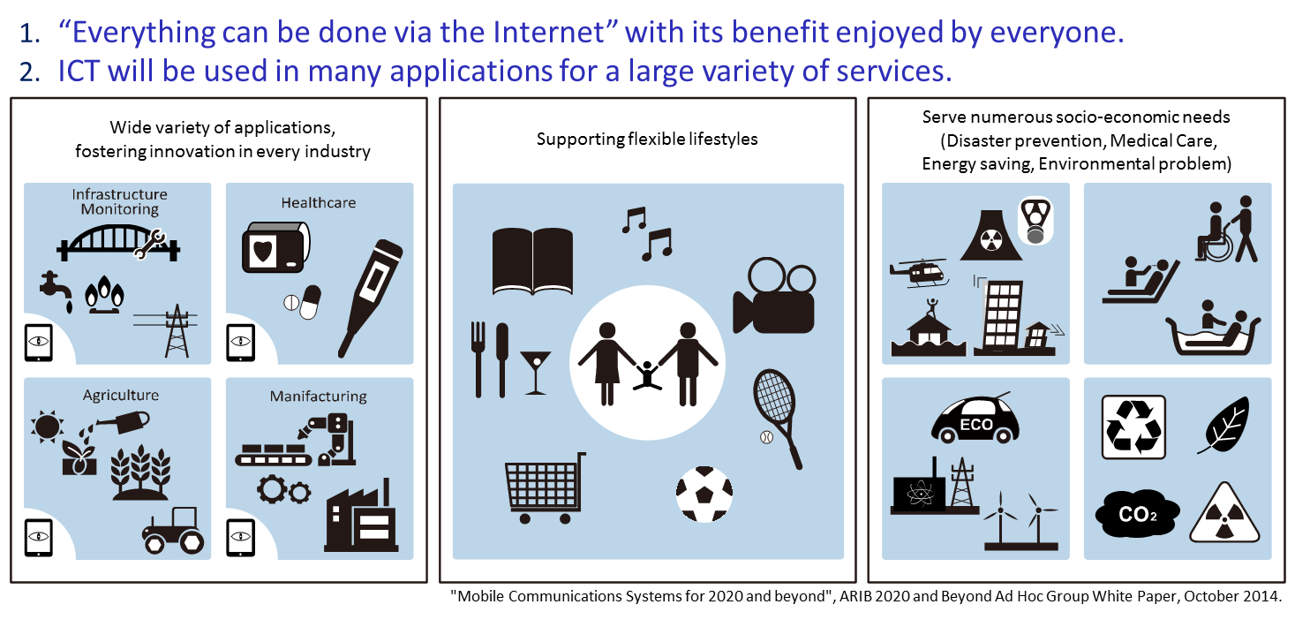
Market and user trends
Notes:
10

Slide 11
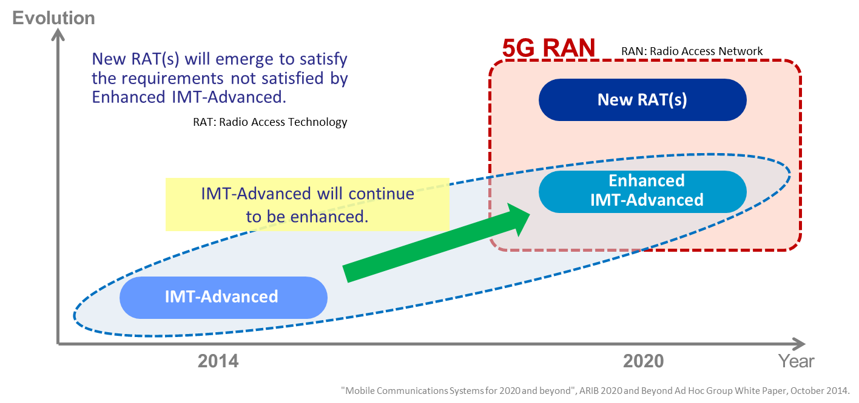
Road to 5G mobile
Notes:
11

Slide 12
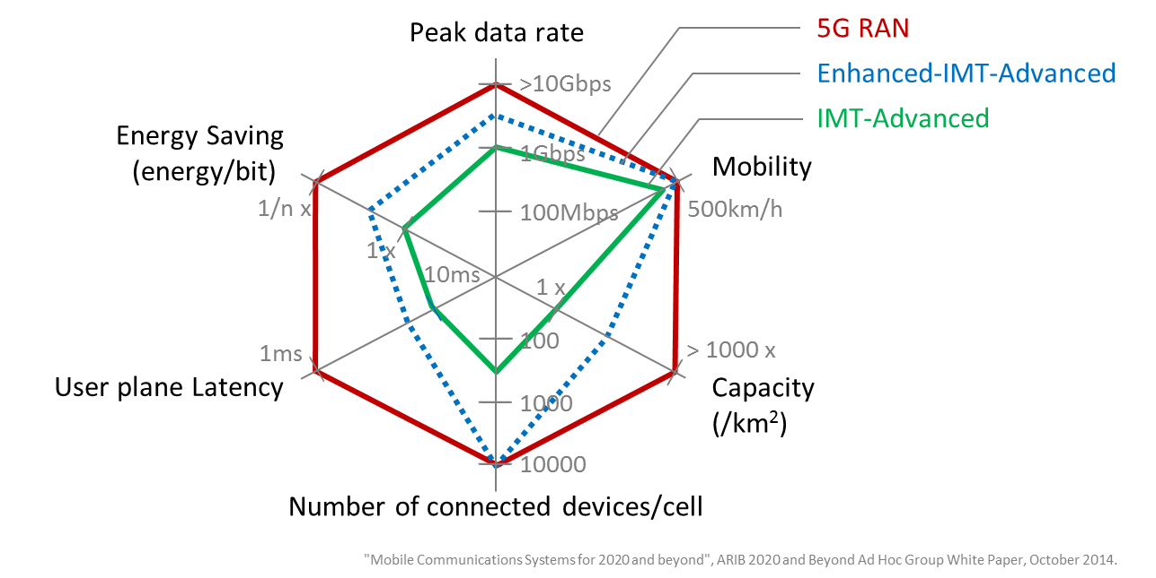
Maximum system capabilities
Notes:
12

Slide 13
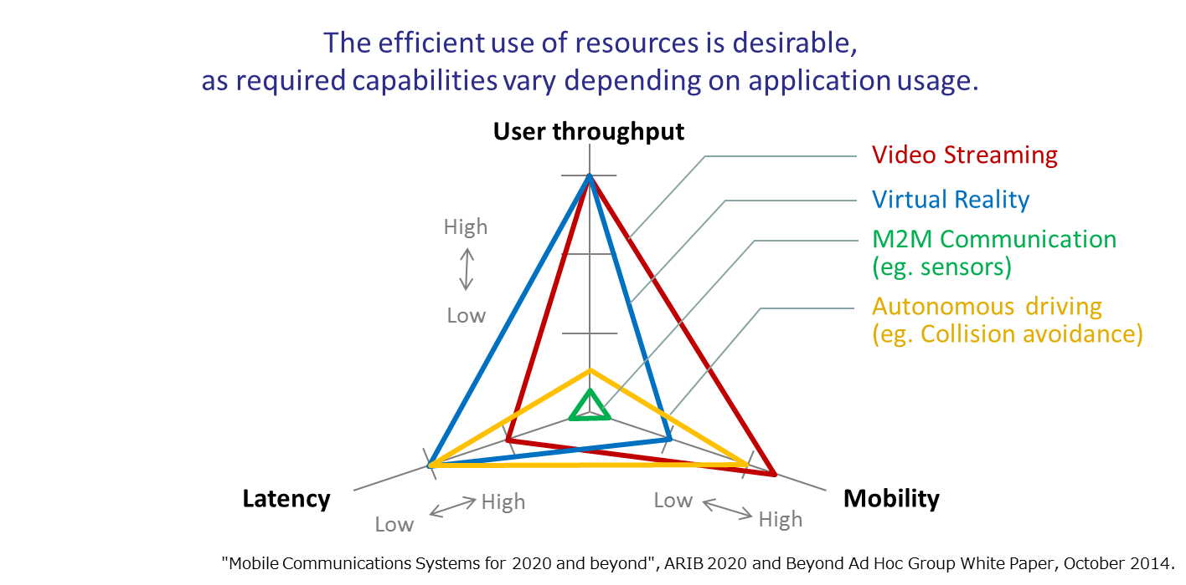
Required capabilities
Notes:
13

Slide 14
3. 5G mobile concept
Framework for 5G RAN
Keywords for 5G
Radio Access Technologies for 5G mobile
Potential Application enabled by 5G mobile
Notes:
14

Slide 15
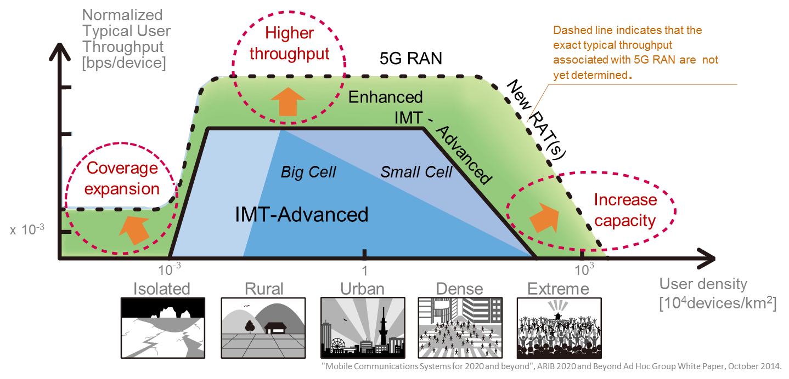
Framework for 5G RAN
Notes:
15

Slide 16
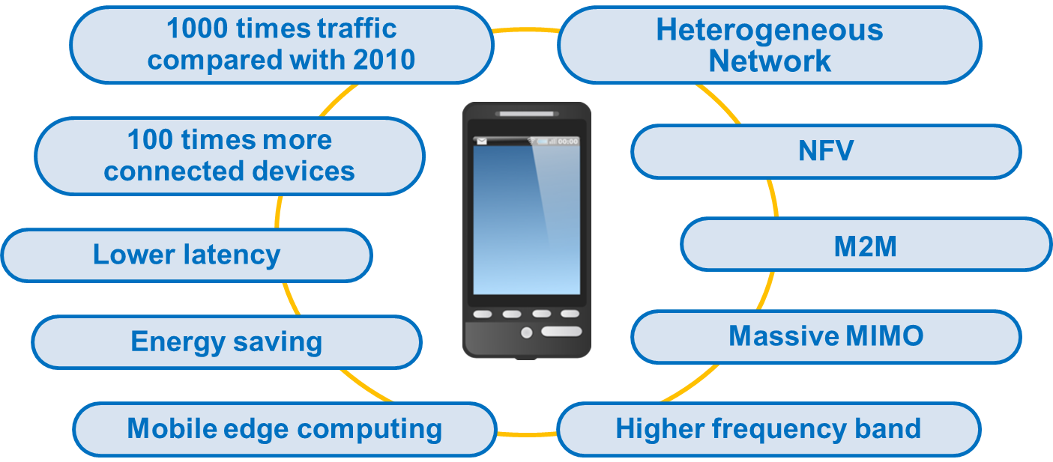
Keywords for 5G
Potential Application enabled by 5G mobile
Notes:
16

Slide 17
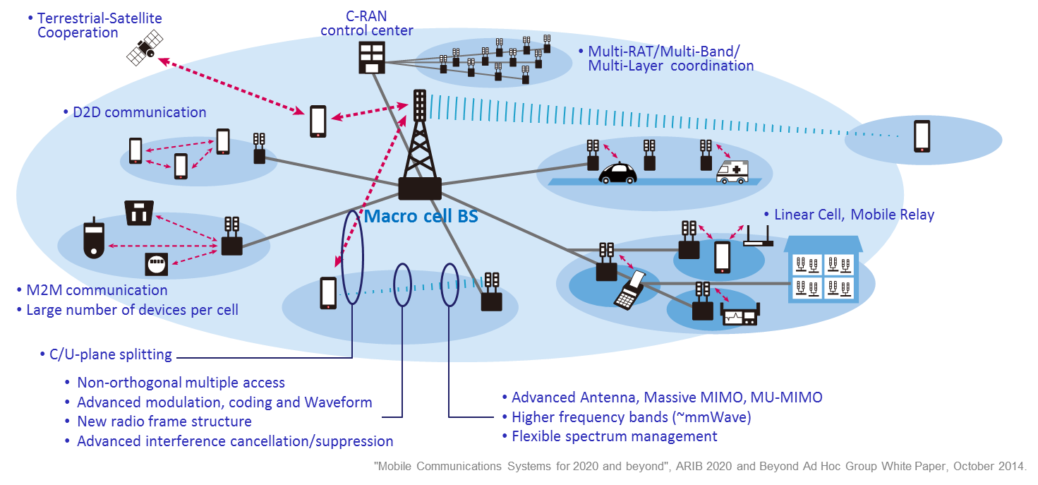
Radio Access Technologies for 5G mobile
Potential Application enabled by 5G mobile
Notes:
17

Slide 18
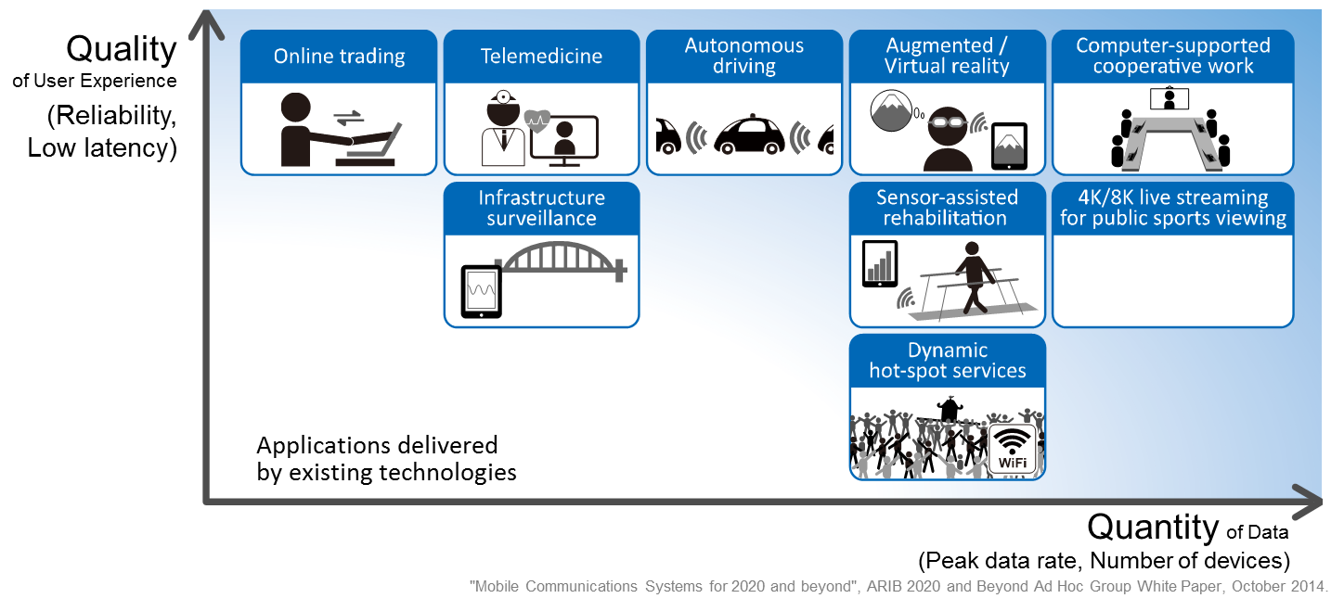
Potential Application enabled by 5G mobile
Notes:
18

Slide 19
4. Progresses towards ‘5G’
This is where the main content of this slide can be put :
5G network technology
Timeline of 5G network technology
Spectrum ranges above 6GHz and characteristics
User trend survey, Technology survey of application platforms
Notes:
19

Slide 20
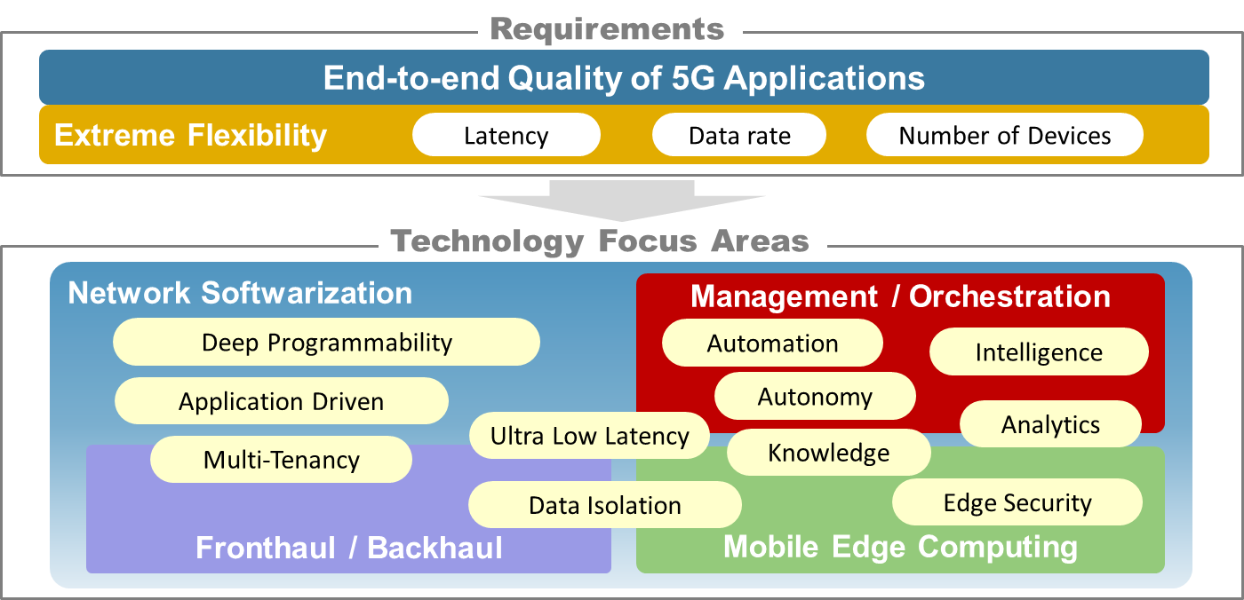
5G network technology
Notes:
20

Slide 21
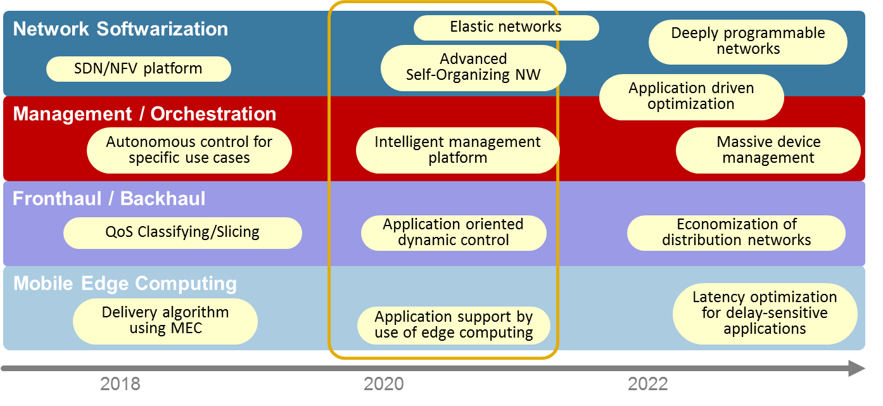
Timeline of 5G network technology
Notes:
21

Slide 22
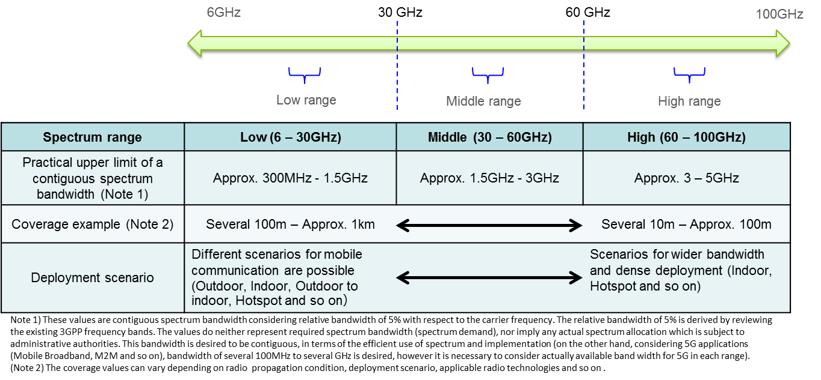
Spectrum ranges above 6GHz and characteristics
Notes:
22

Slide 23
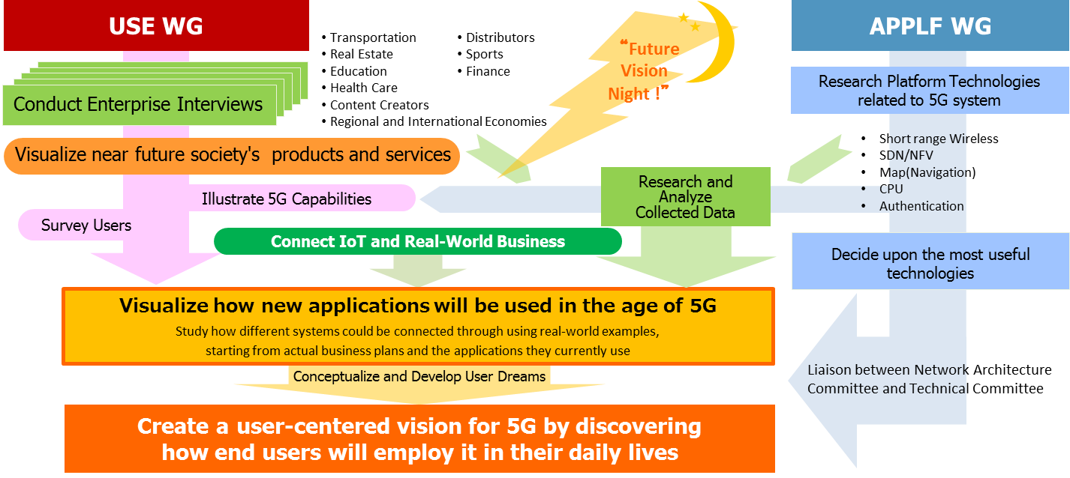
User trend survey, Technology survey of application platforms
Notes:
23

Slide 24
5. Updated action plan toward 5G mobile
Schedule Overview of 5G Integrated Verification Trial
Image of Verification Trial
Notes:
24

Slide 25
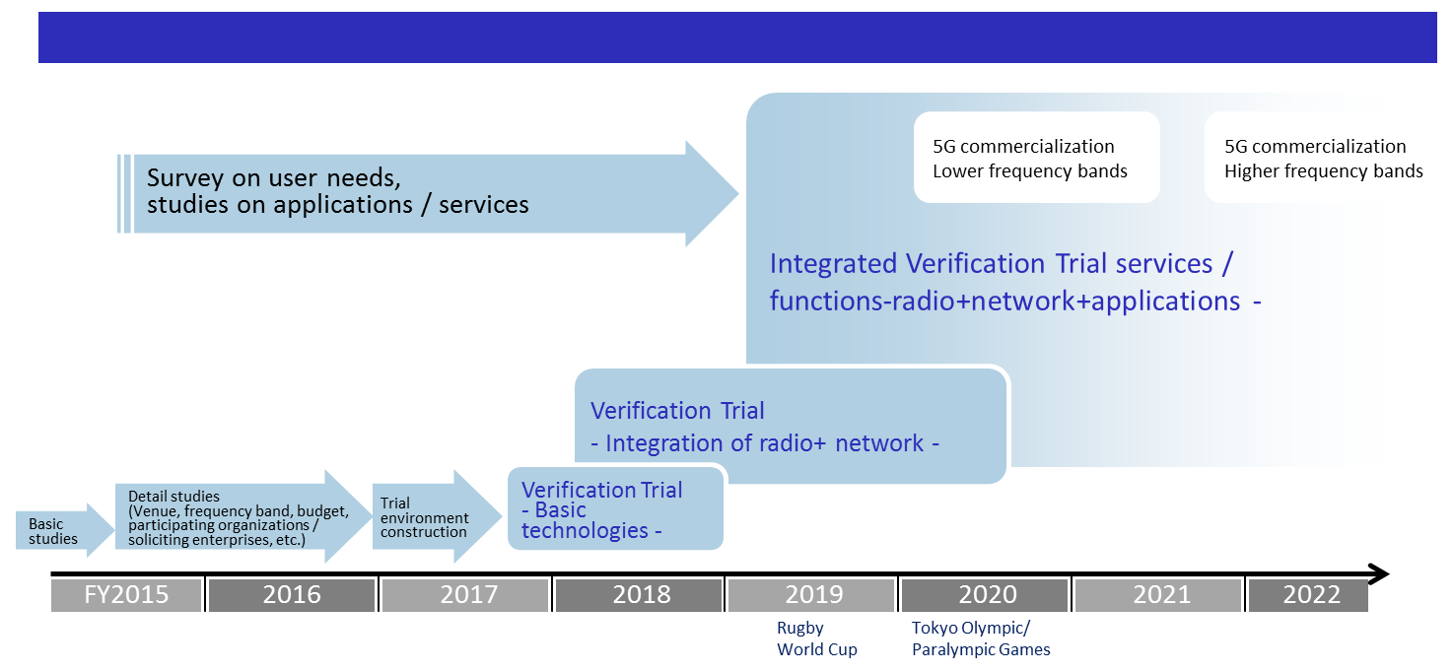
Schedule Overview of 5G Integrated Verification Trial
Notes:
25

Slide 26
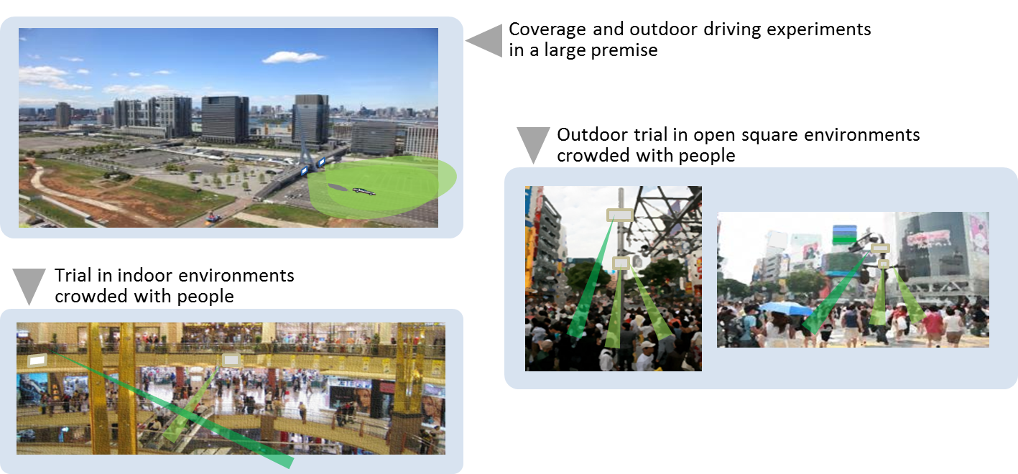
Image of Verification Trial
Notes:
26

Slide 27
6. Global collaboration on 5G
This is where the main content of this slide can be put :
5G in the World
Global Collaboration on 5G
Notes:
27

Slide 28
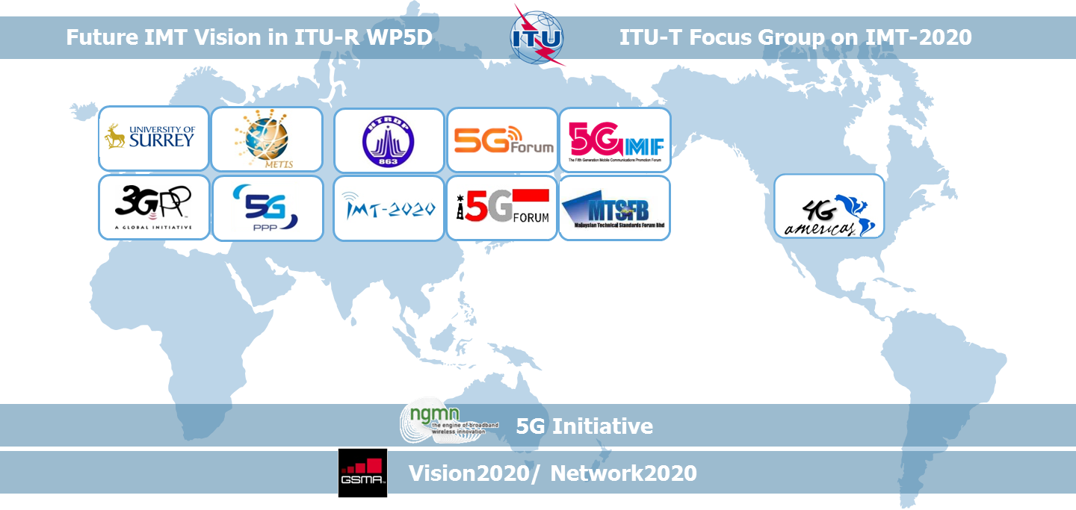
5G in the World
Notes:
28

Slide 29
Global Collaboration on 5G
Collaborate bilaterally with other organizations
  5G PPP
    Meeting, Munich, 11 April 2014, MOU signed, Frankfurt, 25 March 2015
  Korea 5G Forum
    Meetings: Tokyo, 19 August 2013, Tokyo, 3 July 2014
    MOU signed, Tokyo, 6 April 2015
  Wireless World Research Forum （WWRF）
    MOU signed , e-mail, 21 August 2015
  Indonesia 5G Forum
    Meeting & MOU signed , Bali (Indonesia), 21-22 September 2015
  Malaysian Technical Standards Forum (MTSFB) IMT Sub- WG 5G
    Meeting & MOU signed, Kuala Lumpur (Malaysia), 6 April 2016
Notes:
29

Slide 30
Summary
Activities in 5GMF is briefly introduced:
Organization of 5GMF
Nation-wide cooperation amongst academia, industry and government offices. Involving virtual stake holders: Applications, NW, RAN.
Progresses in 5GMF
Use cases, Requirements, framework and RAN technologies.
Updated action plan towards ‘5G’
  PoC plan towards 2020 and beyond
Collaboration activities
  Bilateral collaboration with Indonesia and Malaysia
  ‘5G’ workshop is being planned: CEATEC-Japan (Oct.)
Notes:
30

